Slide 1
Lecture 4
How to think about Cities
4.2 Time Geography and Time Invariants in Mobility
IUS 2.3
©Luís M. A. Bettencourt 2024
Notes:
This lecture introduces a few other ideas from Geography

Slide 2
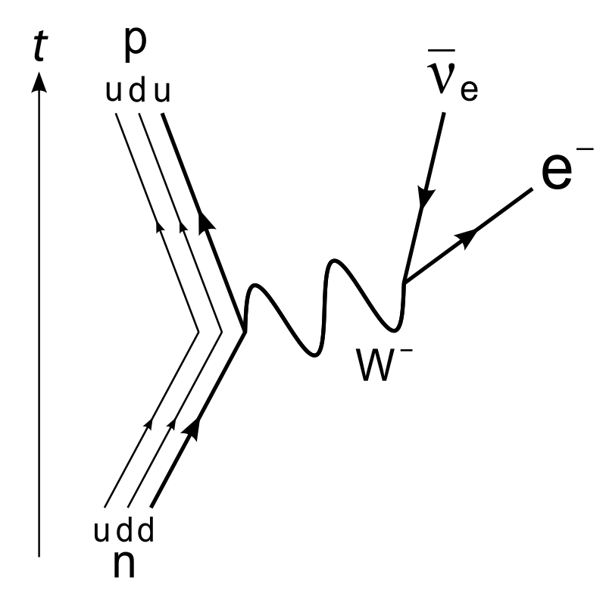
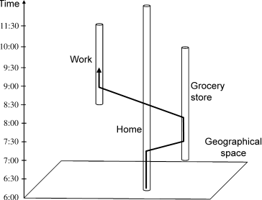
Time Geography
IUS 2.3.2
Time has a critical importance when it comes to fitting people and things together for functioning in socio-economic systems, whether these undergo long-term changes, or rest in something which could be defined as a steady state.
- Thorsten Hägerstrand
life-paths
Feynman diagram (particle physics)
Fitting people and things together
credit: Harvey J. Miller
Notes:
The concept of the life path will be central to later modeling.

Slide 3
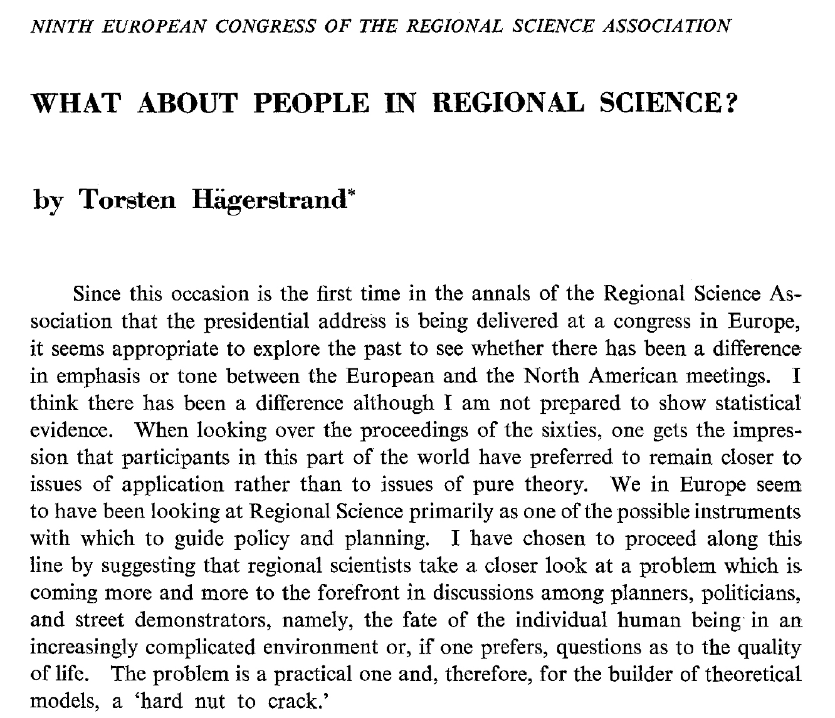

Reading materials

Slide 4
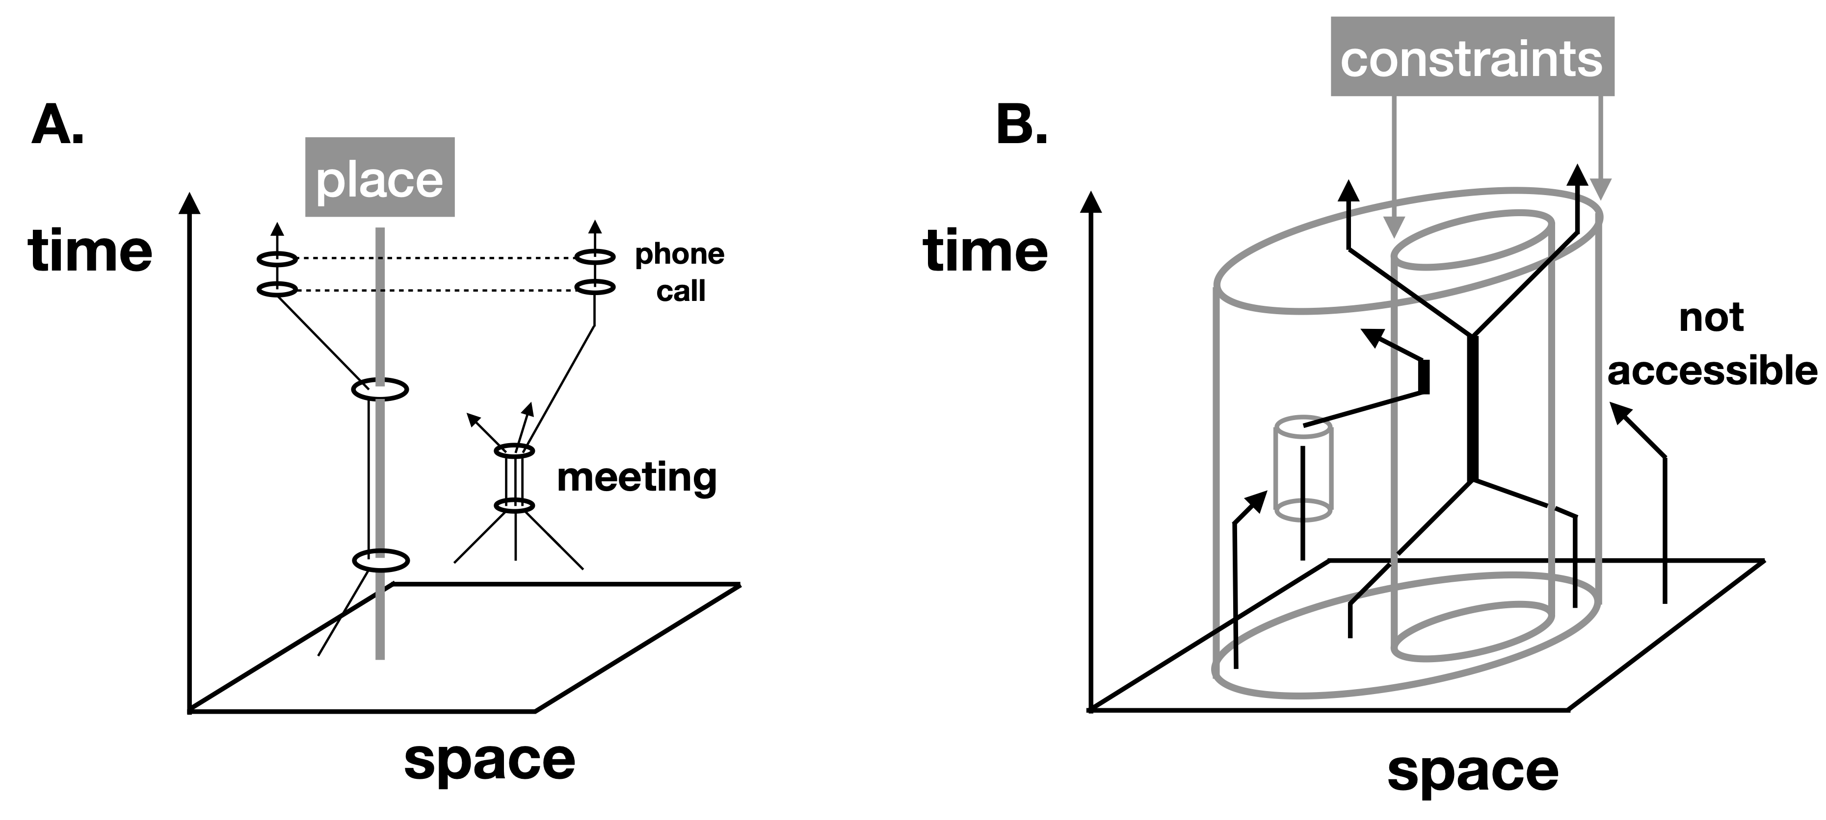
SpaceTime Graphs: life paths or world lines
Examples from Time Geography:
Fitting people and things together

Slide 5
Types of Lifepath Constraints
Capability Constraints
The physical scape available to an agent due to their mobility possibilities
Coupling Constraints
Refer to obstacles in realizing social and economic interactions
Authority Constraints
Mediated by institutions: firms, universities, public spaces: shaping where and when and by whom spaces can be used
Combine to shape, regulate and coordinate collective socioeconomic behavior

Slide 6
Time Invariances in Urban Mobility
Is the size of a city set by space or by time?
IUS 2.3.2

Slide 7
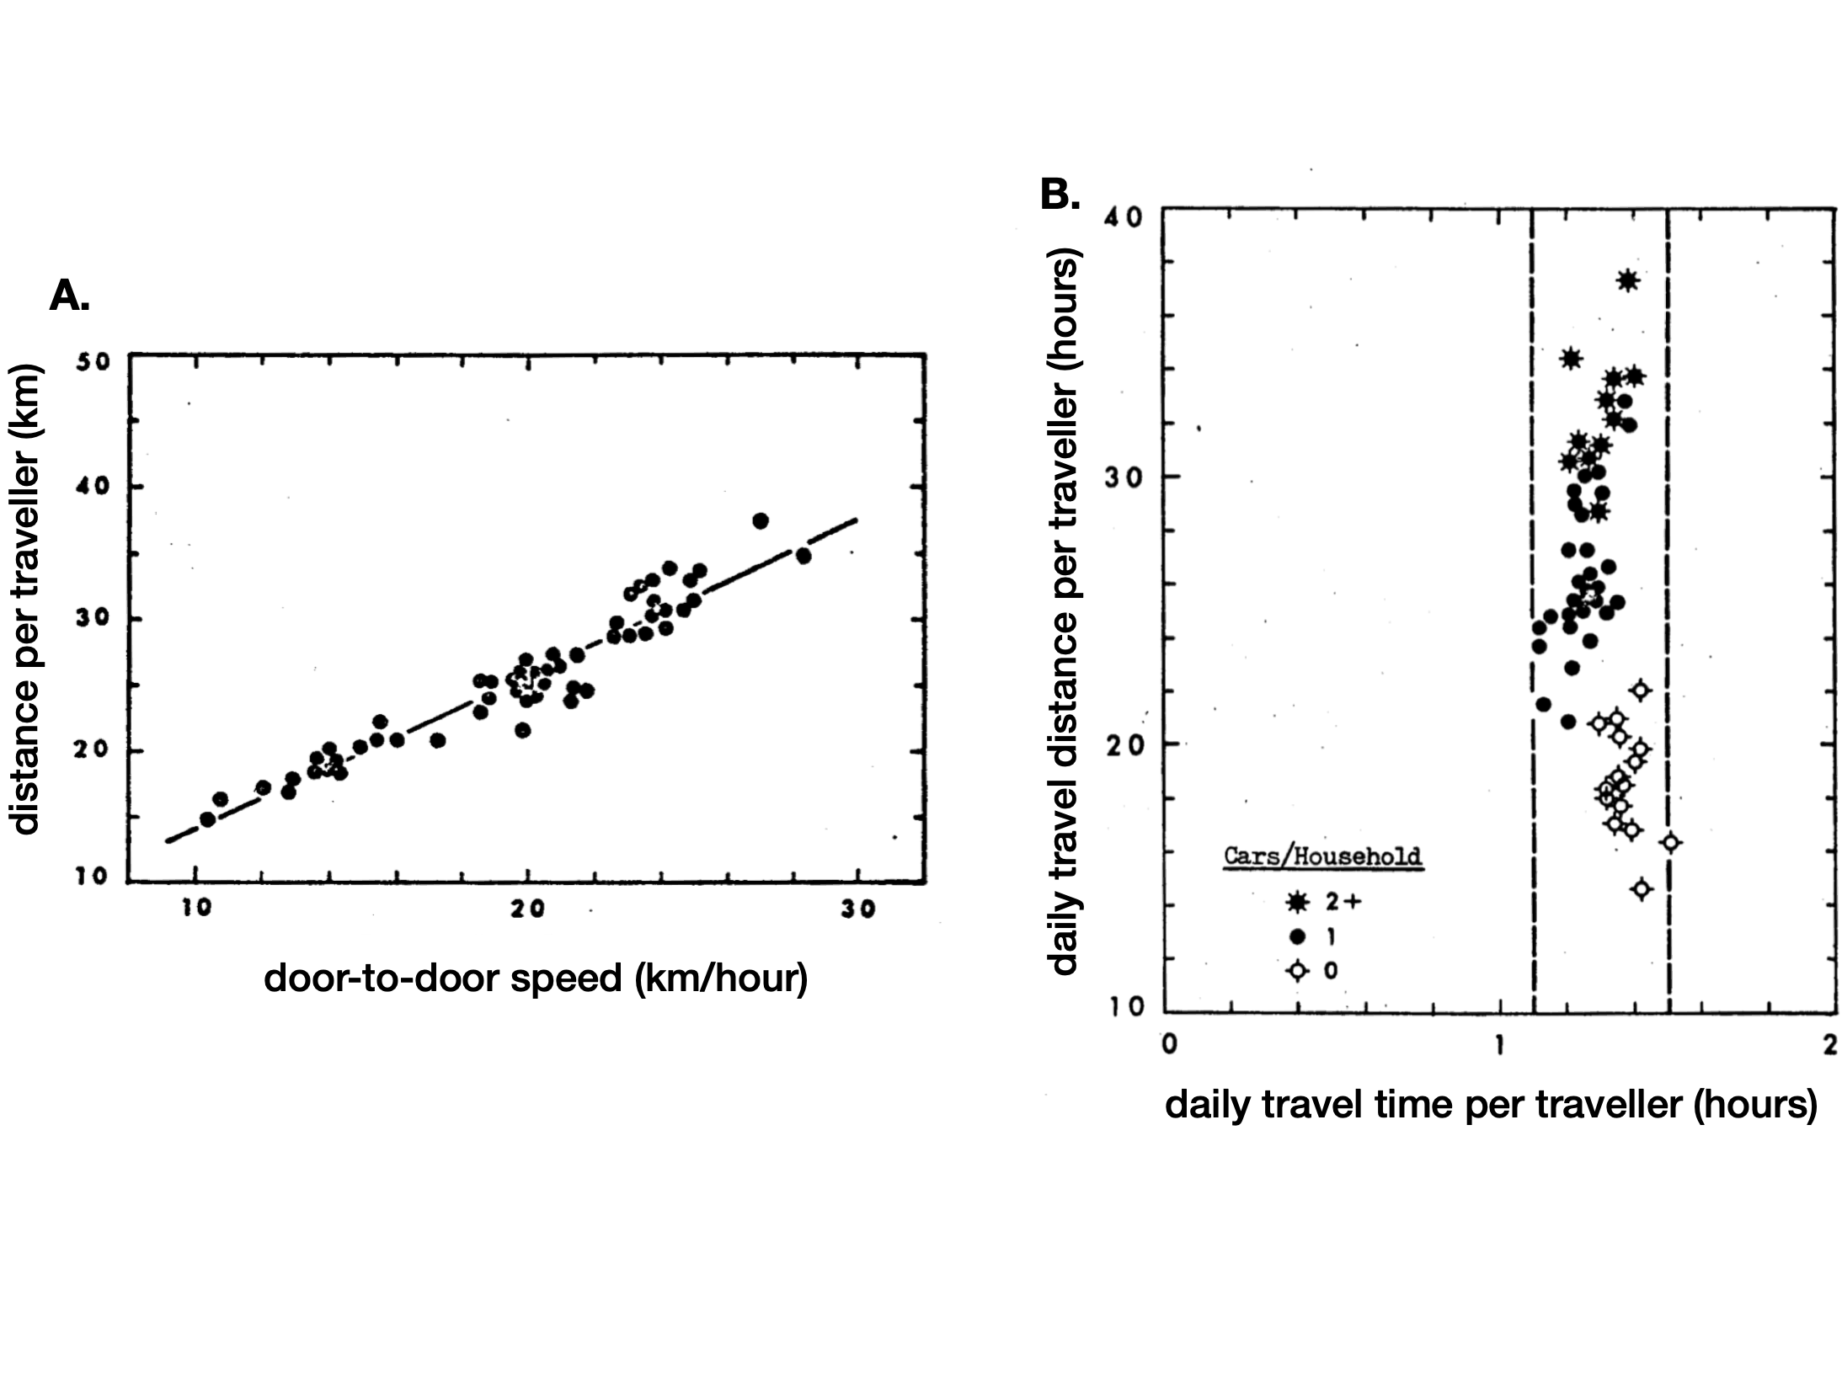
Anthropological Invariants in Transportation: Space & time intertwined
city extent= ~1.5 h/day
Zahavi’s concept of a constant travel-time budget
Imagine planning transit systems for time, rather than space…
Notes:
The extent traveled per day may be a temporal invariant (up to a few hours).

Slide 8
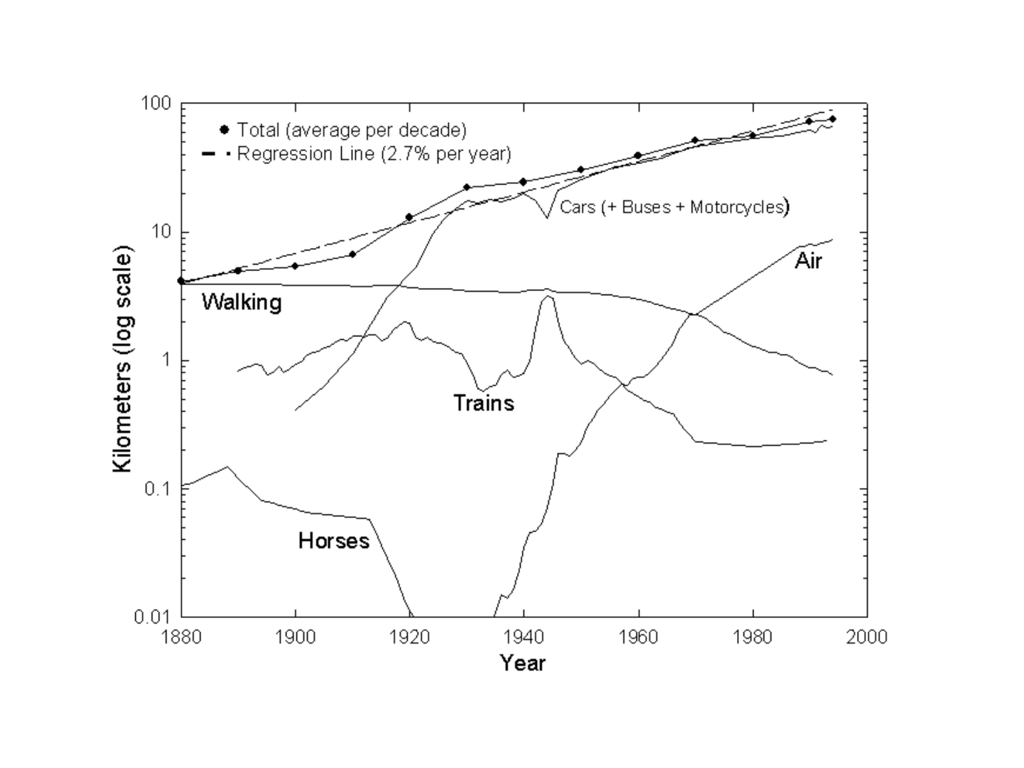
Anthropological Invariants in Transportation: Space & time intertwined
Marchetti’s Constant

Slide 9
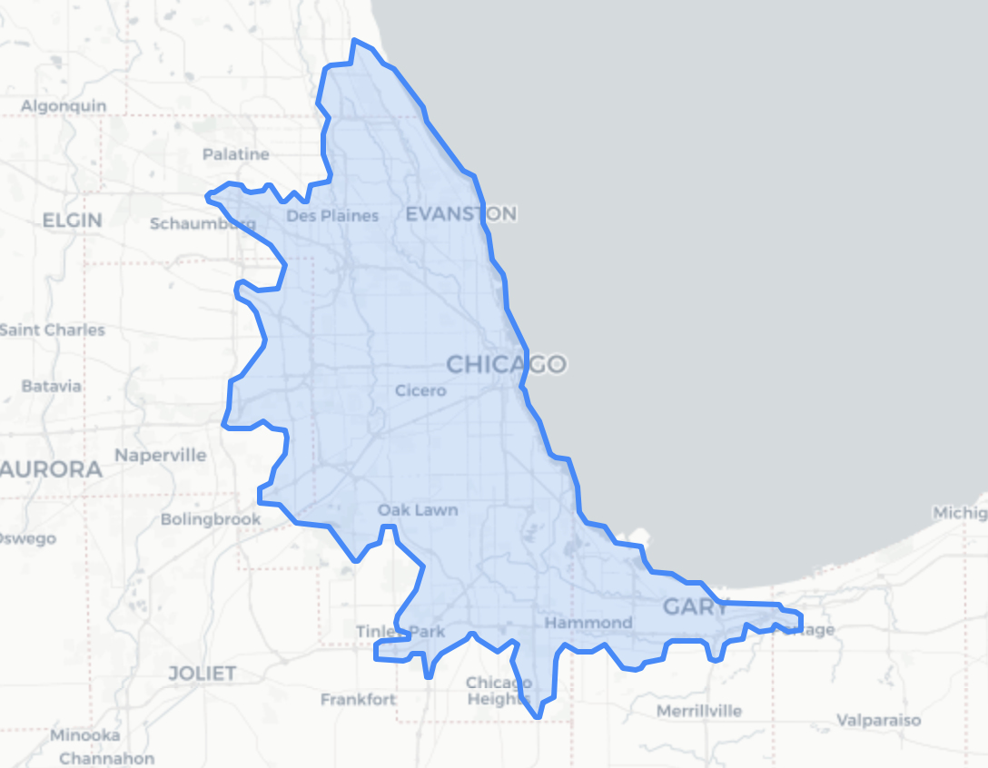
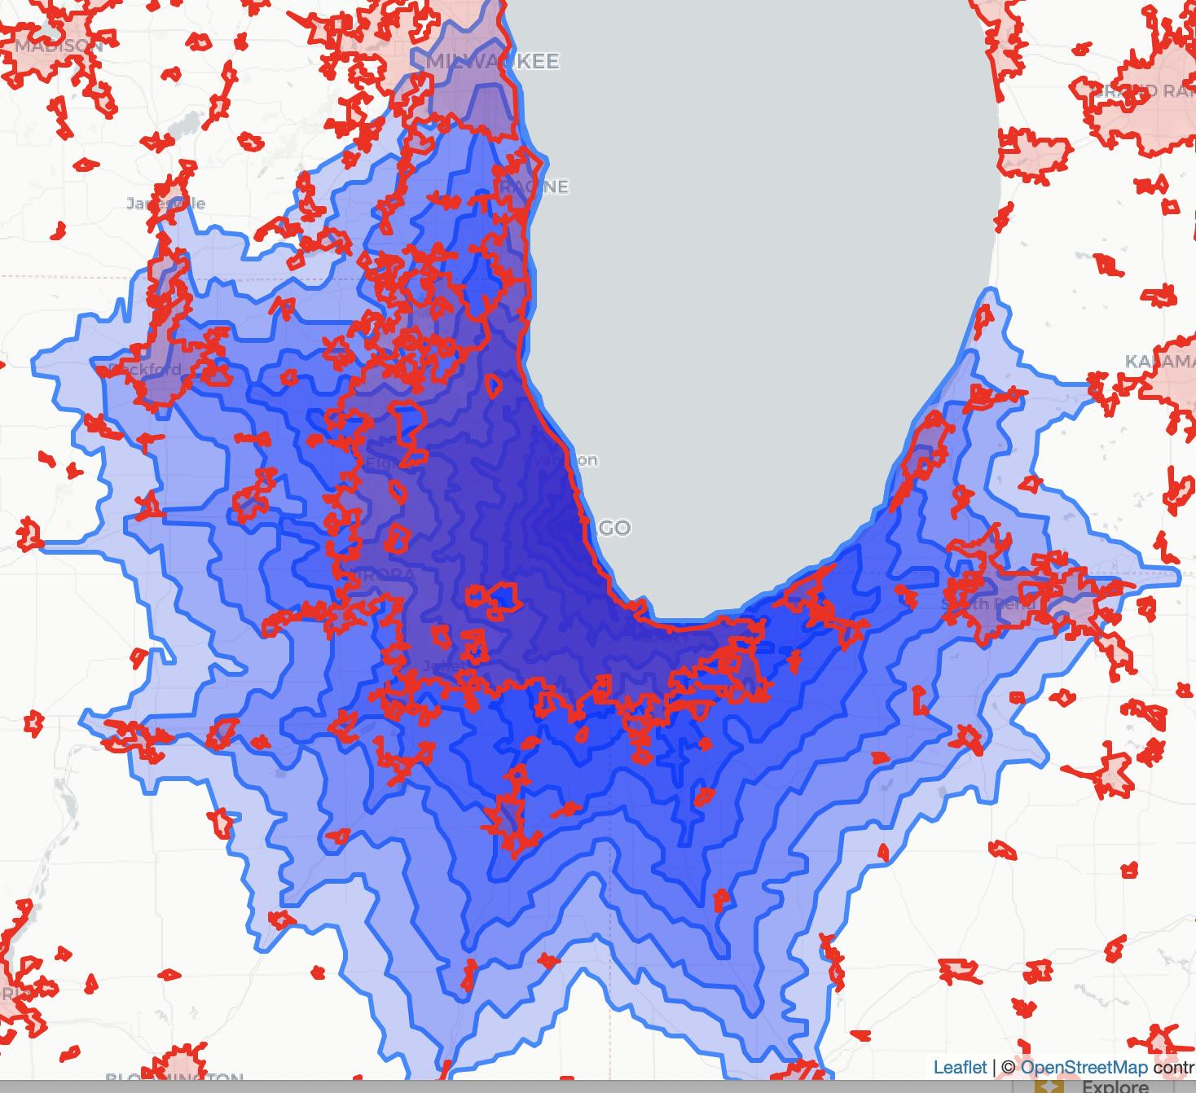
This has come to suggest that
Cities are limited in extent by a fixed time budget ~ 1-2 h.
A constant time budget corresponds to exponentially growing spatial extent, because of infrastructure and technology improvements
(Predictable) Urban Expansion
1h isochrone
This can be done worldwide
Go use it:
https://github.com/mansueto-institute/urban-isolines/

