Slide 1
Lecture 2
Early Concepts: Chicago School of Sociology and Classical Models of Economic Geography
2.3 Classical Models of Cities in Geography and Economics
©Luís M. A. Bettencourt 2024
IUS 2.1
Notes:
This is the beginning of more mathematical models.

Slide 2
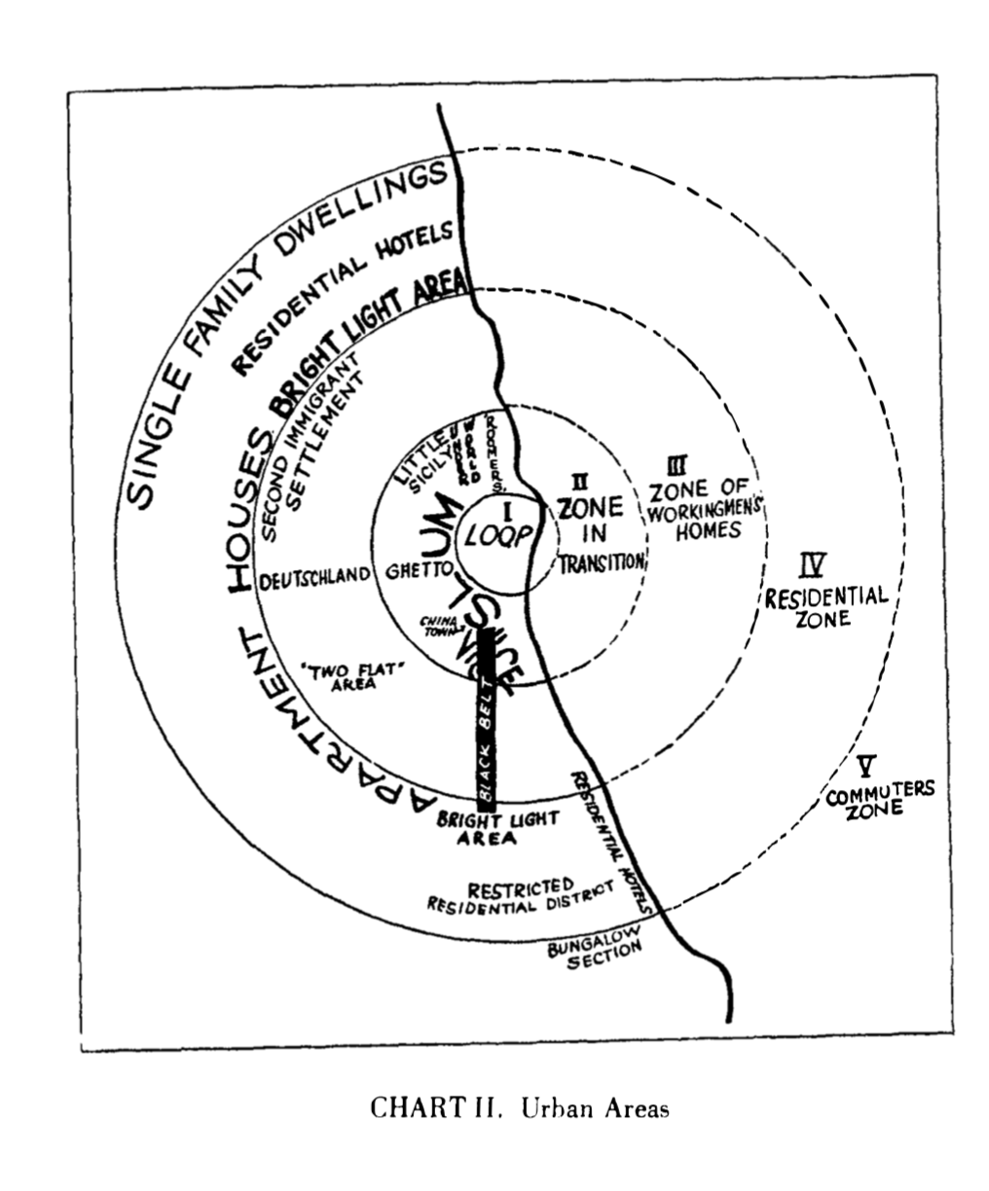
Chicago
This paper will treat first of the expansion of the city, and then of the less-known processes of urban metabolism and mobility which are closely related to expansion.
The metropolitan area may be taken to include territory that is physically contiguous, but it is coming to be defined by that facility of transportation that enables a business man to live in a suburb of Chicago and to work in the loop.
The tendency of each inner zone to extend its area by the invasion of the next outer zone. This aspect of expansion may be called succession
Besides extension and succession, the general process of expan­sion in urban growth involves the antagonistic and yet comple­mentary processes of concentration and decentralization
This differentiation into natural economic and cultural group­ings gives form and character to the city
The division of labor in the city likewise illustrates disorganiza­tion, reorganization, and increasing differentiation, movement and mobility
Ernest W Burgess 1925
Notes:
The ring model of Chicago had been anticipated by von Thunen.

Slide 3
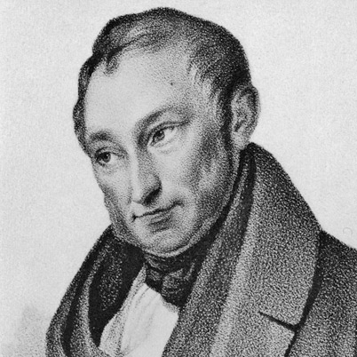
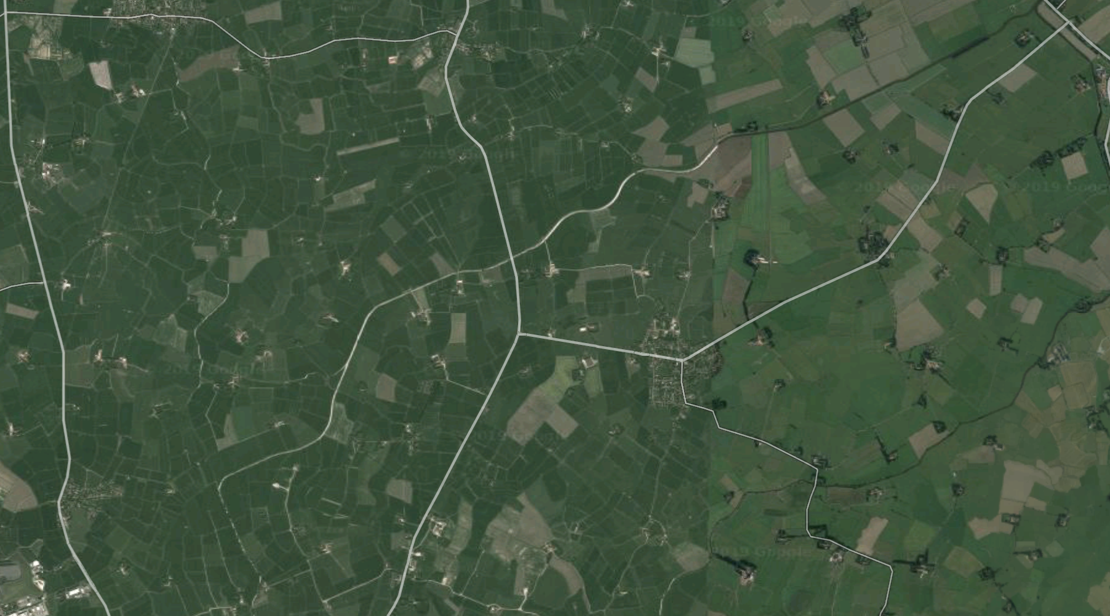
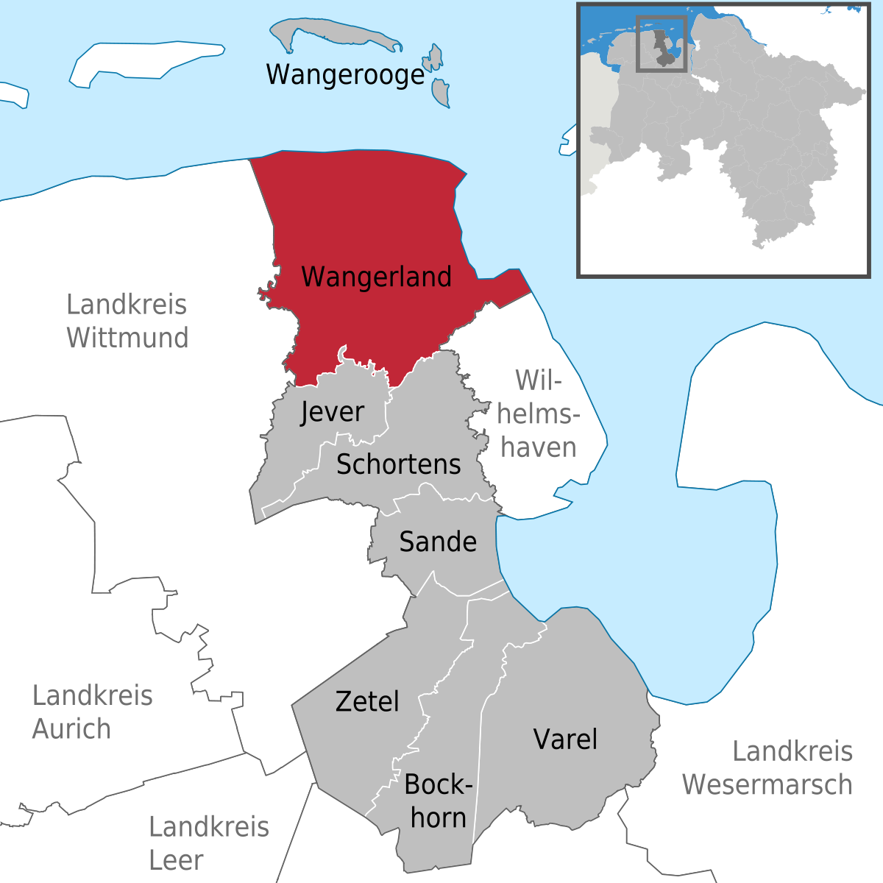
The first mathematical model
Johann Heinrich von Thünen 1783-1850
Canarienhausen, Wangerland. State of Mecklenburg-Vorpommern, Germany.
Notes:
Here he is. But he was not interested in cities at all, and was a landowner in a rural area in a German periphery, actually.

Slide 4
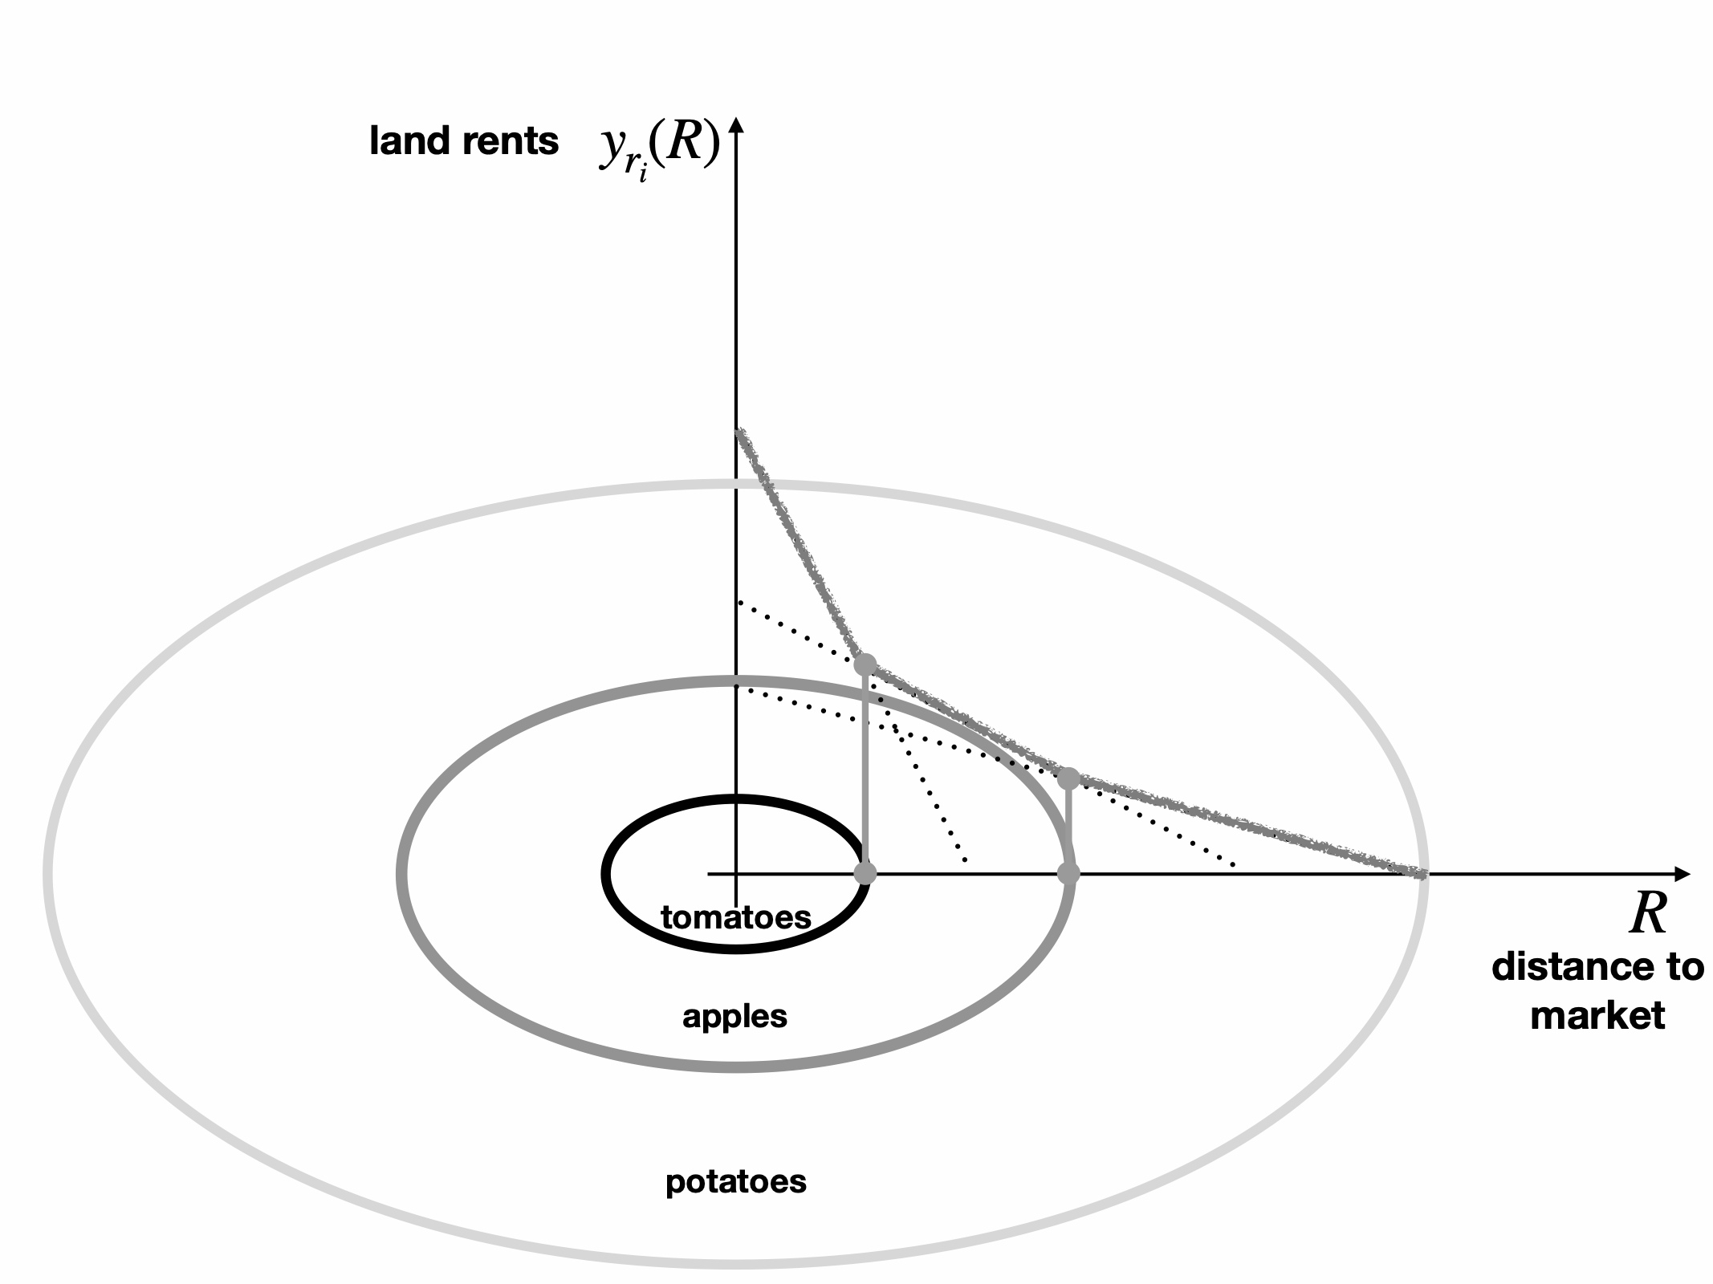
Spatial Equilibria in the “Isolated State”
not a city at all
von Thünen Model [1826, beginnings Central Place & Locational Theory]
Farmers create incomes by selling goods i at a central market
Land rent of crop i at R should equal farmers net profits
$$y_{i}(R)$$
Crops organize themselves to maximize profits
(and land rents)
“invisible hand”
net income per unit i sold
price (p) - production costs (s)
land rent:
$ per unit land area
$$y_{i}(R)=Q_{i}[(p_{i}-c_{i})-{c_{T}}_{i}R]$$
crop i quantity
per unit land area
transportation costs for i
assumed proportional to distance
credit: Fujita 2010 The Evolution of Spatial Economics
Notes:
The von Thunen model is not about a city at all but about the production of agricultural produce ! He figured out that the value of land is the value of the produce it can support, once these are brought to market (including their transport costs).

Slide 5



Alonso Model of the Monocentric city
Central Market for Labor
Warning: 2 averages (time and population) !
Extent of City is determined by Budget Constraint
city boundary
Idea: each person has a budget:
$$R_{max}$$
$$y=c_{r}(R)+c_{T}(R)$$
net income
(from work at CBD)
commuting costs
(home work)
$$R$$
land rent expense
(at home)
CBD
At CBD:
$$c_{T}(R=0)=0$$
minimum commuting costs
$$c_{r}(R=0)=c_{r_{max}}$$
maximum rent
$$y=c_{r_{max}}$$
rural areas surround city
At the city boundary:
$$c_{T}(R=R_{max})=c_{T_{max}}$$
maximum c. costs
$$c_{T}(R)=c_{T_{0}}R,c_{T_{0}}=\frac{c_{T_{max}}}{R_{max}}$$
cost/time/distance travelled
minimum rent
$$c_{r}(R=R_{max})=c_{r_{rural}}=c_{r_{min}}$$
$$c_{r}(R)=y-c_{T}(R)$$
$$y=c_{r_{min}}+c_{T_{max}}$$
Notes:
The von Thunen model was then ported (via Burgess’s ideas) to a city. Instead of a central market for produce, it becomes a central market for labor !

Slide 6
Individuals tradeoff lower rent and higher commuting costs
costs
budget (net income)
$$y$$
$$c_{r}(R)$$
City
rural areas
$$c_{T}(R)$$
distance from CBD
$$R$$
$$R_{max}=\frac{y-c_{r_{rural}}}{c_{T_{0}}}$$
Questions:
where do people choose to live?
how much space should they use?
what happens if incomes or transportation costs go up/down?
Size of city depends on income, commuting cost technology
and rural productivity
Notes:
The spatial extent of the city is set not by geography or density, but by the interplay between incomes and transportation (commuting) costs. Urban geography is derived, not primary, as we will see also later.

Slide 7
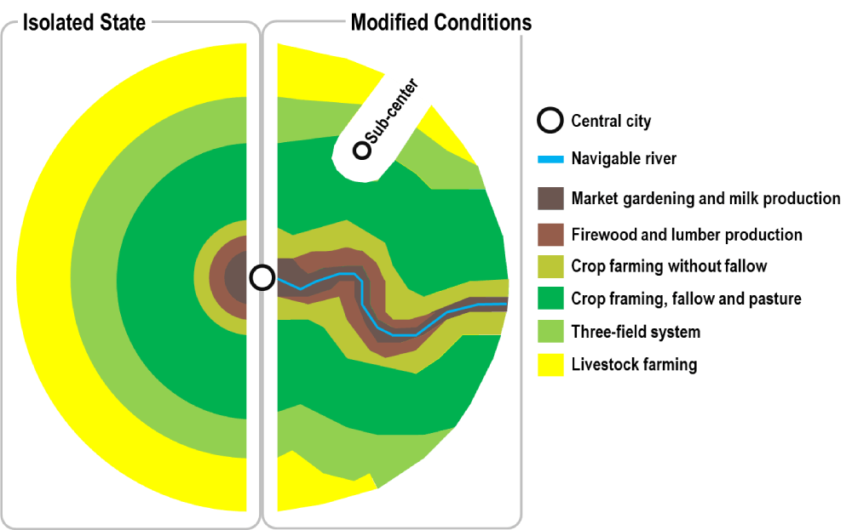
Generalizations:
https://transportgeography.org/contents/chapter8/urban-land-use-transportation/von-thunen-regional-land-use/
Notes:
If transportation costs vary (because of natural geography, or built infrastructure) so will the shape of the city. This is clear around transit lines and highways in modern cities.

