Slide 1
Lecture 7
Network Models of Cities
7.3 Urban Infrastructure, Energy Costs of Movement, Spatial Equilibrium
©Luís M. A. Bettencourt 2023
IUS 3.2.2 pp 82-89

Slide 2
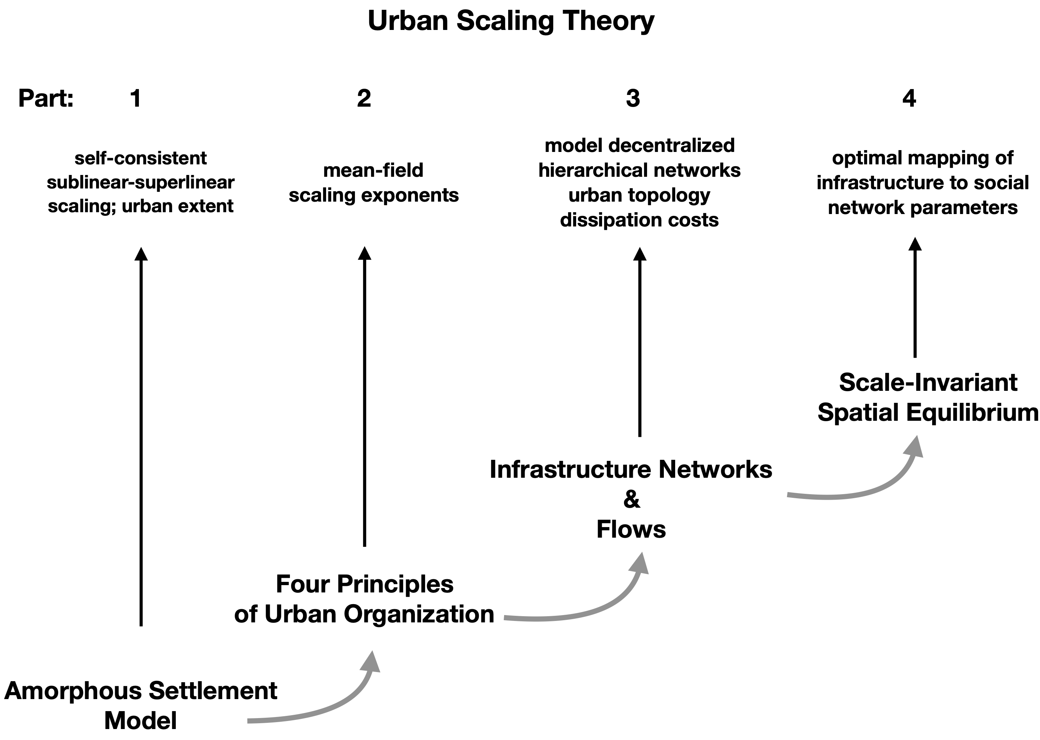

IUS Figure 3.5

Slide 3
To get closer to the right answer need:
To understand fundamental constraints on human interactions
To understand the general characteristics of urban spaces
A better model of social interactions over built space
To better compute costs of transportation and land rents

Slide 4
The Scale-Independence of City Size
in the presence of increasing returns and transportation costs
1. Detailed Model of Urban Infrastructure
2. General Model of Cost of Transportation in Cities
3. The Properties of Scale-Independent Equilibrium
Notes:
We now approach the final piece, which is the hierarchy of infrastructure and the costs of movement, and how these scale like social outputs, and not with a stronger exponent.

Slide 5
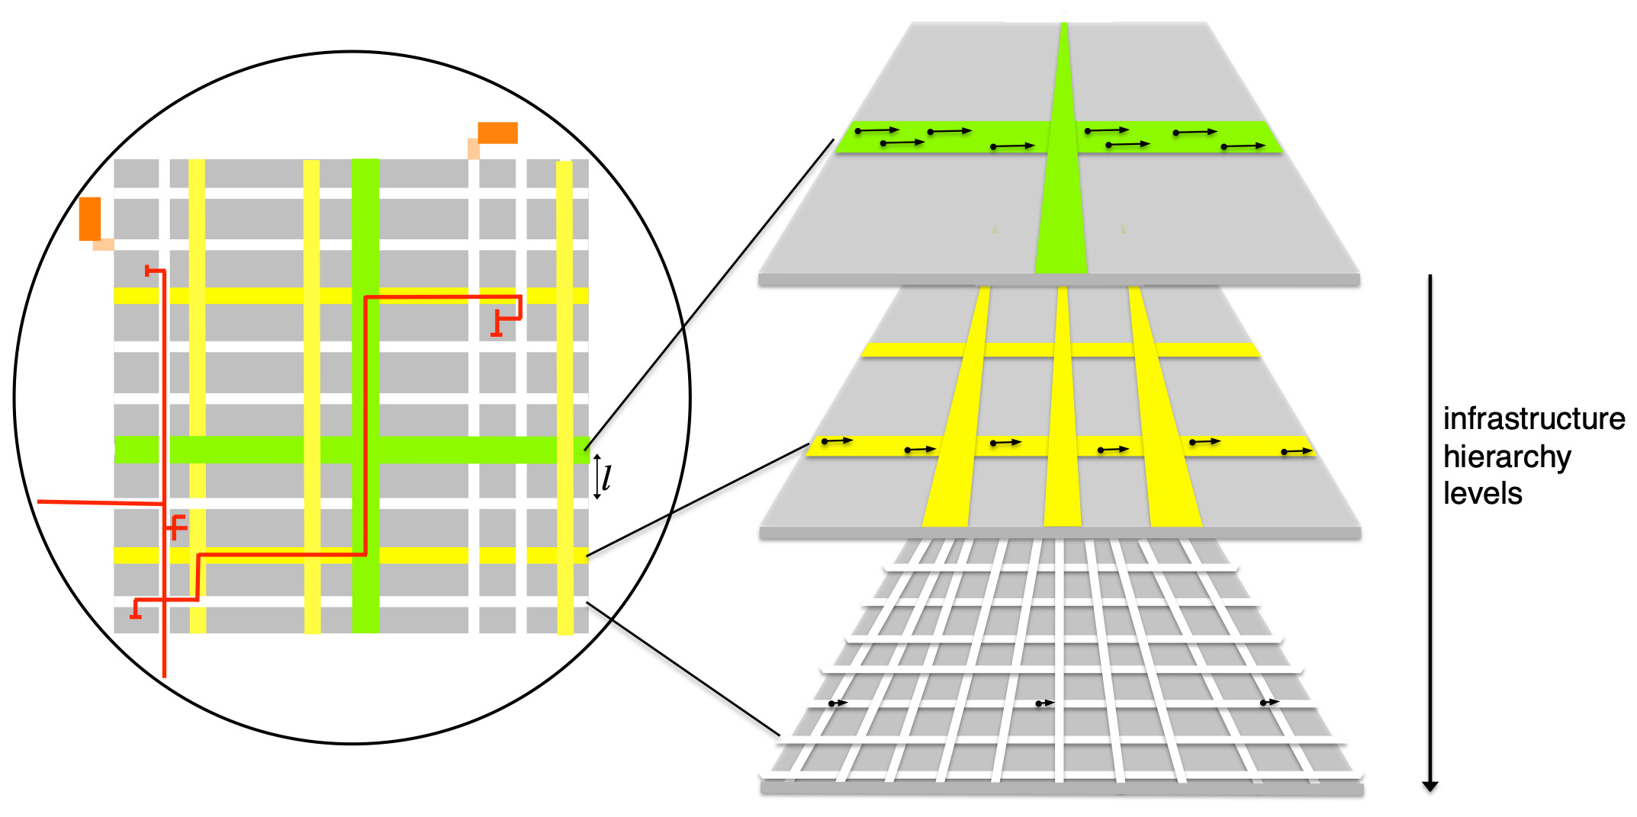

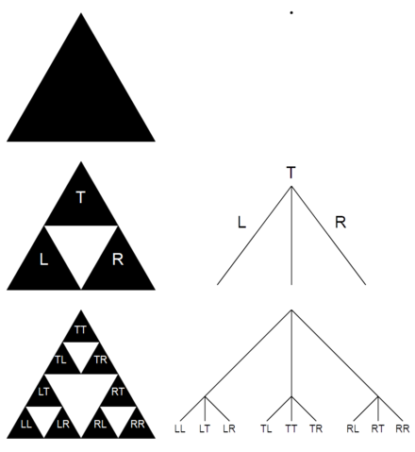
Infrastructure Networks in the City have a Hierarchy
$$i=0$$
Highways: wider + faster
$$N_{i}=b^{i}$$
Main Roads
units of infrastructure
at level i
remember?
$$h=\frac{lnN}{lnb}$$
Local Roads
$$i=h$$
$$N=b^{h}$$
$$s_{i}=s_{*}b^{(1-δ)(h-i)}$$
width segments
$$a_{i}=ab^{(α-1)i}$$
land area segments
$$s_{0}=s_{*}b^{(1-δ)h}≫s_{h}=s_{*}$$
$$a_{h}=ab^{(α-1)h}=aN^{α-1}$$
width
highways
width
doorways
land area per person
keeps increasing with city size
(and individual flows)
same everywhere
$$l_{i}=\frac{a_{i}}{l}$$
infrastructure length segments
$$l_{h}=\frac{a}{l}N^{α-1}$$
minimal distance between people
Notes:
This is a bit of a dense slide: the idea is that we can approach the road system of a city as a hierarchy, at the lowest level (white) there are local streets, then there are wides and faster ones and highways eventually. We can relate the length, area and width of these streets in terms of exponents that vary with the level of the hierarchy, i.

Slide 6
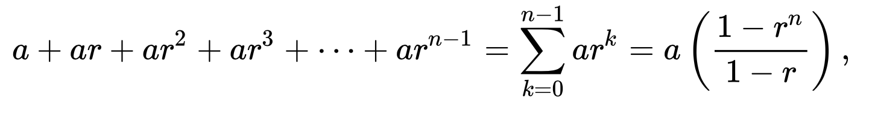
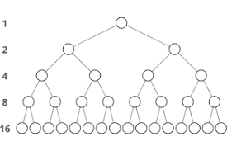
We will need this math trick to sum over levels of hierarchies:
Sum of geometric series:
hierarchical networks
(exponentials)
number of nodes at level 0 (root)
branching ratio: b=2
i=0
$$N_{0}=2^{0}=1$$
i=1
i=2
This is a form of self-similarity (~fractals)
i=3
i=h=4
$$N_{h}=b^{h}=2^{4}=16$$
number of nodes at level h (leaves)
Notes:
This is the rule for the sum of a geometric series, that allows us to add up the width, length, area and so on. By adding up the levels we get the full results for the city.

Slide 7
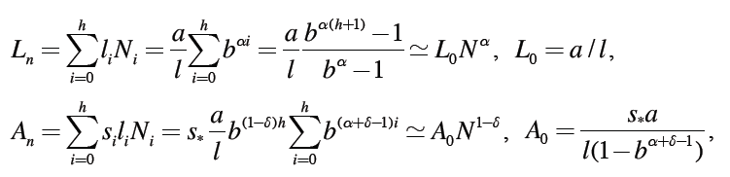
Sum of geometric series
Total Length and Area of Infrastructure Networks
Length is area filling
L ~ A
width of network
$$α=\frac{2}{3};δ=\frac{1}{6}$$
This gives us back our empirical observations with
but now also gives us a theory of the entire infrastructure of cities
Notes:
And here is what we get for the total network length and area.

Slide 8
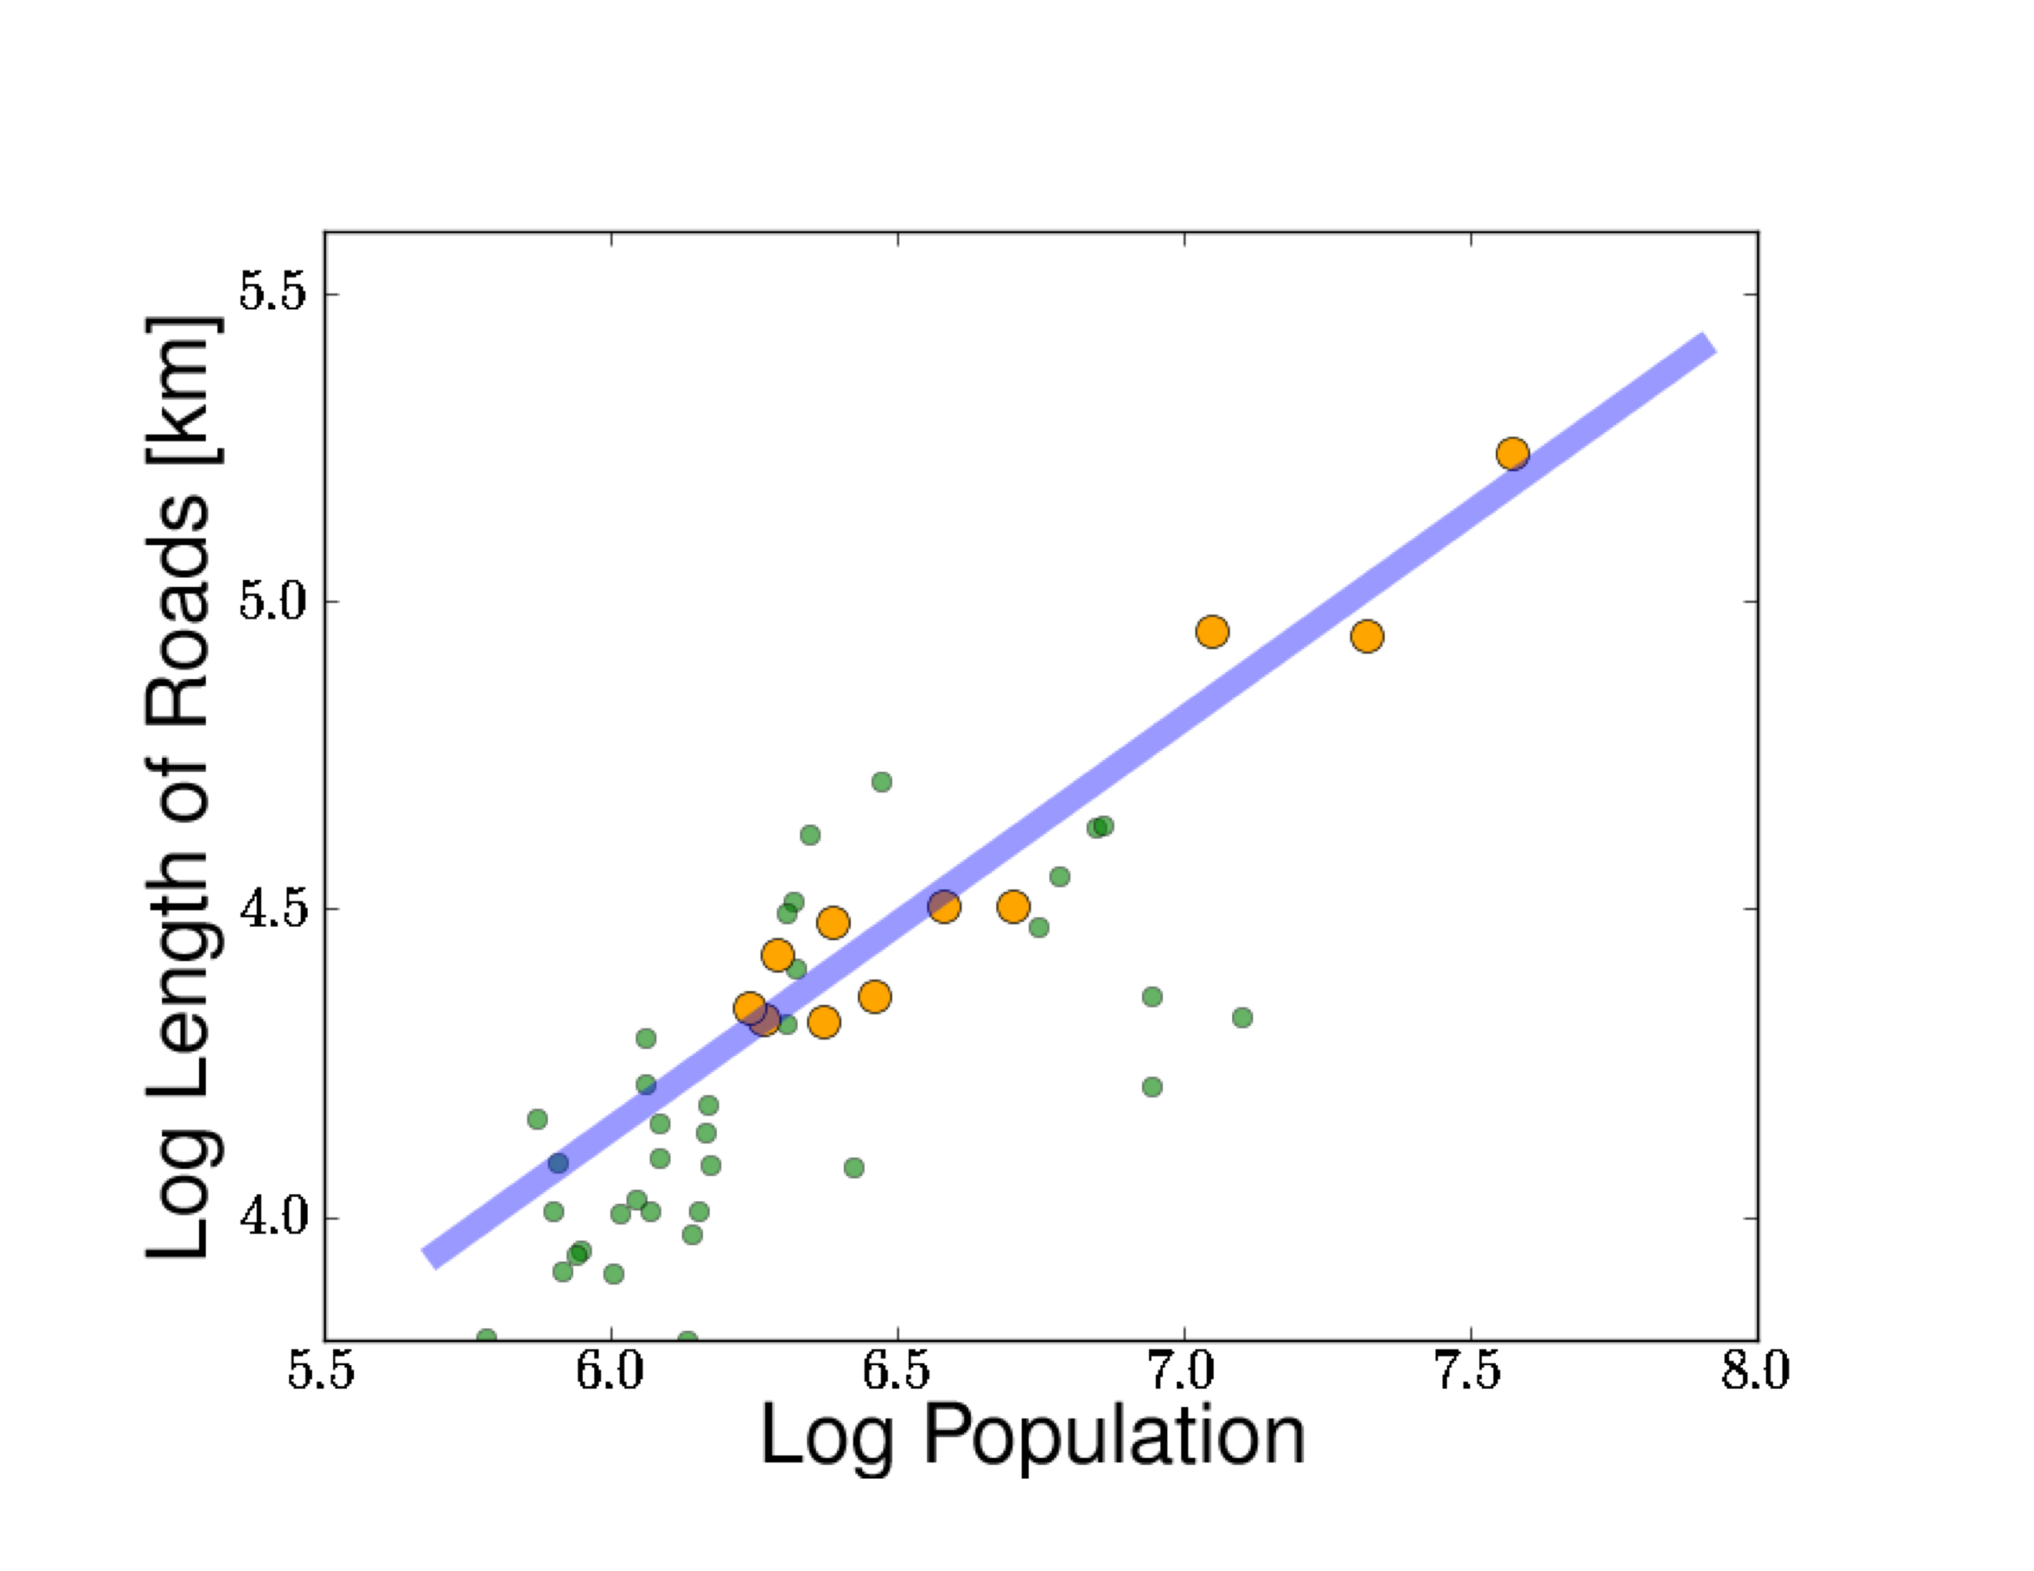

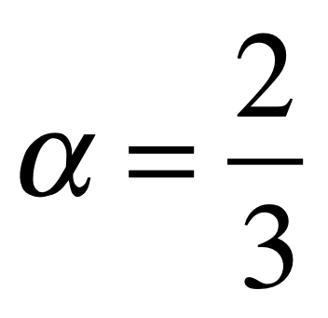
Japan
Notes:
Here is some data about the length of roads from Japan. Orange are metropolitan areas; green are prefectures (which are political units).

Slide 9

IUS Figure 3.5
Notes:
To finish, we want to compute the costs of mobility over these networks; and understand the city from the perspective of its agents’ cost and benefits (not just the volumes and lengths of infrastructure).

Slide 10






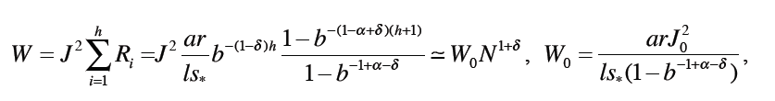
The Cost of Socializing in the City
Conservation of Current across infrastructural levels
$$ρ_{0}v_{0}≫ρ_{h}v_{h}$$
highways
doorways
flow per unit area
faster and more densely packed
the same everywhere
Resistance accounts for Cost of Movement:
Parallel resistance because flow can take alternate routes (decentralized networks)
Cost of Transportation scales super linearly
like Social Benefits -> Spatial Equilibrium independent of City population size
Notes:
Now, what we do is to compute the energy dissipated by all motion across the city. What is important here is that there are many paths between any two points in the city, so its infrastructure network behaves as a parallel resistor. It is this effect that makes urban networks from circulatory systems in organisms, which are purely hierarchical (along with other differences).

Slide 11
New (scale-invariant) Spatial Equilibrium

Slide 12
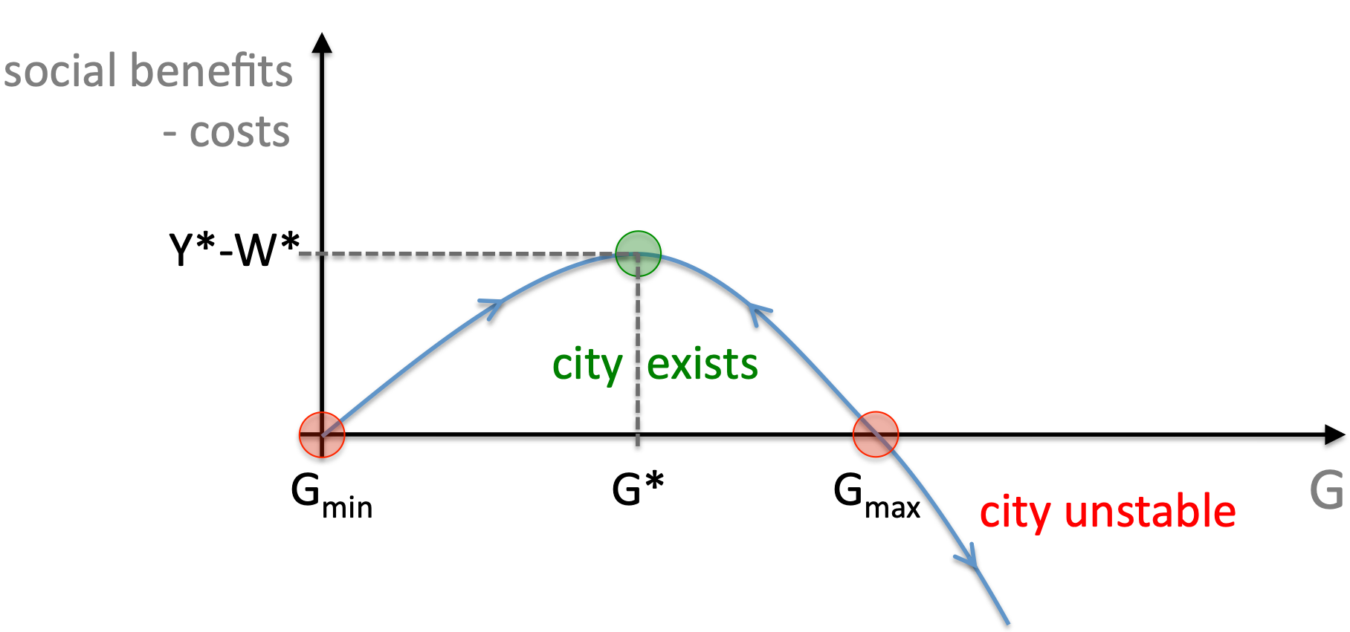
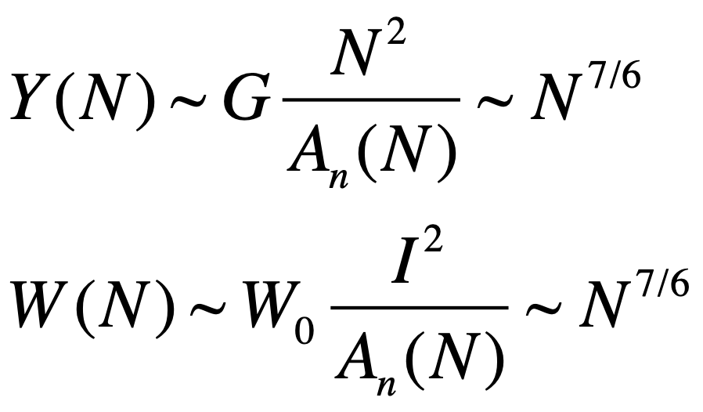




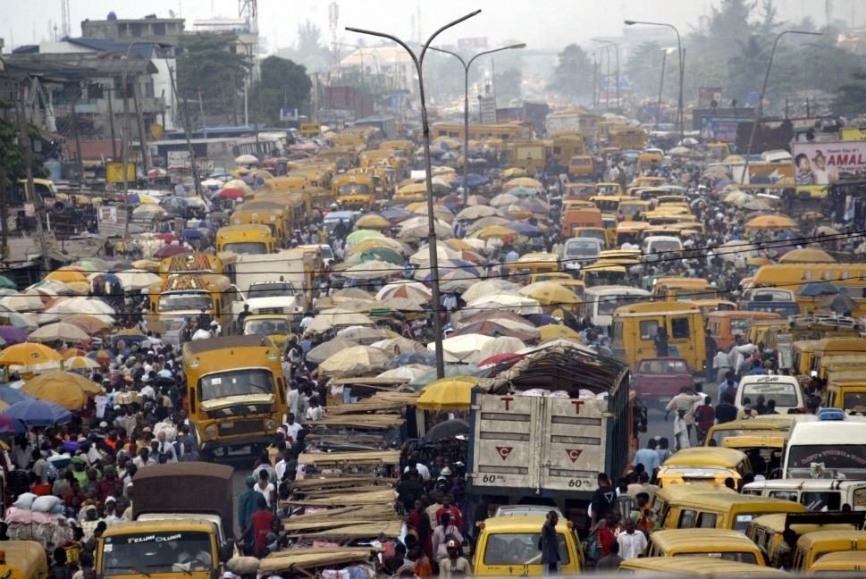
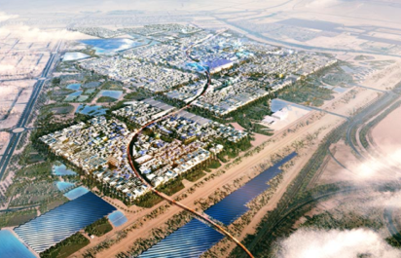
Spatial equilibrium between networked social benefits and costs
Scale invariance: cities can exist at “any” population size
Different from Urban Economics: V Henderson
Real “Income”:
$$Y(N)-W(N)$$
social benefits:
- costs:
Congestion/Danger
High Costs/Dispersion
calculation in IUS pp 88-89
~Lagos
~”Florida”
Poor, congested, intense, dangerous
Diffuse, sprawling, uneventful
Notes:
Because, under these conditions, both costs of mobility and (net) benefits from interactions scale in the same way, the city can exist as a scale invariant equilibrium (across many scales). We can also calculate how G can be optimized because pre-factors depend on it in different ways. If G is too large or two small the city becomes unstable and breaks up into smaller regions.

Slide 13
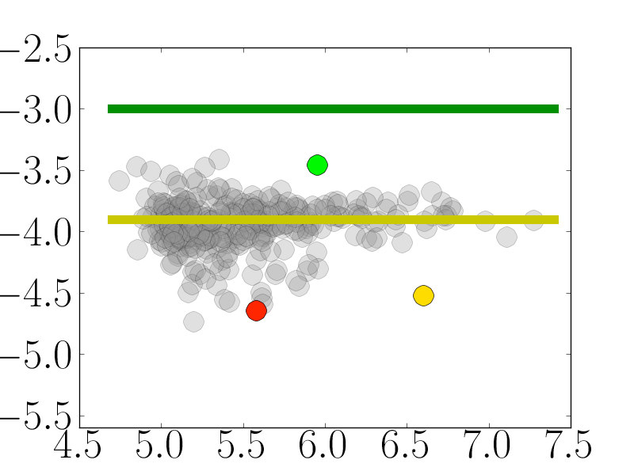

Human Effort is conserved: Estimating G
log G
The parameter G
measures the strength of social interactions over a life path.
For a city it is:
Gmax
Bridgeport CT
G*
Riverside CA
$$G=\left(\frac{Y}{N}\right)\left(\frac{A_{n}}{N}\right)=a_{0}ℓ\overline{g}$$
Brownsville TX
average income x average area per capita
log N
Total “freedom” = social x spatial freedom
Tradeoff between more Social Space versus more Physical Space
larger cities
smaller towns
Notes:
This results in an optimal value of G= G*, which achieves the greatest benefit to cost ratio possible, in terms of parameters of individual behavior and infrastructure efficiency. These parameters are interesting targets for urban planning and policy.

Slide 14
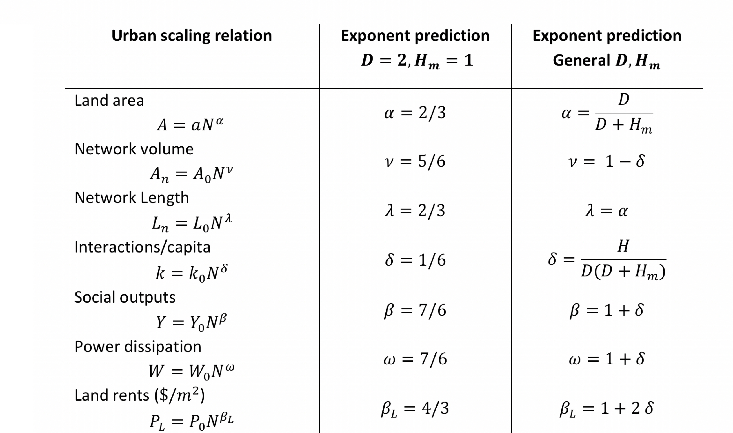
Many quantitative predictions + general consequences
Summary of Urban Scaling relations and exponent predictions for various important quantities. Note that agglomeration effects vanish when $H_{m}→0$ because then people remain spatially separated social networks fail to emerge (we will look at internet quantities later).
Notes:
This table summarizes many different relations that follow from urban scaling theory, They are all the result ultimately of two parameters D, H_m which are the (fractal) dimensions of the embedding space, and of mobility. You can ask what a city would feel like (what its exponents would be, in say 3D). Is the city in 2D special?

