Slide 1

Object Oriented Programming Design Coupling, Inheritance vs Composition
Air Force Institute of Technology
Scott Nykl, PhD

Slide 2
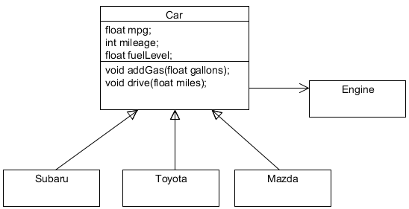

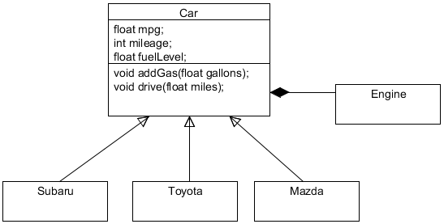
“Strength” of Relationship
Association
Aggregation
Composition
Inheritance

Slide 3
“Strength” of Inheritance
Association
What about this?
Inheritance is the second-tightest coupling relationship in C++

Slide 4
What is stronger? (in C++)
“Friend” classes and functions
(no such concept in Java)

Slide 5
Coupling or Dependency
The degree to which each program module relies on each one of the other modules
Low coupling is often a sign of a well-structured design

Slide 6
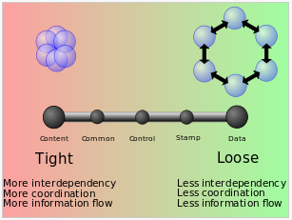
Conceptual Model of Coupling
Ref: http://en.wikipedia.org/wiki/Coupling_(computer_programming)

Slide 7
Conceptual Model of Coupling
Procedural programming
Content coupling (high)
One module relies on the internal workings of another module
Common coupling
When two modules share the same global data
Control coupling
When one module controls the flow of another, by passing it information on what to do
Stamp coupling (data-structured coupling)
When modules share a composite data structure and use only part of it (e.g., passing a whole record to a function that only needs one field of it)
Data coupling
When modules share data (e.g., parameters)
Message coupling (low)
Loosest type of coupling – can be viewed as state decentralization (as in objects) and component communication is done via parameters or message passing
No coupling
No communication

Slide 8
Conceptual Model of Coupling
Object-oriented programming
Subclass coupling
Describes the relationship between a child and its parent. The child is connected to the parent, but the parent is not connected to the child
Temporal coupling
When two actions are bundled together into one module just because they happen to occur at the same time

Slide 9
Coupling Disadvantages
Tightly coupled system tend to exhibit the following developmental characteristics
A change in one module usually forces a ripple effect of changes in other modules
Assembly of modules might require more effort and/or time due to the increased inter-module dependency
A particular module might be harder to reuse and/or test because dependent modules must be included

Slide 10
Coupling Disadvantages
Performance issues
System’s performance is often reduced by message and parameter creation, transmission, translation (e.g., marshaling) and message interpretation…

Slide 11
Coupling Increases….
Coupling increases between two classes A and B if
A has an attribute that refers to (is of type) B
A calls on services of an object B
A has a method that references B
A is a subclass of (or implements) class B

Slide 12
Solutions to Decrease Coupling
Functional design!
Seeks to limit the responsibilities of modules along functionality

Slide 13
Coupling can Create Problems in Object Hierarchies

Slide 14

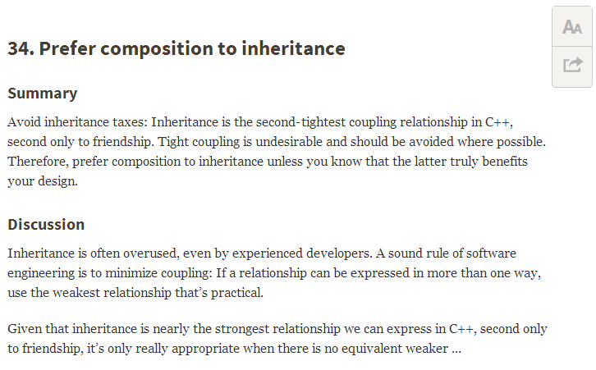
Prefer Composition to Inheritance
Ref: C++ Coding Standards: 101 Rules, Guidelines, and Best Practices

Slide 15
“Evolve Your Hierarchy” (excellent discussion of composition vs inheritance)
Ref: http://cowboyprogramming.com/2007/01/05/evolve-your-heirachy/

Slide 16
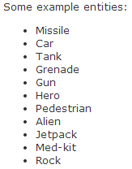
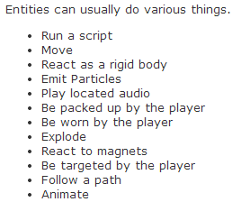
Game ‘Engine’ Example
Most games have the concept of a game entity that exists in the game world
Usually visible, and usually it can move around

Slide 17
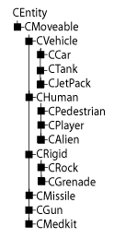
Traditional Deep Hierarchies
Object-oriented decomposition usually starts out with good intentions
As development progresses, we usually need to add various points of functionality to the entities

Slide 18
An Aggregation of Components
Is one of separating the functionality into individual components that are mostly independent of one another.
The traditional object hierarchy is dispensed with, and an object is now created as an aggregation (a collection) of independent components.

Slide 19
Trouble Starts Here
Is this really an “IS-A” relationship?

