Slide 1
Hands-On Normalization and Statistical Analysis
Ryan McClure
Scientist, Pacific Northwest National Laboratory
Notes:
About the Image: Glass Lab Equipment
Glass lab equipment on a table at the regional American Chemical Society meeting
https://www.flickr.com/photos/pnnl/41280037010/in/album-72157692716565760/

Slide 2
Normalization: DESeq2
To normalize raw count data with DESe2 you need:
Raw count data as a .csv file
A condition information file telling DESeq2 which columns go to which experiment
Condition Information
Raw Count Data
 | condition
Retene_Rep1 | A
Retene_Rep2 | A
Retene_Rep3 | A
Retene_Rep4 | A
BjF_Rep1 | B
BjF_Rep2 | B
BjF_Rep3 | B
BjF_Rep4 | B
ProbeID | Retene_Rep1 | Retene_Rep2 | Retene_Rep3 | Retene_Rep4 | BjF_Rep1 | BjF_Rep2
ENSDARG00000000001.5 | 203 | 130 | 189 | 199 | 195 | 125
ENSDARG00000000002.7 | 201 | 139 | 243 | 161 | 303 | 242
ENSDARG00000000018.8 | 2452 | 2272 | 2341 | 2017 | 2743 | 2367
ENSDARG00000000019.8 | 5242 | 4798 | 4416 | 3981 | 5508 | 4385
ENSDARG00000000068.8 | 235 | 315 | 347 | 297 | 351 | 391
ENSDARG00000000069.6 | 1366 | 1200 | 1654 | 953 | 2022 | 1740
ENSDARG00000000086.11 | 1647 | 1347 | 1774 | 1381 | 1978 | 1458
ENSDARG00000000103.11 | 5671 | 5391 | 6489 | 5216 | 7308 | 6006
ENSDARG00000000142.9 | 335 | 228 | 335 | 246 | 343 | 308
ENSDARG00000000151.13 | 115 | 92 | 135 | 98 | 147 | 109

Slide 3
Normalization: DESeq2
To normalize raw count data with DESe2 you need:
Raw count data as a .csv file
A condition information file telling DESeq2 which columns go to which experiment
Condition Information
Raw Count Data
 | condition
Retene_Rep1 | A
Retene_Rep2 | A
Retene_Rep3 | A
Retene_Rep4 | A
BjF_Rep1 | B
BjF_Rep2 | B
BjF_Rep3 | B
BjF_Rep4 | B
ProbeID | Retene_Rep1 | Retene_Rep2 | Retene_Rep3 | Retene_Rep4 | BjF_Rep1 | BjF_Rep2
ENSDARG00000000001.5 | 203 | 130 | 189 | 199 | 195 | 125
ENSDARG00000000002.7 | 201 | 139 | 243 | 161 | 303 | 242
ENSDARG00000000018.8 | 2452 | 2272 | 2341 | 2017 | 2743 | 2367
ENSDARG00000000019.8 | 5242 | 4798 | 4416 | 3981 | 5508 | 4385
ENSDARG00000000068.8 | 235 | 315 | 347 | 297 | 351 | 391
ENSDARG00000000069.6 | 1366 | 1200 | 1654 | 953 | 2022 | 1740
ENSDARG00000000086.11 | 1647 | 1347 | 1774 | 1381 | 1978 | 1458
ENSDARG00000000103.11 | 5671 | 5391 | 6489 | 5216 | 7308 | 6006
ENSDARG00000000142.9 | 335 | 228 | 335 | 246 | 343 | 308
ENSDARG00000000151.13 | 115 | 92 | 135 | 98 | 147 | 109

Slide 4
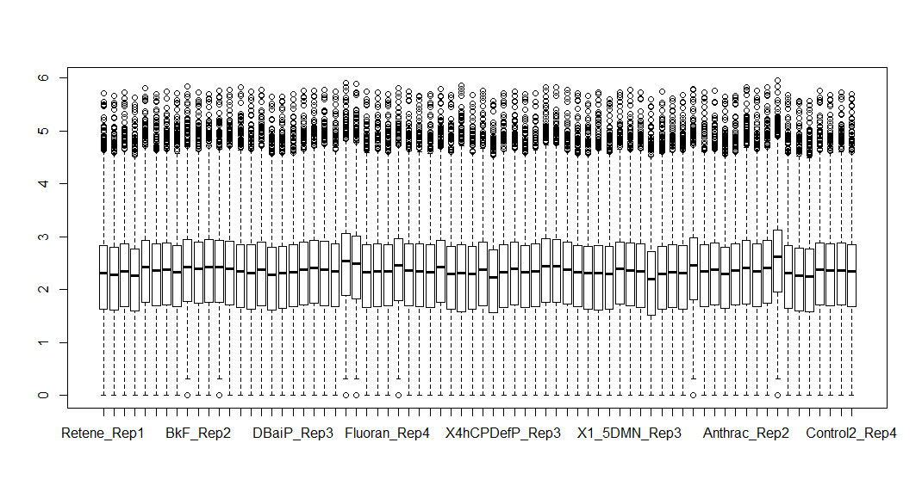
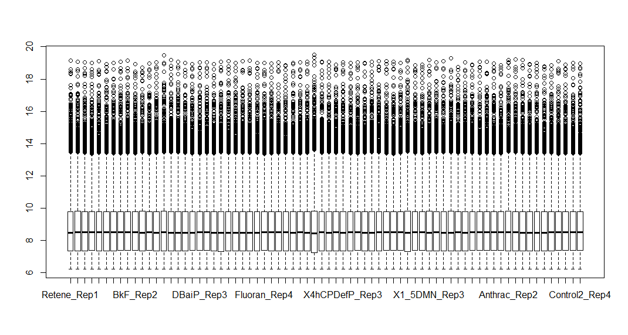
Normalization: DESeq2
Raw
Zebrafish
Data
Normalized
Zebrafish
Data

Slide 5
Statistical Analysis: DESeq2
p-value adjusted for multiple hypothesis testing
First Value/Second Value
baseMean | log2FoldChange | lfcSE | stat | pvalue | padj | names
1255.755 | 5.342099 | 0.171084 | 31.22499 | 4.88E-214 | 1.11E-209 | ENSDARG00000101195.1
416.2773 | 3.213865 | 0.103163 | 31.15319 | 4.59E-213 | 5.22E-209 | ENSDARG00000101789.2
1057.001 | 2.052907 | 0.086946 | 23.61131 | 2.95E-123 | 2.23E-119 | ENSDARG00000097491.1
8617.569 | 2.382304 | 0.111154 | 21.43237 | 6.67E-102 | 3.79E-98 | ENSDARG00000104068.1
13349.81 | 7.715566 | 0.431863 | 17.86576 | 2.18E-71 | 9.90E-68 | ENSDARG00000098315.1
1289.655 | 2.472738 | 0.143809 | 17.19464 | 2.91E-66 | 1.10E-62 | ENSDARG00000086826.3
845.9056 | 2.553241 | 0.163838 | 15.58392 | 9.36E-55 | 3.04E-51 | ENSDARG00000068934.5
86.58186 | 4.372841 | 0.288932 | 15.13452 | 9.59E-52 | 2.72E-48 | ENSDARG00000101364.1
313.2074 | 2.461376 | 0.165656 | 14.85837 | 6.14E-50 | 1.55E-46 | ENSDARG00000030896.6

Slide 6
Data Visualization
Ryan McClure
Scientist, Pacific Northwest National Laboratory
Notes:
About the Image: Glass Lab Equipment
Glass lab equipment on a table at the regional American Chemical Society meeting
https://www.flickr.com/photos/pnnl/41280037010/in/album-72157692716565760/

Slide 7
Data Visualization
Identifying Outliers
MDS Plots
Visualizing Data
PCA Plots
Volcano Graphs
Heatmaps
Venn Diagrams

Slide 8
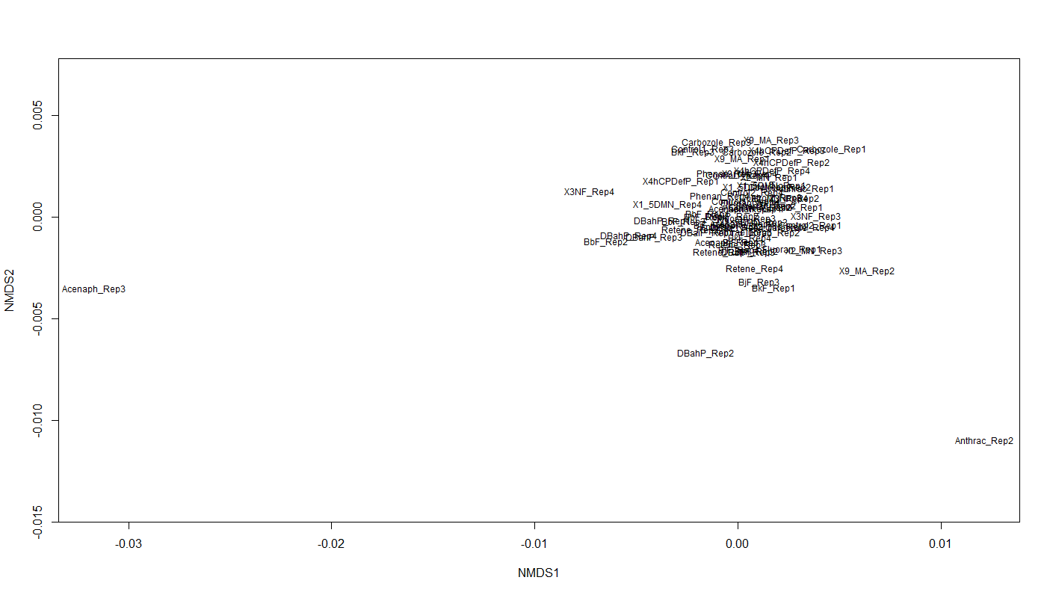
Data Visualization: Outliers
Identify the genes with the most variability in expression (CV, coefficient of variation: standard deviation/mean)
Transpose data (Rows are conditions, columns are genes/proteins/etc)
Create MDS Plot

Slide 9
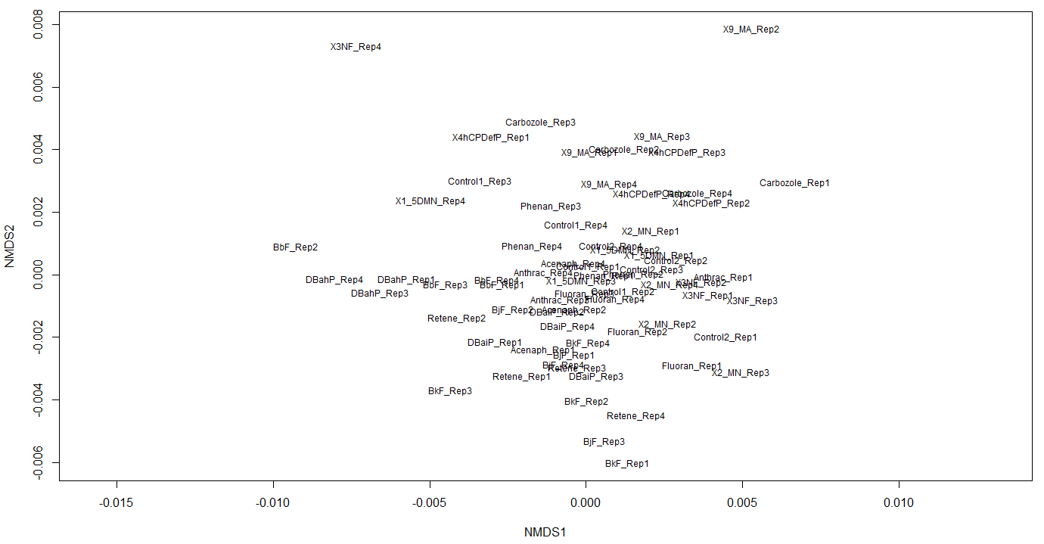
Data Visualization: Outliers
Identify the genes with the most variability in expression (CV, coefficient of variation: standard deviation/mean)
Transpose data (Rows are conditions, columns are genes/proteins/etc)
Create MDS Plot

Slide 10
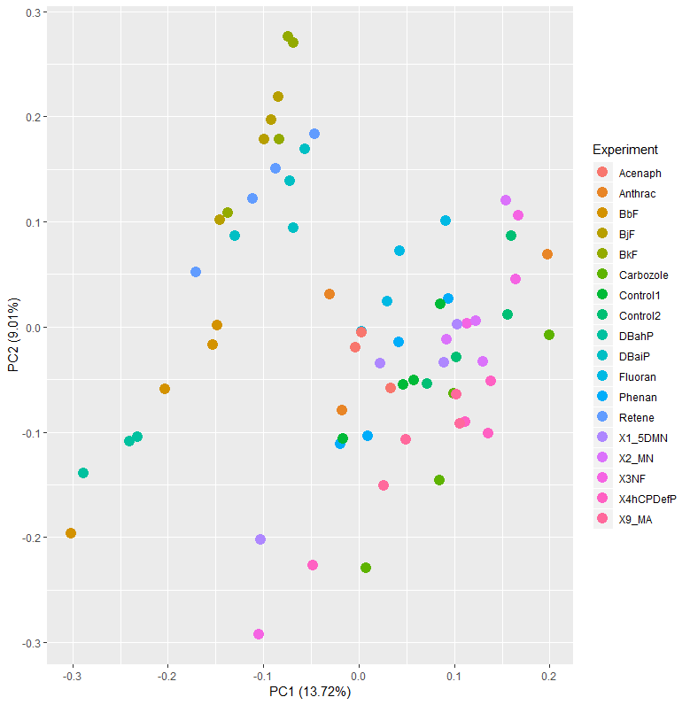
Data Visualization: PCA Plots

Slide 11
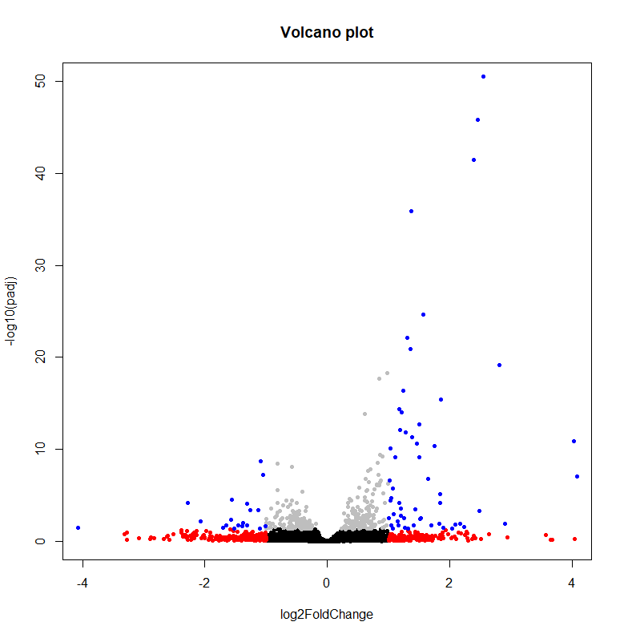
Data Visualization: Volcano Plots

Slide 12
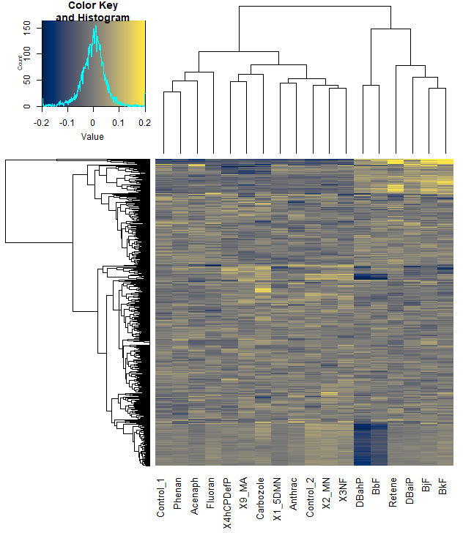
Data Visualization: Heatmaps

Slide 13
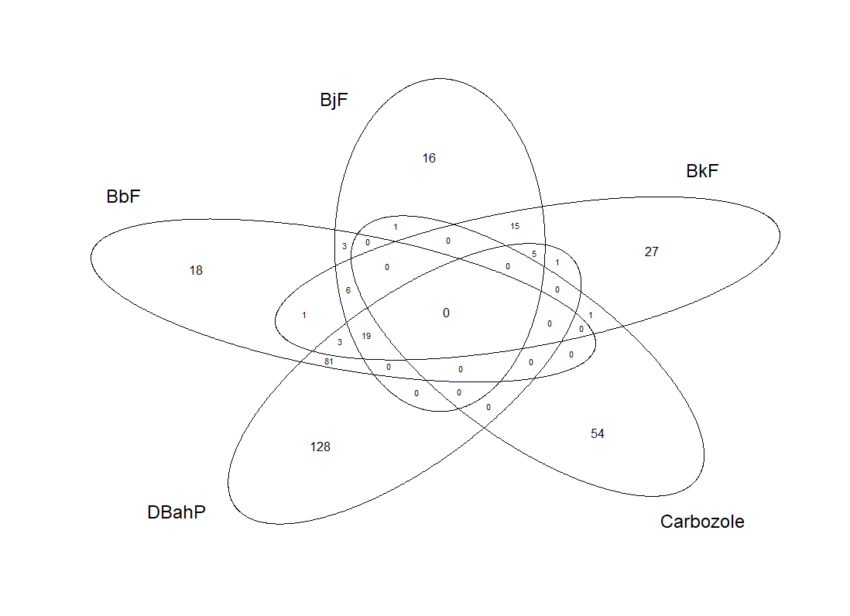
Data Visualization: Venn Diagrams

