Slide 1
Network Analysis
Ryan McClure
Scientist, Pacific Northwest National Laboratory
Notes:
About the Image: Glass Lab Equipment
Glass lab equipment on a table at the regional American Chemical Society meeting
https://www.flickr.com/photos/pnnl/41280037010/in/album-72157692716565760/

Slide 2
Gene Co-Expression Networks
Network Analysis
Highlight where & how processes are related in biological systems (McClure, 2016, 2018).
Identify new targets of regulatory proteins (Faith, 2007).
Identify genes of importance to infection in human pathogens (McDermott, 2009).
Assign putative functions to unknown genes (Beiki, 2016).

Slide 3

Co-Expression/High School Networks
Network analysis links nodes (genes) based on their interactions across conditions (edges). This can reveal how processes are related and identify nodes of importance
In a high school, clusters of students emerge as groups are formed based on activities. Certain students occupy central positions linking different groups.
High School Network
Football Team
Band
Student in Band and Football
Student in Drama and
Football
Drama Club

Slide 4
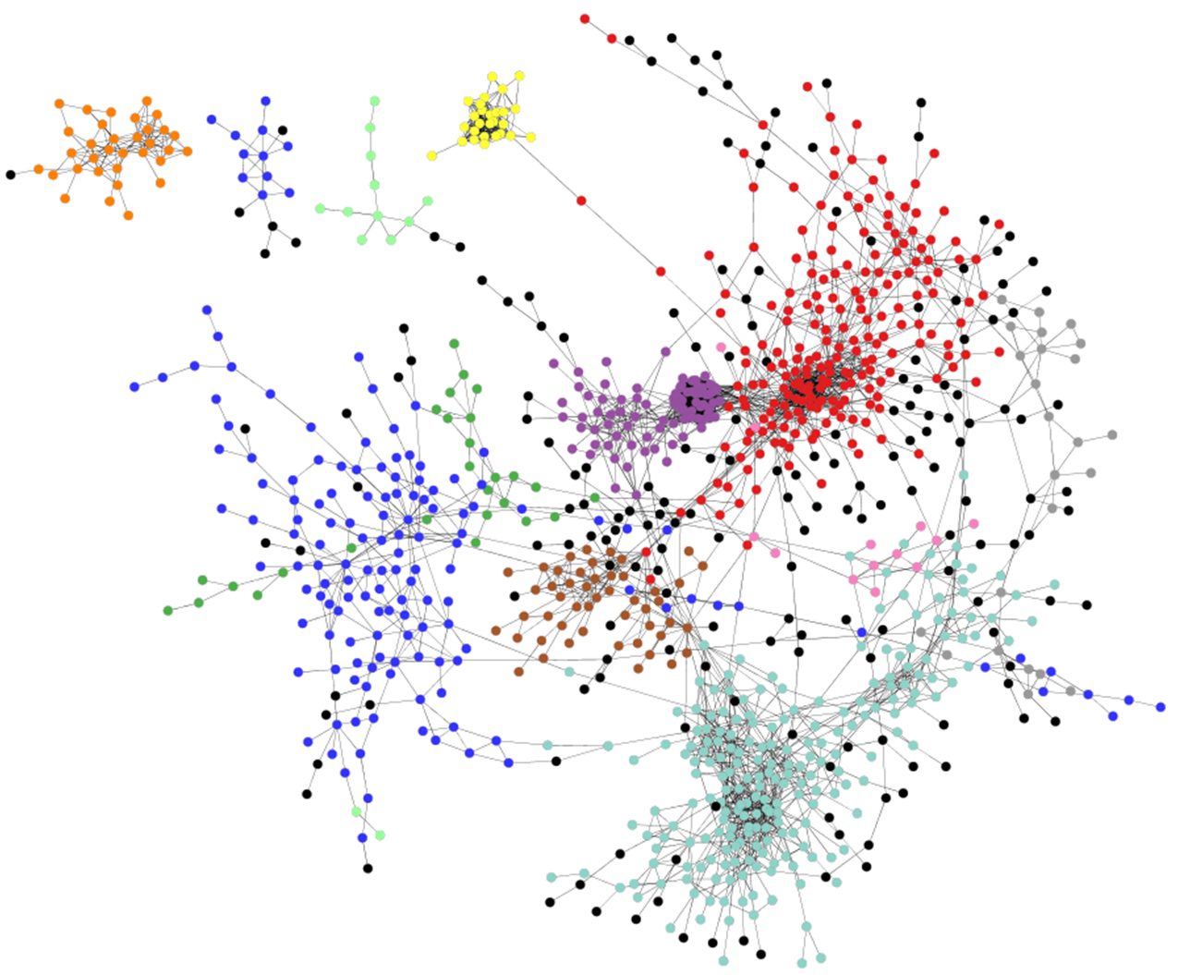
Gene Co-Expression Network Analysis of Synechococcus
Transcriptomic data from different sources
CLR
(Context Likelihood of Relatedness)
1) Assigns a measure of coordination for each gene pair
2) Keeps only the most highly coordinated genes pairs
3) Infers network from these gene pairs
G3
G4
4.5
G1
G2
G3
G4
2.5
4.5
G5
G6
1.5

Slide 5
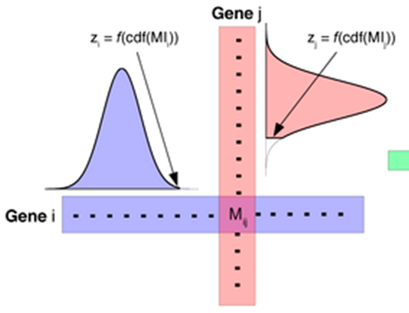
Specifics of CLR Analysis
Mutual Information Scores (MI)
Z-scores (= MI – Av)/StDev)
 | Gene 1 | Gene 2 | Gene 3 | Gene 4 | Gene 5
Gene 1 | 0 | 3.58 | -2.068 | -0.928 | 0.256
Gene 2 | 3.58 | 0 | 5.1178 | 4.4544 | 1.2441
Gene 3 | -2.78 | 5.0381 | 0 | 6.1664 | -2.071
Gene 4 | -1.42 | 4.4544 | 5.7933 | 0 | -0.949
Gene 5 | 0.256 | -1.162 | -2.815 | -1.464 | 0
Average MI (Av)
Standard Deviations (StDev)
Z-score cutoff = 2.0
Node
Gene
1
Gene
3
Edge
Gene
2
Gene
4
We’re looking for genes that are very highly linked by mutual information compared to all mutual information links between all genes

Slide 6
Network Inference Steps
Collect normalized expression data for at least 15 different conditions/replicates
Determine Z-scores (or other measure of association)
Choose cutoff used to define an edge in the network
Create a .sif file (a list of edges and the genes that are linked by them)
Import .sif file into Cytoscape for viewing

Slide 7
Network Inference Steps
Collect normalized expression data for at least 15 different conditions/replicates
Transpose Data
Synonym | Expression C-Lim | Expression N-Lim | Expression L-Lim | Expression AB 3-1 | Expression AB 3-2
SYNPCC7002_A0001 | 10 | 14 | 10 | 11 | 13
SYNPCC7002_A0002 | 21 | 18 | 18 | 26 | 25
SYNPCC7002_A0003 | 1137 | 848 | 842 | 3215 | 2245
SYNPCC7002_A0004 | 7 | 20 | 6 | 10 | 13
SYNPCC7002_A0005 | 8 | 26 | 8 | 13 | 9
SYNPCC7002_A0006 | 9 | 9 | 6 | 2 | 2
SYNPCC7002_A0007 | 8 | 18 | 8 | 3 | 8
SYNPCC7002_A0008 | 25 | 22 | 26 | 11 | 18
SYNPCC7002_A0009 | 23 | 15 | 10 | 13 | 11
SYNPCC7002_A0010 | 24 | 13 | 26 | 18 | 13
SYNPCC7002_A0011 | 60 | 40 | 48 | 108 | 124
SYNPCC7002_A0012 | 76 | 103 | 73 | 560 | 354
SYNPCC7002_A0013 | 78 | 59 | 56 | 491 | 426
SYNPCC7002_A0014 | 78 | 49 | 88 | 71 | 75
SYNPCC7002_A0015 | 23 | 21 | 26 | 37 | 27
Synonym | _A0001 | _A0002 | _A0003 | _A0004 | _A0005 | _A0006 | _A0007 | _A0008 | _A0009 | _A0010 | _A0011 | _A0012 | _A0013 | _A0014 | _A0015
Expression C-Lim | 10 | 21 | 1137 | 7 | 8 | 9 | 8 | 25 | 23 | 24 | 60 | 76 | 78 | 78 | 23
Expression N-Lim | 14 | 18 | 848 | 20 | 26 | 9 | 18 | 22 | 15 | 13 | 40 | 103 | 59 | 49 | 21
Expression L-Lim | 10 | 18 | 842 | 6 | 8 | 6 | 8 | 26 | 10 | 26 | 48 | 73 | 56 | 88 | 26
Expression AB 3-1 | 11 | 26 | 3215 | 10 | 13 | 2 | 3 | 11 | 13 | 18 | 108 | 560 | 491 | 71 | 37
Expression AB 3-2 | 13 | 25 | 2245 | 13 | 9 | 2 | 8 | 18 | 11 | 13 | 124 | 354 | 426 | 75 | 27
Delete Row Names (Condition Information)
_A0001 | _A0002 | _A0003 | _A0004 | _A0005 | _A0006 | _A0007 | _A0008 | _A0009 | _A0010 | _A0011 | _A0012 | _A0013 | _A0014 | _A0015
10 | 21 | 1137 | 7 | 8 | 9 | 8 | 25 | 23 | 24 | 60 | 76 | 78 | 78 | 23
14 | 18 | 848 | 20 | 26 | 9 | 18 | 22 | 15 | 13 | 40 | 103 | 59 | 49 | 21
10 | 18 | 842 | 6 | 8 | 6 | 8 | 26 | 10 | 26 | 48 | 73 | 56 | 88 | 26
11 | 26 | 3215 | 10 | 13 | 2 | 3 | 11 | 13 | 18 | 108 | 560 | 491 | 71 | 37
13 | 25 | 2245 | 13 | 9 | 2 | 8 | 18 | 11 | 13 | 124 | 354 | 426 | 75 | 27

Slide 8
Network Inference Steps
2. Determine Z-scores (or other measure of association)
 | SYNPCC7002_A0001 | SYNPCC7002_A0002 | SYNPCC7002_A0003 | SYNPCC7002_A0004 | SYNPCC7002_A0005 | SYNPCC7002_A0006 | SYNPCC7002_A0007 | SYNPCC7002_A0008
SYNPCC7002_A0001 | 0 | 0 | 0.137438 | 0 | 0.691609 | 0 | 0 | 0
SYNPCC7002_A0002 | 0 | 0 | 0 | 0.798212 | 0 | 0.271413 | 0 | 0
SYNPCC7002_A0003 | 0.137438 | 0 | 0 | 0 | 0 | 0 | 1.388529 | 2.395533528
SYNPCC7002_A0004 | 0 | 0.798212 | 0 | 0 | 6.013484 | 3.36465 | 0.020022 | 0
SYNPCC7002_A0005 | 0.691609 | 0 | 0 | 6.013484 | 0 | 3.083369 | 0.815965 | 0
SYNPCC7002_A0006 | 0 | 0.271413 | 0 | 3.36465 | 3.083369 | 0 | 1.102571 | 0
SYNPCC7002_A0007 | 0 | 0 | 1.388529 | 0.020022 | 0.815965 | 1.102571 | 0 | 2.161886273
SYNPCC7002_A0008 | 0 | 0 | 2.395534 | 0 | 0 | 0 | 2.161886 | 0
=
=

Slide 9
Network Inference Steps
3. Choose cutoff used to define an edge in the network
 | Edge_Cutoff | edges
SYNPCC7002_F00882695 | 7.730963 | 10000
SYNPCC7002_A2818755 | 8.097309 | 8000
SYNPCC7002_G01353094 | 8.5697 | 6000
SYNPCC7002_A27771999 | 9.235387 | 4000
SYNPCC7002_A2152692 | 10.48079 | 2000
SYNPCC7002_A28292134 | 11.90295 | 1000
SYNPCC7002_A19921989 | 13.61929 | 500
Will provide a network of the top 5000 Z-scores (5000 edges)
Will provide a network of the top 250 Z-scores (250 edges)

Slide 10
Network Inference Steps
4. Create a .sif file (a list of edges and the genes that are linked by them)
 | SYNPCC7002_A0001 | SYNPCC7002_A0002 | SYNPCC7002_A0003 | SYNPCC7002_A0004 | SYNPCC7002_A0005 | SYNPCC7002_A0006 | SYNPCC7002_A0007 | SYNPCC7002_A0008
SYNPCC7002_A0001 | 0 | 0 | 0.137438 | 0 | 0.691609 | 0 | 0 | 0
SYNPCC7002_A0002 | 0 | 0 | 0 | 0.798212 | 0 | 0.271413 | 0 | 0
SYNPCC7002_A0003 | 0.137438 | 0 | 0 | 0 | 0 | 0 | 1.388529 | 2.395533528
SYNPCC7002_A0004 | 0 | 0.798212 | 0 | 0 | 6.013484 | 3.36465 | 0.020022 | 0
SYNPCC7002_A0005 | 0.691609 | 0 | 0 | 6.013484 | 0 | 3.083369 | 0.815965 | 0
SYNPCC7002_A0006 | 0 | 0.271413 | 0 | 3.36465 | 3.083369 | 0 | 1.102571 | 0
SYNPCC7002_A0007 | 0 | 0 | 1.388529 | 0.020022 | 0.815965 | 1.102571 | 0 | 2.161886273
SYNPCC7002_A0008 | 0 | 0 | 2.395534 | 0 | 0 | 0 | 2.161886 | 0
.sif file format
SYNPCC7002_A0005 C SYNPCC7002_A0004
SYNPCC7002_A0006 C SYNPCC7002_A0004
SYNPCC7002_A0005 C SYNPCC7002_A0006

Slide 11
Network Inference Steps
5. Import .sif file into Cytoscape for viewing
 | SYNPCC7002_A0001 | SYNPCC7002_A0002 | SYNPCC7002_A0003 | SYNPCC7002_A0004 | SYNPCC7002_A0005 | SYNPCC7002_A0006 | SYNPCC7002_A0007 | SYNPCC7002_A0008
SYNPCC7002_A0001 | 0 | 0 | 0.137438 | 0 | 0.691609 | 0 | 0 | 0
SYNPCC7002_A0002 | 0 | 0 | 0 | 0.798212 | 0 | 0.271413 | 0 | 0
SYNPCC7002_A0003 | 0.137438 | 0 | 0 | 0 | 0 | 0 | 1.388529 | 2.395533528
SYNPCC7002_A0004 | 0 | 0.798212 | 0 | 0 | 6.013484 | 3.36465 | 0.020022 | 0
SYNPCC7002_A0005 | 0.691609 | 0 | 0 | 6.013484 | 0 | 3.083369 | 0.815965 | 0
SYNPCC7002_A0006 | 0 | 0.271413 | 0 | 3.36465 | 3.083369 | 0 | 1.102571 | 0
SYNPCC7002_A0007 | 0 | 0 | 1.388529 | 0.020022 | 0.815965 | 1.102571 | 0 | 2.161886273
SYNPCC7002_A0008 | 0 | 0 | 2.395534 | 0 | 0 | 0 | 2.161886 | 0
.sif file format
SYNPCC7002_A0005 C SYNPCC7002_A0004
SYNPCC7002_A0006 C SYNPCC7002_A0004
SYNPCC7002_A0005 C SYNPCC7002_A0006

Slide 12
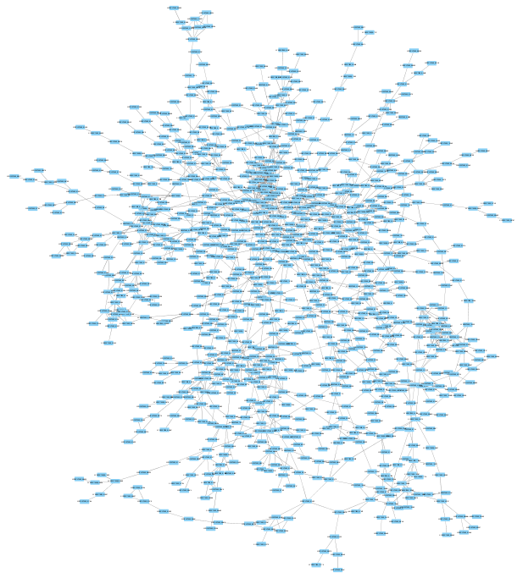
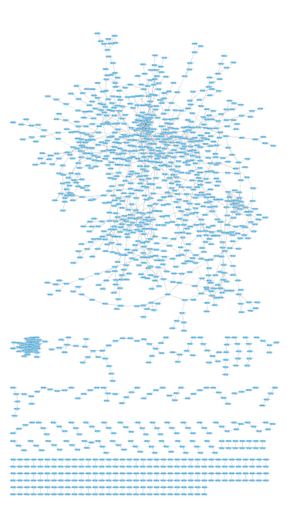
Synechococcus 7002 Network
Circles represent genes (i.e., nodes).
Lines between genes represent connections (i.e., edges).
Connections are assigned between two genes if they have a high mutual information score within the context of the network.
1,395 genes (43% of genome)
2,000 connections between them
Synechococcus sp. PCC 7002

Slide 13
Network Analysis: Centrality
Degree: The number of edges a node has with other nodes
Betweenness: A normalized value of the number of shortest paths between any two nodes in the network that pass through the node in question
name | Degree | BetweennessCentrality
SYNPCC7002_A1201 | 2 | 0.0021645
SYNPCC7002_A1216 | 1 | 0
SYNPCC7002_A1671 | 4 | 0.01332919
SYNPCC7002_A2435 | 2 | 0.00692781
SYNPCC7002_A1206 | 1 | 0
SYNPCC7002_A2562 | 2 | 0.0021645
SYNPCC7002_A1219 | 1 | 0
SYNPCC7002_A1221 | 1 | 0
SYNPCC7002_A2413 | 2 | 0.0021645
SYNPCC7002_A1233 | 1 | 0
SYNPCC7002_F0102 | 2 | 0.0021645
SYNPCC7002_A2695 | 2 | 0.01505302
Gene of High Betweenness
Genes of High Degree

Slide 14
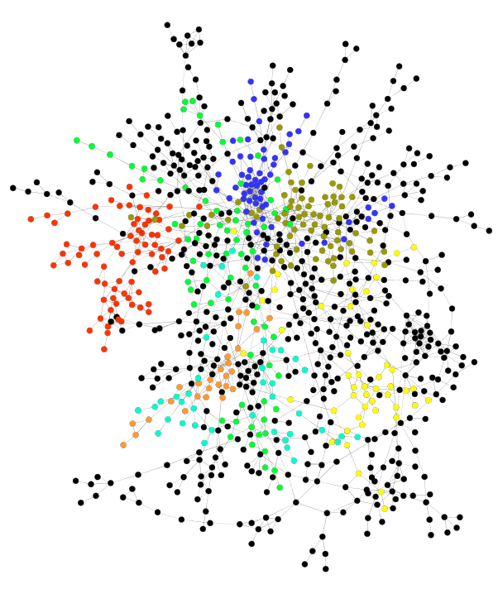
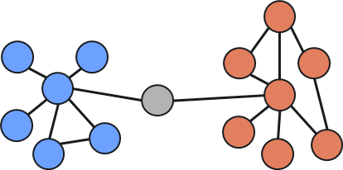
Network Analysis: Modules
Module 2
Module 1

