Slide 1
Post Sequencing Transcriptomic Data QC
Ryan McClure
Scientist, Pacific Northwest National Laboratory
Notes:
About the Image: Glass Lab Equipment
Glass lab equipment on a table at the regional American Chemical Society meeting
https://www.flickr.com/photos/pnnl/41280037010/in/album-72157692716565760/

Slide 2
RNA-seq Data Quality Control
What is Data QC for Transcriptomic Data?
Examining quality of sequencing data
How confident is the machine in the call
Examining the length of the reads in the data
How long are the reads, does that match what we want
Determining the duplication level of reads
How many times are certain reads found over and over
Identifying if adaptor sequences are parts of reads
Were inserts too short? Did the machine sequence all the way into the adaptor
Most of these problems can be fixed through filtering the data.

Slide 3
RNA-seq Data Quality Control
Why do QC
Examining quality of sequencing data
Reads of low quality can be removed, improving alignment to reference genome
Examining the length of the reads in the data
Short reads can be dropped, again improving alignment.
Determining the duplication level of reads
PCR bias can be identified, highly duplicated reads can be removed
Identifying if adaptor sequences are parts of reads
Adaptors can be removed, improving alignment. Insert length issues can be identified

Slide 4
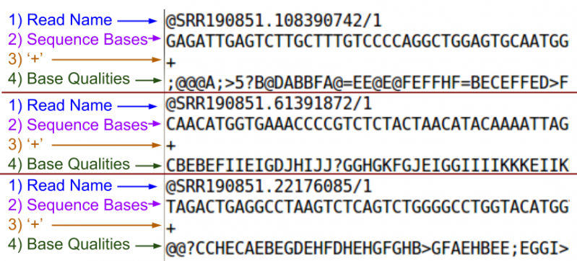
A fastq Read
fastq = fasta + quality

Slide 5
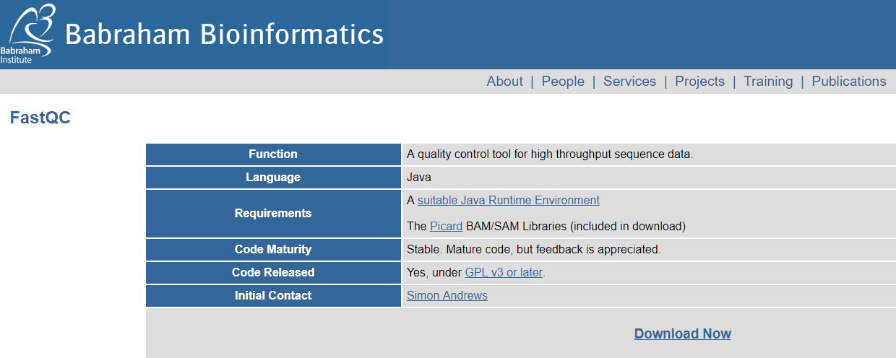
FastQC: A tool for QC of Fastq files
https://www.bioinformatics.babraham.ac.uk/projects/fastqc/

Slide 6
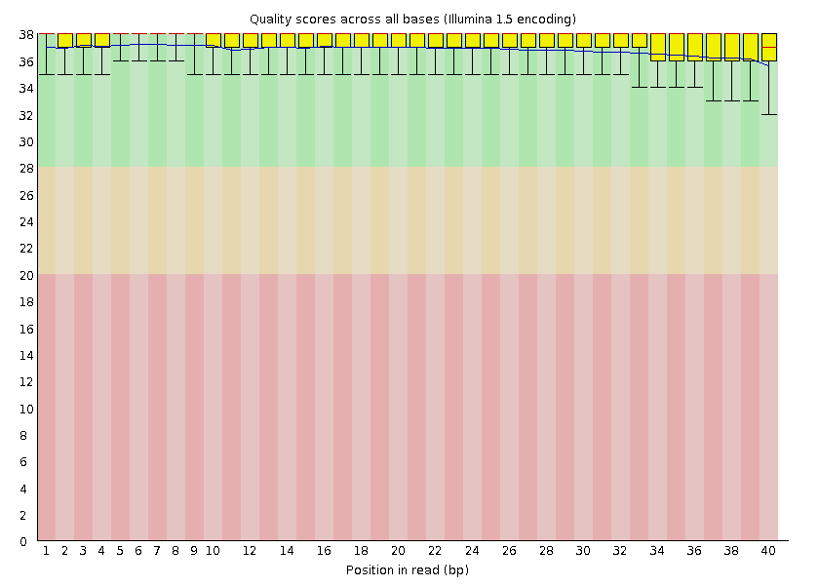
FastQC: Base Quality
Phred Quality Score | Probability of incorrect base call | Base call accuracy
10 | 1 in 10 | 90%
20 | 1 in 100 | 99%
30 | 1 in 1000 | 99.9%
40 | 1 in 10,000 | 99.99%
Great
Good
The central red line is the median value
The yellow box represents the inter-quartile range (25-75%)
The upper and lower whiskers represent the 10% and 90% points
The blue line represents the mean quality
Poor

Slide 7
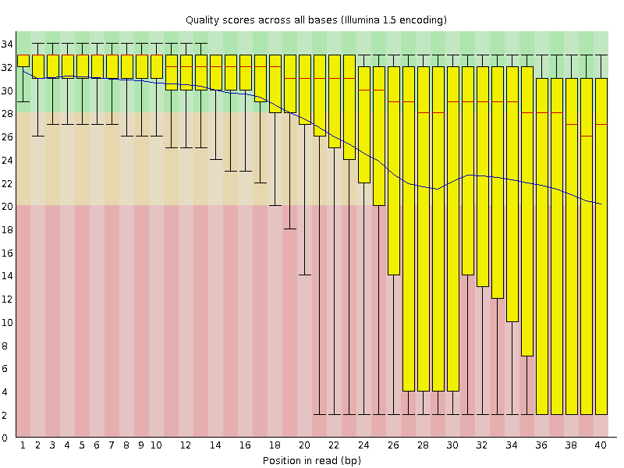
FastQC: Base Quality
Good Data
Bad Data

Slide 8
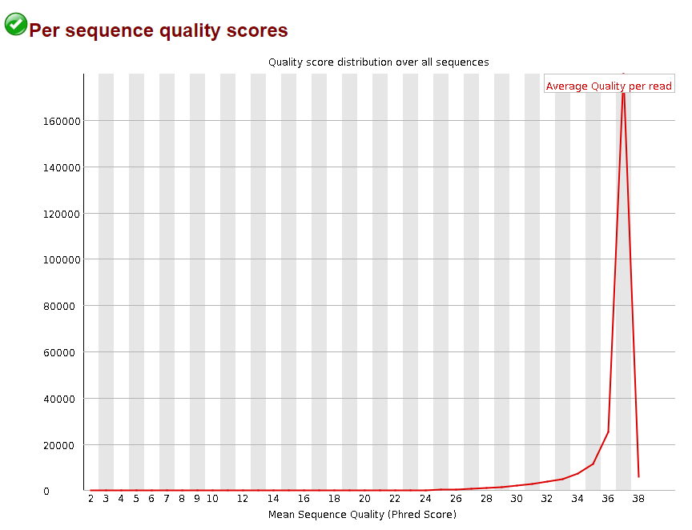
FastQC: Base Quality
Number of Reads

Slide 9
FastQC: Base Quality
Number of Reads

Slide 10
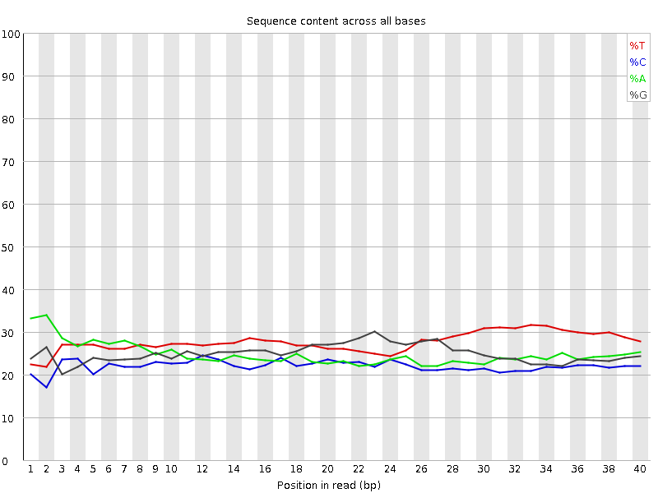
FastQC: Base Identity
Proper Interpretation of FastQC is critical!
Libraries made from random hexamer primers will not pass this module.
Nearly all RNA-Seq libraries will fail this module because of this bias, but this is not a problem which can be fixed by processing, and it doesn't seem to adversely affect the ability to measure expression
-FastQC

Slide 11
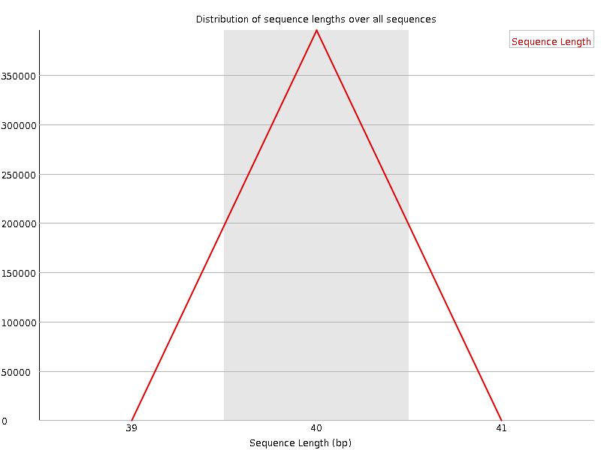
FastQC: Read Length
Almost always passes the first time
Best to look after trimming

Slide 12
FastQC: Duplication Levels
Proper Interpretation of FastQC is critical!
Some RNA-seq data will certainly show significant duplication
1869 nucs: length of 18s gene
50 million reads
20% rRNA (10 million reads)
Half are 18s
An 1869 region is sequenced 5 million times
~2700 duplicates
Percent of Reads

Slide 13
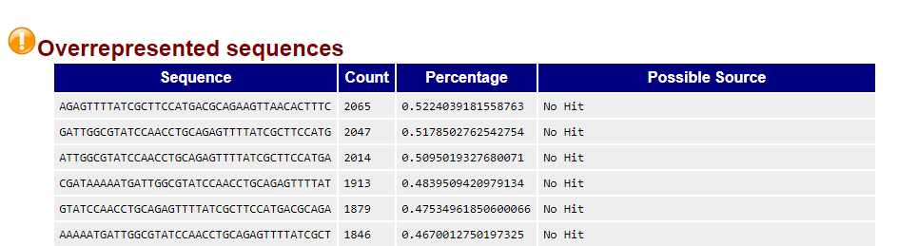
FastQC: Overrepresented Sequences
Good for identifying possible adaptor sequences
Can identify other odd sequences that can be dropped (e.g. AAAAAAAAAAAAAAAA)

Slide 14
FastQC: Adaptors
Adaptors, if found,
can be removed

Slide 15
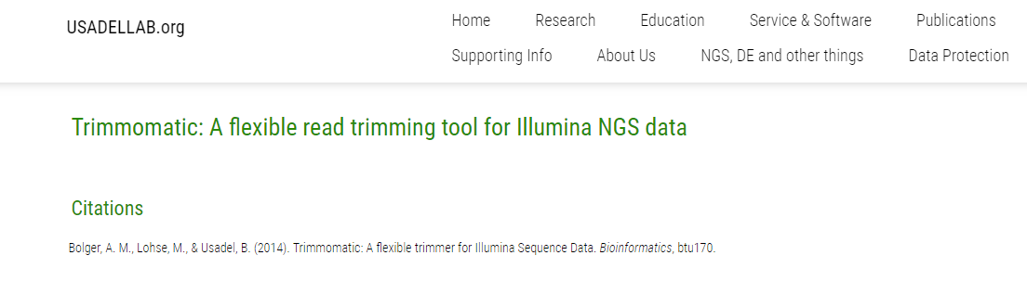
Post QC Improvement
Trimming reads that show low quality or adaptor content
http://www.usadellab.org/cms/?page=trimmomatic

Slide 16
Trimming Reads
Trim reads if the quality dips near the end of the read OR
If Adaptor sequences are present in the read
Trim Here
Example Read
Quality Issue
ACGTCAGCTGACCGTACCGTAGGACCCCAGCTCA
40
Quality
0
Trim Here
Adaptor Issue
ACGTCAGCTGACCGTACCGTAGGACCCCAGCTCAACCTGGA
Illumina Adaptor Seq.

Slide 17
Trimming Reads: The command
Trim reads if the quality dips near the end of the read OR
If Adaptor sequences are present in the read
java –jar trimmomatic-0.36.jar SE –phred33 <input_sample_name>.fastq <output_sample_name>_Trim_LT.fastq ILLUMINACLIP:TruSeq2-LT.fa:2:30:10 LEADING:25 TRAILING:25
Adaptor sequence you want trimmed
Nucleotides at the BEGINNING of the read below this quality score will be trimmed
Nucleotides at the END of the read below this quality score will be trimmed

