Slide 1
RNA-Seq Processing
Ryan McClure
Scientist, Pacific Northwest National Laboratory
Notes:
About the Image: Glass Lab Equipment
Glass lab equipment on a table at the regional American Chemical Society meeting
https://www.flickr.com/photos/pnnl/41280037010/in/album-72157692716565760/

Slide 2
Overview of RNA-seq Processing
Three Main Steps
Alignment of fastq reads to a reference genome (Alignment)
Each read is matched to the genome at a specific point
Aligned reads are assigned to genes (Counting)
A file contains start and stop sites for genes, this is used to determine how many reads aligned to each gene.
Normalization of reads between RNA-seq datasets (Normalization)
Differences between runs can be accounted for to better understand comparisons

Slide 3
Alignment
Multiple Programs
BFAST Good for working with lots of SNPs or errors
https://omictools.com/bfast-tool
Bowtie2 Good for longer reads (up to 1000s of nucleotides)
http://bowtie-bio.sourceforge.net/bowtie2/index.shtml
Burrows-Wheeler Aligner (BWA) Good for short reads (50-150 bp)
http://bio-bwa.sourceforge.net/
Rockhopper: Good for alignment of bacterial and other prokaryotic data, GUI
https://cs.wellesley.edu/~btjaden/Rockhopper/

Slide 4
Alignment
Alignment requires a Genome file (fasta) in most cases
Fastq File
Genome
Sequence Alignment Map (SAM) File
RCA347587
actgatcgaccggtac
+
hsanbvubndBvnfhdfunrr
+
actgatccgtacgctcagctgaccgtaccgtagccgtgaccgtgtagatgctacgctaccgtaccggccagctgaccgtac
=
RCA347587 99 ref 7 30 8M2I4M1D3M = 37 39
actgatcgaccggtac *
Read Name
Read
Genomic Position of Read Start
Quality of alignment
SAM and BAM are the same thing. BAM is a binary, non-human readable, version of a SAM file
Once you have SAM (BAM), the next step is counting.
This is a memory intensive step as fastq/SAM files are generally several GB in size

Slide 5
Counting
Multiple Programs
featureCounts Uses R
http://subread.sourceforge.net/
HTSeq Uses Python
https://htseq.readthedocs.io/en/release_0.11.1/
Rockhopper: Good for alignment of bacterial and other prokaryotic data, GUI
https://cs.wellesley.edu/~btjaden/Rockhopper/

Slide 6
Counting
Counting requires a Gene Transfer Format (GTF) or General Feature Format (GFF) file
SAM File
Gene Transfer Format (GTF)
Raw Counts File (RCF)
+
 | Strand | Start | End
Gene 1 | + | 1 | 10
Gene 2 | - | 11 | 23
Gene 3 | - | 24 | 51
=
 | Counts
Gene 1 | 20
Gene 2 | 100
Gene 3 | 75
RCA347587 99 ref 7 30 8M2I4M1D3M = 37 39 actgatcgaccggtac *
Once you have a RCF the next step is normalization
This is a memory intensive step as fastq/SAM files are generally several GB in size
However, the RCF file is generally far smaller as data has now been significantly collapsed

Slide 7
Counting: Something to watch out for
Quality of Alignment set to 10
Quality of Alignment set to 0
__no_feature | 240186
__ambiguous | 33906
__too_low_aQual | 8906264
__not_aligned | 2677097
__alignment_not_unique | 0
__no_feature | 285395
__ambiguous | 34549
__too_low_aQual | 0
__not_aligned | 2677097
__alignment_not_unique | 0
Sections of the genome that are highly sequenced may not accurate results
Aligned Reads

Slide 8
Normalization
Multiple Programs
Cufflinks Good for eukaryotic data, goes well with Bowtie
http://cole-trapnell-lab.github.io/cufflinks/
DESeq2 Uses R, we’re using today, very common tool
https://bioconductor.org/packages/release/bioc/html/DESeq2.html
edgeR Also common tool
https://bioconductor.org/packages/release/bioc/html/edgeR.html
Rockhopper: Good for alignment of bacterial and other prokaryotic data, GUI
https://cs.wellesley.edu/~btjaden/Rockhopper/

Slide 9
Normalization
Raw Data
 | Counts Exp 1 | Counts Exp 2 | Counts Exp 3
Gene 1 | 100 | 50 | 200
Gene 2 | 200 | 100 | 400
Gene 3 | 300 | 150 | 600
Gene 4 | 300 | 150 | 600
Gene 5 | 340 | 170 | 680
Gene 6 | 210 | 105 | 420
Gene 7 | 560 | 280 | 1120
Gene 8 | 1000 | 500 | 2000
Gene 9 | 190 | 95 | 380
Gene 10 | 670 | 335 | 1340
Total | 3870 | 1935 | 7740

Slide 10
Normalization: Why
All genes are showing 2-fold decrease in expression
Raw Data
 | Counts Exp 1 | Counts Exp 2 | Counts Exp 3
Gene 1 | 100 | 50 | 200
Gene 2 | 200 | 100 | 400
Gene 3 | 300 | 150 | 600
Gene 4 | 300 | 150 | 600
Gene 5 | 340 | 170 | 680
Gene 6 | 210 | 105 | 420
Gene 7 | 560 | 280 | 1120
Gene 8 | 1000 | 500 | 2000
Gene 9 | 190 | 95 | 380
Gene 10 | 670 | 335 | 1340
Total | 3870 | 1935 | 7740
All genes are showing 2-fold increase in expression

Slide 11
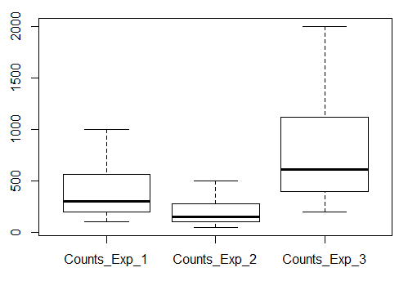
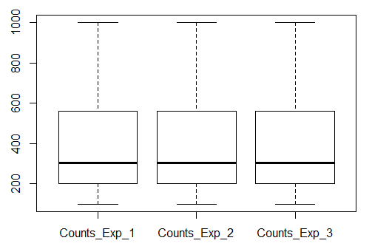
Normalization: How
Raw Data
Raw Data
X2
X0.5
Norm Data
 | Counts Exp 1 | Counts Exp 2 | Counts Exp 3
Gene 1 | 100 | 50 | 200
Gene 2 | 200 | 100 | 400
Gene 3 | 300 | 150 | 600
Gene 4 | 300 | 150 | 600
Gene 5 | 340 | 170 | 680
Gene 6 | 210 | 105 | 420
Gene 7 | 560 | 280 | 1120
Gene 8 | 1000 | 500 | 2000
Gene 9 | 190 | 95 | 380
Gene 10 | 670 | 335 | 1340
Total | 3870 | 1935 | 7740
 | Counts Exp 1 | Counts Exp 2 | Counts Exp 3
Gene 1 | 100 | 50 | 200
Gene 2 | 200 | 100 | 400
Gene 3 | 300 | 150 | 600
Gene 4 | 300 | 150 | 600
Gene 5 | 340 | 170 | 680
Gene 6 | 210 | 105 | 420
Gene 7 | 560 | 280 | 1120
Gene 8 | 1000 | 500 | 2000
Gene 9 | 190 | 95 | 380
Gene 10 | 670 | 335 | 1340
Total | 3870 | 1935 | 7740
 | Counts Exp 1 | Counts Exp 2 | Counts Exp 3
Gene 1 | 100 | 100 | 100
Gene 2 | 200 | 200 | 200
Gene 3 | 300 | 300 | 300
Gene 4 | 300 | 300 | 300
Gene 5 | 340 | 340 | 340
Gene 6 | 210 | 210 | 210
Gene 7 | 560 | 560 | 560
Gene 8 | 1000 | 1000 | 1000
Gene 9 | 190 | 190 | 190
Gene 10 | 670 | 670 | 670
Total | 3870 | 3870 | 3870

