Slide 1
Post Sequencing Transcriptomic Data QC
Ryan McClure
Scientist, Pacific Northwest National Laboratory
Notes:
About the Image: Glass Lab Equipment
Glass lab equipment on a table at the regional American Chemical Society meeting
https://www.flickr.com/photos/pnnl/41280037010/in/album-72157692716565760/

Slide 2
RNA-seq Data Quality Control
What is Data QC for Transcriptomic Data?
Examining quality of sequencing data
How confident is the machine in the call
Examining the length of the reads in the data
How long are the reads, does that match what we want
Determining the duplication level of reads
How many times are certain reads found over and over
Identifying if adaptor sequences are parts of reads
Were inserts too short? Did the machine sequence all the way into the adaptor
Most of these problems can be fixed through filtering the data.

Slide 3
RNA-seq Data Quality Control
Why do QC
Examining quality of sequencing data
Reads of low quality can be removed, improving alignment to reference genome
Examining the length of the reads in the data
Short reads can be dropped, again improving alignment.
Determining the duplication level of reads
PCR bias can be identified, highly duplicated reads can be removed
Identifying if adaptor sequences are parts of reads
Adaptors can be removed, improving alignment. Insert length issues can be identified

Slide 4
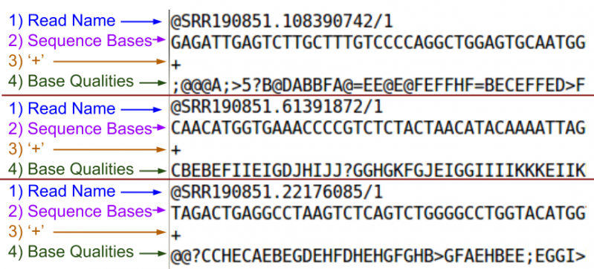
A fastq Read
fastq = fasta + quality

Slide 5
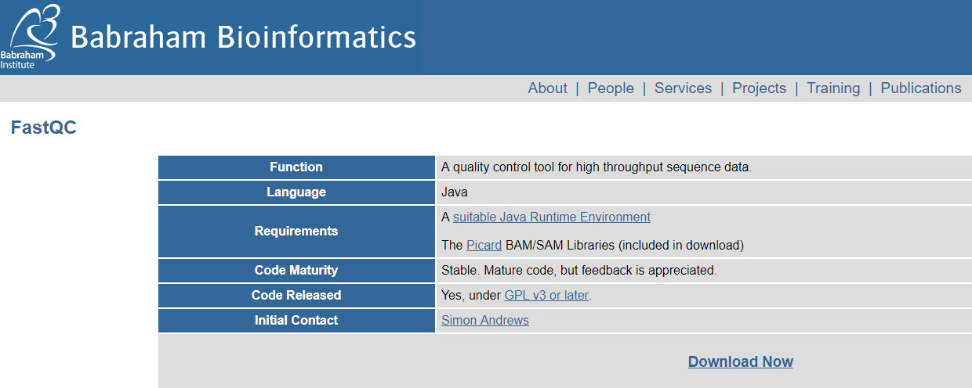
FastQC: A tool for QC of Fastq files
https://www.bioinformatics.babraham.ac.uk/projects/fastqc/

Slide 6
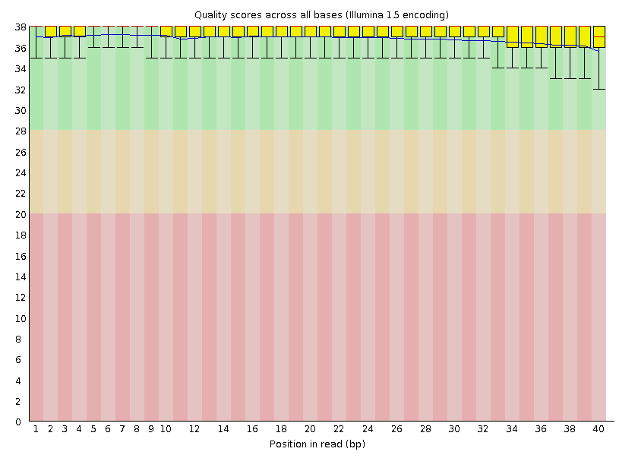
FastQC: Base Quality
Phred Quality Score | Probability of incorrect base call | Base call accuracy
10 | 1 in 10 | 90%
20 | 1 in 100 | 99%
30 | 1 in 1000 | 99.9%
40 | 1 in 10,000 | 99.99%
Great
Good
The central red line is the median value
The yellow box represents the inter-quartile range (25-75%)
The upper and lower whiskers represent the 10% and 90% points
The blue line represents the mean quality
Poor

Slide 7
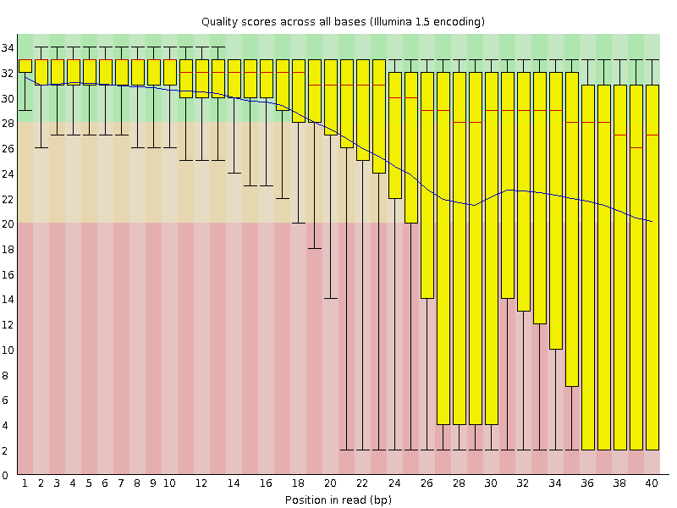
FastQC: Base Quality
Good Data
Bad Data

Slide 8
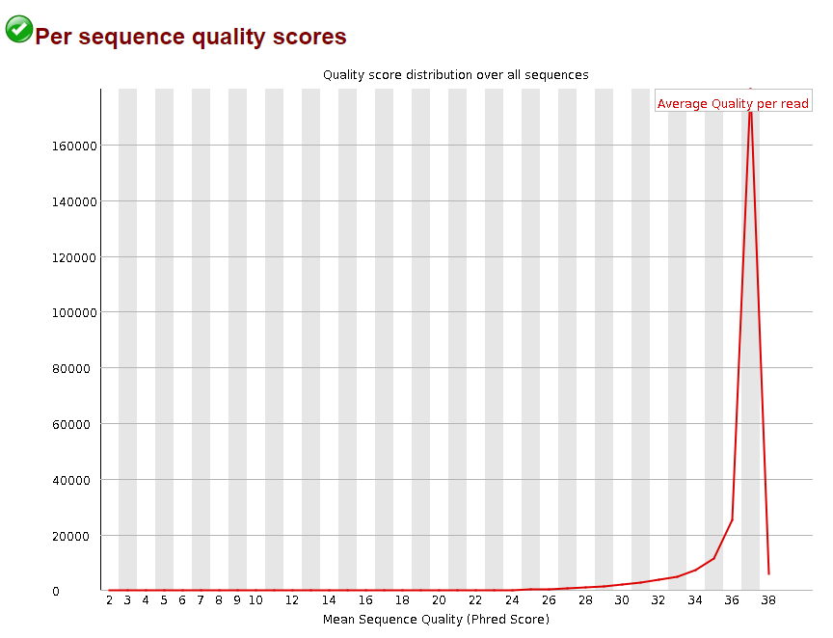
FastQC: Base Quality
Number of Reads

Slide 9
FastQC: Base Quality
Number of Reads

Slide 10
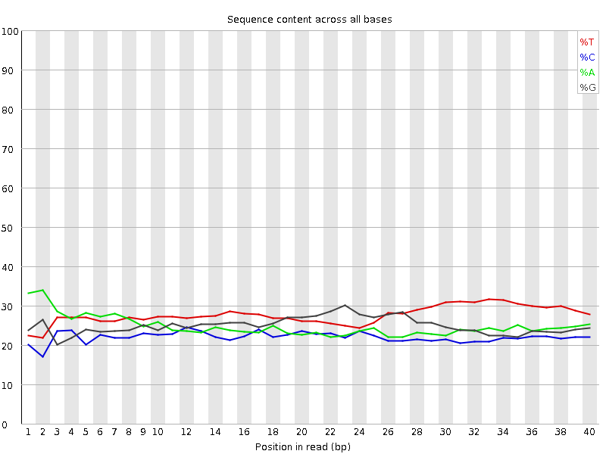
FastQC: Base Identity
Proper Interpretation of FastQC is critical!
Libraries made from random hexamer primers will not pass this module.
Nearly all RNA-Seq libraries will fail this module because of this bias, but this is not a problem which can be fixed by processing, and it doesn't seem to adversely affect the ability to measure expression
-FastQC

Slide 11
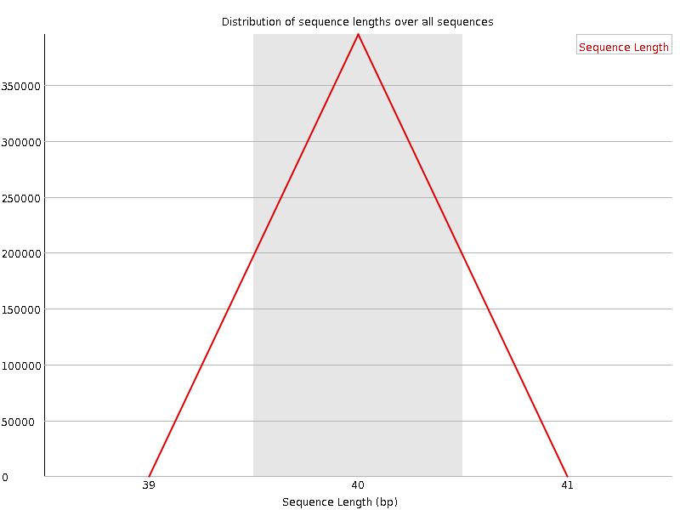
FastQC: Read Length
Almost always passes the first time
Best to look after trimming

Slide 12
FastQC: Duplication Levels
Proper Interpretation of FastQC is critical!
Some RNA-seq data will certainly show significant duplication
1869 nucs: length of 18s gene
50 million reads
20% rRNA (10 million reads)
Half are 18s
An 1869 region is sequenced 5 million times
~2700 duplicates
Percent of Reads

Slide 13
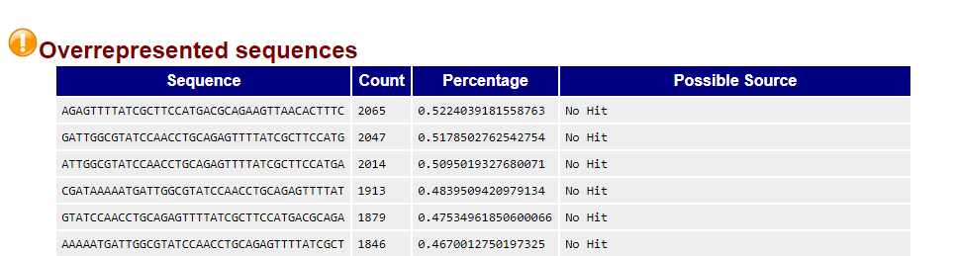
FastQC: Overrepresented Sequences
Good for identifying possible adaptor sequences
Can identify other odd sequences that can be dropped (e.g. AAAAAAAAAAAAAAAA)

Slide 14
FastQC: Adaptors
Adaptors, if found,
can be removed

Slide 15
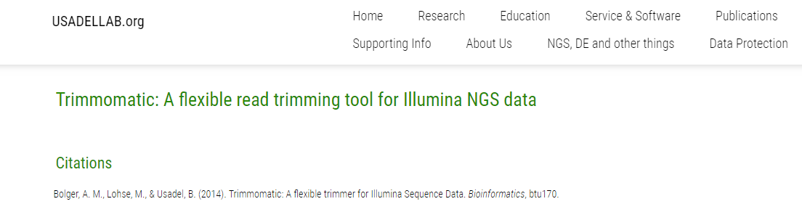
Post QC Improvement
Trimming reads that show low quality or adaptor content
http://www.usadellab.org/cms/?page=trimmomatic

Slide 16
Trimming Reads
Trim reads if the quality dips near the end of the read OR
If Adaptor sequences are present in the read
Trim Here
Example Read
Quality Issue
ACGTCAGCTGACCGTACCGTAGGACCCCAGCTCA
40
Quality
0
Trim Here
Adaptor Issue
ACGTCAGCTGACCGTACCGTAGGACCCCAGCTCAACCTGGA
Illumina Adaptor Seq.

Slide 17
Trimming Reads: The command
Trim reads if the quality dips near the end of the read OR
If Adaptor sequences are present in the read
java –jar trimmomatic-0.36.jar SE –phred33 <input_sample_name>.fastq <output_sample_name>_Trim_LT.fastq ILLUMINACLIP:TruSeq2-LT.fa:2:30:10 LEADING:25 TRAILING:25
Adaptor sequence you want trimmed
Nucleotides at the BEGINNING of the read below this quality score will be trimmed
Nucleotides at the END of the read below this quality score will be trimmed

Slide 18
RNA-Seq Processing
Ryan McClure
Scientist, Pacific Northwest National Laboratory
Notes:
About the Image: Glass Lab Equipment
Glass lab equipment on a table at the regional American Chemical Society meeting
https://www.flickr.com/photos/pnnl/41280037010/in/album-72157692716565760/

Slide 19
Overview of RNA-seq Processing
Three Main Steps
Alignment of fastq reads to a reference genome (Alignment)
Each read is matched to the genome at a specific point
Aligned reads are assigned to genes (Counting)
A file contains start and stop sites for genes, this is used to determine how many reads aligned to each gene.
Normalization of reads between RNA-seq datasets (Normalization)
Differences between runs can be accounted for to better understand comparisons

Slide 20
Alignment
Multiple Programs
BFAST Good for working with lots of SNPs or errors
https://omictools.com/bfast-tool
Bowtie2 Good for longer reads (up to 1000s of nucleotides)
http://bowtie-bio.sourceforge.net/bowtie2/index.shtml
Burrows-Wheeler Aligner (BWA) Good for short reads (50-150 bp)
http://bio-bwa.sourceforge.net/
Rockhopper: Good for alignment of bacterial and other prokaryotic data, GUI
https://cs.wellesley.edu/~btjaden/Rockhopper/

Slide 21
Alignment
Alignment requires a Genome file (fasta) in most cases
Fastq File
Genome
Sequence Alignment Map (SAM) File
RCA347587
actgatcgaccggtac
+
hsanbvubndBvnfhdfunrr
+
actgatccgtacgctcagctgaccgtaccgtagccgtgaccgtgtagatgctacgctaccgtaccggccagctgaccgtac
=
RCA347587 99 ref 7 30 8M2I4M1D3M = 37 39
actgatcgaccggtac *
Read Name
Read
Genomic Position of Read Start
Quality of alignment
SAM and BAM are the same thing. BAM is a binary, non-human readable, version of a SAM file
Once you have SAM (BAM), the next step is counting.
This is a memory intensive step as fastq/SAM files are generally several GB in size

Slide 22
Counting
Multiple Programs
featureCounts Uses R
http://subread.sourceforge.net/
HTSeq Uses Python
https://htseq.readthedocs.io/en/release_0.11.1/
Rockhopper: Good for alignment of bacterial and other prokaryotic data, GUI
https://cs.wellesley.edu/~btjaden/Rockhopper/

Slide 23
Counting
Counting requires a Gene Transfer Format (GTF) or General Feature Format (GFF) file
SAM File
Gene Transfer Format (GTF)
Raw Counts File (RCF)
+
 | Strand | Start | End
Gene 1 | + | 1 | 10
Gene 2 | - | 11 | 23
Gene 3 | - | 24 | 51
=
 | Counts
Gene 1 | 20
Gene 2 | 100
Gene 3 | 75
RCA347587 99 ref 7 30 8M2I4M1D3M = 37 39 actgatcgaccggtac *
Once you have a RCF the next step is normalization
This is a memory intensive step as fastq/SAM files are generally several GB in size
However, the RCF file is generally far smaller as data has now been significantly collapsed

Slide 24
Counting: Something to watch out for
Quality of Alignment set to 10
Quality of Alignment set to 0
__no_feature | 240186
__ambiguous | 33906
__too_low_aQual | 8906264
__not_aligned | 2677097
__alignment_not_unique | 0
__no_feature | 285395
__ambiguous | 34549
__too_low_aQual | 0
__not_aligned | 2677097
__alignment_not_unique | 0
Sections of the genome that are highly sequenced may not accurate results
Aligned Reads

Slide 25
Normalization
Multiple Programs
Cufflinks Good for eukaryotic data, goes well with Bowtie
http://cole-trapnell-lab.github.io/cufflinks/
DESeq2 Uses R, we’re using today, very common tool
https://bioconductor.org/packages/release/bioc/html/DESeq2.html
edgeR Also common tool
https://bioconductor.org/packages/release/bioc/html/edgeR.html
Rockhopper: Good for alignment of bacterial and other prokaryotic data, GUI
https://cs.wellesley.edu/~btjaden/Rockhopper/

Slide 26
Normalization
Raw Data
 | Counts Exp 1 | Counts Exp 2 | Counts Exp 3
Gene 1 | 100 | 50 | 200
Gene 2 | 200 | 100 | 400
Gene 3 | 300 | 150 | 600
Gene 4 | 300 | 150 | 600
Gene 5 | 340 | 170 | 680
Gene 6 | 210 | 105 | 420
Gene 7 | 560 | 280 | 1120
Gene 8 | 1000 | 500 | 2000
Gene 9 | 190 | 95 | 380
Gene 10 | 670 | 335 | 1340
Total | 3870 | 1935 | 7740

Slide 27
Normalization: Why
All genes are showing 2-fold decrease in expression
Raw Data
 | Counts Exp 1 | Counts Exp 2 | Counts Exp 3
Gene 1 | 100 | 50 | 200
Gene 2 | 200 | 100 | 400
Gene 3 | 300 | 150 | 600
Gene 4 | 300 | 150 | 600
Gene 5 | 340 | 170 | 680
Gene 6 | 210 | 105 | 420
Gene 7 | 560 | 280 | 1120
Gene 8 | 1000 | 500 | 2000
Gene 9 | 190 | 95 | 380
Gene 10 | 670 | 335 | 1340
Total | 3870 | 1935 | 7740
All genes are showing 2-fold increase in expression

Slide 28
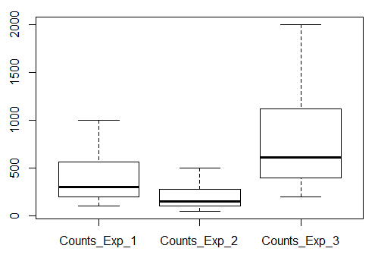
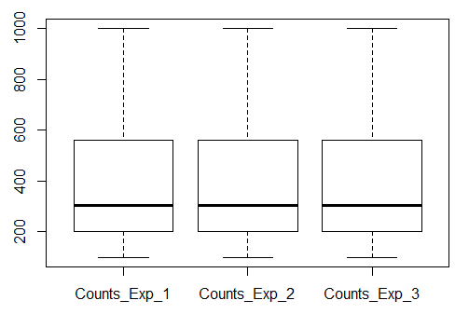
Normalization: How
Raw Data
Raw Data
X2
X0.5
Norm Data
 | Counts Exp 1 | Counts Exp 2 | Counts Exp 3
Gene 1 | 100 | 50 | 200
Gene 2 | 200 | 100 | 400
Gene 3 | 300 | 150 | 600
Gene 4 | 300 | 150 | 600
Gene 5 | 340 | 170 | 680
Gene 6 | 210 | 105 | 420
Gene 7 | 560 | 280 | 1120
Gene 8 | 1000 | 500 | 2000
Gene 9 | 190 | 95 | 380
Gene 10 | 670 | 335 | 1340
Total | 3870 | 1935 | 7740
 | Counts Exp 1 | Counts Exp 2 | Counts Exp 3
Gene 1 | 100 | 50 | 200
Gene 2 | 200 | 100 | 400
Gene 3 | 300 | 150 | 600
Gene 4 | 300 | 150 | 600
Gene 5 | 340 | 170 | 680
Gene 6 | 210 | 105 | 420
Gene 7 | 560 | 280 | 1120
Gene 8 | 1000 | 500 | 2000
Gene 9 | 190 | 95 | 380
Gene 10 | 670 | 335 | 1340
Total | 3870 | 1935 | 7740
 | Counts Exp 1 | Counts Exp 2 | Counts Exp 3
Gene 1 | 100 | 100 | 100
Gene 2 | 200 | 200 | 200
Gene 3 | 300 | 300 | 300
Gene 4 | 300 | 300 | 300
Gene 5 | 340 | 340 | 340
Gene 6 | 210 | 210 | 210
Gene 7 | 560 | 560 | 560
Gene 8 | 1000 | 1000 | 1000
Gene 9 | 190 | 190 | 190
Gene 10 | 670 | 670 | 670
Total | 3870 | 3870 | 3870

Slide 29
Hands-On Normalization and Statistical Analysis
Ryan McClure
Scientist, Pacific Northwest National Laboratory
Notes:
About the Image: Glass Lab Equipment
Glass lab equipment on a table at the regional American Chemical Society meeting
https://www.flickr.com/photos/pnnl/41280037010/in/album-72157692716565760/

Slide 30
Normalization: DESeq2
To normalize raw count data with DESe2 you need:
Raw count data as a .csv file
A condition information file telling DESeq2 which columns go to which experiment
Condition Information
Raw Count Data
 | condition
Retene_Rep1 | A
Retene_Rep2 | A
Retene_Rep3 | A
Retene_Rep4 | A
BjF_Rep1 | B
BjF_Rep2 | B
BjF_Rep3 | B
BjF_Rep4 | B
ProbeID | Retene_Rep1 | Retene_Rep2 | Retene_Rep3 | Retene_Rep4 | BjF_Rep1 | BjF_Rep2
ENSDARG00000000001.5 | 203 | 130 | 189 | 199 | 195 | 125
ENSDARG00000000002.7 | 201 | 139 | 243 | 161 | 303 | 242
ENSDARG00000000018.8 | 2452 | 2272 | 2341 | 2017 | 2743 | 2367
ENSDARG00000000019.8 | 5242 | 4798 | 4416 | 3981 | 5508 | 4385
ENSDARG00000000068.8 | 235 | 315 | 347 | 297 | 351 | 391
ENSDARG00000000069.6 | 1366 | 1200 | 1654 | 953 | 2022 | 1740
ENSDARG00000000086.11 | 1647 | 1347 | 1774 | 1381 | 1978 | 1458
ENSDARG00000000103.11 | 5671 | 5391 | 6489 | 5216 | 7308 | 6006
ENSDARG00000000142.9 | 335 | 228 | 335 | 246 | 343 | 308
ENSDARG00000000151.13 | 115 | 92 | 135 | 98 | 147 | 109

Slide 31
Normalization: DESeq2
To normalize raw count data with DESe2 you need:
Raw count data as a .csv file
A condition information file telling DESeq2 which columns go to which experiment
Condition Information
Raw Count Data
 | condition
Retene_Rep1 | A
Retene_Rep2 | A
Retene_Rep3 | A
Retene_Rep4 | A
BjF_Rep1 | B
BjF_Rep2 | B
BjF_Rep3 | B
BjF_Rep4 | B
ProbeID | Retene_Rep1 | Retene_Rep2 | Retene_Rep3 | Retene_Rep4 | BjF_Rep1 | BjF_Rep2
ENSDARG00000000001.5 | 203 | 130 | 189 | 199 | 195 | 125
ENSDARG00000000002.7 | 201 | 139 | 243 | 161 | 303 | 242
ENSDARG00000000018.8 | 2452 | 2272 | 2341 | 2017 | 2743 | 2367
ENSDARG00000000019.8 | 5242 | 4798 | 4416 | 3981 | 5508 | 4385
ENSDARG00000000068.8 | 235 | 315 | 347 | 297 | 351 | 391
ENSDARG00000000069.6 | 1366 | 1200 | 1654 | 953 | 2022 | 1740
ENSDARG00000000086.11 | 1647 | 1347 | 1774 | 1381 | 1978 | 1458
ENSDARG00000000103.11 | 5671 | 5391 | 6489 | 5216 | 7308 | 6006
ENSDARG00000000142.9 | 335 | 228 | 335 | 246 | 343 | 308
ENSDARG00000000151.13 | 115 | 92 | 135 | 98 | 147 | 109

Slide 32
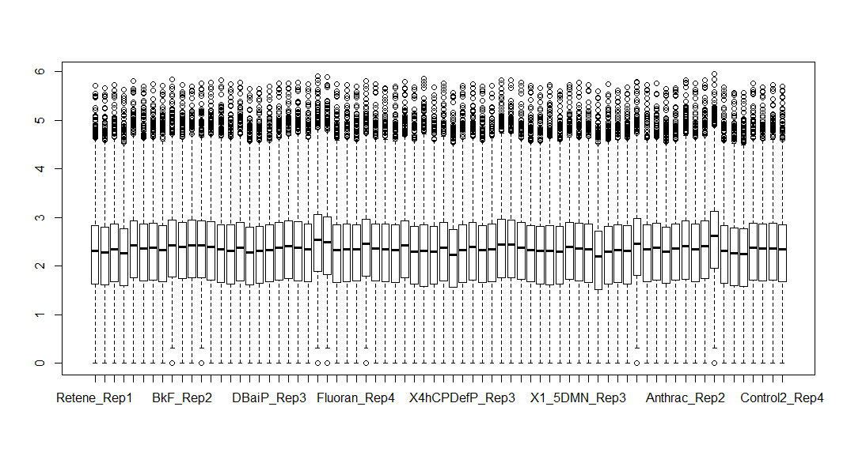
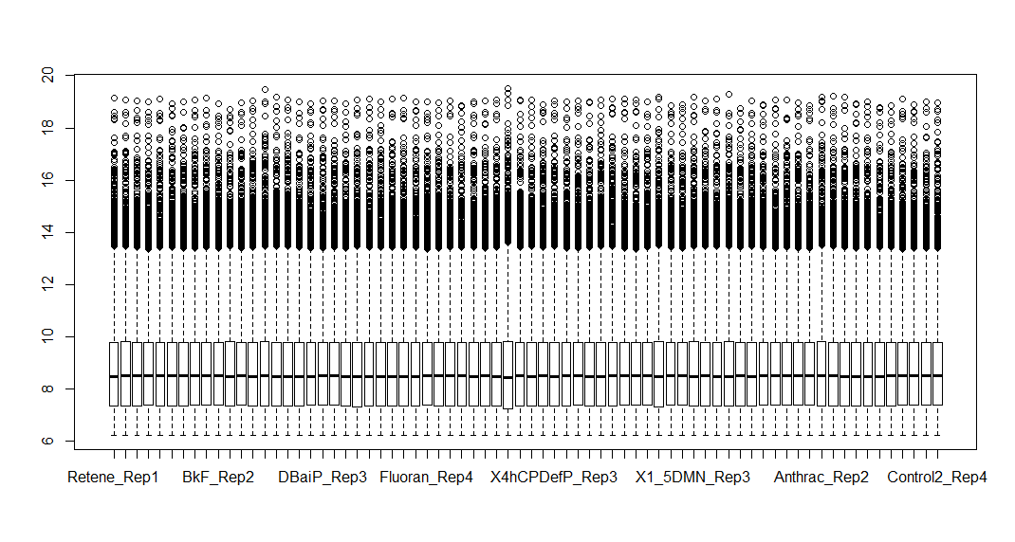
Normalization: DESeq2
Raw
Zebrafish
Data
Normalized
Zebrafish
Data

Slide 33
Statistical Analysis: DESeq2
p-value adjusted for multiple hypothesis testing
First Value/Second Value
baseMean | log2FoldChange | lfcSE | stat | pvalue | padj | names
1255.755 | 5.342099 | 0.171084 | 31.22499 | 4.88E-214 | 1.11E-209 | ENSDARG00000101195.1
416.2773 | 3.213865 | 0.103163 | 31.15319 | 4.59E-213 | 5.22E-209 | ENSDARG00000101789.2
1057.001 | 2.052907 | 0.086946 | 23.61131 | 2.95E-123 | 2.23E-119 | ENSDARG00000097491.1
8617.569 | 2.382304 | 0.111154 | 21.43237 | 6.67E-102 | 3.79E-98 | ENSDARG00000104068.1
13349.81 | 7.715566 | 0.431863 | 17.86576 | 2.18E-71 | 9.90E-68 | ENSDARG00000098315.1
1289.655 | 2.472738 | 0.143809 | 17.19464 | 2.91E-66 | 1.10E-62 | ENSDARG00000086826.3
845.9056 | 2.553241 | 0.163838 | 15.58392 | 9.36E-55 | 3.04E-51 | ENSDARG00000068934.5
86.58186 | 4.372841 | 0.288932 | 15.13452 | 9.59E-52 | 2.72E-48 | ENSDARG00000101364.1
313.2074 | 2.461376 | 0.165656 | 14.85837 | 6.14E-50 | 1.55E-46 | ENSDARG00000030896.6

Slide 34
Data Visualization
Ryan McClure
Scientist, Pacific Northwest National Laboratory
Notes:
About the Image: Glass Lab Equipment
Glass lab equipment on a table at the regional American Chemical Society meeting
https://www.flickr.com/photos/pnnl/41280037010/in/album-72157692716565760/

Slide 35
Data Visualization
Identifying Outliers
MDS Plots
Visualizing Data
PCA Plots
Volcano Graphs
Heatmaps
Venn Diagrams

Slide 36
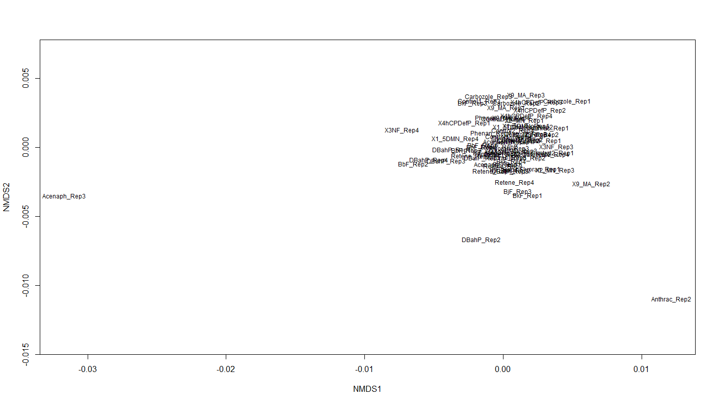
Data Visualization: Outliers
Identify the genes with the most variability in expression (CV, coefficient of variation: standard deviation/mean)
Transpose data (Rows are conditions, columns are genes/proteins/etc)
Create MDS Plot

Slide 37
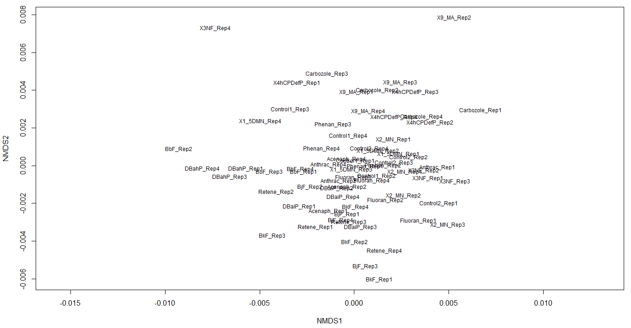
Data Visualization: Outliers
Identify the genes with the most variability in expression (CV, coefficient of variation: standard deviation/mean)
Transpose data (Rows are conditions, columns are genes/proteins/etc)
Create MDS Plot

Slide 38
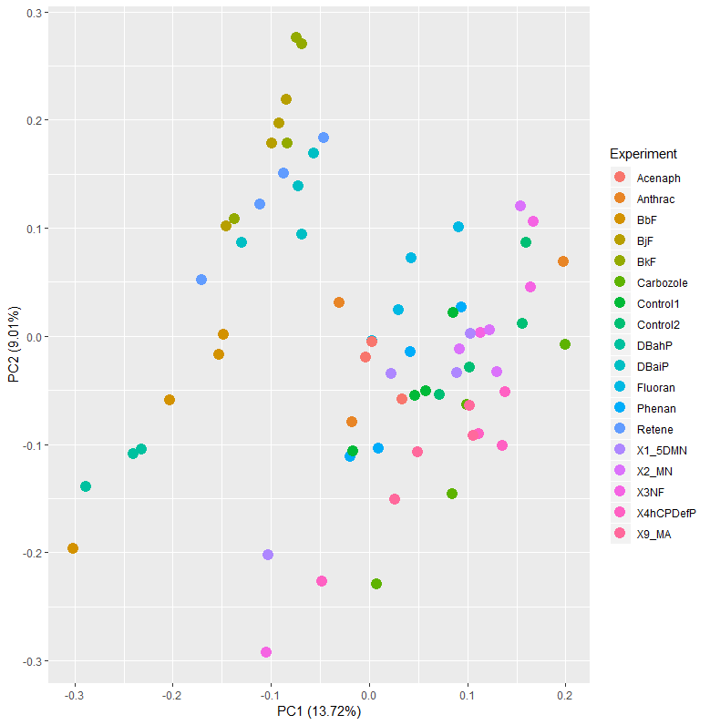
Data Visualization: PCA Plots

Slide 39
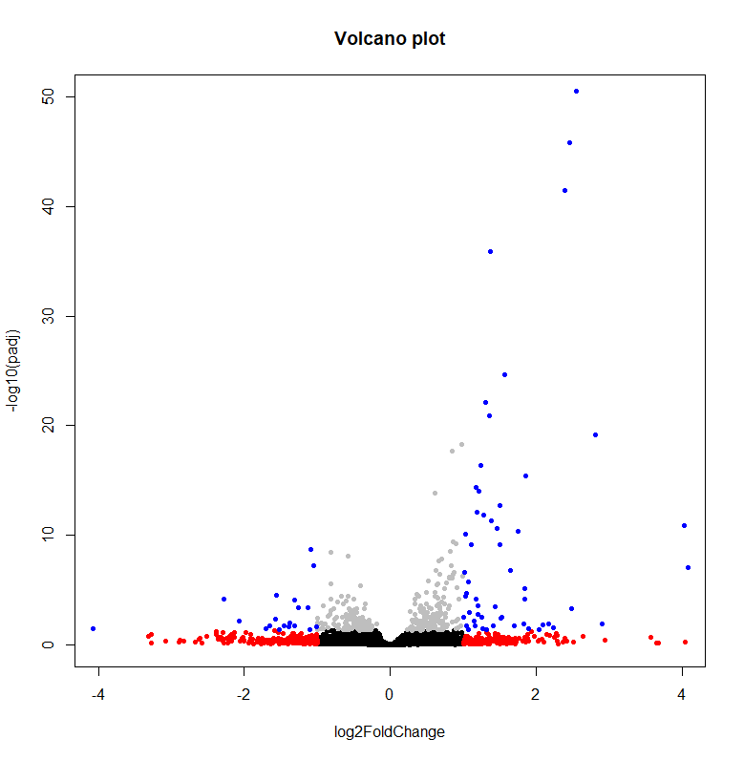
Data Visualization: Volcano Plots

Slide 40
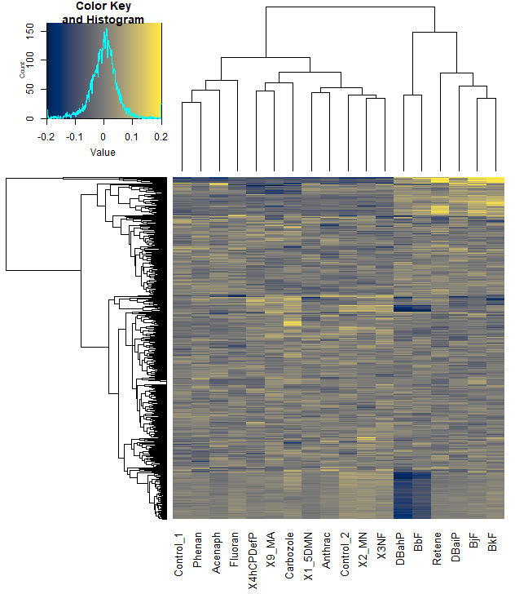
Data Visualization: Heatmaps

Slide 41
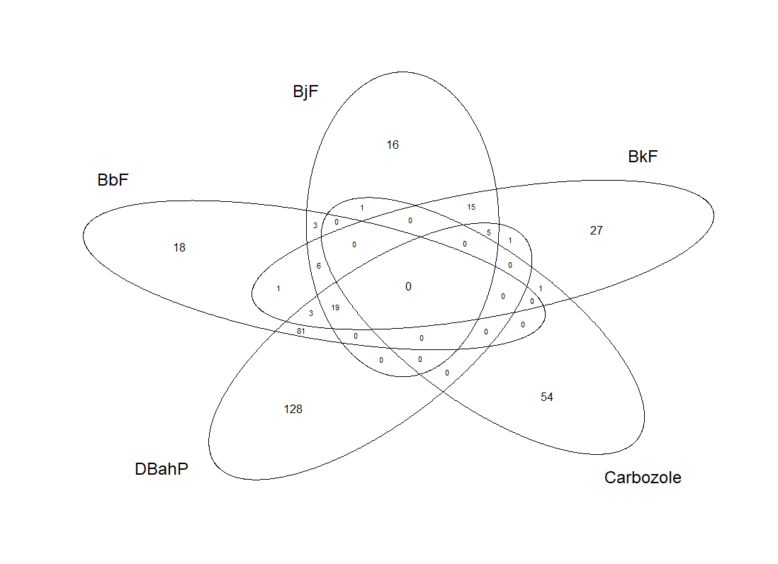
Data Visualization: Venn Diagrams

Slide 42
Network Analysis
Ryan McClure
Scientist, Pacific Northwest National Laboratory
Notes:
About the Image: Glass Lab Equipment
Glass lab equipment on a table at the regional American Chemical Society meeting
https://www.flickr.com/photos/pnnl/41280037010/in/album-72157692716565760/

Slide 43
Gene Co-Expression Networks
Network Analysis
Highlight where & how processes are related in biological systems (McClure, 2016, 2018).
Identify new targets of regulatory proteins (Faith, 2007).
Identify genes of importance to infection in human pathogens (McDermott, 2009).
Assign putative functions to unknown genes (Beiki, 2016).

Slide 44

Co-Expression/High School Networks
Network analysis links nodes (genes) based on their interactions across conditions (edges). This can reveal how processes are related and identify nodes of importance
In a high school, clusters of students emerge as groups are formed based on activities. Certain students occupy central positions linking different groups.
High School Network
Football Team
Band
Student in Band and Football
Student in Drama and
Football
Drama Club

Slide 45
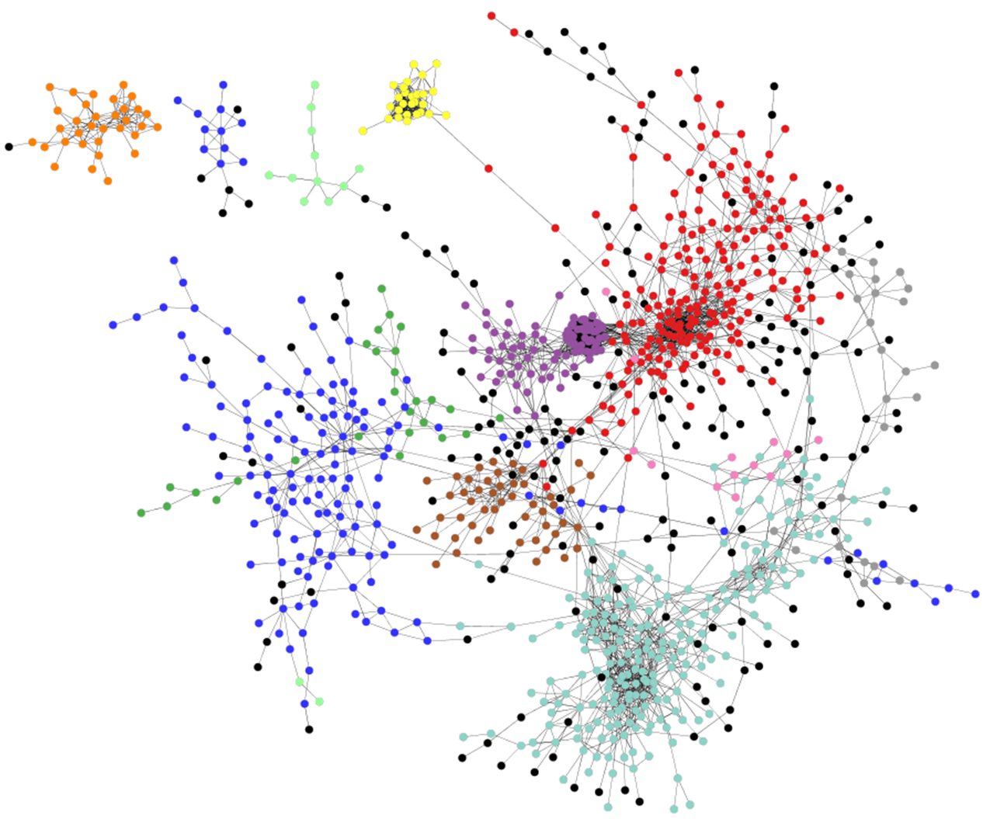
Gene Co-Expression Network Analysis of Synechococcus
Transcriptomic data from different sources
CLR
(Context Likelihood of Relatedness)
1) Assigns a measure of coordination for each gene pair
2) Keeps only the most highly coordinated genes pairs
3) Infers network from these gene pairs
G3
G4
4.5
G1
G2
G3
G4
2.5
4.5
G5
G6
1.5

Slide 46
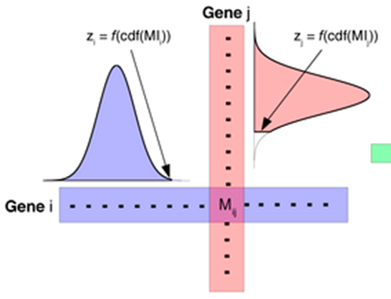
Specifics of CLR Analysis
Mutual Information Scores (MI)
Z-scores (= MI – Av)/StDev)
 | Gene 1 | Gene 2 | Gene 3 | Gene 4 | Gene 5
Gene 1 | 0 | 3.58 | -2.068 | -0.928 | 0.256
Gene 2 | 3.58 | 0 | 5.1178 | 4.4544 | 1.2441
Gene 3 | -2.78 | 5.0381 | 0 | 6.1664 | -2.071
Gene 4 | -1.42 | 4.4544 | 5.7933 | 0 | -0.949
Gene 5 | 0.256 | -1.162 | -2.815 | -1.464 | 0
Average MI (Av)
Standard Deviations (StDev)
Z-score cutoff = 2.0
Node
Gene
1
Gene
3
Edge
Gene
2
Gene
4
We’re looking for genes that are very highly linked by mutual information compared to all mutual information links between all genes

Slide 47
Network Inference Steps
Collect normalized expression data for at least 15 different conditions/replicates
Determine Z-scores (or other measure of association)
Choose cutoff used to define an edge in the network
Create a .sif file (a list of edges and the genes that are linked by them)
Import .sif file into Cytoscape for viewing

Slide 48
Network Inference Steps
Collect normalized expression data for at least 15 different conditions/replicates
Transpose Data
Synonym | Expression C-Lim | Expression N-Lim | Expression L-Lim | Expression AB 3-1 | Expression AB 3-2
SYNPCC7002_A0001 | 10 | 14 | 10 | 11 | 13
SYNPCC7002_A0002 | 21 | 18 | 18 | 26 | 25
SYNPCC7002_A0003 | 1137 | 848 | 842 | 3215 | 2245
SYNPCC7002_A0004 | 7 | 20 | 6 | 10 | 13
SYNPCC7002_A0005 | 8 | 26 | 8 | 13 | 9
SYNPCC7002_A0006 | 9 | 9 | 6 | 2 | 2
SYNPCC7002_A0007 | 8 | 18 | 8 | 3 | 8
SYNPCC7002_A0008 | 25 | 22 | 26 | 11 | 18
SYNPCC7002_A0009 | 23 | 15 | 10 | 13 | 11
SYNPCC7002_A0010 | 24 | 13 | 26 | 18 | 13
SYNPCC7002_A0011 | 60 | 40 | 48 | 108 | 124
SYNPCC7002_A0012 | 76 | 103 | 73 | 560 | 354
SYNPCC7002_A0013 | 78 | 59 | 56 | 491 | 426
SYNPCC7002_A0014 | 78 | 49 | 88 | 71 | 75
SYNPCC7002_A0015 | 23 | 21 | 26 | 37 | 27
Synonym | _A0001 | _A0002 | _A0003 | _A0004 | _A0005 | _A0006 | _A0007 | _A0008 | _A0009 | _A0010 | _A0011 | _A0012 | _A0013 | _A0014 | _A0015
Expression C-Lim | 10 | 21 | 1137 | 7 | 8 | 9 | 8 | 25 | 23 | 24 | 60 | 76 | 78 | 78 | 23
Expression N-Lim | 14 | 18 | 848 | 20 | 26 | 9 | 18 | 22 | 15 | 13 | 40 | 103 | 59 | 49 | 21
Expression L-Lim | 10 | 18 | 842 | 6 | 8 | 6 | 8 | 26 | 10 | 26 | 48 | 73 | 56 | 88 | 26
Expression AB 3-1 | 11 | 26 | 3215 | 10 | 13 | 2 | 3 | 11 | 13 | 18 | 108 | 560 | 491 | 71 | 37
Expression AB 3-2 | 13 | 25 | 2245 | 13 | 9 | 2 | 8 | 18 | 11 | 13 | 124 | 354 | 426 | 75 | 27
Delete Row Names (Condition Information)
_A0001 | _A0002 | _A0003 | _A0004 | _A0005 | _A0006 | _A0007 | _A0008 | _A0009 | _A0010 | _A0011 | _A0012 | _A0013 | _A0014 | _A0015
10 | 21 | 1137 | 7 | 8 | 9 | 8 | 25 | 23 | 24 | 60 | 76 | 78 | 78 | 23
14 | 18 | 848 | 20 | 26 | 9 | 18 | 22 | 15 | 13 | 40 | 103 | 59 | 49 | 21
10 | 18 | 842 | 6 | 8 | 6 | 8 | 26 | 10 | 26 | 48 | 73 | 56 | 88 | 26
11 | 26 | 3215 | 10 | 13 | 2 | 3 | 11 | 13 | 18 | 108 | 560 | 491 | 71 | 37
13 | 25 | 2245 | 13 | 9 | 2 | 8 | 18 | 11 | 13 | 124 | 354 | 426 | 75 | 27

Slide 49
Network Inference Steps
2. Determine Z-scores (or other measure of association)
 | SYNPCC7002_A0001 | SYNPCC7002_A0002 | SYNPCC7002_A0003 | SYNPCC7002_A0004 | SYNPCC7002_A0005 | SYNPCC7002_A0006 | SYNPCC7002_A0007 | SYNPCC7002_A0008
SYNPCC7002_A0001 | 0 | 0 | 0.137438 | 0 | 0.691609 | 0 | 0 | 0
SYNPCC7002_A0002 | 0 | 0 | 0 | 0.798212 | 0 | 0.271413 | 0 | 0
SYNPCC7002_A0003 | 0.137438 | 0 | 0 | 0 | 0 | 0 | 1.388529 | 2.395533528
SYNPCC7002_A0004 | 0 | 0.798212 | 0 | 0 | 6.013484 | 3.36465 | 0.020022 | 0
SYNPCC7002_A0005 | 0.691609 | 0 | 0 | 6.013484 | 0 | 3.083369 | 0.815965 | 0
SYNPCC7002_A0006 | 0 | 0.271413 | 0 | 3.36465 | 3.083369 | 0 | 1.102571 | 0
SYNPCC7002_A0007 | 0 | 0 | 1.388529 | 0.020022 | 0.815965 | 1.102571 | 0 | 2.161886273
SYNPCC7002_A0008 | 0 | 0 | 2.395534 | 0 | 0 | 0 | 2.161886 | 0
=
=

Slide 50
Network Inference Steps
3. Choose cutoff used to define an edge in the network
 | Edge_Cutoff | edges
SYNPCC7002_F00882695 | 7.730963 | 10000
SYNPCC7002_A2818755 | 8.097309 | 8000
SYNPCC7002_G01353094 | 8.5697 | 6000
SYNPCC7002_A27771999 | 9.235387 | 4000
SYNPCC7002_A2152692 | 10.48079 | 2000
SYNPCC7002_A28292134 | 11.90295 | 1000
SYNPCC7002_A19921989 | 13.61929 | 500
Will provide a network of the top 5000 Z-scores (5000 edges)
Will provide a network of the top 250 Z-scores (250 edges)

Slide 51
Network Inference Steps
4. Create a .sif file (a list of edges and the genes that are linked by them)
 | SYNPCC7002_A0001 | SYNPCC7002_A0002 | SYNPCC7002_A0003 | SYNPCC7002_A0004 | SYNPCC7002_A0005 | SYNPCC7002_A0006 | SYNPCC7002_A0007 | SYNPCC7002_A0008
SYNPCC7002_A0001 | 0 | 0 | 0.137438 | 0 | 0.691609 | 0 | 0 | 0
SYNPCC7002_A0002 | 0 | 0 | 0 | 0.798212 | 0 | 0.271413 | 0 | 0
SYNPCC7002_A0003 | 0.137438 | 0 | 0 | 0 | 0 | 0 | 1.388529 | 2.395533528
SYNPCC7002_A0004 | 0 | 0.798212 | 0 | 0 | 6.013484 | 3.36465 | 0.020022 | 0
SYNPCC7002_A0005 | 0.691609 | 0 | 0 | 6.013484 | 0 | 3.083369 | 0.815965 | 0
SYNPCC7002_A0006 | 0 | 0.271413 | 0 | 3.36465 | 3.083369 | 0 | 1.102571 | 0
SYNPCC7002_A0007 | 0 | 0 | 1.388529 | 0.020022 | 0.815965 | 1.102571 | 0 | 2.161886273
SYNPCC7002_A0008 | 0 | 0 | 2.395534 | 0 | 0 | 0 | 2.161886 | 0
.sif file format
SYNPCC7002_A0005 C SYNPCC7002_A0004
SYNPCC7002_A0006 C SYNPCC7002_A0004
SYNPCC7002_A0005 C SYNPCC7002_A0006

Slide 52
Network Inference Steps
5. Import .sif file into Cytoscape for viewing
 | SYNPCC7002_A0001 | SYNPCC7002_A0002 | SYNPCC7002_A0003 | SYNPCC7002_A0004 | SYNPCC7002_A0005 | SYNPCC7002_A0006 | SYNPCC7002_A0007 | SYNPCC7002_A0008
SYNPCC7002_A0001 | 0 | 0 | 0.137438 | 0 | 0.691609 | 0 | 0 | 0
SYNPCC7002_A0002 | 0 | 0 | 0 | 0.798212 | 0 | 0.271413 | 0 | 0
SYNPCC7002_A0003 | 0.137438 | 0 | 0 | 0 | 0 | 0 | 1.388529 | 2.395533528
SYNPCC7002_A0004 | 0 | 0.798212 | 0 | 0 | 6.013484 | 3.36465 | 0.020022 | 0
SYNPCC7002_A0005 | 0.691609 | 0 | 0 | 6.013484 | 0 | 3.083369 | 0.815965 | 0
SYNPCC7002_A0006 | 0 | 0.271413 | 0 | 3.36465 | 3.083369 | 0 | 1.102571 | 0
SYNPCC7002_A0007 | 0 | 0 | 1.388529 | 0.020022 | 0.815965 | 1.102571 | 0 | 2.161886273
SYNPCC7002_A0008 | 0 | 0 | 2.395534 | 0 | 0 | 0 | 2.161886 | 0
.sif file format
SYNPCC7002_A0005 C SYNPCC7002_A0004
SYNPCC7002_A0006 C SYNPCC7002_A0004
SYNPCC7002_A0005 C SYNPCC7002_A0006

Slide 53
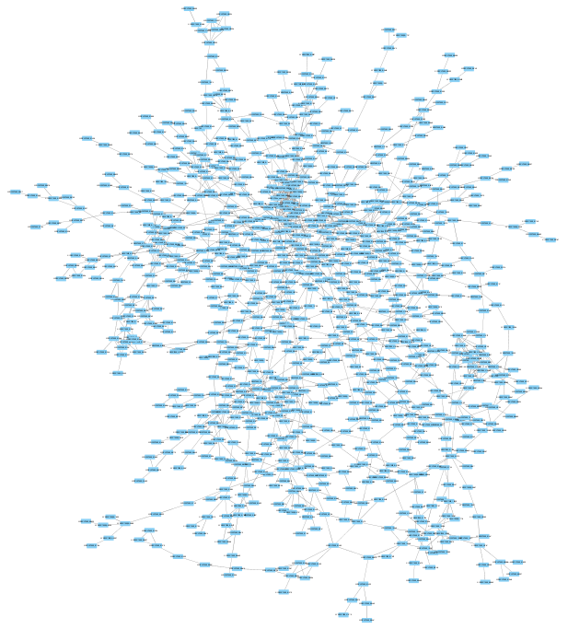
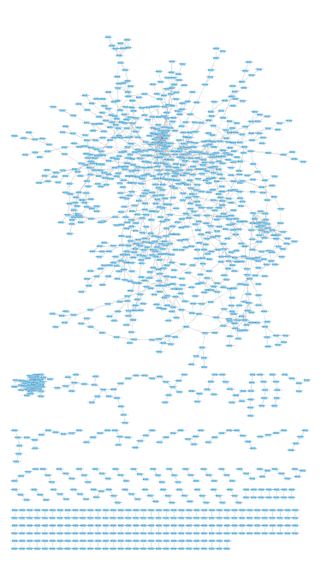
Synechococcus 7002 Network
Circles represent genes (i.e., nodes).
Lines between genes represent connections (i.e., edges).
Connections are assigned between two genes if they have a high mutual information score within the context of the network.
1,395 genes (43% of genome)
2,000 connections between them
Synechococcus sp. PCC 7002

Slide 54
Network Analysis: Centrality
Degree: The number of edges a node has with other nodes
Betweenness: A normalized value of the number of shortest paths between any two nodes in the network that pass through the node in question
name | Degree | BetweennessCentrality
SYNPCC7002_A1201 | 2 | 0.0021645
SYNPCC7002_A1216 | 1 | 0
SYNPCC7002_A1671 | 4 | 0.01332919
SYNPCC7002_A2435 | 2 | 0.00692781
SYNPCC7002_A1206 | 1 | 0
SYNPCC7002_A2562 | 2 | 0.0021645
SYNPCC7002_A1219 | 1 | 0
SYNPCC7002_A1221 | 1 | 0
SYNPCC7002_A2413 | 2 | 0.0021645
SYNPCC7002_A1233 | 1 | 0
SYNPCC7002_F0102 | 2 | 0.0021645
SYNPCC7002_A2695 | 2 | 0.01505302
Gene of High Betweenness
Genes of High Degree

Slide 55
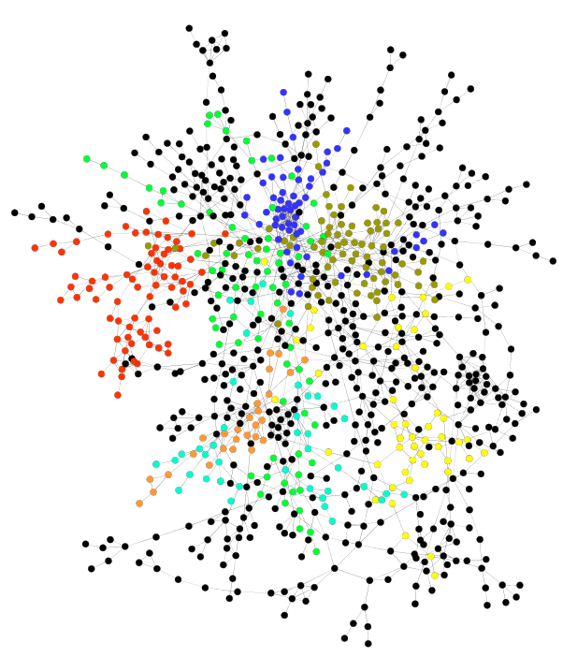
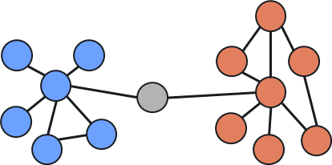
Network Analysis: Modules
Module 2
Module 1

