Slide 1
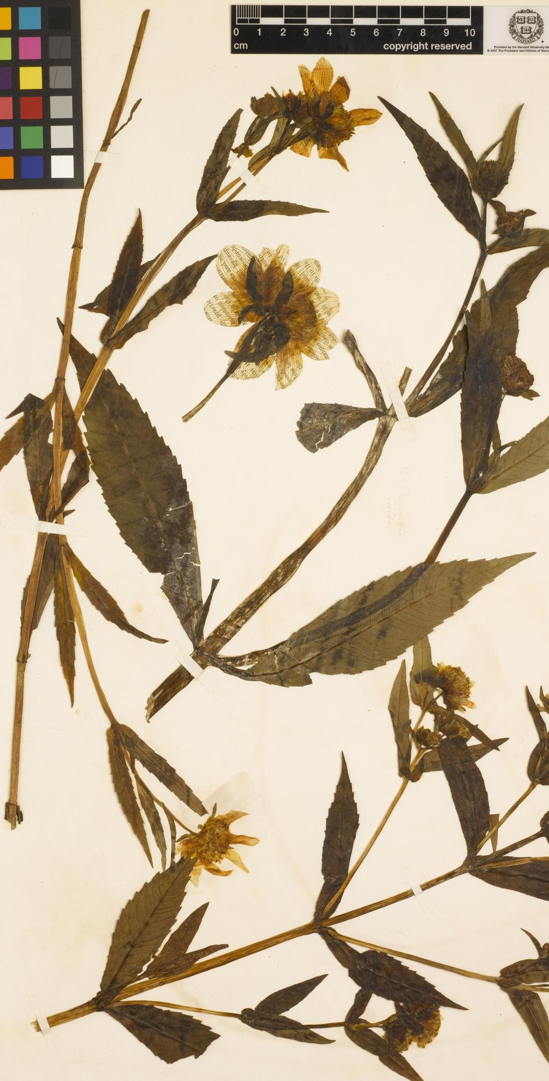
Herbariomics-based biodiversity research: from specimen to phylogeny
All images are subject to © Liming Cai
(CC BY 4.0) unless otherwise noted
Botany 2021 workshop
Liming Cai (UC Riverside daybreak.chua@gmail.com);
Hongrui Zhang (Harvard University zhanghr0429@gmail.com);
Charles C Davis (Harvard University cdavis@oeb.harvard.edu)
Left: Bidens chrysanthemoides The Herbarium of Henry David Thoreau

Slide 2
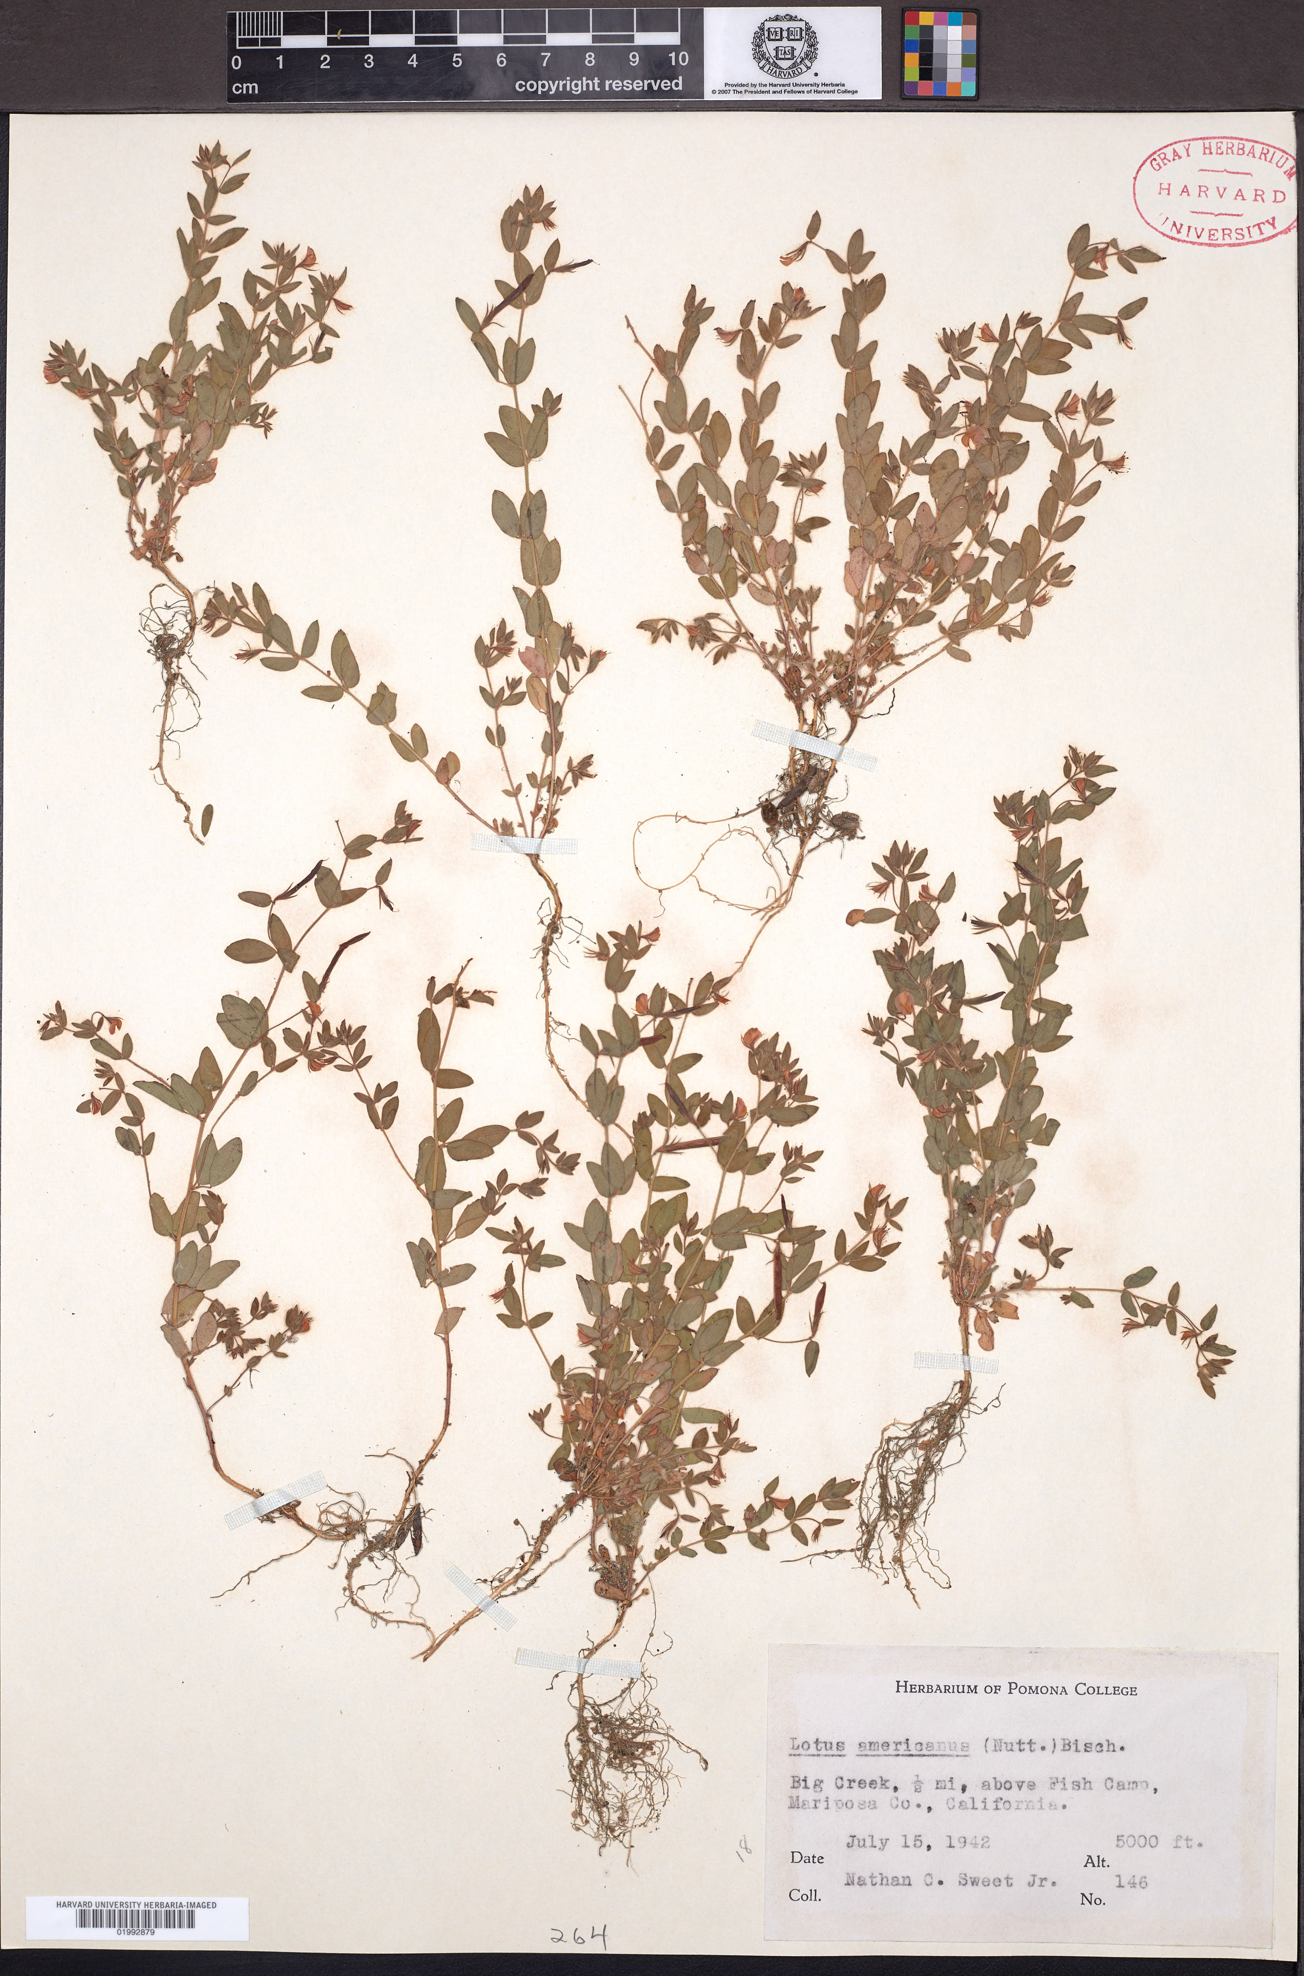
Scale measures
Phenology
Institute stamp
DNA
Morphology
Taxonomy
Distribution
Time
Ecology
Barcode
© Harvard University Herbaria

Slide 3


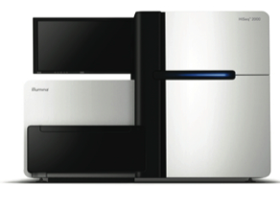


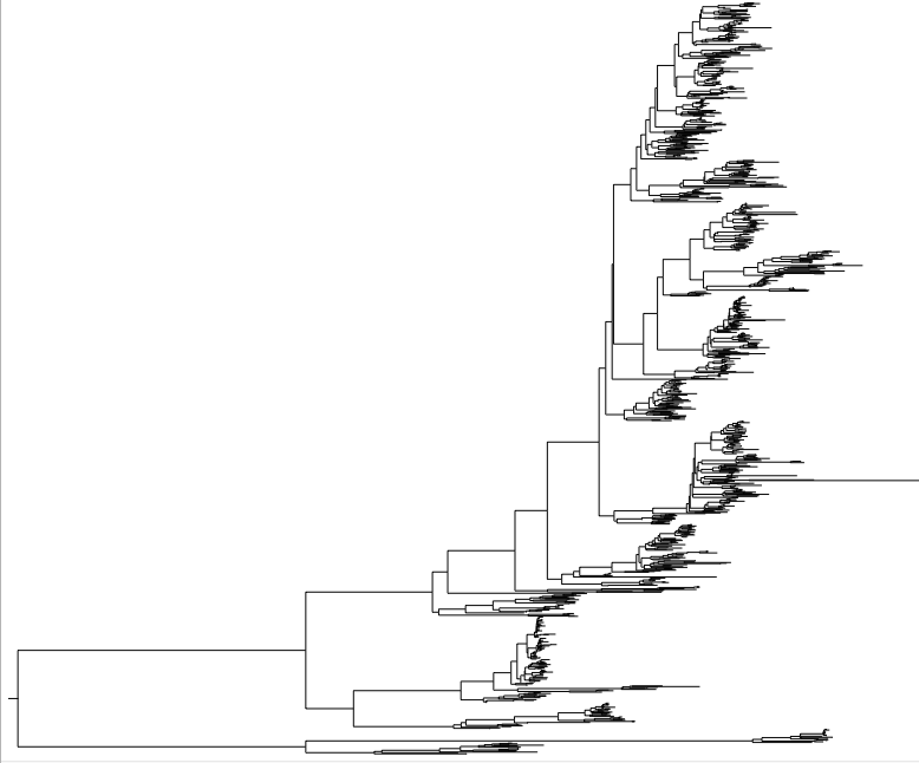




Herbariomics — herbarium specimen sequencing
All workshop materials is available on GitHub:
PhyloHerb (https://github.com/lmcai/PhyloHerb)
DNA extraction
Library preparation, Illumina sequencing
Trait evolution
Biogeography
Phenology
Macroevolutionary hypothesis testing
Phylogeny

Slide 4
Why using herbarium specimens?
All workshop materials is available on GitHub:
PhyloHerb (https://github.com/lmcai/PhyloHerb)
Pros:
Easy access to materials
Nearly perfect taxon sampling
Reliable taxonomy, locality, morphology, etc.
Fragmented DNA suitable for Illumina sequencing
Cons:
DNA quality
Restrictions for special collections
Preserve conditions

Slide 5
Experiment design — Which regions to target?
All workshop materials is available on GitHub:
PhyloHerb (https://github.com/lmcai/PhyloHerb)
Genome skimming
Unbiased sampling of the genome
Target enrichment/Sequence capture
Enriching target regions

Slide 6
Experiment design — Which regions to target?
All workshop materials is available on GitHub:
PhyloHerb (https://github.com/lmcai/PhyloHerb)
Estimations below are very rough!!!
 | Genome skimming | Target enrichment
Target region | Plastome, ribosomal regions, mitochondrial | Highly conserved nuclear (mostly) regions and the flanking region
Output per species | 160 kb (plastome) + 6-9kb (rDNA) + 10 kb (mito) = 180 kb | ~400 loci x 400 bp = 160 kb (depends on the probes)
Minimum reads | 100 mb
Price | $20 for library prep + $6 for sequencing | + $30 for sequencing
Data processing | Easy, but not suitable for testing hybridization or coalescence | Tricky (missing data, paralog, flanking region), but can test complex evolution history
Phylogenetic informativeness | Informative at all depth, but rapid radiations are challenging | Informative at all depth, but potential bias in missing data, high gene tree error due to short alignments

Slide 7
Experiment design — Which regions to target?
All workshop materials is available on GitHub:
PhyloHerb (https://github.com/lmcai/PhyloHerb)

Slide 8
All workshop materials is available on GitHub:
PhyloHerb (https://github.com/lmcai/PhyloHerb)
20 M 50 M 100 M 200 M 1G
Failed
assembly
50% genes
Most genes
+ 50% intergenic
Nearly
complete
Circular

Slide 9
All workshop materials is available on GitHub:
PhyloHerb (https://github.com/lmcai/PhyloHerb)
Data collection
Data collection
What PhyloHerb pipeline is good at
What is not covered

Slide 10
Schedule
All workshop materials is available on GitHub:
PhyloHerb (https://github.com/lmcai/PhyloHerb)
1:00 – 1:30 PM I. Introduction to herbariomics
1:30 – 2:30 PM II. Plastome assembly using GetOrganelle
2:30 – 2:40 PM Break
2:40 – 3:00 PM III. Annotation using GeSeq
3:00 – 4:00 PM IV. Alignment assembly and curation
4:00 – 4:10 PM Break
4:10 – 4:30 PM V. Phylogeny reconstruction
4:30 – 5:00 PM Q&A

Slide 11
All workshop materials is available on GitHub:
PhyloHerb (https://github.com/lmcai/PhyloHerb)
G1
G2
G3
G4-6
G7
G1
G2
G3
G4-6
G7
Genes only
G1
G2
G3
G4-6
G7
Genes on both ends + everything in between
G1
G2
G3
G4-6
G7
Everything in between the start and end genes

