Slide 1
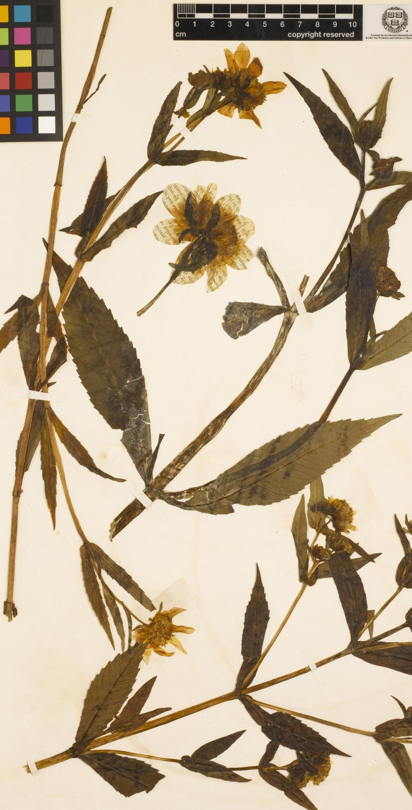
Herbariomics-based biodiversity research: from specimen to phylogeny
Botany 2021 workshop
Liming Cai (UC Riverside daybreak.chua@gmail.com);
Hongrui Zhang (Harvard University zhanghr0429@gmail.com);
Charles C Davis (Harvard University cdavis@oeb.harvard.edu)

Slide 2
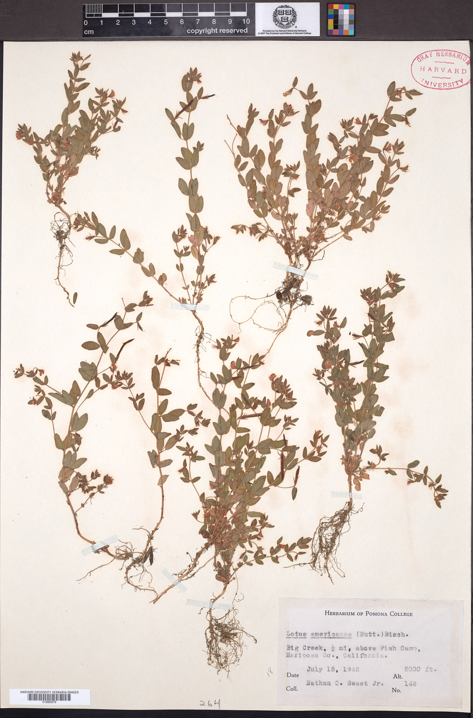

Slide 3
20 M 50 M 100 M 200 M 1G
Failed
assembly
50% genes
Most genes
+ 50% intergenic
Nearly
complete
Circular

