Slide 1
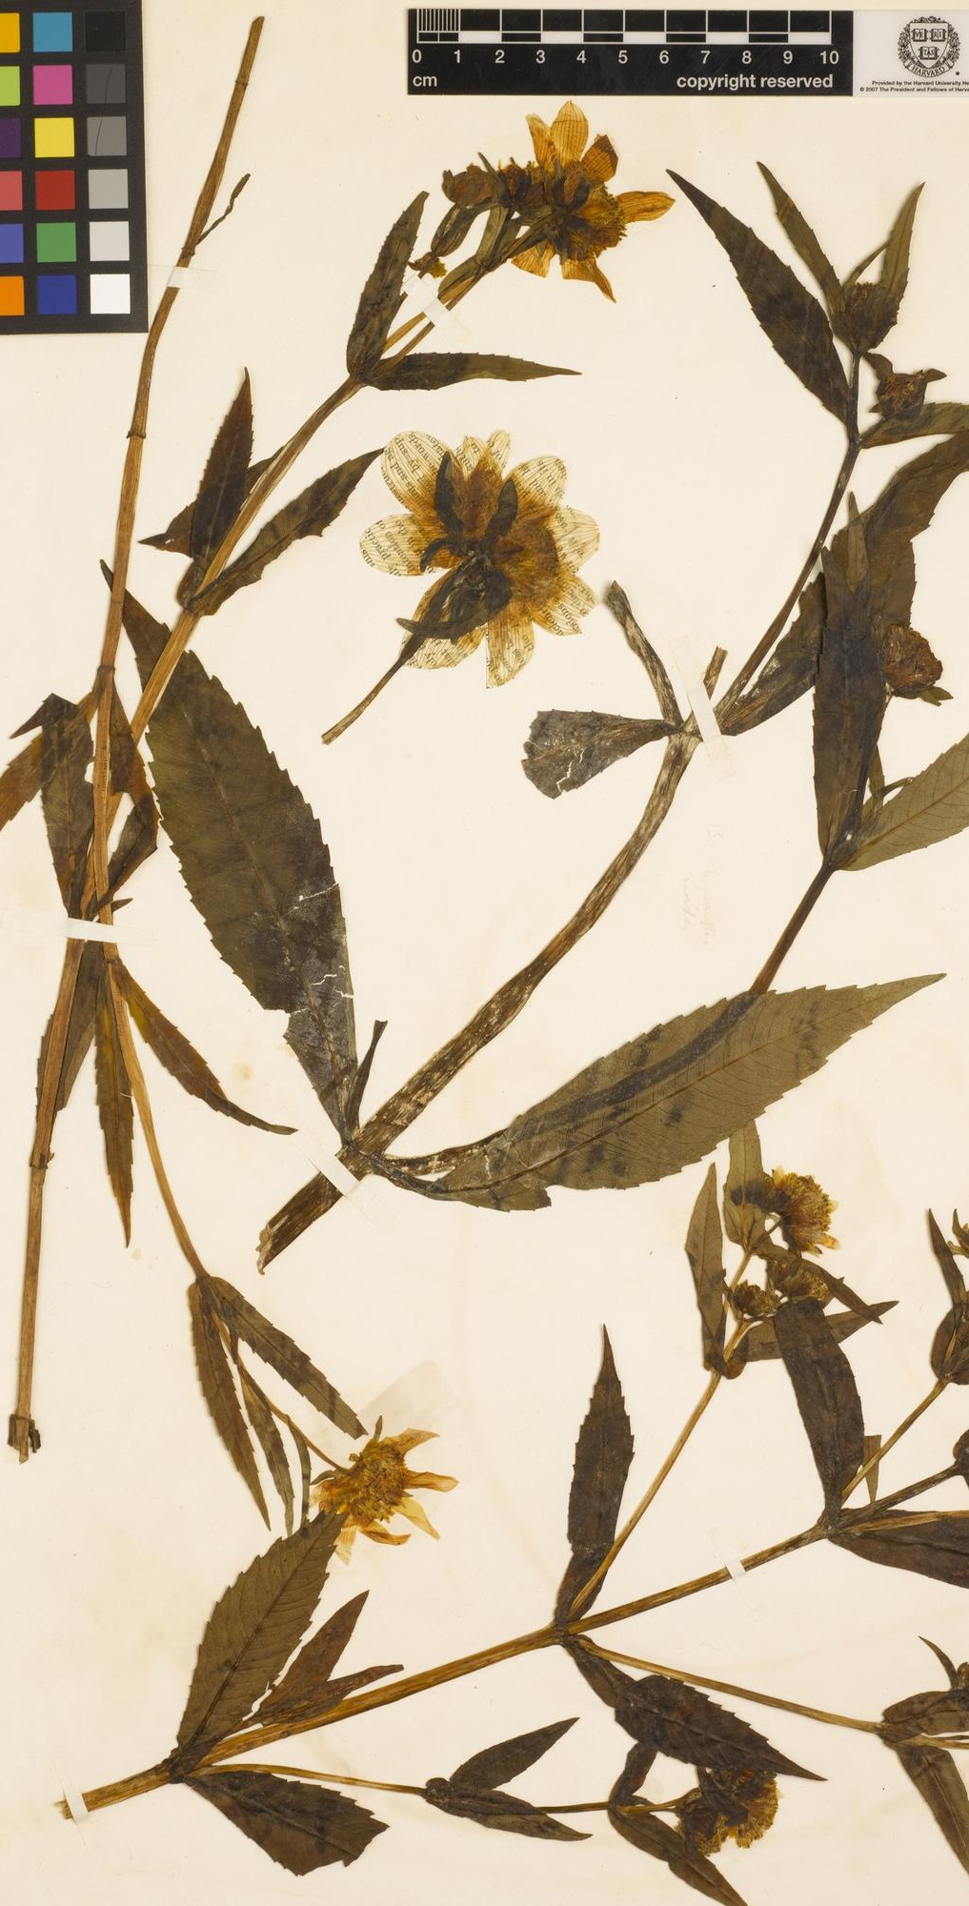
Herbariomics-based biodiversity research: from specimen to phylogeny
Images are subject to copy right Liming Cai (CC BY 4.0) unless otherwise noted
Botany 2021 workshop
Liming Cai (UC Riverside daybreak.chua@gmail.com);
Hongrui Zhang (Harvard University zhanghr0429@gmail.com);
Charles C Davis (Harvard University cdavis@oeb.harvard.edu)
Left: Bidens chrysanthemoides The Herbarium of Henry David Thoreau

Slide 2
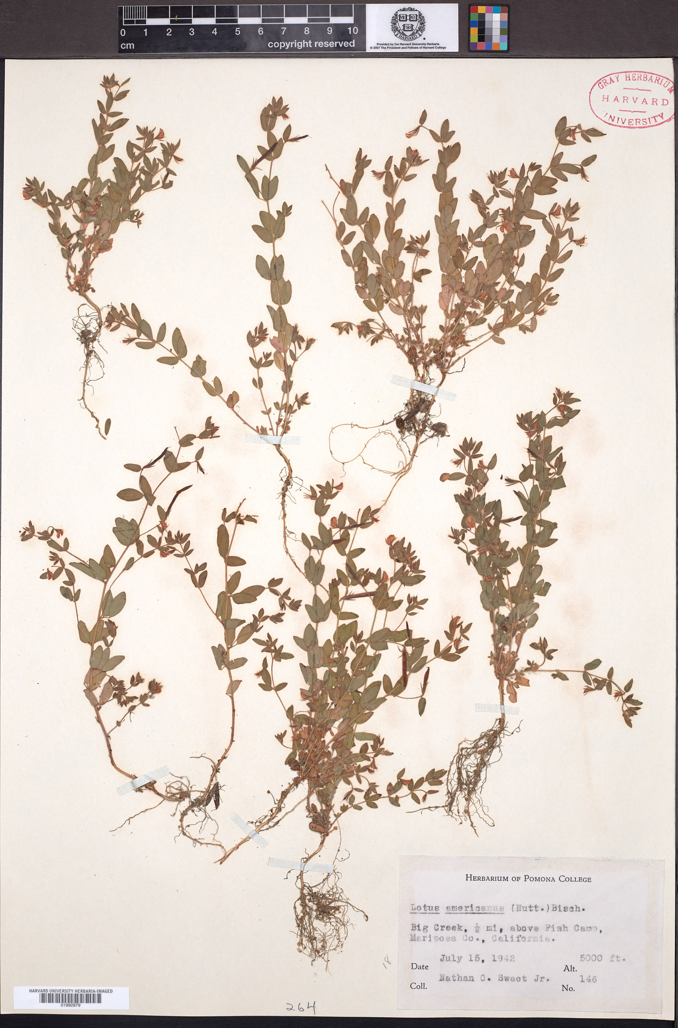

Slide 3
What portion of the data is used?

Slide 4
Data collection
Data collection
What PhyloHerb pipeline is good at
What is not covered

Slide 5
20 M 50 M 100 M 200 M 1G
Failed
assembly
50% genes
Most genes
+ 50% intergenic
Nearly
complete
Circular

Slide 6
Schedule

