Slide 1
Data Augmentation for NLP
YCNG-229 Final project
Andre Godin

Slide 2
THE CONTEXT
General Data Protection Regulation (GDPR) has set a new standard for Ericsson’s customer rights regarding their data.
Ericsson is looking at migrating more and more workload into some off-premises cloud solution (e.g., public cloud like AWS, GCP, Azure) in different geographically regions.
Hundreds of customer managed service contracts to revisit to validate if there are any constraint with regards to what we are allowed to do with customer data
We need some automation and intelligence to facilitate this tedious task.

Slide 3
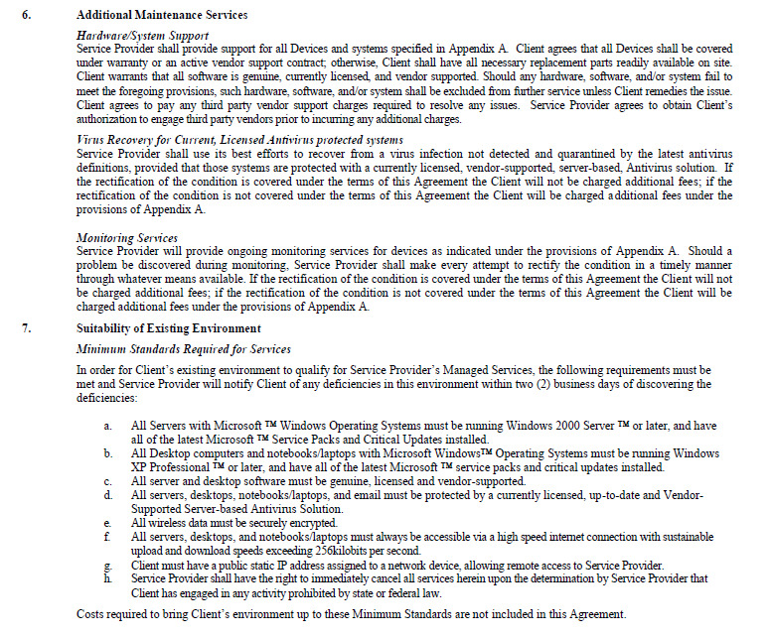


customer managed service contracts

Slide 4


The goal
Extract text from the contracts that are in PDF form and detect sentences referring to ‘data’ entity.
Use a text classifier to determine whether or not an extracted sentence indicates that the customer contract is putting some constraints on what we are allowed to do with their data
With Constraint
The data must stay in customer premises
Data should be anonymized before exporting it
Without Constraint
Data can be stored in public cloud
Data can be used for troubleshooting issues

Slide 5









Solution architecture
AWS Cloud
User upload some Managed Service contract as .pdf file to an AWS S3 bucket
The upload triggers an AWS Lambda function to initiate AWS Textract processing
The AWS Lambda function triggers AWS Textract service to extract text from the contract document
The extracted parsed text is sent to the AWS Comprehend custom model for custom entity extraction
Prior to this, a custom entity recognition model should have been trained with Amazon Comprehend to recognize the ‘data’ entity
Data augmentation
Data augmentation techniques are applied to enrich the dataset to train the classifier on
Text Classification
Use BERT as a service to fine-tune BERT and use BERT’s embeddings to train a Logistic Regression Text Classification to determine whether or not a sentence containing a ‘data’ entity indicating data constraint or not
Managed Service Contracts (.pdf)
1
2
3
4
S3
Lambda
Textract DetectDocumentText
Comprehend Custom Entity Recognition
User
5
Data Augmentation
Notebook
6
Classifier
Google Colab

Slide 6

MY Project focus
One of the important factors that determine the generalization of a model is the amount and variety of related data it sees during training.
Data augmentation techniques can be used to enrich the dataset to train the classifier on
2 techniques were explored and implemented
Lexical substitution: EDA (Easy Data Augmentation)
Generative Model/Pre-trained Transformer Models: GPT2

Slide 7
Lexical substitution: EDA
EDA (Easy Data Augmentation) consists of 4 simple operations:
Synonym replacement
NLTK WordNet
List of Synonyms
Word Similarity (score denoting how similar two word senses are)
Spacy
Extract/sort out verbs and nouns
Word comparison (score denoting how close two words are semantically)
random insertion
random swap
random deletion
EDA: Easy Data Augmentation Techniques for Boosting Performance on Text Classification Tasks

Slide 8
results
Here’s a sample of what EDA can generate
Input Sentence:
data has to stay in customer premises
Generated sentence with synonym replacement:
data has to remain in customer premises
information has to stay in customer premises
information has to remain in customer premises
information has to remain in client premises
data has to remain in customer place
information has to remain in customer place
It is not allowed to export the data→ It is not let to export the data

Slide 9
Generative Model Pre-trained Transformer Models GPT2
We would ideally want a model that already knows a lot about syntactic, grammatical, semantic structures of natural language. The pre-trained GPT2 becomes a perfect candidate for this task !
GTP2 is based on Transformer Architecture trained on 40GB of WebText. It’s a stack of multiple decoder units on top of each other.
I used GPT-2 Medium model from HuggingFace Transformers library
12-decoders, 24-layer, 1024-hidden, 16-heads, 345M parameters.
The objective that GPT2 tries to optimize is essentially to predict the next word (token) in the sequence having seen past words
The way this model works is that after each token is produced, that token is ad ded to the sequence of inputs, and that new sequence becomes the input to the model in its next step. This is called “auto-regression”.
It uses a Top-k, Top-p sampling strategy to sample word at each step while decoding.
Train GPT2 on our dataset and expect it to learn the word usage, language structure of our data, then generate samples
Results are pretty amazing!!

Slide 10
results
SENTENCES = 20
SENTENCE_LENGTH = 20
START_SENTENCE = 'the customer data can’
the customer data can be compromised if somebody is sending the wrong email or someone else has access to the information and is sending
the customer data can be traced back to a single location and not the address or mobile number which is used to register an
the customer data can be shared with third parties, including our commercial and academic partners."
the customer data can be used in the case of fraud or abuse and also in any other cases for other reasons of course
the customer data can be read/viewed, used for business purpose and to communicate with its users," it said.
the customer data can also be used to search for advertising and other forms of service from which to monetize or connect with
the customer data can be obtained by using a custom script that will make calls to our database and query the data to determine
the customer data can then be obtained by any government agency" or "the data will be sold to a private company or
the customer data can be saved to file or cloud storage.'
the customer data can be read," the company said.
the customer data can be compromised if the person you're logging into an account with doesn't know what they're signing up
the customer data can be linked back to the customer) and the company claims that such data is stored on its own servers
the customer data can now be accessed from outside the store, and is stored separately from the credit card information," he said
the customer data can be used to provide better customer experience, better service, enhanced customer service, improved risk mitigation and/
the customer data can then be sold to third parties for profit."
the customer data can be used by their own servers," he said.
the customer data can be used by any of the five authorities under UK law," he said.
the customer data can be very difficult to obtain as much as that of an Apple customer."
the customer data can be obtained and monitored as required by law or pursuant to lawful orders of law enforcement authorities."
the customer data can be easily shared with the bank," the statement added.

Slide 11
results
SENTENCES = 20
SENTENCE_LENGTH = 20
START_SENTENCE = 'the customer data cannot’
the customer data cannot be sold without prior consent from the customer or unless there is a compelling reason to suspect that the data
the customer data cannot be sold, altered, transferred or otherwise removed without the express written consent of the customer.
the customer data cannot be reused without prior authorization."
the customer data cannot be reused if the company can do so without incurring liability for the data, and the risk of
the customer data cannot be acquired with the expectation that any personal information is transmitted in the email," the memo says.
the customer data cannot be stored for as long as 24 hours, however they can be transferred once a day to another storage
the customer data cannot be read, analyzed or shared outside of the company's end user agreement," a representative for the company
the customer data cannot be used for fraud, illegal conduct, or harassment or for any other purpose that violates the law."
the customer data cannot be used for any purpose other than to provide you with information on that customer, which includes personal information
the customer data cannot be copied in order to send it to a third party," the company added.
the customer data cannot be used to create ad-tracking systems or other artificial, automated systems of the type which have been
the customer data cannot be disclosed, unless the customer specifically states they would like to be notified."
the customer data cannot be accessed for free."
the customer data cannot be used to obtain information about people with intellectual disabilities", although many do offer service with an intellectual disability
the customer data cannot be used to identify any particular user, as the data would not be usable to identify the individual,"
the customer data cannot be viewed or otherwise processed without your prior consent and consent to this agreement is granted automatically.
the customer data cannot be accessed without customer consent."
the customer data cannot be used without the permission of the client."
the customer data cannot be shared as such," the company said.
the customer data cannot be accessed.

