Slide 1
Writing Plug-ins for ArchivesSpace
Laney McGlohon
Lora Woodford
Notes:
Confirm a local version of ArchivesSpace is running, and tabs are open in a browser for github.com/archivesspace and github.com/lorawoodford
Have everyone make sure their local version will start up (and they know how to do that)

Slide 2
Agenda
What is an ArchivesSpace plug-in?
Plug-in directory structure
Create the plug-in
Enable the plug-in
Examples
Resources

Slide 3
What is an ArchivesSpace plug-in?
ArchivesSpace plug-ins provide a mechanism to customize ArchivesSpace by overriding or extending functions without changing the core codebase. As they are self-contained, they also permit the ready sharing of packages of customization between ArchivesSpace instances.
Notes:
NOTE: After installing the plugin code, you will need to restart ArchivesSpace

Slide 4
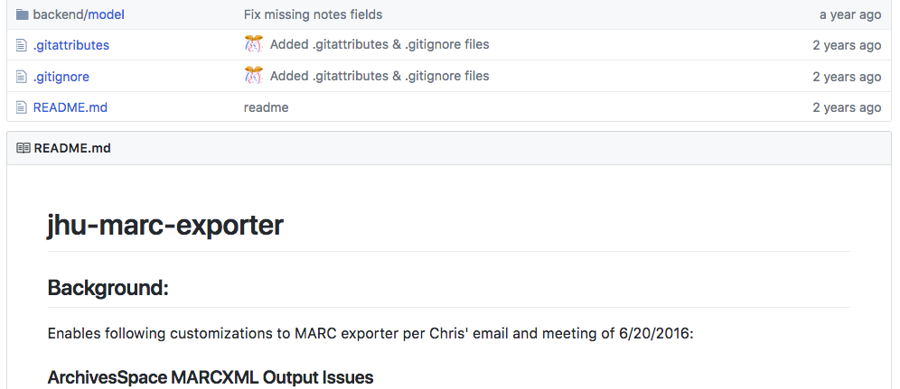
When should you use a plug-in?
To add institution-specific extended functionality, style, branding, and customizations
Examples:
Customizing exporters
Setting required fields
Auto-generating DOIDs, accession numbers, etc.
Modifying labels
Customizing staff or public display

Slide 5
When shouldn’t you use a plug-in (in a perfect world)
Obvious bugs
Bugs should be reported to the program and fixes incorporated into the core code
You may still wish to expedite the fix by implementing a plug-in in the interim, and may even wish to submit a pull request back to the core code!
One-off data needs
When you can’t commit to a maintenance plan

Slide 6
Maintenance considerations
New major releases may impact the efficacy (or even need for) your plug-in
Pay attention to release notes and always confirm your plug-ins are still working as intended
Example:
JHU MARC exporter initially included bug fix for AR-1189
JHU PUI plug-in (not surprisingly) broken post-2.1

Slide 7
Plug-in directory structure
The directory structure within a plug-in is similar to the structure of the core application. The following shows the supported plug-in structure. Files contained in these directories can be used to override or extend the behavior of the core application.
local ............... Enabled by default
backend ............. Database and API
controllers ......... backend endpoints
model ............... database mapping models
converters .......... classes for importing data
job_runners ......... classes for defining background jobs
plugin_init.rb ...... if present, loaded when the backend first starts
frontend ............ Staff Interface
assets .............. static assets (such as images, javascript) in the staff interface
controllers ......... controllers for the staff interface
locales ............. locale translations for the staff interface
views ............... templates for the staff interface
plugin_init.rb ...... if present, loaded when the staff interface first starts
public .............. Public User Interface
assets .............. static assets (such as images, javascript) in the public interface
controllers ......... controllers for the public interface
locales ............. locale translations for the public interface
views ............... templates for the public interface
plugin_init.rb ...... if present, loaded when the public interface first starts
migrations .......... Database migrations
schemas ............. JSONModel schema definitions
search_definitions.rb Advanced search fields

Slide 8
Steps to Create a Plug-in
Identify what change is required. Should the implementation be extended or overridden?
Determine where implementation is in the code
To override behavior, rather than extend it, match the path to the file that contains the behavior to be overridden.
NOTE: The name layout_head.html.erb is special:
anything you put in a file under
[plugin_name]/frontend/views/layout_head.html.erb
or
[plugin_name]/public/views/layout_head.html.erb
will be inserted at the top of every page delivered by ArchivesSpace.

Slide 9
How to enable the plug-in
Plug-ins are enabled by placing them in the ArchivesSpace installation plugins directory and referencing them in the ArchivesSpace configuration, common/config/config.rb.
For example: AppConfig[:plugins] = ['local', 'my_plugin']
Note that the order that the plug-ins are listed in the :plugins configuration option determines the order in which they are loaded by the application. Be mindful of how plug-ins “play” together.
Make sure that you uncomment the line with AppConfig[:plugins] = ['local', 'my_plugin’]

Slide 10
Examples
Customizing Field and Option Labels
Customizing Branding Image
Moving Branding Image from Right to Left
Customizing MARC Exporter
Autogenerating Digital Object Identifier

Slide 11
Customizing Field and Option Labels
To override some part of a locale file for the staff interface, you can just add the following structure to the local plug-in:
plugins/local/frontend/locales/en.yml
For example, to change the text in the become-user pull-down entry, put this in the en.yml file mentioned above:
en:
navbar:
become-user: Become Another User
Restart ArchivesSpace
Notes:
Spacing in a yml file is very important - always have 2 space indentation from the previous line to keep it in the current hierarchy. Remove 2 spaces at a time to move back up the hierarchy.

Slide 12
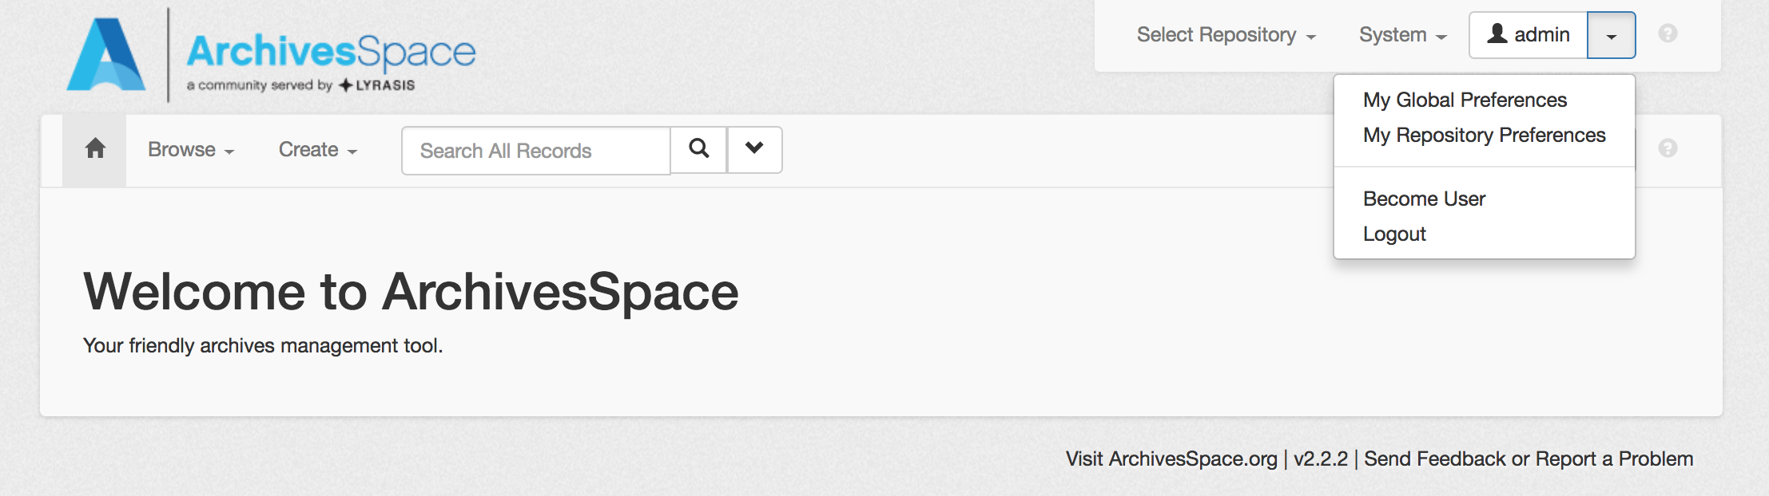
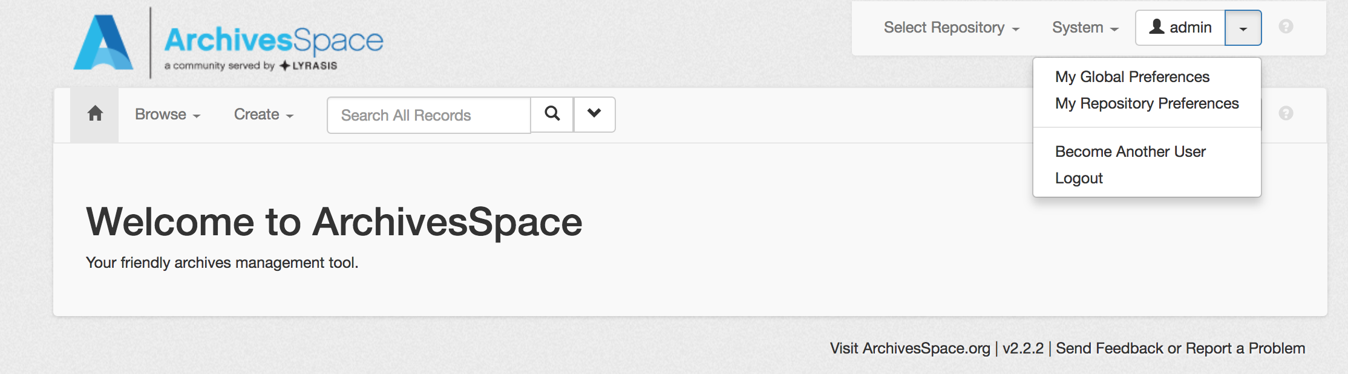
Customizing Field and Option Labels

Slide 13
Customizing Branding Image
To change the branding image,
In the plugins/local/public directory, add a new directory called assets and put the branding image in there
Modify the config.rb file by setting AppConfig[:pui_branding_img] equal to the name of the branding image in the assets directory – eg. AppConfig[:pui_branding_img] = 'my_branding_image.png'
Restart ArchivesSpace

Slide 14
Moving Branding Image From Right to Left
The placement of the branding image is handled by the public/app/views/shared/_header.html.erb file, so in order to change the position from right to left, the file needs to be overridden in a plug-in.
The contents of the core code public/app/views/shared/_header.html.erb is:
<section id="header">
<div class="row">
<div class="col-sm-9 h1">
<% unless request.original_fullpath == '/' %>
<a title="<%=t('brand.title_link_text') %>"
href="<%= AppConfig[:public_proxy_url] %>">
<% end %>
<%= t('brand.title') %>
<% unless request.original_fullpath == '/' %>
</a>
<% end %>
</div>
<div class="col-sm-3 hidden-xs">
<img class="logo" src="<%= asset_url(AppConfig[:pui_branding_img]) %>" alt="" />
</div>
</div>
</section>
A
B

Slide 15
Moving Branding Image From Right to Left (2)
In the plugins/local/public/views directory, add a new directory called shared and create a file called “_header.html.erb” there.
Add this snippet to the plugins/local/public/views/shared/_header.html.erb file:
<section id="header">
<div class="row">
<div class="col-sm-2 hidden-xs">
<img class="logo" src="<%= asset_url(AppConfig[:pui_branding_img]) %>" alt="" />
</div>
<div class="col-sm-9 h1">
<% unless request.original_fullpath == '/' %>
<a title="<%=t('brand.title_link_text') %>"
href="<%= AppConfig[:public_proxy_url] %>">
<% end %>
<%= t('brand.title') %>
<% unless request.original_fullpath == '/' %>
</a>
<% end %>
</div>
</div>
</section>
B
A

Slide 16
Moving Branding Image From Right to Left (3)
So what did this change do?
It swapped the order of the two <div> tags in the erb file. By putting the <div> that handles the branding image before the <div> that handles the text that displays, the columns where these <div> tags are rendered are rearranged.
Don’t forget to restart ArchivesSpace to be able to see the change!

Slide 17
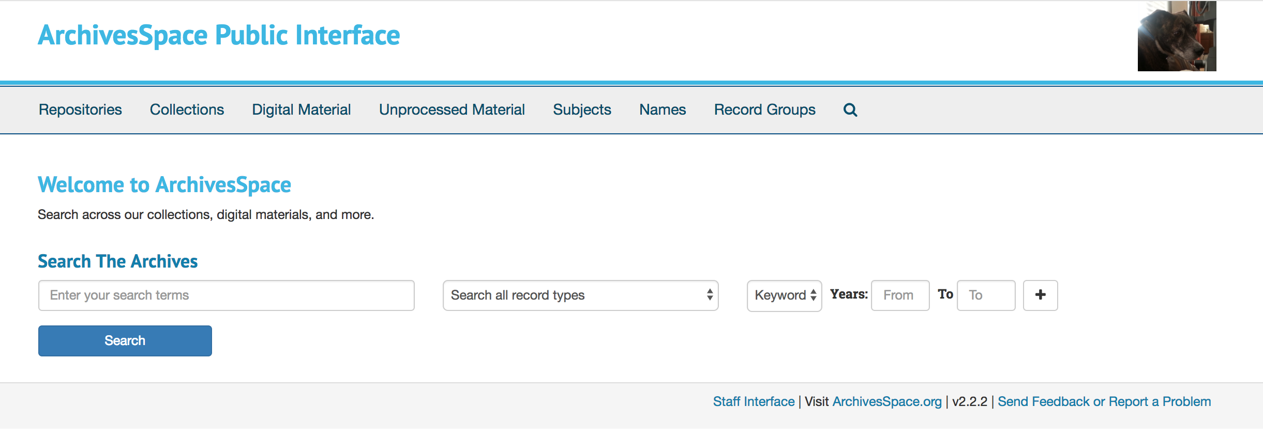
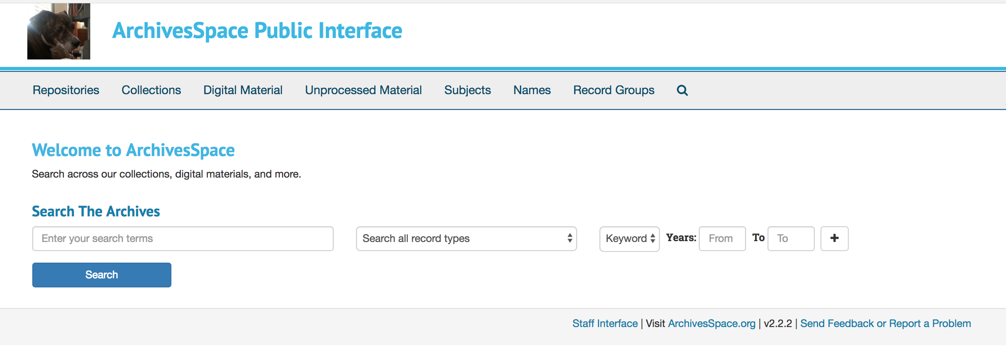
Moving Branding Image From Right to Left (4)

Slide 18
Customizing MARC Exporter
Exporters packaged with the application are necessarily non-specific in nature
Exporters can be customized by overriding the defaults set in backend/app/exporters/models
Create a plugin with custom settings with the following two files:
backend/model/custom-marc21-overrides.rb
backend/model/utils-marc-overrides.rb
Copy the existing relevant exporter model from the core code and use it as your guide as you make overrides
Delete out any block you’re not changing
Leave in and alter any blocks you are changing
Pro-tip: Comments are your friends.
You can see what has been changed in the MARC exporter we’re using here in the plug-in’s README.md

Slide 19
Customizing MARC Exporter
Go to https://github.com/lorawoodford/custom-marc-exporter
Navigate to archivesspace/plugins and either git clone or download and unzip custom-marc-exporter
Add ‘custom-marc-exporter’ to config/config.rb under AppConfig[:plugins]
Restart ArchivesSpace

Slide 20
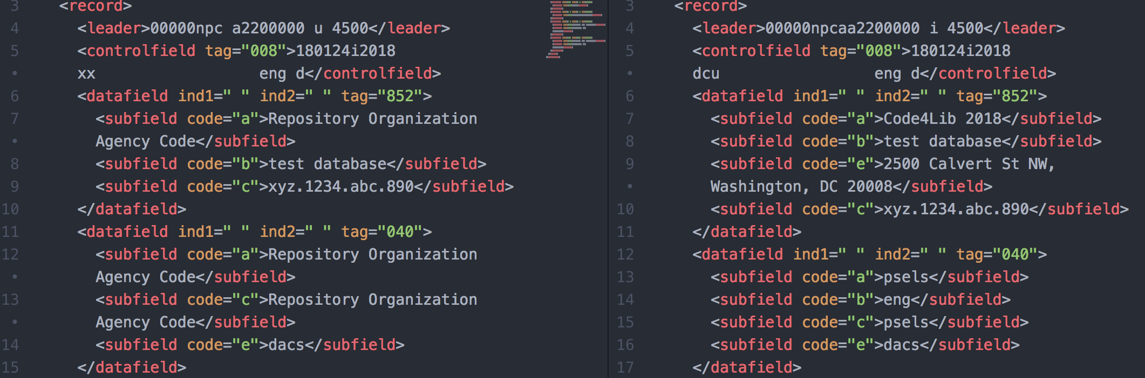
Customizing MARC Exporter
Default exporter
Overridden exporter

Slide 21
Autogenerating Digital Object IDs
ArchivesSpace’s Digital Object records require an identifier, defined as:
A unique identifier for the digital object as a whole. May be an ARK, HANDLE, a URI, or any string that uniquely identifies the digital object. The field needs to be completed for a valid METS record to be exported.
What if you have nothing obvious to use to populate that field? Can we autogenerate a random hash to fill this field?
Yes!
ArchivesSpace already uses the SecureRandom.hex Ruby method to do exactly this elsewhere in the application
Create a plug-in that modifies:
backend/model/digital_object.rb
Call SecureRandom.hex on initial save.
frontend/views/digital_objects/_form_container.html.erb
Display text informing user that field will be autogenerated on save
schemas/digital_object.rb
Set hex pattern and do not require field for initial save

Slide 22
Autogenerating Digital Object IDs
Go to https://github.com/lorawoodford/autogenerate-doid
Navigate to archivesspace/plugins and either git clone or download and unzip autogenerate-doid
Add ‘custom-marc-exporter’ to config/config.rb under AppConfig[:plugins]
Restart ArchivesSpace

Slide 23
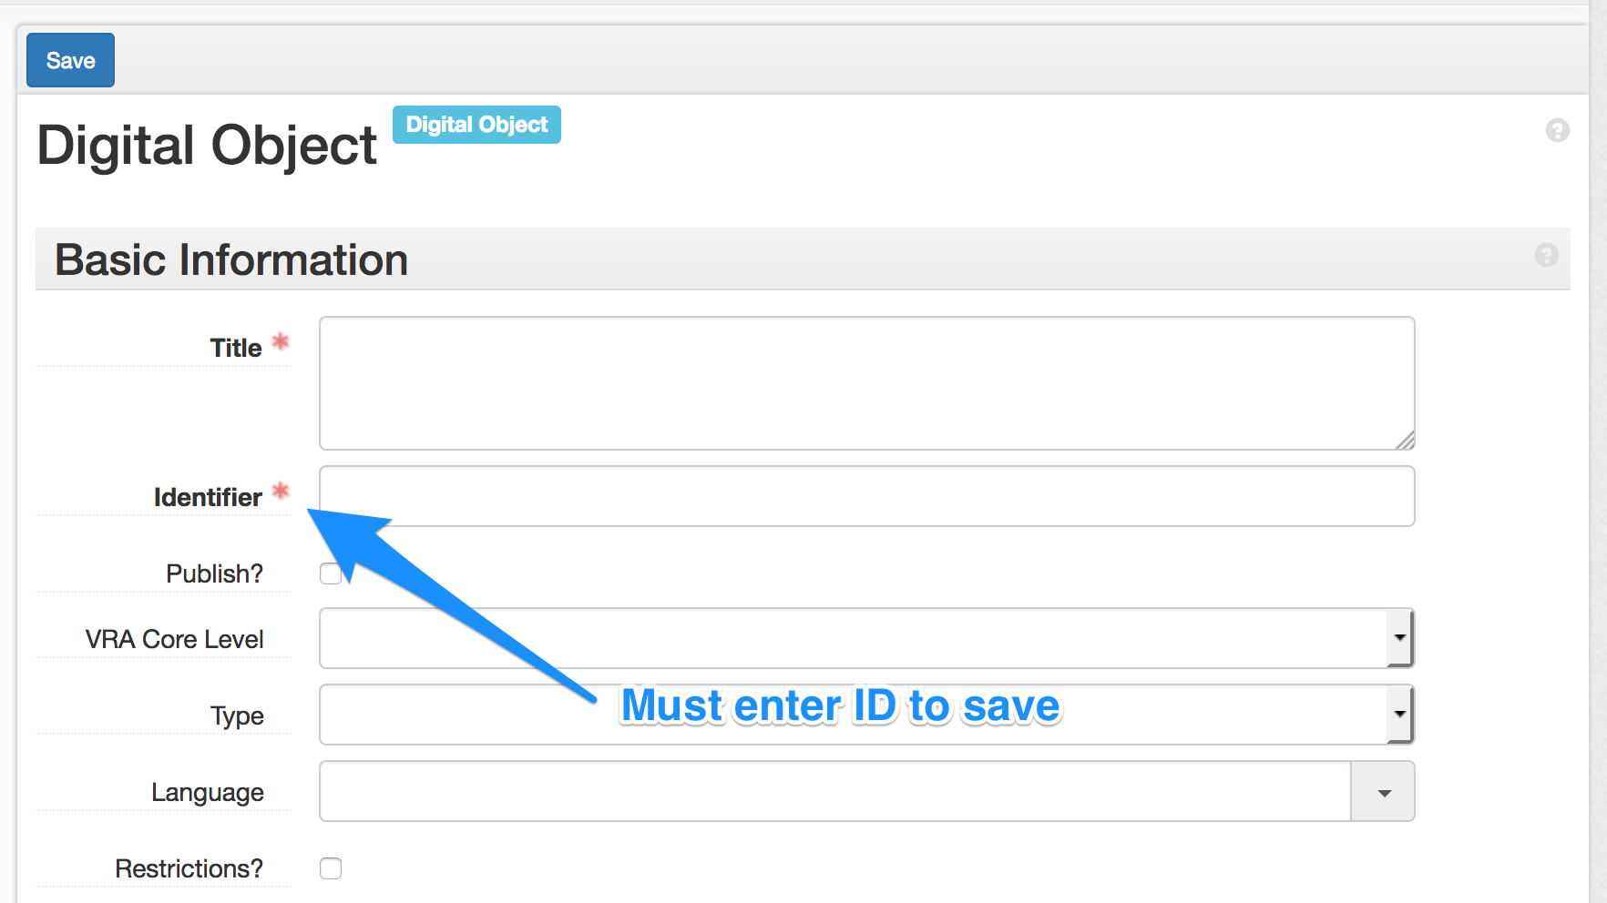
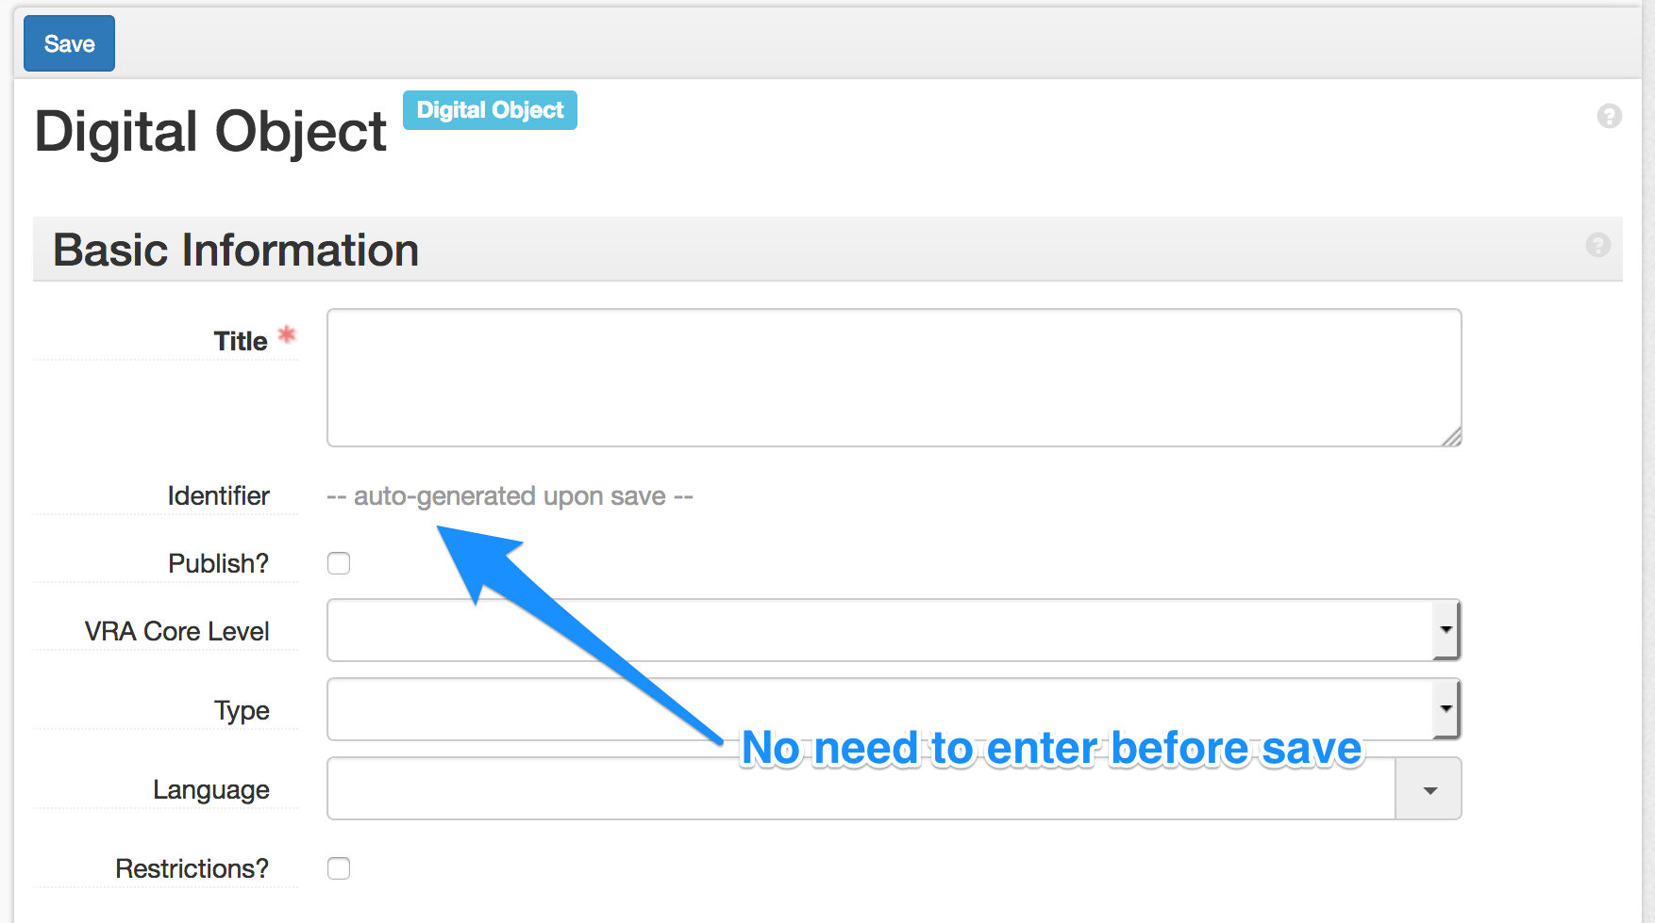
Autogenerating Digital Object IDs
Added functionality
Original functionality

Slide 24
Resources
https://github.com/archivesspace/archivesspace/blob/master/plugins/PLUGINS_README.md
https://archivesspace.atlassian.net/wiki/spaces/ADC/pages/17137734/Plugins+and+Scripts
http://campuspress.yale.edu/yalearchivesspace/category/what-archivesspace-does/
http://libraryblogs.is.ed.ac.uk/librarylabs/tag/archivesspace/
http://archival-integration.blogspot.com/2015/07/archivesspace-donor-details-plugin.html
https://guides.nyu.edu/archivesspace/development
https://blogs.library.duke.edu/bitstreams/2016/09/21/archivesspace-api-fun/
https://blogs.harvard.edu/archivaldescription/2017/01/26/spreadsheet_to_ead_to_as/
https://rubyexample.com/user/djpillen
https://library.osu.edu/blogs/it/category/archivesspace/
https://www.youtube.com/watch?v=hWP430Q5EWM
Turning a plug-in into core code: https://archivesspace.atlassian.net/wiki/spaces/ADC/pages/349995159/Turning+an+ArchivesSpace+Plugin+into+Core+Code

Slide 25
Thank you!
Any Questions?
Contact Information:
Laney McGlohon – laney.mcglohon@lyrasis.org
Lora Woodford – lora.woodford@lyrasis.org

