Slide 1
A photosensory two-component system regulates bacterial cell attachment
  Erin B. Purcell*, Dan Siegal-Gaskins†, David C. Rawling*, Aretha Fiebig*, and Sean Crosson*‡§

Slide 2
Caulobacter crescentus
Gram-negative, oligotrophic bacterium
Dimorphic lifecycle
One circular chromosome
containing ~3,700 genes

Slide 3
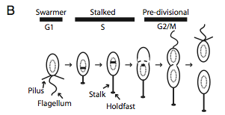
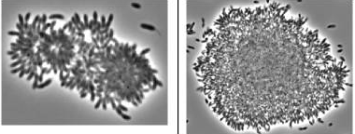
Bacterial Attachment
Holdfast complex allows cell-surface, cell-cell binding
Polysaccharide composed in part of N-acetylglucosamine
Can form rosettes when one holdfast attaches to another

Slide 4
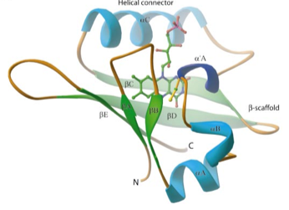
LOV domains
Light, oxygen, voltage sensory domain
Conserved across many plants, algae, and prokaryotes
Flavin-binding
Often coupled to kinases, phosphodiesterases, F-box domains, STAS domains, and zinc fingers

Slide 5
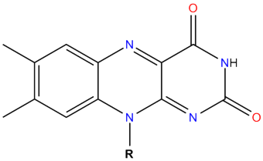
Flavin
Tricyclic heteronuclear ring structure
Obtained from riboflavin, vitamin B2

Slide 6
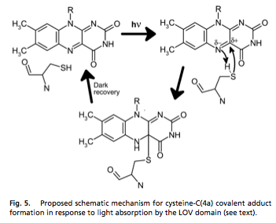
Photoactivation
Nucleophilic attack on flavin ring by cystine side chain driven by light.
Flavin-Protein adduct is the active state

Slide 7
Single domain response regulator
Basic stimulus-response coupling mechanism
ATP phosphorylates histidine kinase
Histidine kinase transfers phosphoryl group to aspartic acid residues

Slide 8
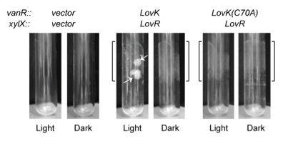
Microfluidics
Laminar flow is defined as a flow were all layers are parallel and there is no turbulence.
Applies a constant equal force to bacteria in the channel.

Slide 9
References
Smith et al. Journ. Bacterio. 185, 1432-1442; Feb. 2003
Crosson et al. Biochem. 42, 2-10; Dec. 2002
Crosson et Moffat. PNAS. 98, 2995-3000; Feb. 2001
Stock et al. Microbio. 53, 450-90; Dec. 1989
Christie et al. PNAS. 96, 8779-8783; July 1999
Briggs, W. Journ. Biomed. 14, 499-504; Feb. 2007

