Slide 1
PAPER ID: 282 HammerFilter: Robust Protection and Low Hardware Overhead Method for RowHammer
Kwangrae Kim
Department of EE
Hanyang University
Jeonghyun Woo
Department of ECE
University of Illinois at Urbana-Champaign
Junsu Kim
Department of EE
Hanyang University
Ki-Seok Chung
Department of EE
Hanyang University

Slide 2
Background
Existing Solutions
Motivation&Goal
HammerFilter
Experimental Methodology
Evaluation
Conclusion

Slide 3
Background
Existing Solutions
Motivation&Goal
HammerFilter
Experimental Methodology
Evaluation
Conclusion

Slide 4
What is RowHammer?
Repeatedly access to a DRAM row (aggressor row) causes bit-flip in nearby rows (victim row)
RowHammer
DRAM Bank
DRAM cell
1
0
1
1
0
1
1
Victim row
Access
Row Decoder
Aggressor row
1
1
0
0
1
1
1
Victim row
Sense Amplifier

Slide 5
Why is RowHammer crucial to solve?
RowHammer can be used to make malicious application
-> Security problem
Ex) Gains kernel privileges on x86-64 Linux [Mark+, 2015]
As DRAM process technology scales down, RowHammer is getting worse
RowHammer threshold (RH threshold) gets low
Multiple aggressor rows can be attacked
-> Get complicated
New attack patterns have been being introduced
Ex) Double-sided attack, Half-Double attack

Slide 6
RowHammer Attack Scenarios
Double-sided attack
Makes the victim row between two aggressor rows more vulnerable to RowHammer attacks
Attack using multiple aggressor rows
Complicate RowHamer attack can be made
VICTIM ROW
AGGRESSOR ROW
VICTIM ROW
AGGRESSOR ROW
VICTIM ROW
VICTIM ROW
AGGRESSOR ROW
VICTIM ROW
AGGRESSOR ROW
VICTIM ROW
VICTIM ROW
AGGRESSOR ROW

Slide 7
Background
Existing Solutions
Motivation&Goal
HammerFilter
Experimental Methodology
Evaluation
Conclusion

Slide 8
Hardware-based Protection Methods
Probabilistic methods:
Perform additional refreshes with a certain probability
Can be implemented with simple hardware circuit
Have low protection performance
Counter-based methods:
Keep track of every aggressor rows using counters
Guarantee protection
Suffer from considerate area overhead or extreme additional refreshes (related with performance overhead) or even both

Slide 9
Previous Probabilistic Methods
They still cannot prevent well in the complicate attack
PARA [Kim+, ISCA’14], MRLoc [You+, DAC’19], and PRoHIT [Son, DAC’17]
Cannot mitigate RowHammer
# of aggressor rows increases

Slide 10
Previous Counter-based Methods
TWiCe [Lee+, ISCA’19], and Graphene [Park+, MICRO’20] cause significant hardware overhead to operate them
CBT [Sevedzadeh+, ISCA’18] carries out considerable additional refreshes to prevent RowHammer attacks
Area overhead increases
Additional refreshes # increases

Slide 11
Background
Existing Solutions
Motivation & Goal
HammerFilter
Experimental Methodology
Evaluation
Conclusion

Slide 12
Motivation & Goal
Prior hardware-based methods have limitations, the methods:
Cannot prevent complex RowHammer attacks
Require tremendous area overhead
Cause many additional refreshes (performance overhead)
Goal
Provides protection against RowHammer even in the complicate attack patterns
Operates with low area overhead and low # of additional refreshes

Slide 13
Background
Existing Solutions
Motivation & Goal
HammerFilter
Experimental Methodology
Evaluation
Conclusion

Slide 14
Key Idea & Overview of HammerFilter
Key Idea
Each row has different degree of threat to cause RowHammer
Track the level of threat of each row with modified Counting BloomFilter (CBF)
Perform additional refreshes with a different probability according to the level
Overview
HammerFilter decides the degree of threat based on access frequency
Access frequency is tracked with basic operations of CBF (INSERT & COUNT)
We introduce a new operation to CBF (HALF-DELETE) to reduce the level of threat of refreshed rows
Refreshed rows have no risk of incurring RowHammer for a while
+ we can reduce unnecessary additional refreshes

Slide 15
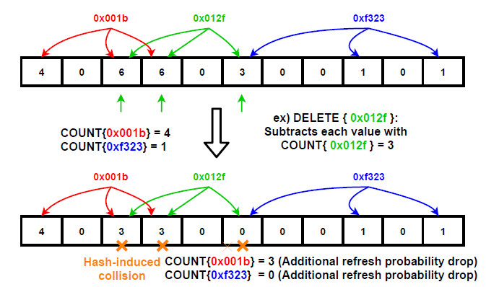
Why HALF-DELETE?
DELETE: subtracts each value in the hashed positions by COUNT value
Impact on other accessed rows’ COUNT value
- Hash-induced collision occurs
DELETE Operation

Slide 16
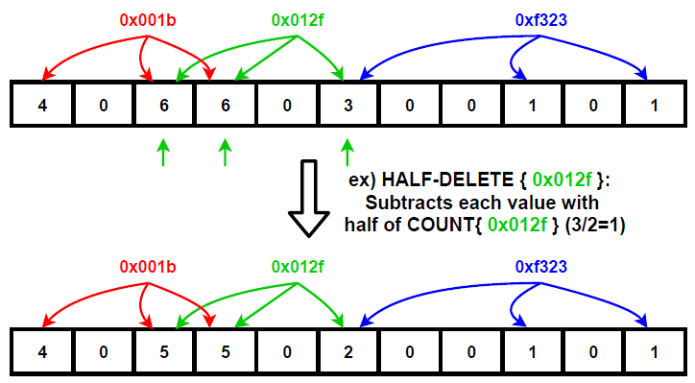
Why HALF-DELETE?
HALF-DELETE: subtracts each value in the hashed positions by one-half of the COUNT value
Avoid a hash-induced collision
COUNT{0x001b} = 4
COUNT{0xf323} = 1
COUNT{0x001b} = 4
COUNT{0xf323} = 1
HALF-DELETE Operation

Slide 17
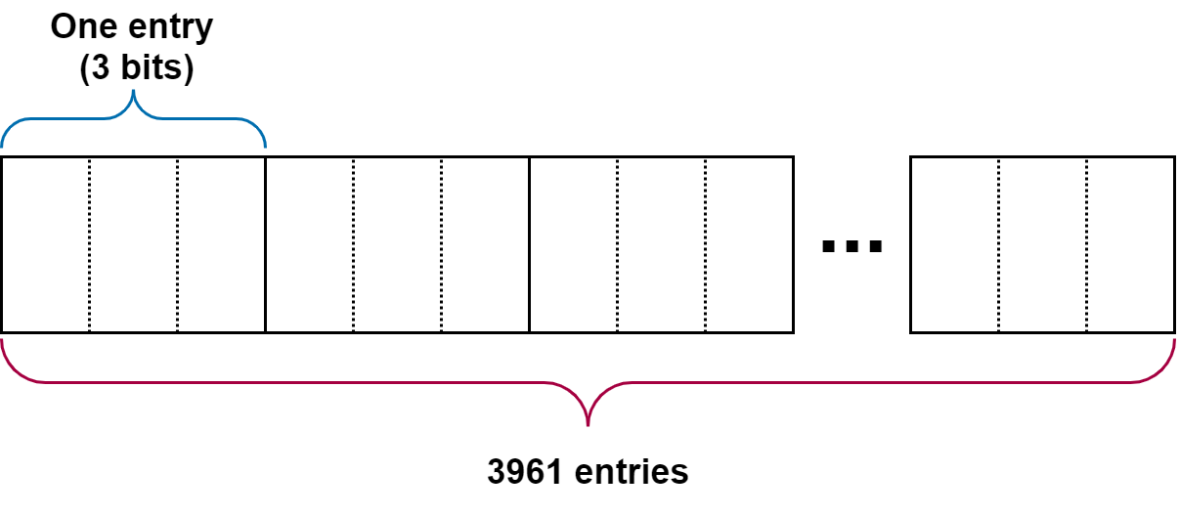
HammerFilter Implementation
CounterTable: stores access frequency of each rows
Hash Unit: hashes the row address to k bits; then, each bit is assigned to CounterTable’s indices
Insert Logic: updates aggressor row candidates with a certain probability
Delete Logic: reduces aggressor row candidate’s value when additional refresh is done
Count Logic: provides the extent of danger of accessed rows to the Refresh Logic

Slide 18
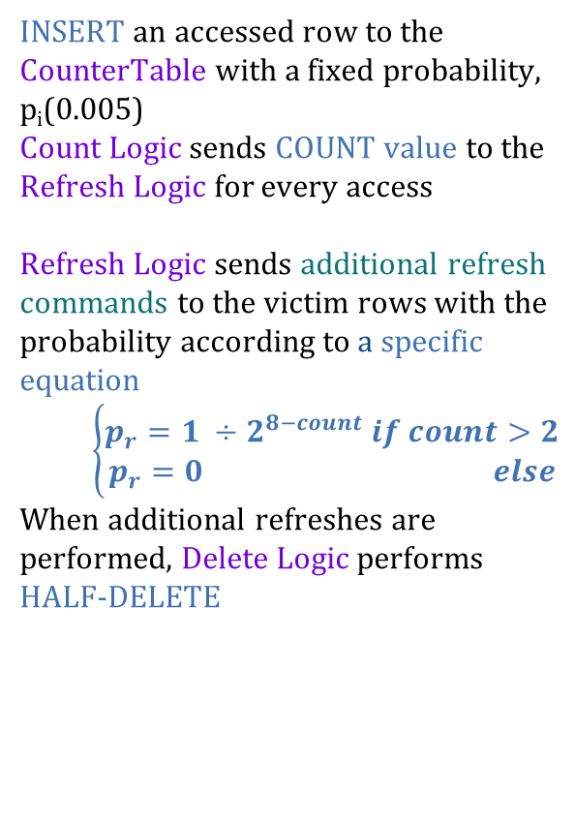
HammerFilter’s Operation
INSERT an accessed row to the CounterTable with a fixed probability, p_{i}(0.005)
Count Logic sends COUNT value to the Refresh Logic for every access
Refresh Logic sends additional refresh commands to the victim rows with the probability according to a specific equation
$$\left\{\begin{aligned}p_{r}=1 ÷2^{8−count} if count>2 \\ p_{r}=0 else\end{aligned}\right.$$
When additional refreshes are performed, Delete Logic performs HALF-DELETE

Slide 19
Background
Existing Solutions
Motivation & Goal
HammerFilter
Experimental Methodology
Evaluation
Conclusion

Slide 20
Experimental Methodology
Simulator
DRAMSim2 (open-source DRAM simulator) integrated with gem5
Processor
8 cores, 2 GHz, 8-wide issue, 7 MSHRs/core, OoO 192-entry instruction window
Last-Level Cache
4 MB shared 64 B cacheline, 8-way associative
Memory Controller
FR-FCFS, 54-entry request queue
Main Memory
32 Gb device, x8 DDR4-3200, 1 channel, 1 rank, 16banks/rank, 64 K rows/bank, 1 KB page, 4K RH threshold

Slide 21
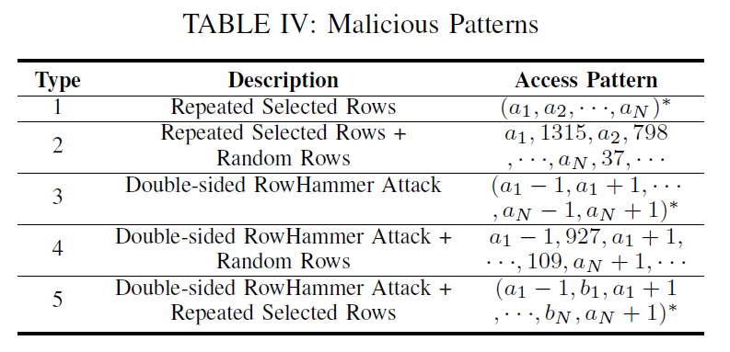
Experimental Methodology
Workload
19 benchmarks from SPEC CPU 2006 for benign applications
Five pattern types of malicious attacks

Slide 22
Background
Existing Solutions
Motivation & Goal
HammerFilter
Experimental Methodology
Evaluation
Conclusion

Slide 23
Analysis in Malicious Applications
Protect all
PARA-0.001, MRLoC, PRoHIT cannot reduce RowHammer sufficiently
HammerFilter achieves superior results

Slide 24
Analysis in Benign Applications
1.5%
HammerFilter performs a small number of additional refreshes
(1.5% of basic refreshes on average)

Slide 25
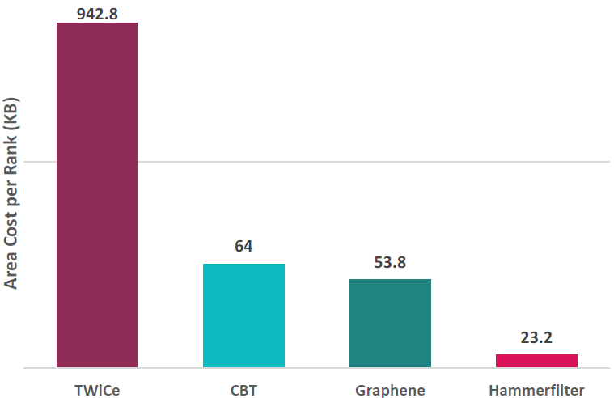


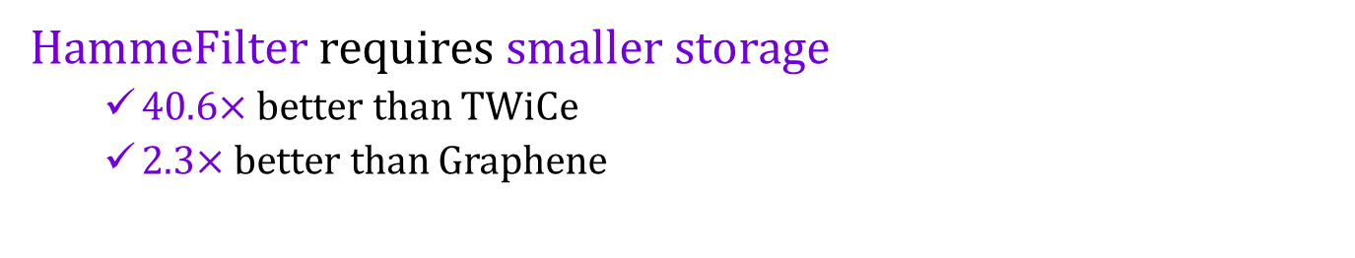
Area Overhead
40.6$×$
2.3$×$
HammeFilter requires smaller storage
40.6$×$ better than TWiCe
2.3$×$ better than Graphene

Slide 26
Background
Existing Solutions
Motivation & Goal
HammerFilter
Experimental Methodology
Evaluation
Conclusion

Slide 27
Conclusion
HammerFilter is a novel method to mitigate RowHammer
Provides robust protection for RowHammer attacks
Has negligible performance overhead
Operates with less area cost compared to previous counter-based methods

