Slide 1

Agile: Lessons Learned & Best Practices
Afshin Chaharmahalian
Jeremy Lerch
Lauren DiCristofario

Slide 2

Purpose
The purpose of this presentation is to provide the audience with a brief overview of the lessons learned for applying Agile Methodologies as they pertain to this course.
4/2/14

Slide 3
Agenda
  Review Lessons Learned
  Best Practices
  Summary
4/2/14

Slide 4
Lessons Learned
Establish Leadership Team & Process Before Development
  Provide vision and strategy for project
Scrum Training
  Ensure all team members understand development process
Early Estimation
  Ensures priority work is developed first & bound to reasonable scope.
Tool Specification
  Provide tools for easy integration and test.
Co-Location
  Allows for better team communication.
4/2/14
Notes:
Talk about why this was the case.
Longer development cycles.
More turnover during longer development cycles.

Slide 5

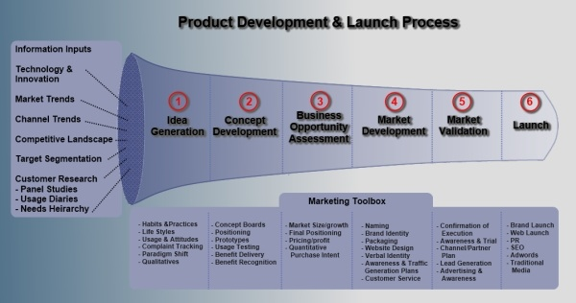
Best Practices
Establish Leadership Team & Process before Development
  Following items should be fleshed out prior to start of development
    Team Organization and Roles
    Product Owner Priorities
    Project Management & Communication Methods
    Configuration Management
    Integration Strategy
    Definition of Done for all Stories
    Evaluation/Grading Criteria
  Legend
    Excellent Effort
    Good Effort
    Needs Improvement
Team can focus on initial research and development ideas while team leadership establishes process details.
4/2/14
Notes:
In February 2001, 17 software developers met at the Snowbird Utah, resort, to discuss lightweight development methods. They published the Manifesto for Agile Software Development to define the approach now known as agile software development.

Slide 6
Best Practices
Scrum Training
  Ensure team is knowledgeable in Scrum terminology.
  More in depth presentation and focus on Scrum methodology.
  Recommend online course or reading material.
Learning how to operate in this framework provides a competitive advantage.
4/2/14
Notes:
In February 2001, 17 software developers met at the Snowbird Utah, resort, to discuss lightweight development methods. They published the Manifesto for Agile Software Development to define the approach now known as agile software development.

Slide 7
Best Practices
Early Estimation
  Scrum relies on sprint planning before every sprint.
  Conduct sprint planning prior to start of development.
Ensures work scope does not grow too large.
4/2/14
Notes:
In February 2001, 17 software developers met at the Snowbird Utah, resort, to discuss lightweight development methods. They published the Manifesto for Agile Software Development to define the approach now known as agile software development.

Slide 8
Best Practices
Tool Specification
  Specify tools prior to development:
    Program Management (JazzHub)
    Configuration Management (Smartgit)
    Testing (Selenium)
Early tool specification allows for streamlined development.
4/2/14
Notes:
In February 2001, 17 software developers met at the Snowbird Utah, resort, to discuss lightweight development methods. They published the Manifesto for Agile Software Development to define the approach now known as agile software development.

Slide 9
Best Practices
Co-Location
  Scrum requires co-location in order to be successful.
  This is challenging in class environment.
  Hold brief retrospectives for classes within a sprint.
  Recommend tools like Piazza for team communication.
4/2/14
Notes:
In February 2001, 17 software developers met at the Snowbird Utah, resort, to discuss lightweight development methods. They published the Manifesto for Agile Software Development to define the approach now known as agile software development.

Slide 10
Summary
Goal of class is to apply software engineering principles:
  Develop software efficiently
  Develop software of high quality
Good Effort on overall program management & establishing early configuration management and integration strategy.
More time needs to be spent upfront on establishing the finer details of the development process.
4/2/14
Notes:
In February 2001, 17 software developers met at the Snowbird Utah, resort, to discuss lightweight development methods. They published the Manifesto for Agile Software Development to define the approach now known as agile software development.

