Slide 1

Agile Development: The Scrum Framework
Afshin Chaharmahalian

Slide 2
Purpose
The purpose of this presentation is to provide the audience with a brief overview of Agile Principles and the SCRUM development framework.
1/11/14

Slide 3
Agenda
  Software Development Methods
  What is Agile?
  SCRUM
  SCRUM Roles
  SCRUM Meetings
  SCRUM Artifacts
  Summary
1/11/14

Slide 4
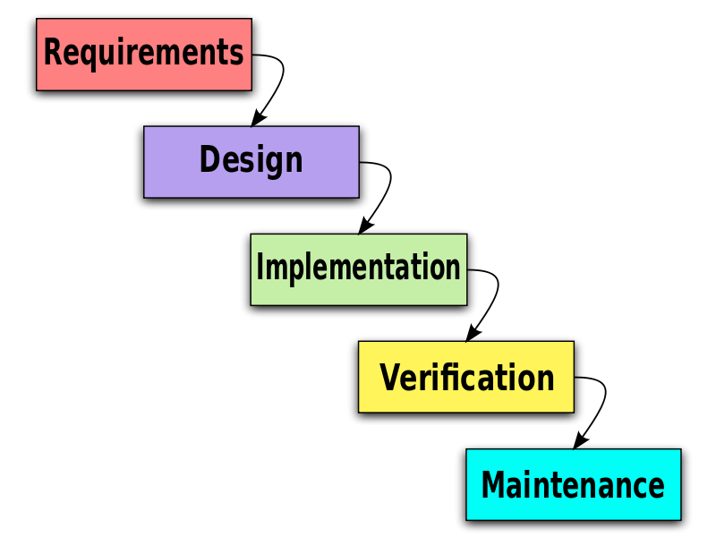
Software Development Methods
Waterfall development characterized by discrete hand off points
  Long lead time to implementation (Months-Years)
  Requirements are constantly changing
  Less funding for requirements and design.
As software complexity grows a more dynamic development process is needed.
1/11/14
Notes:
Talk about why this was the case.
Longer development cycles.
More turnover during longer development cycles.

Slide 5
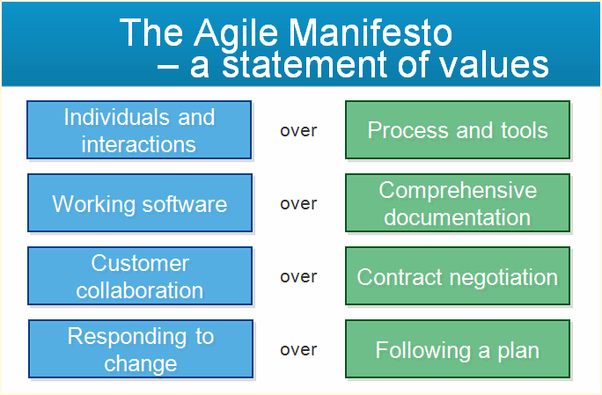
What is Agile?
Software Development Methods that promote iterative and incremental development.
  Build smaller pieces of working functionality.
  Highest priority delivered to user first
  Timeboxed development periods
  (2-4 weeks)
  Manageable integration sizes
Agile processes have proven to develop software with higher quality, while providing an empowering environment for its developers.
1/11/14
Notes:
In February 2001, 17 software developers met at the Snowbird Utah, resort, to discuss lightweight development methods. They published the Manifesto for Agile Software Development to define the approach now known as agile software development.

Slide 6
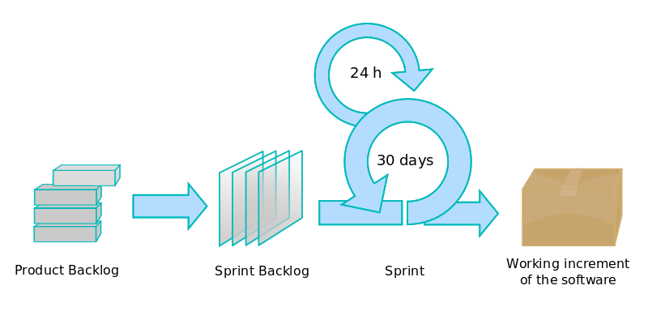
Scrum
Scrum is an iterative and incremental development framework
  Divide end product into features (stories) with associated tasks.
  Includes multiple phases of life cycle development for software increments.
Scrum Team is responsible for determining how much work is done in each Sprint timebox.
1/11/14
Notes:
Mention Scrum: Raytheon approved.
Dissect the process. Product Backlog/Sprint Backlog/Delivered software.
Plan Do Check Adjust.

Slide 7
Scrum Roles
Scrum Roles
Role | Responsibility
Product Owner | Communicates the vision for the final product. Owns the product backlog.
Scrum Master | Facilitates the Scrum framework. Assists in generating the product and sprint backlogs.
The Team | Group responsible for completing assigned work within a sprint.
Three main roles used in Scrum.
1/11/14
Notes:
Talk about the Sprint Planning Meetings here.
Sprint Planning 1 between PO and SM to determine which high priority items to be developed.
Sprint Planning 2 between SM and team to determine how to develop agreed upon features.

Slide 8
Scrum Meetings
Role | Responsibility
Release Planning | Product Owner and ScrumMaster develop top level schedule for delivery of features.
Sprint Planning 1 | Product Owner and ScrumMaster develop prioritized list of stories remaining to be developed.
Sprint Planning 2 | The team determines which stories are to be developed based on priority and generates tasks for them.
Daily Standup | Daily 15 minute meeting that focuses on 3 questions only! What did you do yesterday? What are you planning to do today? What is preventing you from completing your work?
Meetings provide constant guidance and communication for team members.
1/11/14
Notes:
Talk about the Sprint Planning Meetings here.
Sprint Planning 1 between PO and SM to determine which high priority items to be developed.
Sprint Planning 2 between SM and team to determine how to develop agreed upon features.

Slide 9
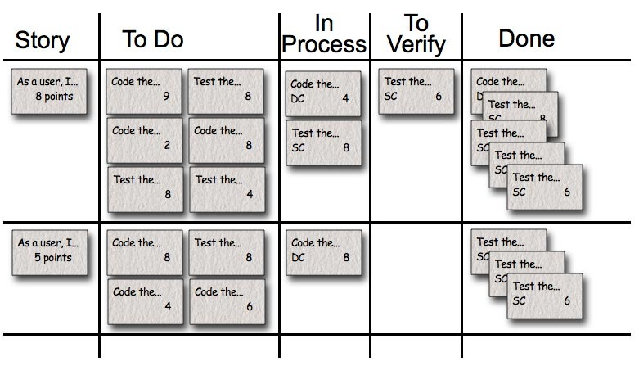
Scrum Artifacts: Example Backlog/Task Board
Backlog & Taskboard allow team to identify tasks for completion of a feature.
1/11/14
Notes:
Disect the taskboard.
Here are stories (high level features) with a degree of difficulty (points).
Here are the tasks for each story that need to be completed in order to determine whether or not its done.
Team can actually see the types of tasks that are holding stories up. Can lead to members of the team wanting to take on similar tasks because they are better at it.

Slide 10
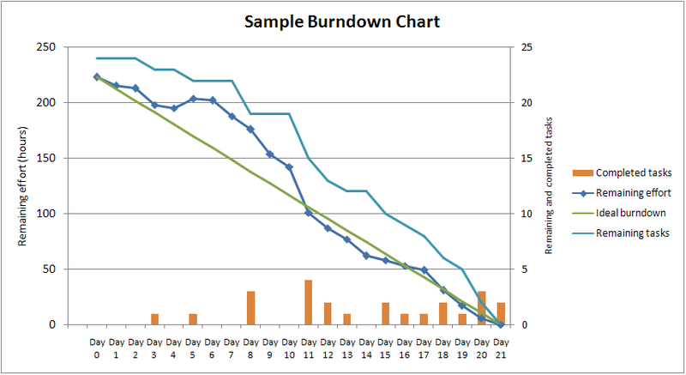
Scrum Artifact: Sprint Burndown Chart
Sprint Burndown provides team with a tool to measure progress.
1/11/14
Notes:
Disect the burndown chart.
Line for tasks that are completed.
Line for the ideal burndown to complete work in sprint.
Line for what is actually remaining.

Slide 11
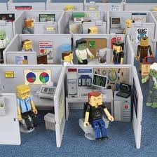
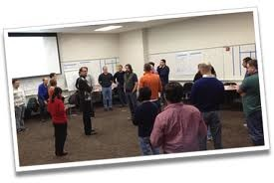
Summary
Why is this important?
Development team has several characteristics
  Produce good work
  Require constant direction (hard time moving forward)
  Dis-integrated
  Uninspired
Great (not good) teams have 3 characteristics
  Autonomous
  Completely Integrated (Systems, Software, and Test)
  Empowered
Great teams are self reliant, extremely productive and provide a competitive edge.
Questions?
1/11/14

