Slide 1
XMI Alternative Analysis
Sahil Patil / Tom Cashavelly

Slide 2
Purpose
Analysis of extending the Parsing Engine to incorporate additional UML file types besides XMI to support ClubUML functionality

Slide 3
Current Implementation
XML Metadata Interchange (XMI)
Specification for UML exchange
Object Management Group standard: Very Mature
System-to-System
Utilized by over 20 tools: ArgoUML, astah, ATL, BOUML, Eclipse UML Tools, Enterprise Architect, GenMyModel, MagicDraw, Modelio, Objecteering, objectiF, Papyrus, PowerDesigner, Prosa UML Modeller, Rational Rhapsody, Rational Software Architect, StarUML, Umbrello, UModel, and more…
ClubUML
Java SAX Parser: Imports XMI into a Custom XMI Java Object
XMI Java Object: Comparing/Merging

Slide 4
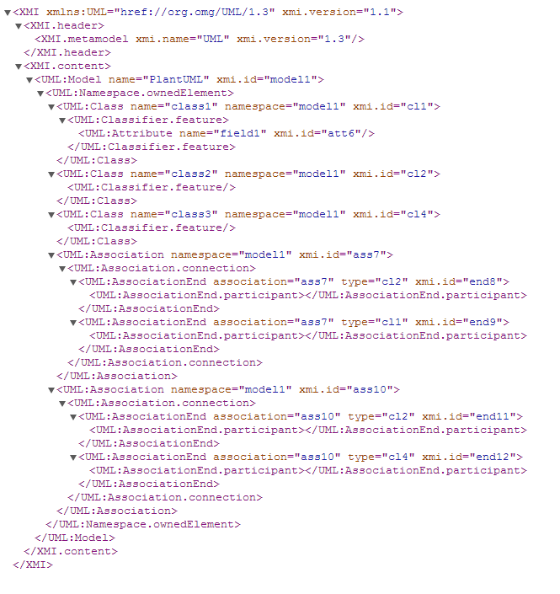
XMI Sample

Slide 5
Possible Additional Formats
UML eXchange Format (UXF)
XML Based
Only used in application: UMLet
Open Source Java XMI Library:
http://www.sdmetrics.com/javadoc/com/sdmetrics/model/package-summary.html

Slide 6
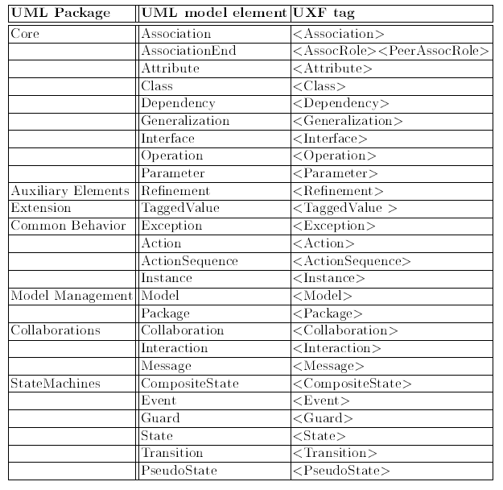
UXF Tagging

Slide 7
UXF Level of Effort
Develop Parser
XML Importer : JAXP for SAX/DOM
Read UXF from local file system/server
Develop Translators (Decouple Merge Engines)
Translate to and from XMI format
Allow comparing and merging
Reduces the amount to code additional comparing/merging engines

Slide 8
Cost Estimate
Develop UXL Parser
Analogy: ClubUML Parser (controller.comparer.xmi)
SLOC: ~2100
Ratio: 100% + 20% Risk → 120%
2625 SLOC / 3 SLOC/HR → 875 Hours + 20% Risk → 1050 Hours
Develop Translators
Analogy: ClubUML Parser (controller.comparer.xmi)
SLOC: ~2100
Ratio: 75% + 20% Risk → 90%
2625 SLOC / 3 SLOC/HR → 875 Hours * 75% → 656.25 + 20% Risk → 787.5 Hours
Total Estimated Effort: 1837.5 Hours
3 Months (170h/m) → 10.8 Developers

Slide 9
Discussions

Slide 10
Backup

Slide 11
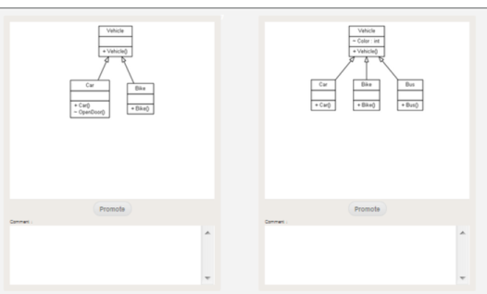




Overview
Features
UML Comparison Management Tool
Support Software Development Projects
Web-based (Thin Client)
UML Comparison
UML Merge
Roles/Permissions
Technical
Processes
Deployment Environment: Browser
IDE: Eclipse
Servers: Tomcat
UI: JavaScript/CSS
Database: mySQL
Agile Development
SCRUM

