Slide 1
Use Case Diagram Team Mid-sprint1
Yang Zheng
Bing Li
Chao Li

Slide 2
Agenda
What we have done last week?
The difficulty we met?
What we need to do next week?

Slide 3
What we have done last week?
We created test UML Diagram by Visual Paradigm and saved it as XMI file.
We try to figure out the structure of XMI file.
We decide to use DOM4j library.

Slide 4
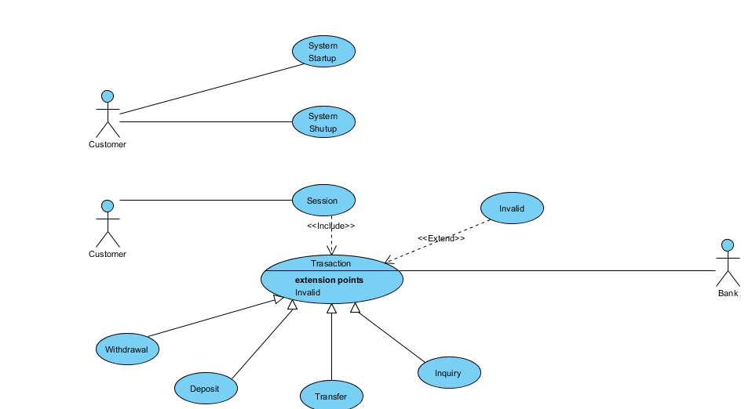

Slide 5
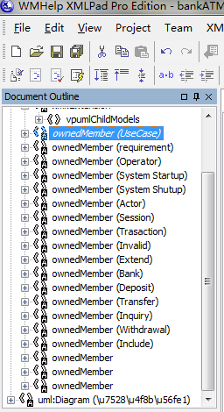
7000 line in XMI file. But current we only need the data from line 5900 to line 6800.

Slide 6
Actor In the XMI file:
<ownedMember isAbstract="false" isLeaf="false" name="Customer" visibility="public" xmi:id="1cC2q8KGAqBwAQUw" xmi:type="uml:Actor">
<xmi:Extension extender="Visual Paradigm for UML">
<isRoot xmi:value="false"/>
<businessModel xmi:value="false"/>
<actorId xmi:value="AC01"/>
<qualityScore value="92"/>
<qualityReason value="1&#9;1&#10;2&#9;2"/>
</xmi:Extension>
</ownedMember>

Slide 7
Use Case In XMI file:
<ownedMember isAbstract="false" isLeaf="false" name="System Startup" xmi:id="AY22q8KGAqBwAQVG" xmi:type="uml:UseCase">
<xmi:Extension extender="Visual Paradigm for UML">
<isRoot xmi:value="false"/>
<justification xmi:value=""/>
<businessModel xmi:value="false"/>
<useCaseId xmi:value="UC01"/>
<qualityScore value="92"/>
<qualityReason value="1&#9;1&#10;2&#9;2"/>
<appliedStereotype xmi:value="UseCase_UseCase_id"/>
</ownedMember>

Slide 8
Association In XMI File:
<ownedMember isAbstract="false" isDerived="false" isLeaf="false" name="" xmi:id=".YR2q8KGAqBwAQWH" xmi:type="uml:Association">
<memberEnd xmi:idref="ZYR2q8KGAqBwAQWJ"/>
<ownedEnd aggregation="none" association=".YR2q8KGAqBwAQWH" isDerived="false" isNavigable="true" name="" type="1cC2q8KGAqBwAQUw" xmi:id="ZYR2q8KGAqBwAQWJ" xmi:type="uml:Property">

Slide 9
The difficulty we met?
1. Different UML tool create different XMI file(Different tags and structure).
2. Can’t find the actor and use case in association tag in Visual Paradigm.(We can found easily in ArgoUML tool.)

Slide 10
What we need to do next week?
1. Resolve the issue listed above.
2 . Implement XMI parser by DOM4j.

