Slide 1

Mitron Bank Analysis
Presented by: Limesh Mahial

Slide 2
Problem Statement
Problem Statement
Actions Expected
Digits and Dreams Analytics, a leading data analytics firm, has the opportunity to collaborate with Mitron Bank, a legacy financial institution based in Mumbai. Mitron Bank plans to introduce a new line of credit cards to expand its financial market footprint and diversify its product offerings.
To evaluate the potential of this partnership, Mitron Bank’s Strategic Director has provided a sample dataset of 4,000 customers across five cities, detailing their online spending and related financial behaviors, as part of a pilot project.
As the lead data analyst, your role is to analyze the provided data and generate actionable insights. These insights will help Mitron Bank tailor its credit card offerings to customer needs and market trends.
The success of this pilot project, and securing the full partnership, depends on delivering impactful recommendations that address customer behavior, preferences, and growth opportunities.
Analyze customer spending patterns and demographics across the provided dataset to identify key trends and opportunities.
Generate actionable insights that align with customer needs and market demands for tailored credit card offerings.
Develop data-backed recommendations to support Mitron Bank’s strategic goals and enhance customer engagement.
Outcome Goals
Deliver a comprehensive and impactful pilot report to impress Mitron Bank’s strategy team.
Secure the full-scale credit card project for Digits and Dreams Analytics.

Slide 3
Mumbai Leads, Hyderabad Shows Potential; Business Owners Earn Most, IT Employees Dominate.
Average Income & Count of Customers by City and Occupation
Key Highlights
occupation | Total Customers | Average Income
Salaried IT Employees | 1,294 | ₹ 61.5k
Salaried Other Employees | 893 | ₹ 38.8k
Freelancers | 784 | ₹ 35.1k
Business Owners | 630 | ₹ 70.1k
Government Employees | 399 | ₹ 52.0k
Grand Total | 4,000 | ₹ 51.7k
Mumbai leads with the largest customer base (1,078), while Hyderabad has the smallest (593), indicating growth potential in Hyderabad.
Business Owners have the highest average income (₹70.4k in Bengaluru), while Freelancers consistently earn the least (₹34.4k–₹35.5k).
Salaried IT Employees dominate across all cities, with a significant presence in Mumbai (364) and Chennai (257).
Presented By: Limesh Mahial

Slide 4
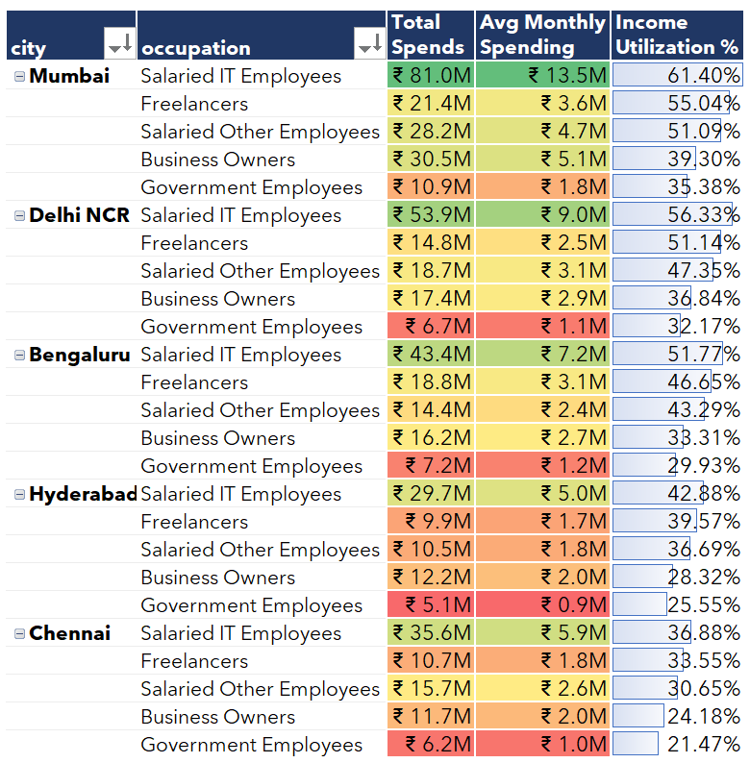
Mumbai IT Employees Lead Spending, Government Employees Show Lowest Utilization
Customer Spending and Income Utilization Patterns
Key Highlights
Salaried IT Employees in Mumbai have the highest spending (₹81.0M) and income utilization (61.40%).
Government Employees in Chennai show the lowest income utilization (21.47%).
Mumbai and Delhi NCR dominate spending and utilization across occupations.
Government Employees consistently show low spending and utilization
Presented By: Limesh Mahial

Slide 5
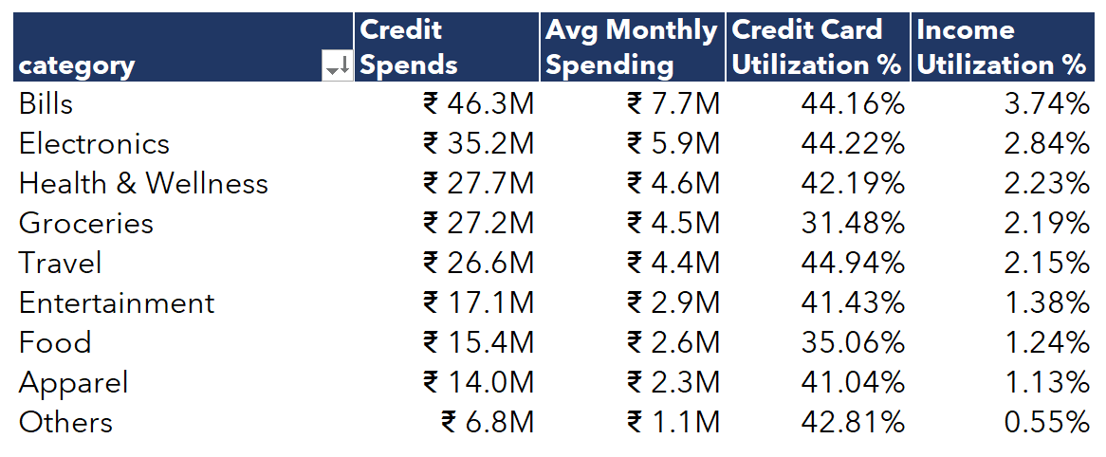
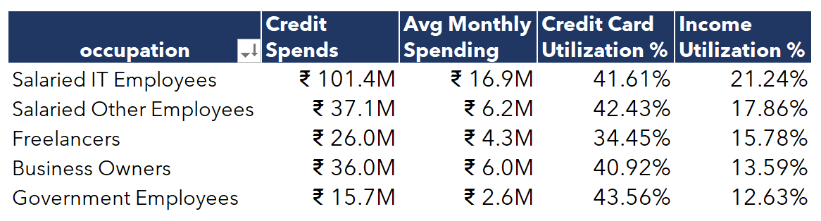
Bills lead spending (₹46.3M). IT Employees dominate spending and utilization, while Government Employees show high credit card preference but low-income utilization.
Spending, Credit Card Utilization, and IU% Analysis by Category and Occupation
Key Highlights
Bills lead in total spending (₹46.3M), Electronics and Travel have similar spending patterns, with a slightly higher credit card utilization (~44%).
Salaried IT Employees have the highest spending (₹101.4M) and income utilization (21.24%).
Government Employees utilize credit cards the most (43.56%) but show low-income utilization (12.63%).
Higher credit card utilization is seen in Bills, Electronics, and Travel categories (around 44%).
Presented By: Limesh Mahial

Slide 6
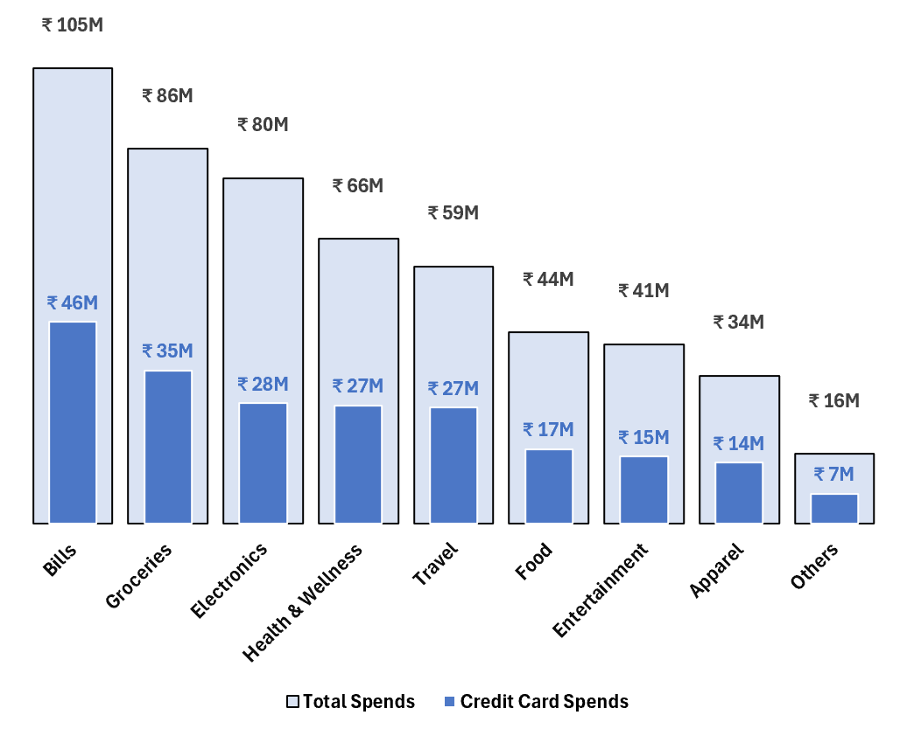
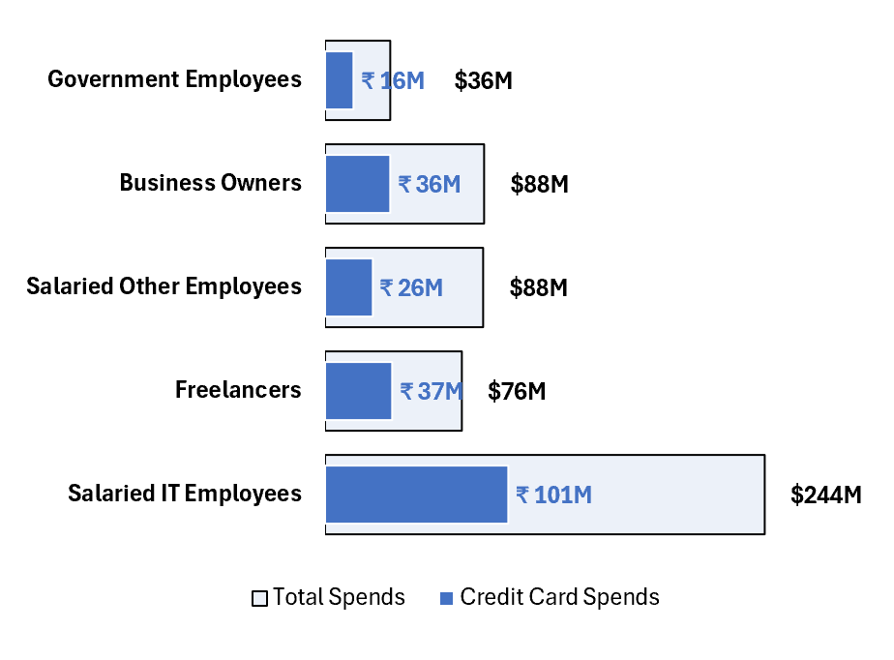
Bills dominate spending (₹46.3M), with significant credit card utilization in Groceries. Salaried IT Employees lead in total spending (₹101M)
Total Spends Vs Credit Card Spends by Categories
Total Spends Vs Credit Card Spends by Occupation
Presented By: Limesh Mahial

Slide 7
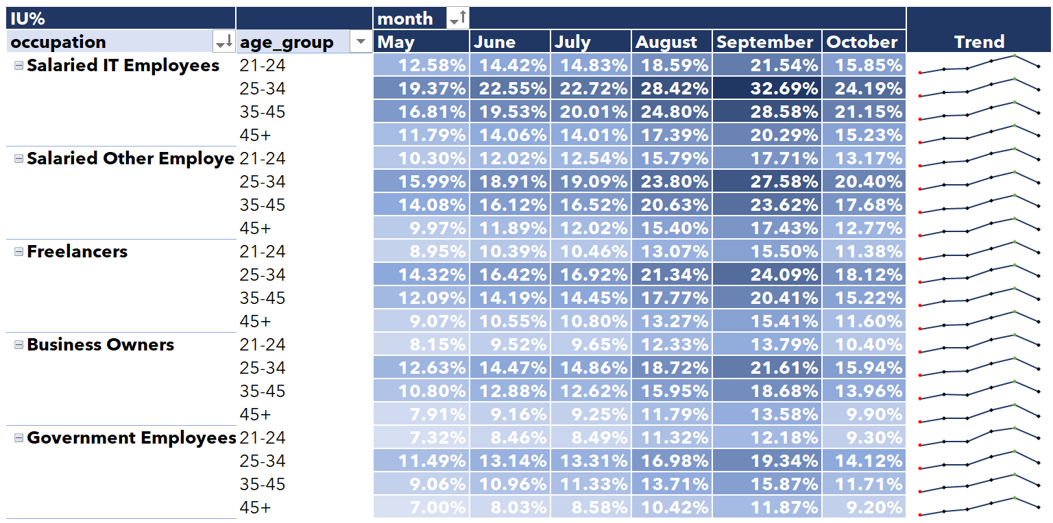
25-34 age group excels in Income Utilization (IU%), with IT Employees peaking in September; Government Employees exhibit the lowest Income Utilization (IU%).
Monthly Income Utilization Trends for Credit Card Payments by Occupation and Age Group
Key Highlights
The 25-34 age group shows the highest income utilization (IU%) across most occupations throughout the months.
Salaried IT Employees have consistently high IU%, especially in the 25-34 and 35-45 age groups, peaking in September.
Government Employees and Business Owners exhibit lower IU%, with Government Employees having the lowest.
Income utilization tends to increase towards September, peaking for most age groups in that month.
Presented By: Limesh Mahial

Slide 8
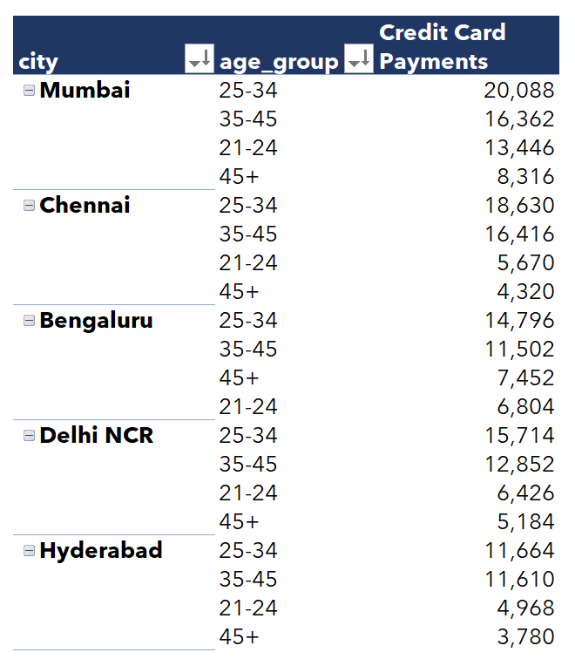
Mumbai and Chennai lead in credit card payments, driven by the 25-34 and 35-45 age groups, with lower activity in Hyderabad and Delhi NCR.
Payment Type Preferences Across Cities and Age Groups
Key Highlights
The 25-34 age group consistently leads in credit card payments across all cities, with the highest count in Mumbai (20,088) followed by Chennai (18,630).
The 35-45 age group shows significant credit card payment activity, with notable counts in Mumbai (16,362) and Chennai (16,416).
Mumbai and Chennai dominate in credit card usage across all age groups, while Hyderabad and Delhi NCR exhibit lower counts, especially among younger and older demographics.
Presented By: Limesh Mahial

Slide 9
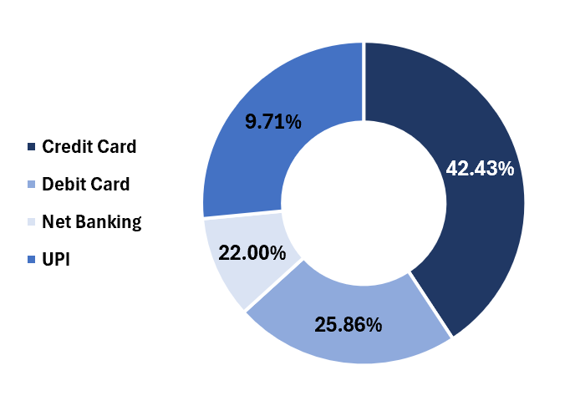
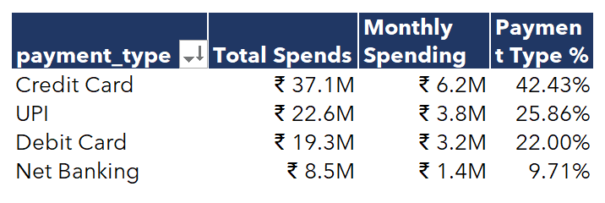
Credit Cards lead spending (42.43%, ₹37.1M), with UPI and Debit Cards trailing; Credit Cards also show the highest monthly usage.
Payment Type Spending Trends and Preferences
Key Highlights
Credit Cards lead in spending, contributing 42.43% (₹37.1M), followed by UPI at 25.86% (₹22.6M).
Debit Cards account for 22% (₹19.3M) of total spending, highlighting their steady usage.
Average monthly spending is highest for Credit Cards (₹6.2M), aligning with their dominant market share.
Presented By: Limesh Mahial

Slide 10
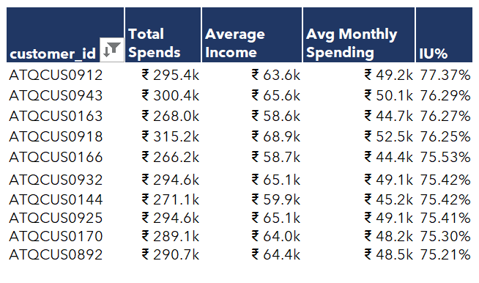
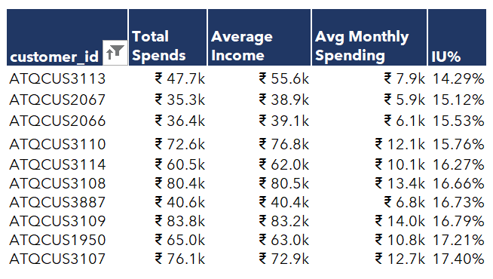
Top customers show significantly higher total spends and income utilization (up to 77%), with monthly spending averaging ₹44.7k–₹52.5k. In contrast, bottom customers have much lower spends and income utilization (as low as 14.29%), with average monthly spending ranging from ₹5.9k to ₹14.0k.
Top 10 Customers
Bottom 10 Customers
Presented By: Limesh Mahial

Slide 11
Key Highlights and Recommendations
Recommendations
Key Insights
Roll out special introductory perks, like zero joining fees and bonus rewards, targeting users in high-usage cities like Mumbai and Chennai.
Offer higher credit limits, loyalty rewards, and tech-focused perks like EMI options for electronic gadgets, targeting Salaried IT Professionals with high spending power.
Introduce a premium credit card tier with lower interest rates on business-related purchases and high reward points for travel to cater to Business Owners.
Highlight security features like fraud protection and insurance benefits for Government Employees, alongside rewards for bill payments and groceries to increase engagement.
Create youth-centric cashback offers for lifestyle expenses like dining, online shopping, and discounts on OTT platform subscriptions to attract the 25-34 age group.
Develop targeted cashback and reward programs for Bills, Electronics, and Travel categories, partnering with airlines, electronics retailers, and travel agencies for exclusive deals.
Collaborate with supermarkets, online grocery platforms, and utility providers to provide cashback deals and reward points for Bills and Grocery purchases, appealing to high-spending segments.
Mumbai and Chennai dominate credit card usage, particularly among the 25-34 and 35-45 age groups.
Salaried IT Employees lead spending with ₹101.4M and show the highest income utilization (21.24%).
Business Owners have higher-than-average spending (₹36M), representing a valuable high-income segment.
Government Employees show high credit card utilization (43.56%) but low-income utilization (12.63%).
The 25-34 age group consistently leads in credit card payments across categories and regions.
Bills, Electronics, and Travel exhibit the highest credit card utilization (~44%).
Bills and Groceries are high-spending categories for many users, especially the younger demographic.
Presented By: Limesh Mahial

Slide 12
Thank You
For further breakdown into additional details and L2-L3 analysis, which may uncover more insights, please explore the full report posted here:
[Insert Link or Location of Full Report]
Feel free to explore and provide your suggestions and recommendations.

