Slide 1
What's Actually on Netflix?
Lucy Dowdle

Slide 2
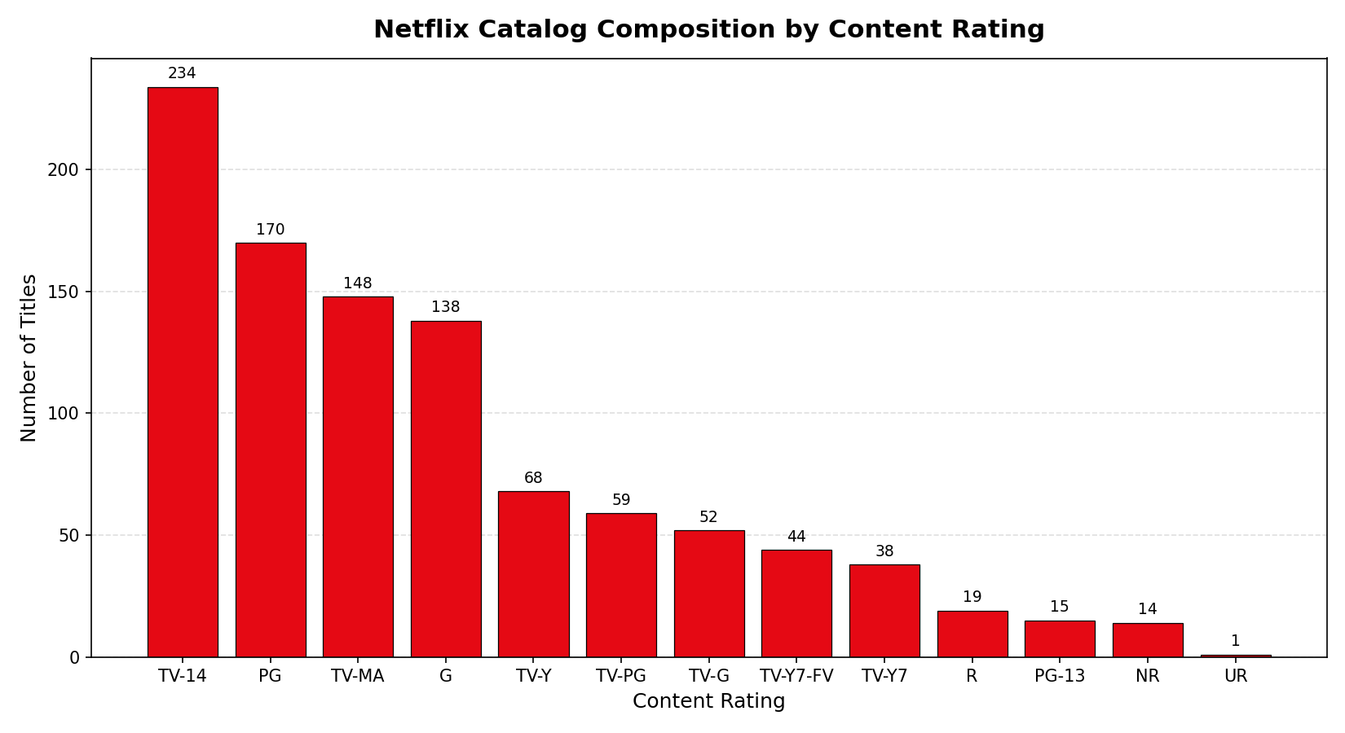
Bar Plot- Family Titles Are Biggest Category
NOTES
Bar plot of title counts across all 13 content ratings, sorted descending.
TV-14 leads (234 titles), but kid/family ratings together cover 569 of 1,000 titles.
Mature content (TV-MA, R, NR) is a clear minority at 18% of the catalog.
Built with ax.bar; counts labeled via ax.annotate.
57%
of the catalog carries a kids/family-friendly rating

Slide 3
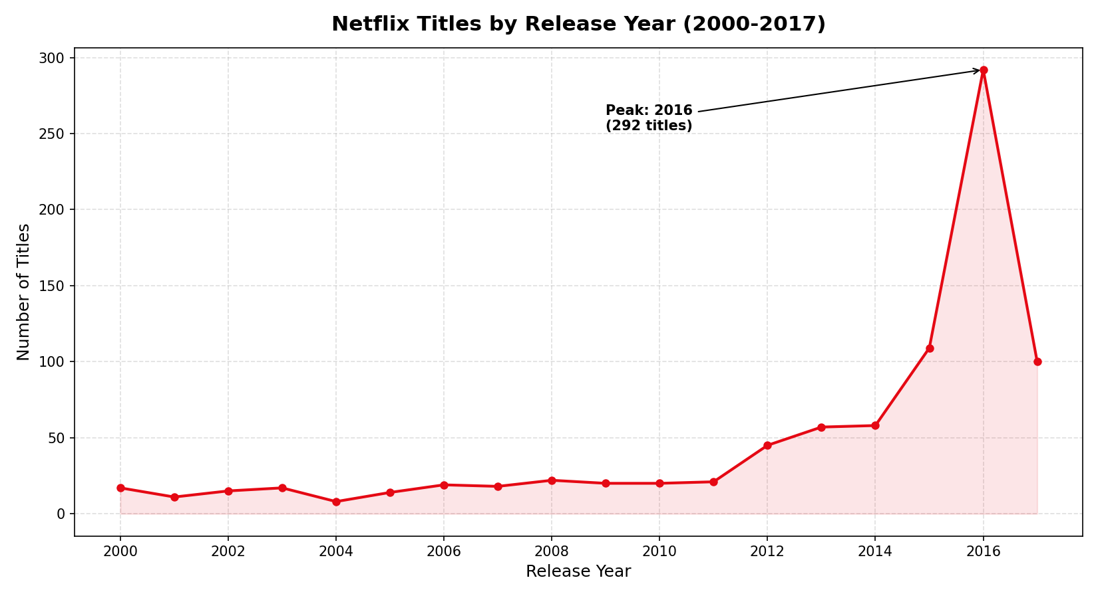
Line Plot- 2016 Was a Busy Year
NOTES
Line plot of titles by release year, 2000–2017, with fill_between() shading under the curve.
Counts stay near 10–20 through 2011, then climb sharply after 2012.
Peak is 2016 with 292 titles, annotated with ax.annotate and an arrow.
Half the catalog was released in 2015–2017.
292
titles from 2016 alone which is more than the years 2000–2011 combined.

Slide 4
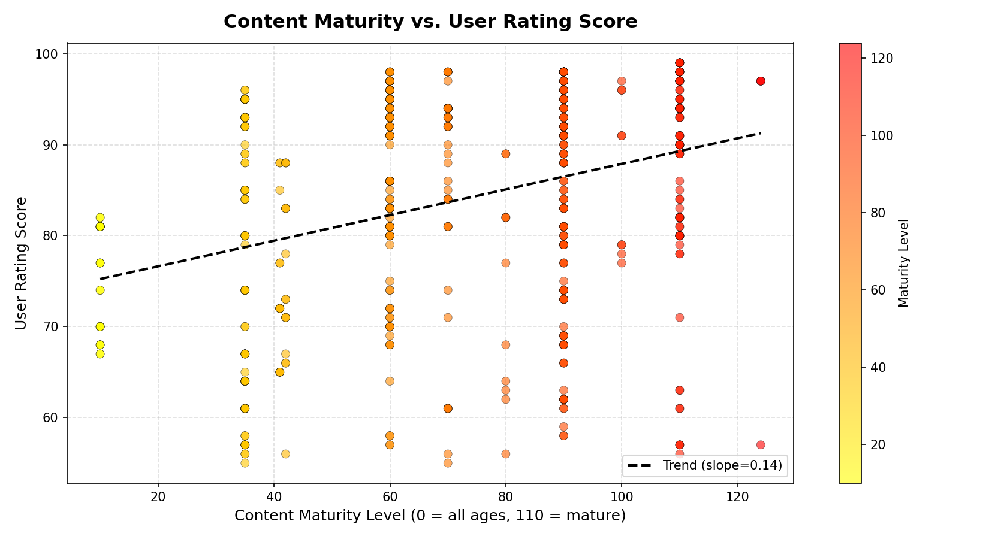
Scatter Plot- Mature Content Rates Are Higher
NOTES
Scatter of maturity level vs. user rating score (605 titles with valid scores).
Points colored by maturity
Least-squares trend line: slope 0.14.
Scores cluster high (mean ≈ 84), but rises with maturity.

Slide 5
Conclusions
1
Netflix was a family platform first. 57% of titles carry kids/family titles.
2
The catalog is newer. Half of all titles were released 2015–2017, peaking at 292 in 2016. Netflix prioritizes recency over a back-catalog.
3
Mature content earns higher scores. User ratings rise with maturity levels showing adult-oriented titles satisfy their audience slightly more.

