Slide 1
MSDS670 · DATA VISUALIZATION
A Decade of Spotify Hits
How the Sound of Popular Music Changed from 2010-2019
Lucy Dowdle

Slide 2
Research Question
How did the audio characteristics of Spotify's most popular songs change over the 2010s, and which musical attributes relate to one another?
01
02
03
Trends over time
Genre dominance
Feature relationship
Did the energy and danceability of top songs rise or fall across the decade?
Which genres produced the most chart-topping songs of the 2010s?
Is a song's loudness associated with how energetic it sounds?

Slide 3
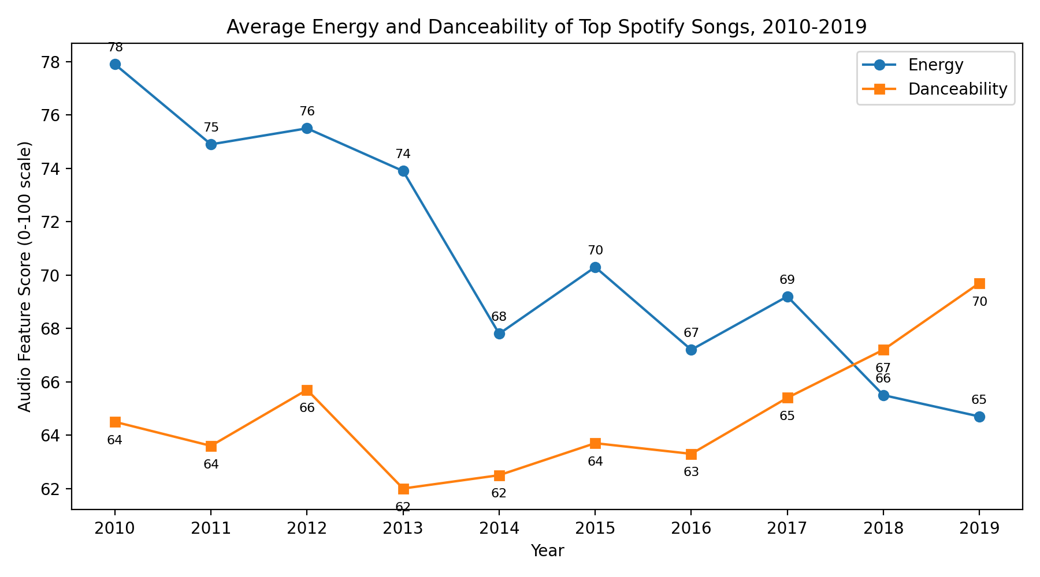
Top Songs Grew Less Energetic, More Danceable
What the data shows
Average energy fell from 78 in 2010 to 65 in 2019, a clear decade-long decline.
Danceability rose over the same period, from 64 to 70, climbing fastest after 2016.
The two lines cross near 2018: showing the change from energy to dance.

Slide 4
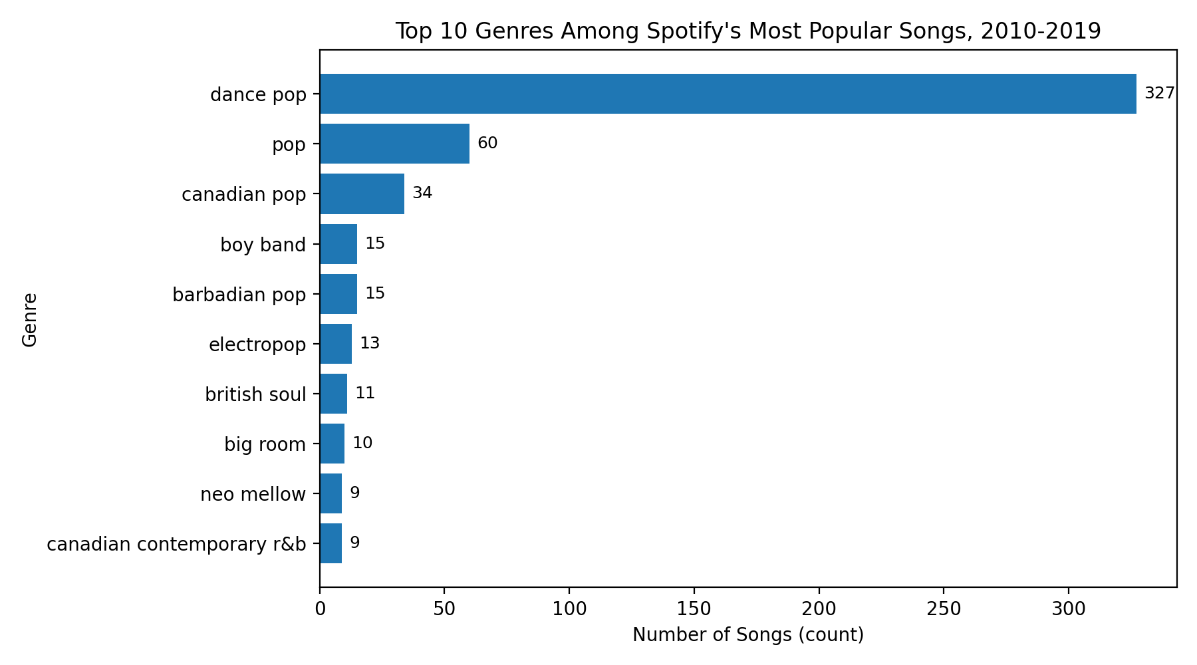
Dance Pop Defined the Decade
What the data shows
Dance pop dominated with 327 of 603 songs, more than half of every top track in the decade.
Plain pop (60) and Canadian pop (34) follow far behind, showing how concentrated the era was.
Pop-derived genres fill nearly the entire top ten.

Slide 5
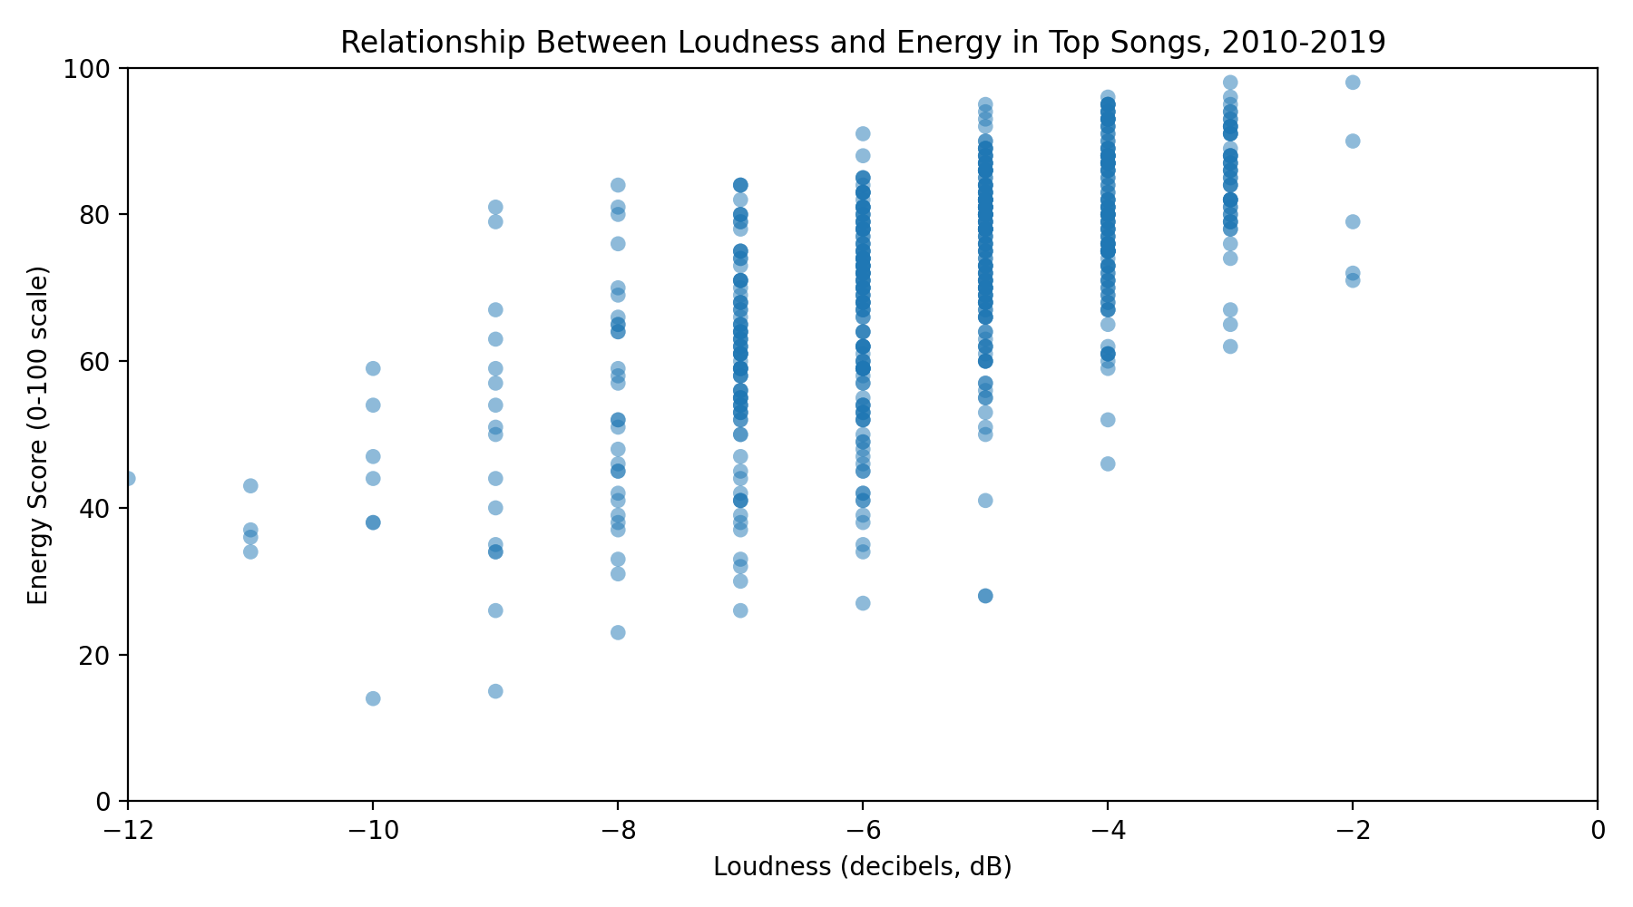
Louder Songs Tend to Be More Energetic
What the data shows
Loudness and energy move together with a moderate positive correlation of 0.64.
The upward trend is consistent but louder is not a guarantee of higher energy.
One impossible record (-60 dB, energy 0) was removed as a data error, strengthening the result.

Slide 6
Conclusions
1
Sound shifted
Top songs traded energy for danceability across the 2010s, the defining audio change of the decade.
2
One genre ruled
Dance pop accounted for over half of all top tracks, a striking concentration of popular taste.
3
Loudness energy
A moderate 0.64 correlation links loudness and energy.

