Slide 1

Prompt
There are three cities vying for a new expansion franchise. Lean into behavioral, transactional, demographic, and psychographic data, at the record level, for each market, to make your case as to which league would be best to expand, which city should be awarded a franchise, and why.
Kansas City
Louisville
Virginia Beach

Slide 2

SSAC 2023 Hackathon
Team Pitch
Lorenzo Dube and Xander Schwartz
The Case for Kansas City Hockey
Notes:
Change KC Hockey?

Slide 3

Notes:
we strongly support the ascension of the KC Mavericks from ECHL AA minor league hockey status to the NHL, With apologies to Mark Cuban for the name infringement

Slide 4
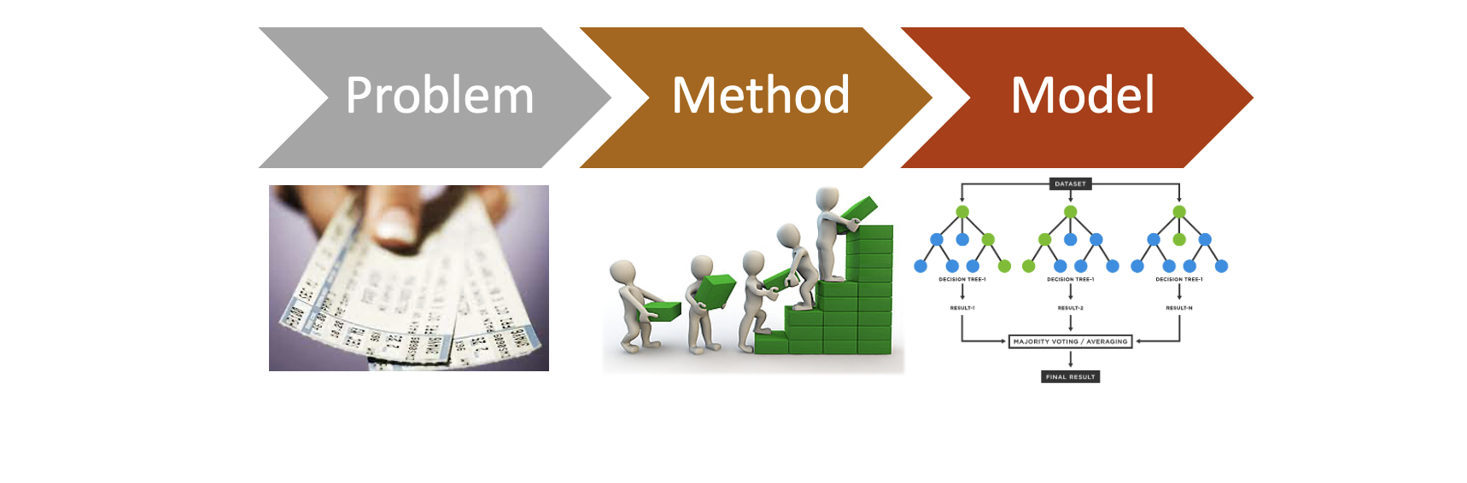
E[Event$] ∼ (FinancialStatus + LifeStage + PrevTixHistory)
Notes:
Problem
Framed the problem of selecting a city and a sport for an expansion franchise using ticket sales
Methodology
Create a micro-behavioral model to apply to a macro setting
Micro - estimate an average event spend per customer, generalized across the three regions to put them all on a level evaluation
Macro - Apply to a population of fans
Modeling
Random Forest modeling - chosen because of prediction robustness and ability to easily handle categorical and continuous data
Prediction - per event ticket spend per customer based on: financial score, ticket buying history – ex. Tickets bought per event, and life stage - ex. Youth to career building with a couple more stops finishing at retirement

Slide 5
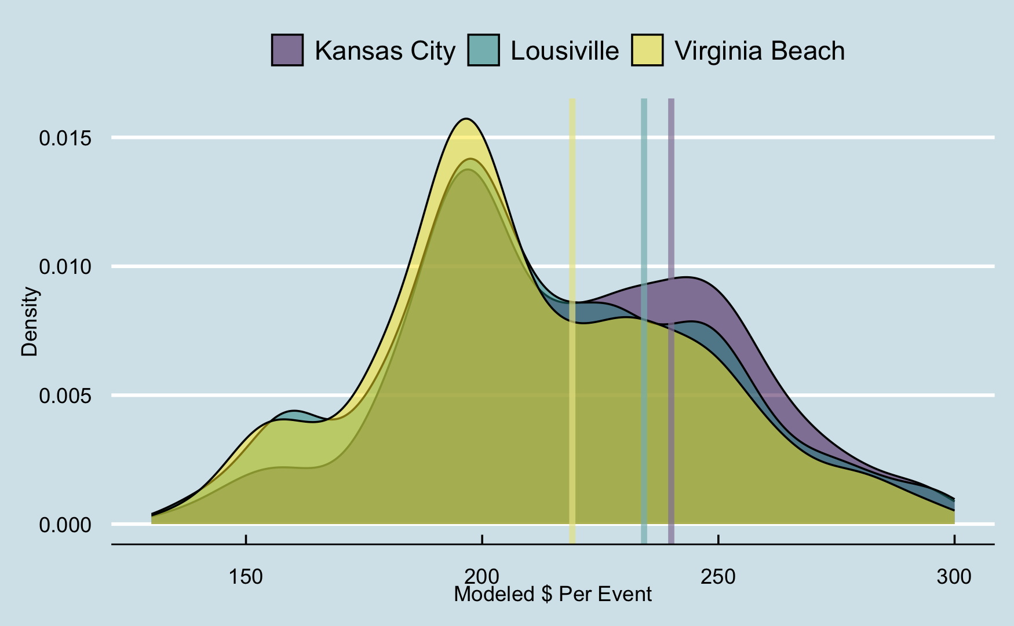
1. Per Event Customer Spend
Notes:
Here is how what we expect the distribution to be by city. Vertical lines are the expected values.
Kansas City had the highest average predicted spend
followed by Louisville which had the highest SD and
VA Beach with had the lowest mean prediction total and SD.
=> VA Beach really doesn’t have a lot of money and the error bars are pretty low relative to KC and LV

Slide 6
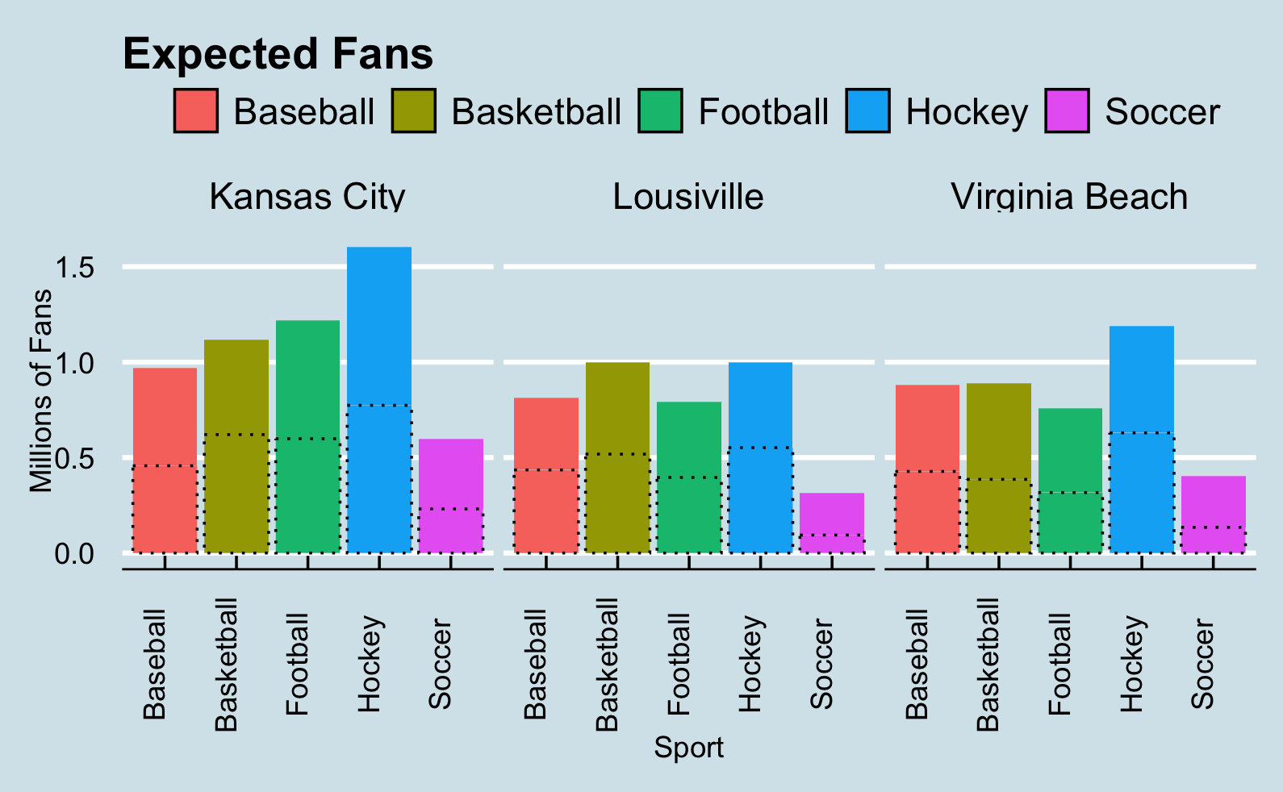
2. Fan Potential By Sport and City
Superfan
Notes:
Give macro setting for micro model to be applied to
Propensity – likelihood to buy tickets scales 1-1000
Evaluating potential fans by upper 50% (~490 score in all regions) of propensity score for each sport in each city and potential “superfans”(indicated as propensity >650 in dataset), indicated by the dotted lines. This gave a population from which to base our micro behavioral model
Superfans are important because they spend more.
Reg fan: $217 Super Fan $263 => 21% increase.

Slide 7
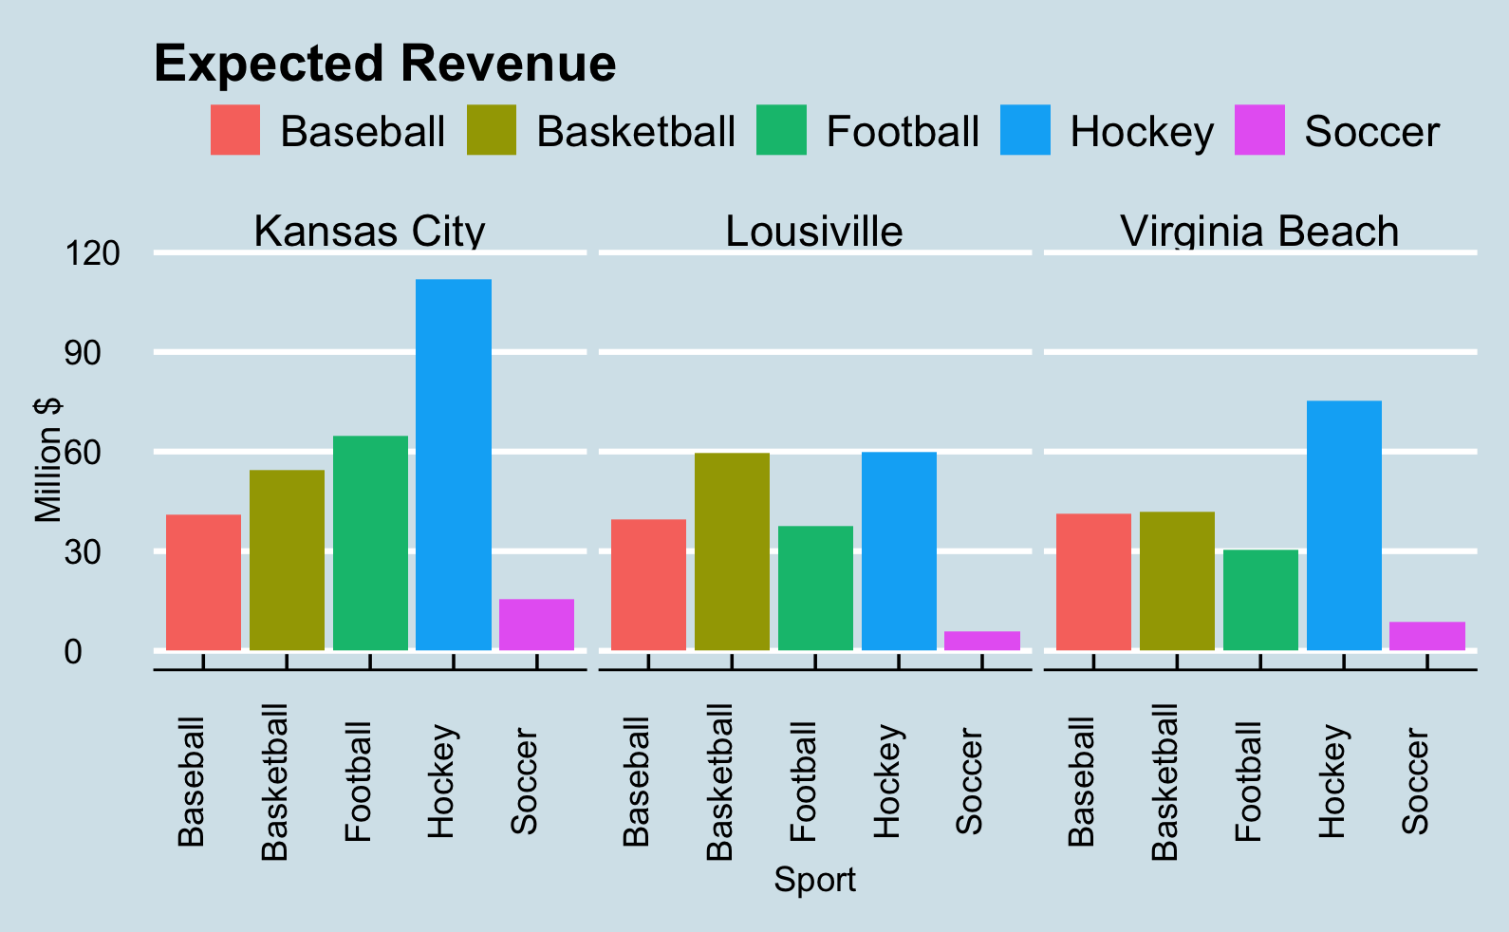
3. Three Year Outlook League Revenue
Notes:
Modeled expected revenue at lower levels and then scaled by ticket purchasing relative to metro area fan population.
36.6% of league revenue comes from ticket sales (NHL)
Blues 131M over 3 year period, but also 27% larger metro population compared to KC– passes sniff test
We were surprised to see hockey as high as it was across the board, but we trust the numbers because each city has a recently successful franchise within 4 hours
Louisville – Nashville Predators
Kansas City – St. Louis Blues
Virginia Beach – Carolina Hurricanes

Slide 8
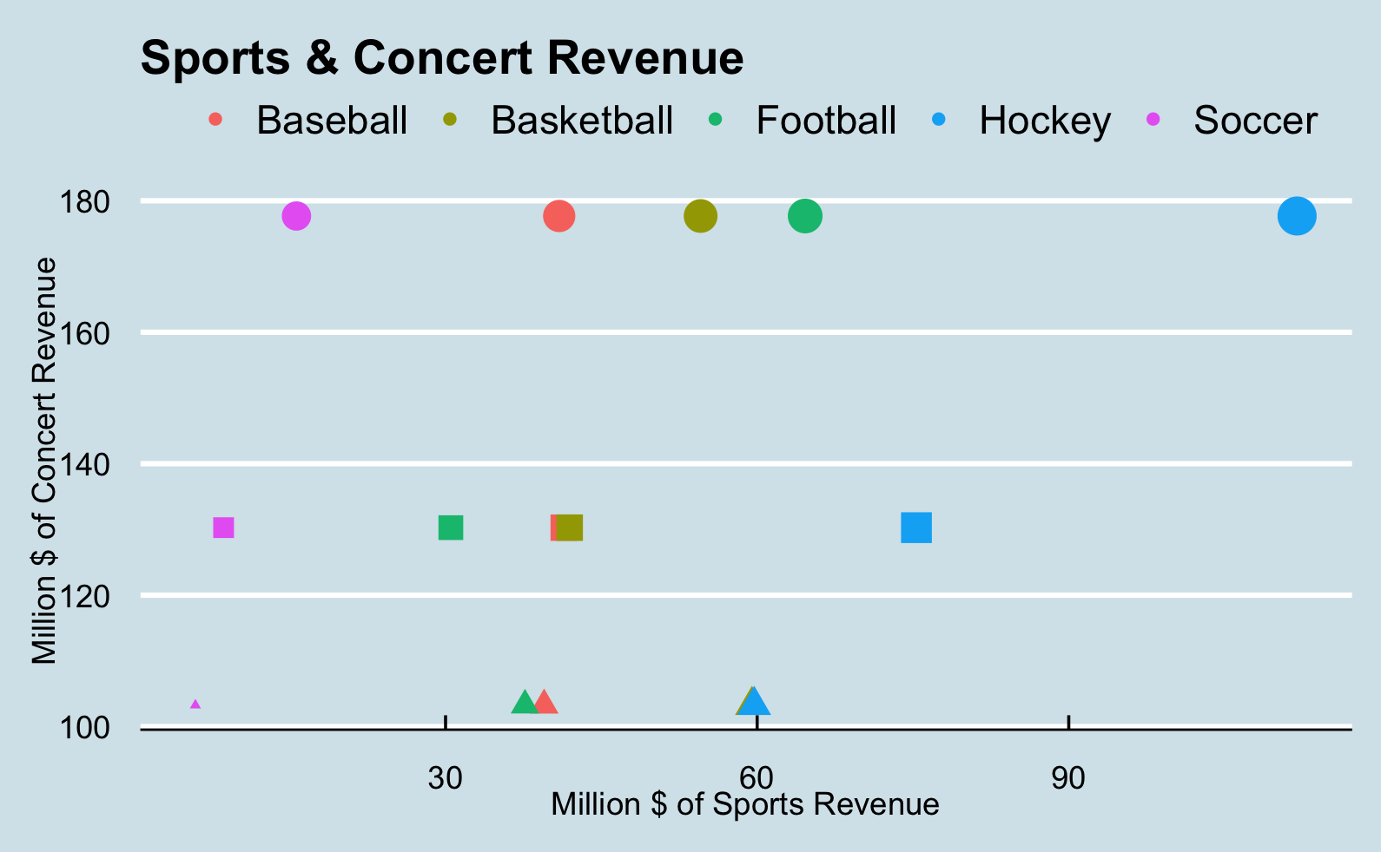
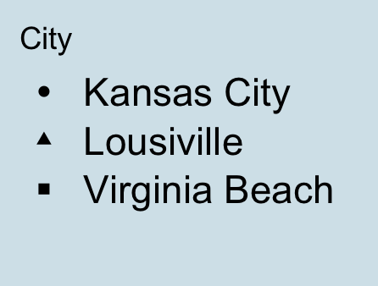
4. Additional Revenue Potential
Notes:
We can see the totals of concert revenue in connection with expected sports revenue. Marker of additional revenue beyond sports tickets. SIZE OF DOT = TOTAL REV
KC > VB > LV
Less precise numbers due to other venue options in each area, but marker of potential. KC could use modern winter home for concerts – if you build it they will come
When NHL comes, NBA follows. Vegas and Seattle - KC with largest potential basketball fanbase of 3

