Slide 1

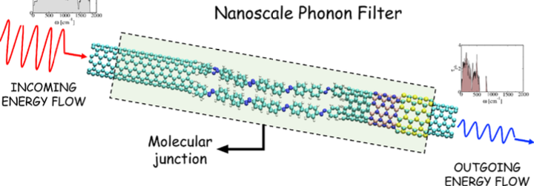
Strain engineering
Grain boundaries
Substrate engineering
Heterostructures
CNT peapods

