Slide 1

PROGRESSIVE – WEB - APPS
Native? More like NEE-tive
Lars Meijdam
&
Marcel Visser

Slide 2
What is a PWA?
Progressive Web Application
Functionality like native apps
  Offline mode
  Push notifications
  Desktop links

Slide 3
Differences between native and PWA
There aren’t many!
PWAs do not require installation
PWAs use the power of web development instead of native code and redeployment
  Browser sandboxing
  CSS
PWAs are generally slower

Slide 4
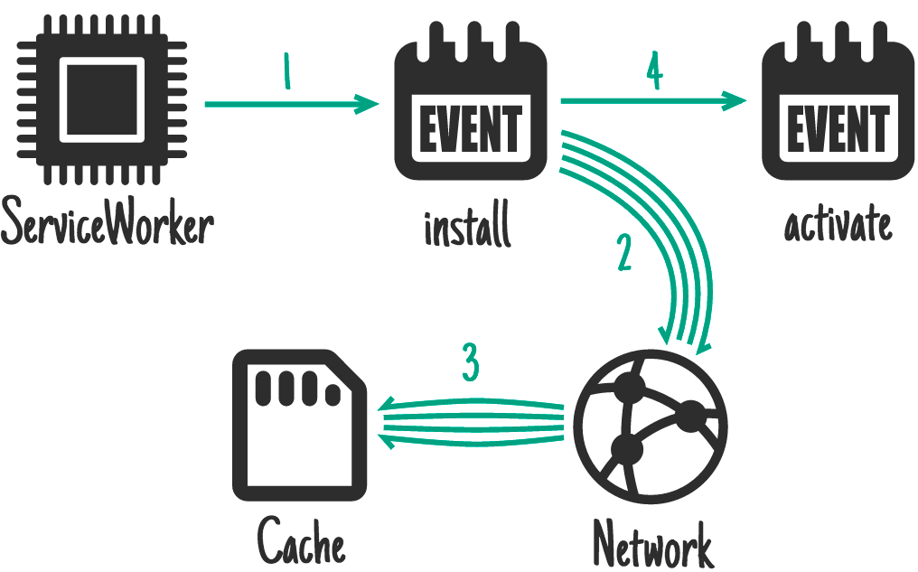
Basic steps to create a PWA
Get acquainted with Service Workers
Courtesy of google.com

Slide 5
Basic steps to create a PWA
Get a service worker running
Run on HTTPS
Ensure all requests return HTTP 200 when offline
Responsive, responsive, responsive.
(more details on the Google checklist)
You now have a baseline PWA!

Slide 6
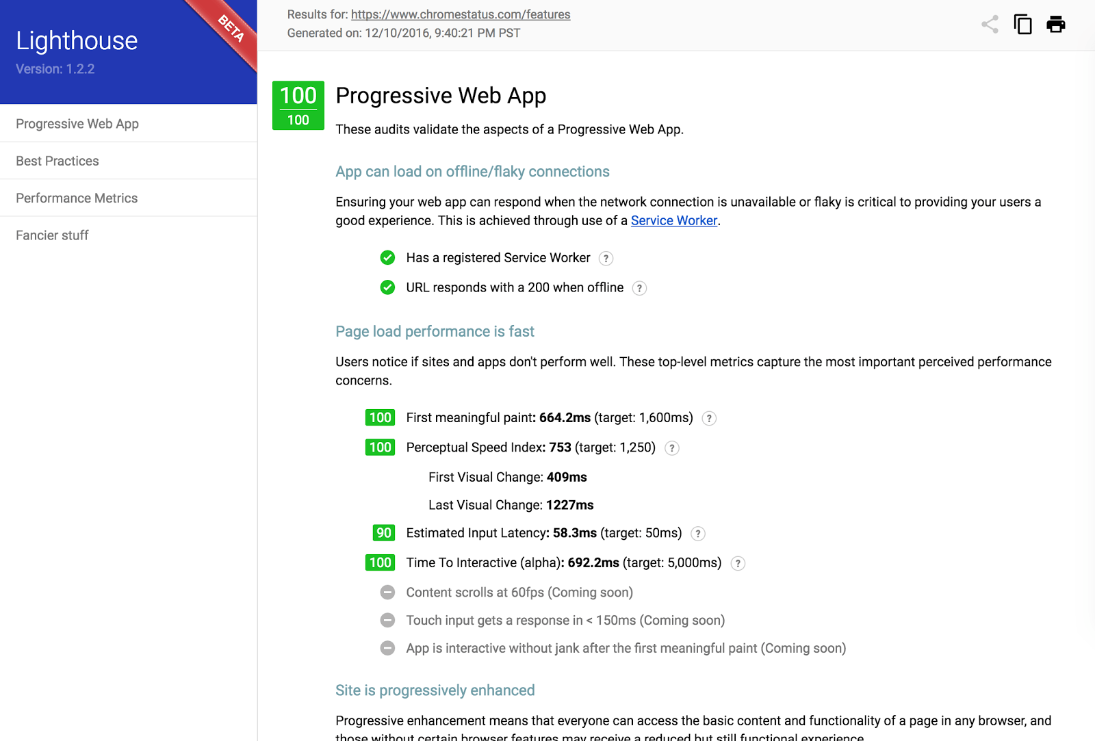
Basic steps to create a PWA
Run a lighthouse audit and fix up the small fry.
Congratulations! Now let’s do it for real.

