Slide 1
Fasting and Stress Eating
Lisa Menghini

Slide 2
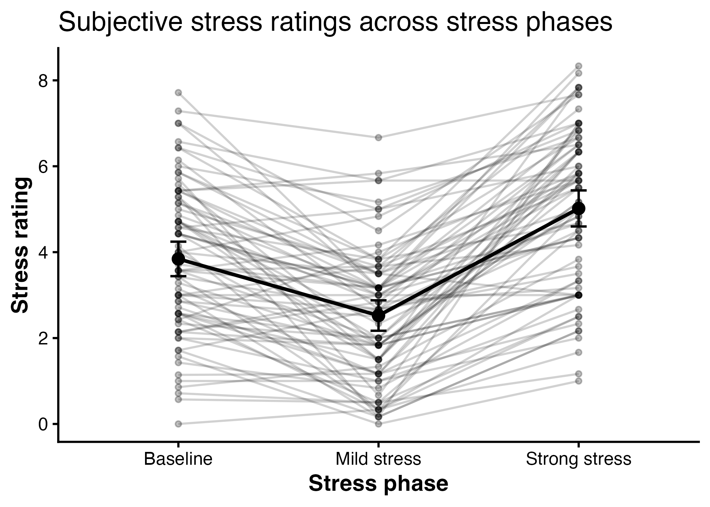
Stress Manipulation Check

Slide 3
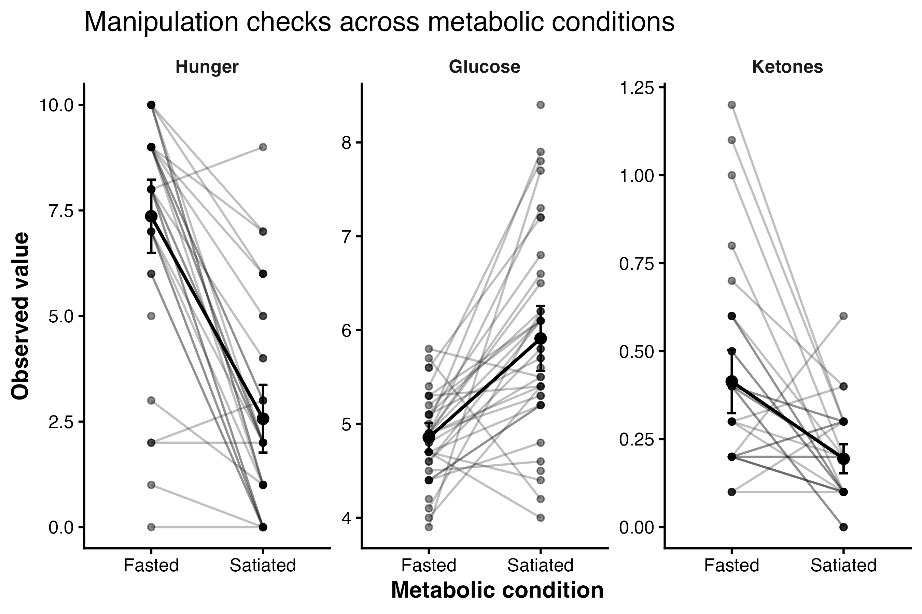
Manipulation Checks

Slide 4
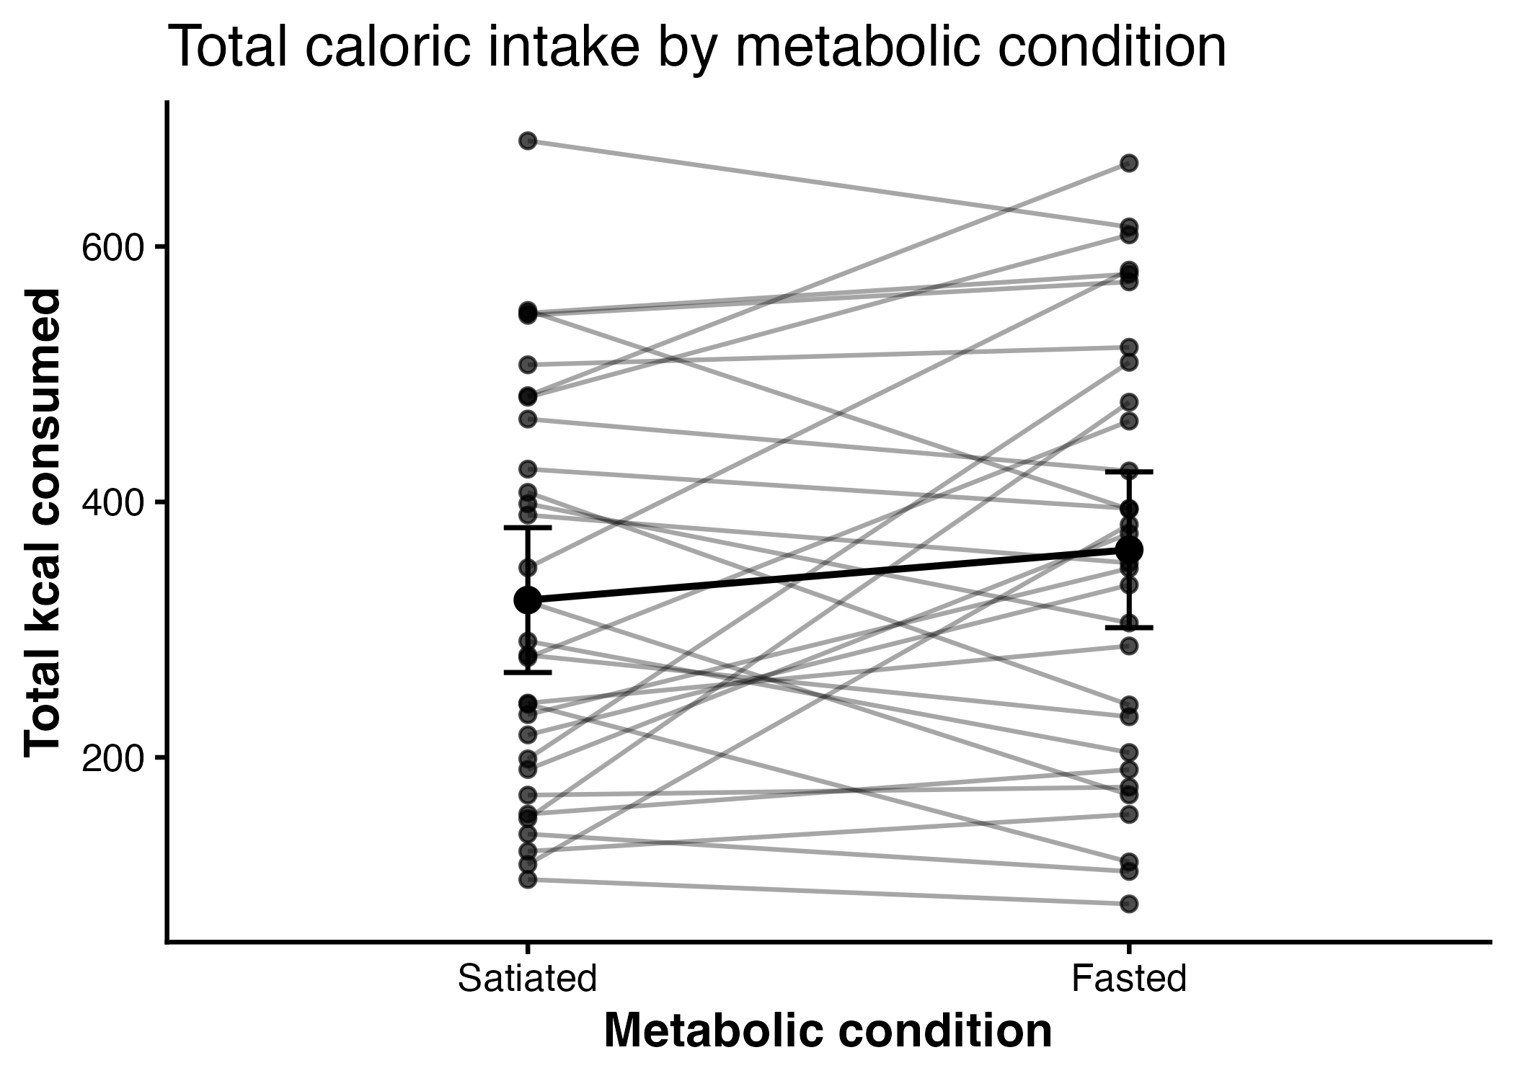
Primary Outcome

Slide 5
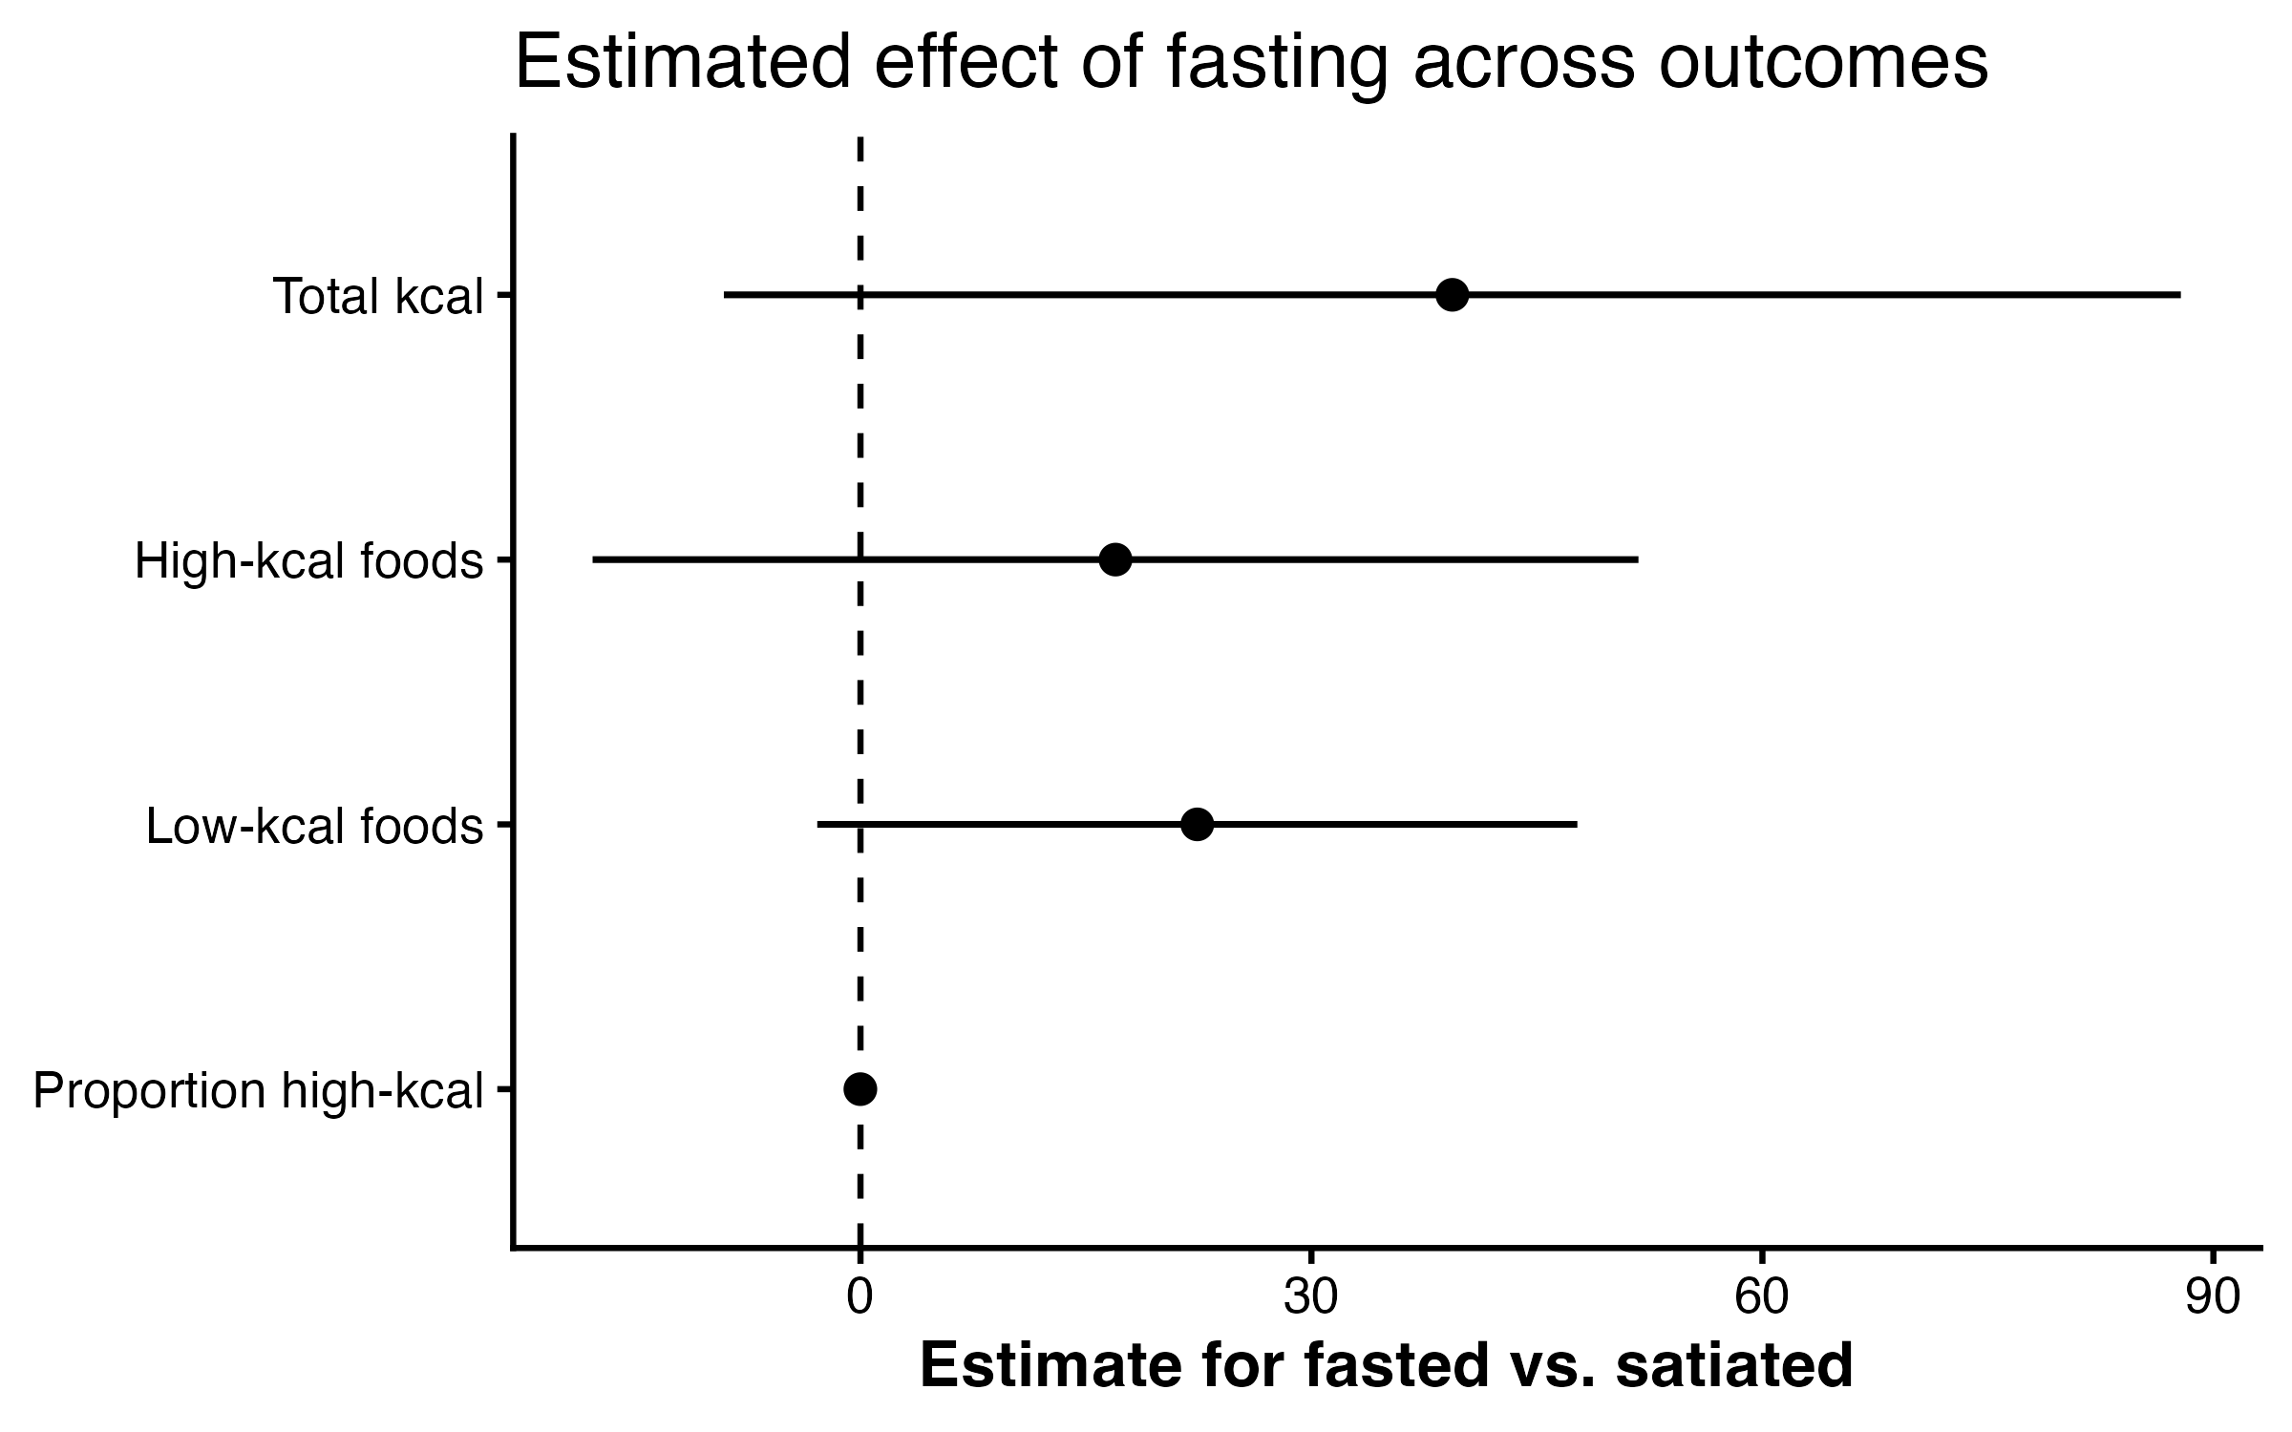
Forest Plot

Slide 6
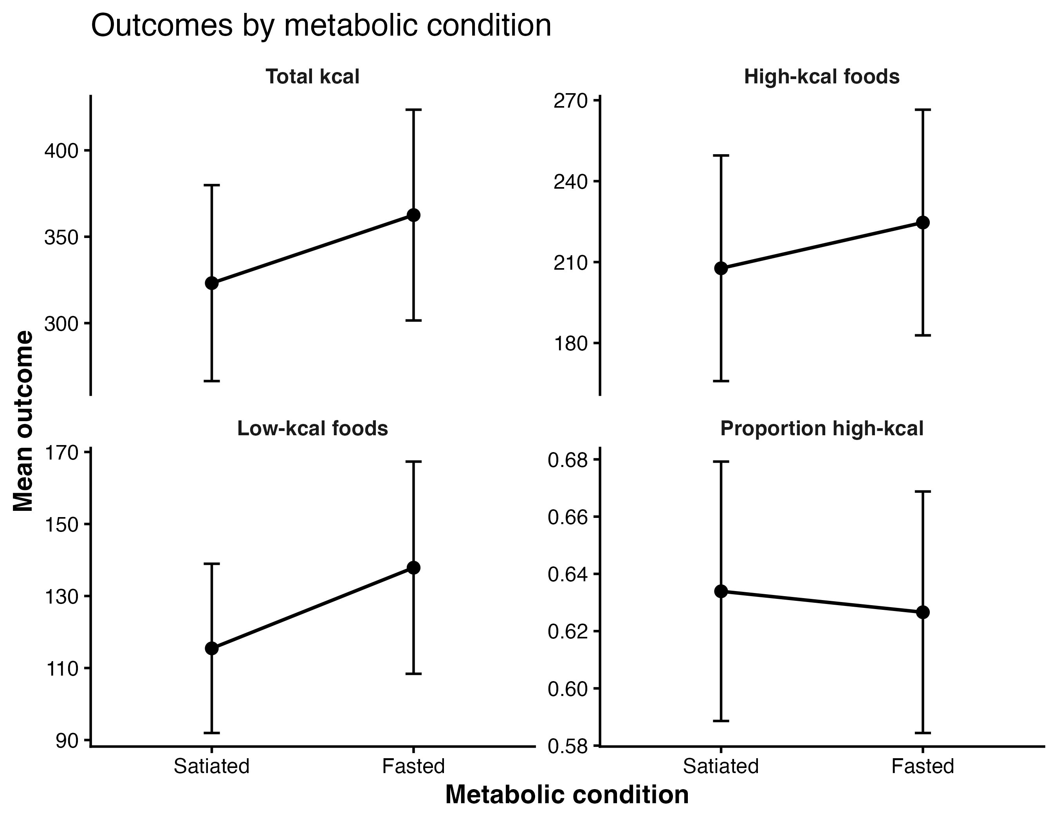
Secondary Outcomes

Slide 7
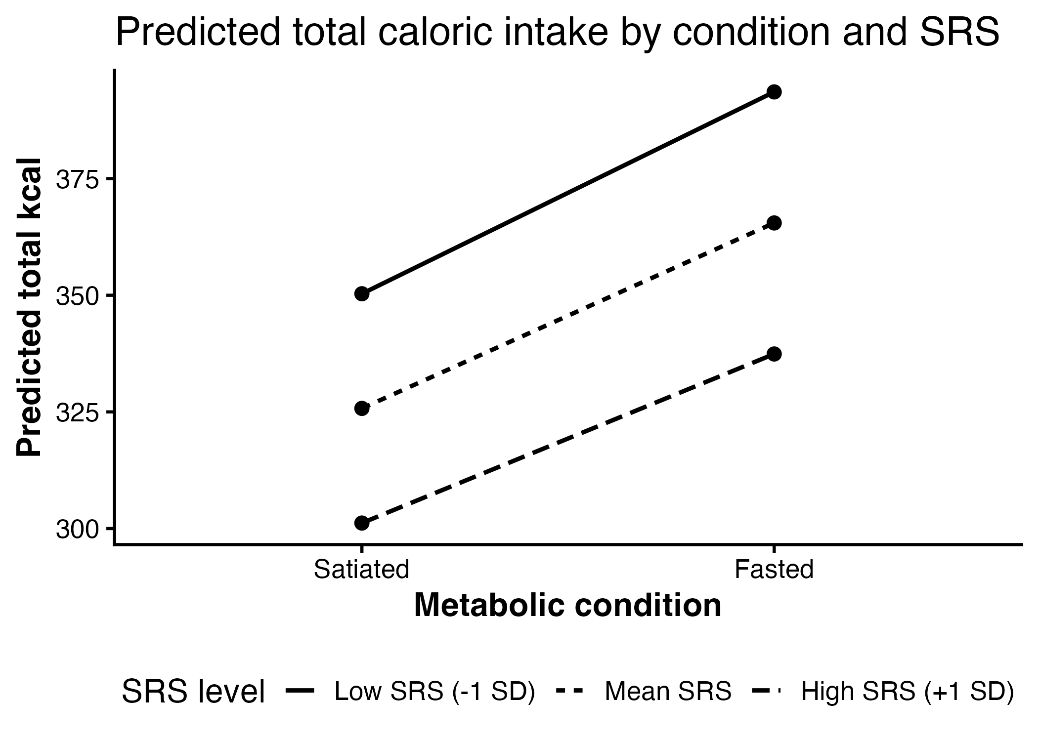
SRS Interaction

Slide 8
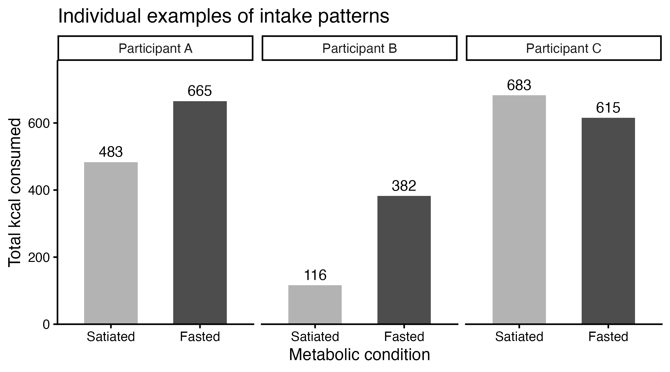
Individual Examples

Slide 9
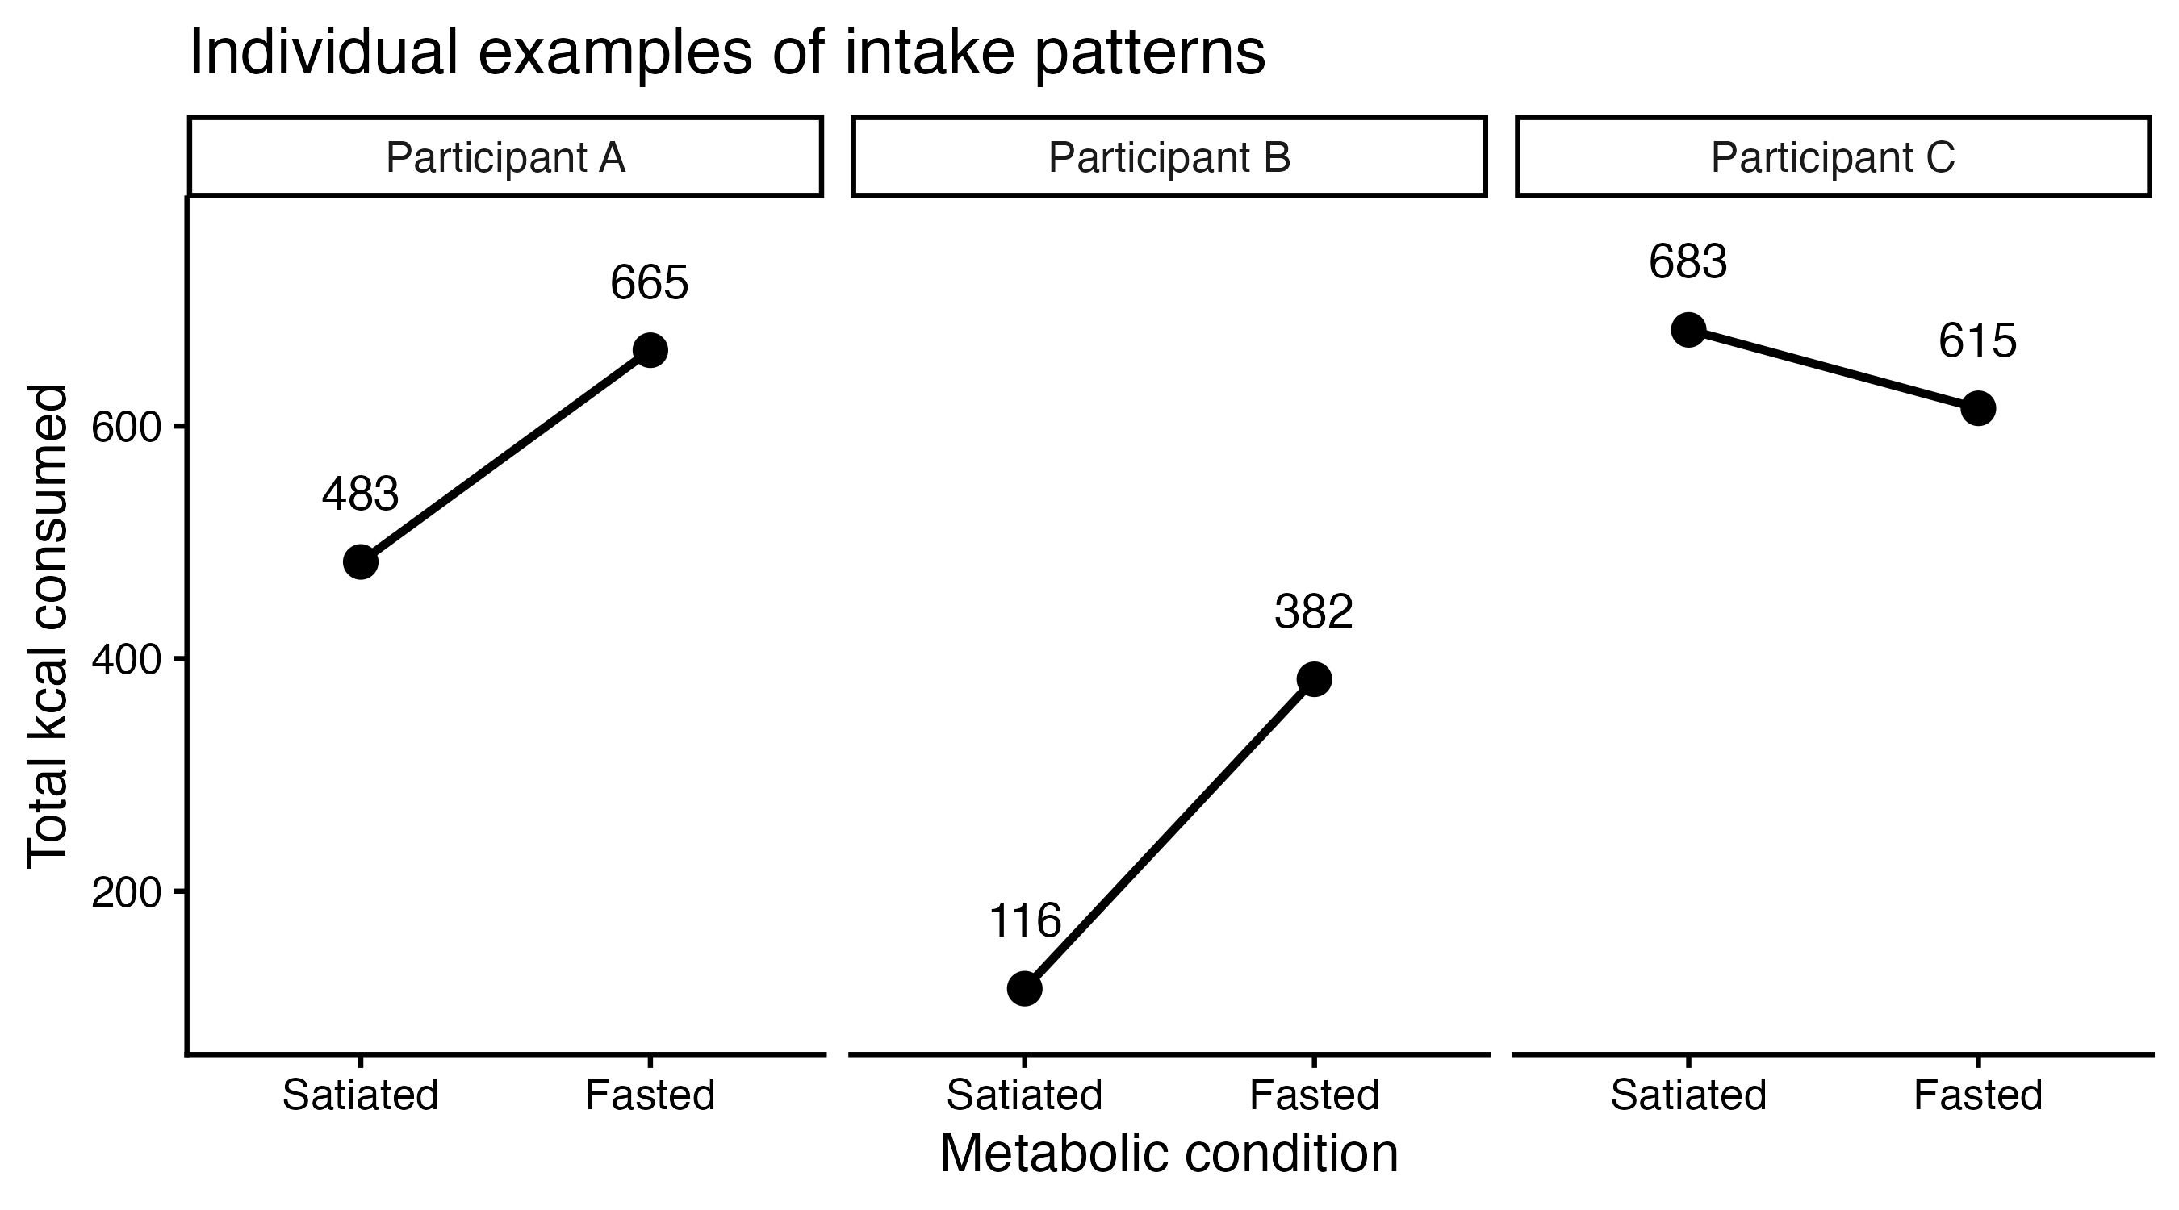
Individual Examples 2

Slide 10
Table 3: Primary Model
Predictor | b | SE | 95% CI | p
Intercept | 323.16 | 29.54 | [263.56, 382.76] | < .001
Metabolic condition (fasted vs. satiated) | 39.37 | 24.73 | [−9.09, 87.84] | .122

Slide 11
Table 5: Moderation Analyses
Moderator | b | SE | 95% CI | χ² | p
Stress reactivity (SRS) | -10.64 | 75.50 | [-164.82, 143.55] | 0.02 | .888
Adaptive ER (CERQ) | -69.21 | 47.58 | [-166.38, 27.96] | 2.04 | .153
Maladaptive ER (CERQ) | -29.48 | 37.37 | [-105.79, 46.83] | 0.62 | .432
Trait anxiety (STADI) | 4.37 | 34.94 | [-66.98, 75.73] | 0.02 | .900
Restrained eating (EDE-Q) | -1.27 | 23.75 | [-49.77, 47.24] | 0.003 | .957
Stress-induced eating (SSES) | 29.48 | 42.63 | [-57.58, 116.54] | 0.47 | .491

