Slide 1
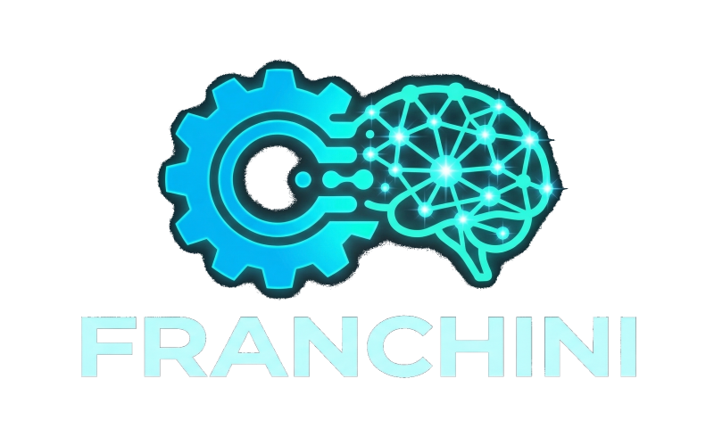
OPENAI BUILD WEEK 2026
Robo-T-Rader turns autonomous trading into an operable platform.
It is not a single bot. It is an ecosystem for discovering, incubating, governing, and operating autonomous systems with discipline.
ECOSYSTEM MAP
Execution
Shared Data
Dev, Prod-Hetzner, Naked, F2, Horizon, CC
MarketData Hub
8
22
3
1
live/lab environments
named modules
discovery modules
shared data plane
Learning
Discovery
Sim, VFL, Opportunity Coach, Gem Mining
Edge Discovery Engine, Incubator, Atlas
Governance
Graphify, Guardian, dashboards, postmortems
The Build Week contribution lives in the platform layer: data contracts, governed discovery, edge incubation, and a clearer way to operate autonomous systems.
Robo-T-Rader Build Week | 01

Slide 2
PROBLEM
Trading bots fail when research, operation, and governance live in the same box.
Black box behavior
Slow learning
Weak governance
The same logic decides, executes, interprets results, and makes it nearly impossible to isolate what worked, what failed, and why.
Without replay, parity, and forensics, every error costs a full session. Teams end up tuning rules by intuition.
Without contracts, incubation, and decision surfaces, every improvement competes against urgency, memory gaps, and guesswork.
Robo-T-Rader's core thesis is simple:
separate layers so a team can improve autonomous robots without guessing.
Robo-T-Rader Build Week | 02

Slide 3
PLATFORM
Robo-T-Rader separates the stack into five layers that can evolve without collapsing into each other.
01 EXECUTION
Execution environments
Dev, Dev-Hetzner, Prod-Hetzner, Naked, F2, Horizon, HorizonMD, and CC operate different styles and horizons.
02 SHARED DATA
MarketData Hub
Normalizes quotes, candles, readiness, mappings, and watchlist/universe products for multiple consumers.
03 LEARNING
Learning and replay
Sim, MarketSim, Forensics, VFL, Opportunity Coach, and Gem Mining turn live sessions into usable learning.
04 DISCOVERY + 05 GOVERNANCE
Discovery
Governance
Edge Discovery Engine, Incubator, and EPIC Atlas search for future edge and stop it from reaching runtime too early.
Graphify, Guardian, dashboards, and postmortems make it visible what to prune, maintain, or observe.
Robo-T-Rader Build Week | 03

Slide 4
SYSTEM
The value is not in one module. It is in the coordination across 22 modules with clear roles.
MODULE INVENTORY
Module
Type
Role
Why it matters
Dev / Dev-Hetzner / Prod-Hetzner / Naked / F2 / Horizon / HorizonMD / CC
execution
robots and runtimes
8 operating surfaces with different styles and maturity levels
MarketData Hub
shared data
quotes, candles, readiness, mappings
turns ingest into a reusable contract
Sim / MarketSim
learning
replay and validation
lets the team test without touching live
VFL / Opportunity Coach / Forensics / Gem Mining
learning
explain and synthesize behavior
turn repeated pain into structured evidence
Edge Discovery Engine / Incubator / EPIC Atlas
discovery
search for edge and mature it
avoids jumping from backtest to live
Graphify / Guardian / Dashboards / Postmortems
governance
decision surfaces and operational discipline
helps the team decide what to prune, maintain, and observe
Summary: 8 execution environments, 1 shared data plane, 6 learning modules, 3 discovery modules, and 4 governance surfaces.
Robo-T-Rader Build Week | 04

Slide 5
SHARED DATA
MarketData Hub turns market data into a common interface for multiple consumers.
Prod-Hetzner
multi-engine runtime
MarketData Hub
Capital.com / Yahoo / mappings
Delivers quotes, candles, readiness, mappings, watchlist, and universe products under one semantic contract.
Horizon / HorizonMD
Internal sources and products for price, status, and coverage.
hub consumers
Edge Discovery Engine
backtests and incubation
EPIC Atlas
NYSE candidate tracker
1
4+
0
N
data contract
active consumers
direct credentials in Atlas
future robots
The advantage is not only reuse. It is shared semantics, quality, and coverage.
Robo-T-Rader Build Week | 05

Slide 6
LEARNING LOOP
Losses do not end in PnL. They become replay, explanation, and candidate improvements.
2. Sim / MarketSim
4. Opportunity Coach
Reproduces the session and separates parity from experimentation.
Compares what the robot did versus what it could have seen.
1. Live trade
3. VFL / Forensics
5. Gem Mining
A real session leaves trades, timing, context, and behavior.
Makes price, decisions, MFE/MAE, and diagnostics visible.
Extracts repeated findings and turns them into candidates.
The lab exists for one reason:
do not touch live by intuition; promote improvements from reproducible evidence.
Robo-T-Rader Build Week | 06

Slide 7
DISCOVERY
Edge Discovery Engine, the Incubator, and EPIC Atlas form a governed pipeline for future edge.
Historical discovery
Paper incubation
Atlas expansion
Governed review
Prod
The Edge Discovery Engine searches history, generates hypotheses, and rejects fragile ideas before runtime.
The Incubator keeps candidates alive but constrained, with contracts, expiry, and kill rules.
EPIC Atlas tracks candidates outside the current watchlist and routes them into research.
Graphify and human review decide whether to prune, maintain, observe, or promote.
Only sufficiently evidenced ideas should arrive here.
The strong principle is this: finding edge is not enough; the system needs a maturation path.
That is why Atlas does not trade, the Incubator does not auto-promote, and Prod should not inherit ideas without evidence, review, and context.
Robo-T-Rader Build Week | 07

Slide 8
GOVERNANCE
Graphify and operational surfaces turn noise into actionable decisions.
DECISION SURFACES
Graphify
Guardian
Dashboards
Postmortems
Maps robots, edges, factors, blockers, and actions of the day into a decision surface.
Runs pre-NYSE, post-NYSE, and night checkpoints for health, debt, and alerts.
Compress balances, findings, and pending work into human-readable views.
Preserve causality so the team does not rely on memory or vibes.
The outcome that matters is not more observability by itself.
It is enabling a team to decide more clearly what to touch, what not to touch, and why.
Robo-T-Rader Build Week | 08

Slide 9
BUILD WEEK
The competition contribution is in the platform layer, not in pretending everything was built from zero.
What already existed
What was meaningfully extended during Build Week
- multiple live and lab robot environments
- demo trading execution
- Telegram control and monitoring
- replay and postmortem practices
- infrastructure across robo-lab and Hetzner
- stronger use of MarketData Hub as a shared contract surface
- EPIC Atlas integration against Hub contracts
- clearer edge discovery and incubation workflow
- competition-grade documentation and public repository packaging
- a cleaner platform narrative for judges
Honest framing: pre-existing system, new platform extension, documented during Build Week.
Robo-T-Rader Build Week | 09

Slide 10
DEMO PATH
The clearest way to understand Robo-T-Rader is to follow one concrete path through Prod-Hetzner and its satellite modules.
1. Prod-Hetzner
2. Hub
3. Sim / VFL
4. Graphify
5. Atlas / Discovery
the multi-engine runtime that now represents the operational face of the platform
the shared data plane for quotes, candles, readiness, and mappings
replay and visual review whenever behavior deserves investigation
the decision surface that summarizes edges, blockers, and priorities
the pipeline for what comes next
Recommended category: Work & Productivity.
The strongest value is not a single trade. It is turning research, data, incubation, and governance into a workflow that a team can use to improve real autonomous systems.
Public repo: github.com/lmfranchini/robo-t-rader-platform
Robo-T-Rader Build Week | 10

