Slide 1
Predicting Future Sales using Recurrent Neural Networks
Youyang, Horace, Miguel, Lucia

Slide 2
Current Issues
Products have different demands at different time
Not able to accurately predict the sales of seasonal products
Stocking of unnecessary products & lack of products in great demand
Predict sales of product at specific date & store

Slide 3
Approaching the problem
Microsoft Azure
Three different models are trained
Same train set(~640000)and test set were used (~280000)
Inputs: Date, store ID, item ID
Desired output: sales

Slide 4
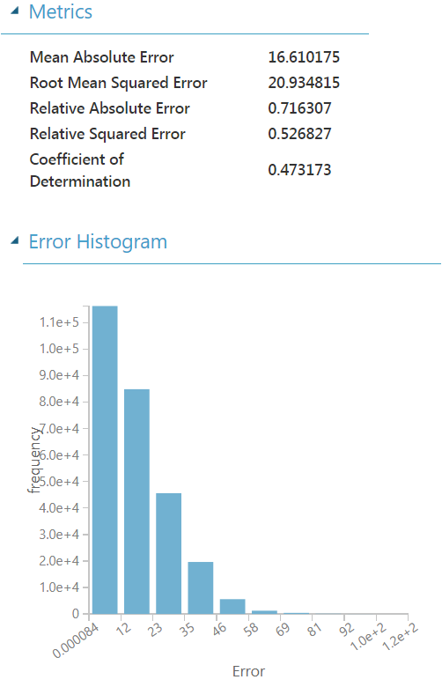
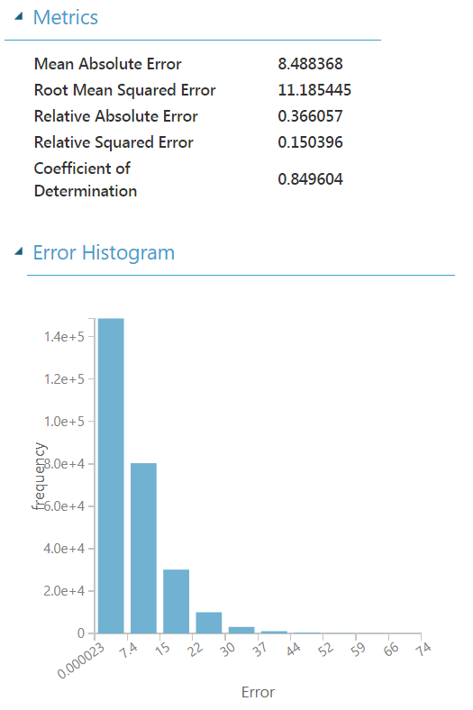
Boosted Decision Tree Regression
Train time: ~10 minutes
Neural Network Regression
Train time: ~5 minutes

Slide 5
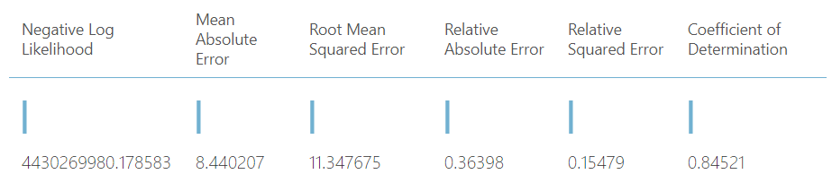
Decision Forest Regression
Train time: ~ 20 minutes

Slide 6
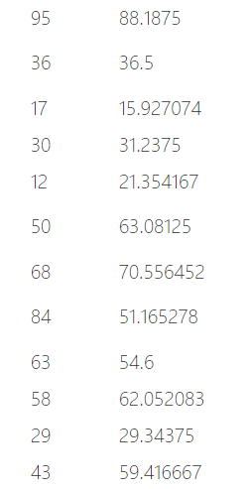
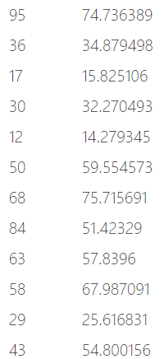
Comparisons
Results of Decision Forest Regression
Result of Boosted Decision Tree Regression

Slide 7
Comparison
Decision Forest
Long train time
Dealt with outliers better (range fits & standard deviation fits bette)
Boosted Decision Tree
Shorter train time
Cannot deal with outliers

Slide 8
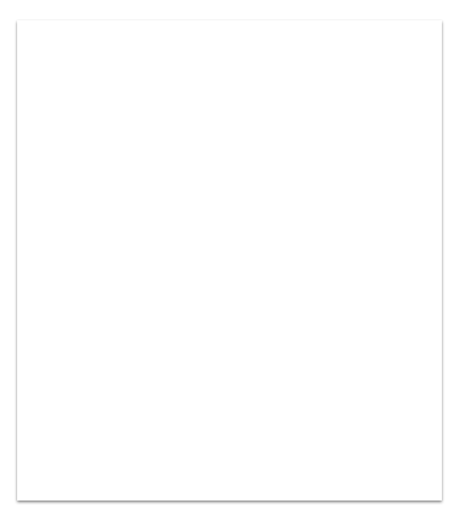
Data Fields
ID an Id that represents a (Shop, Item) tuple within the test set
item_category_name name of item category
item_cnt_day number of products sold on a given day
item_cnt_month number of products sold in a given month
date_block_num a consecutive month number, used for convenience. January 2013 is 0, February 2013 is 1,..., October 2015 is 33
date date in format dd/mm/yy
item_name Name of item
shop_name Name of shop
shop_id Unique identifier of a shop
item_id Unique identifier of a product

Slide 9
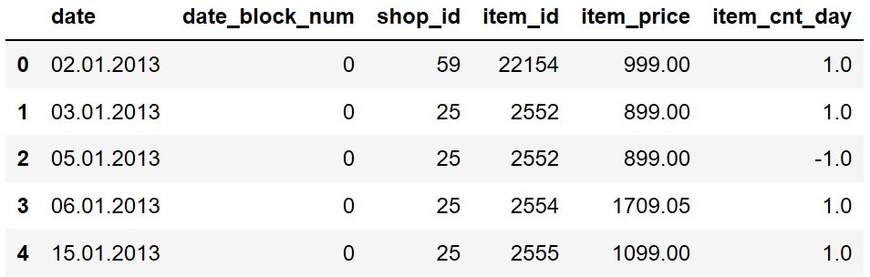
Unprocessed dataset

Slide 10
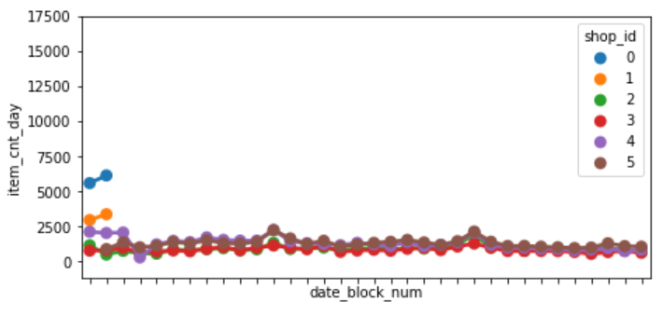
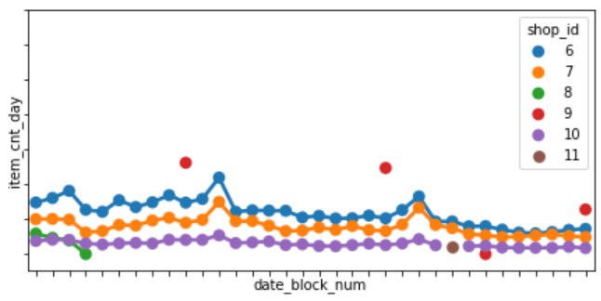
Grouping items sold per day
To organize the data, the items sold per day were grouped by shop_id and then plotted against the number of months. (59 shops in total)

Slide 11
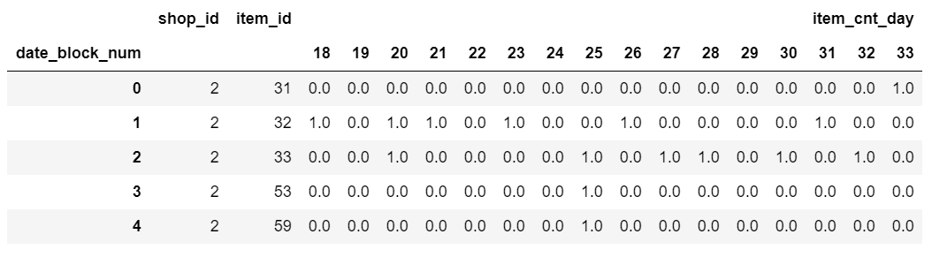
Convert sale per day to month
Removed data before July 2013 since it is unlikely to affect sales in Nov 2015
Replaced all NaN values with zero
If more than one data per month, take average

Slide 12
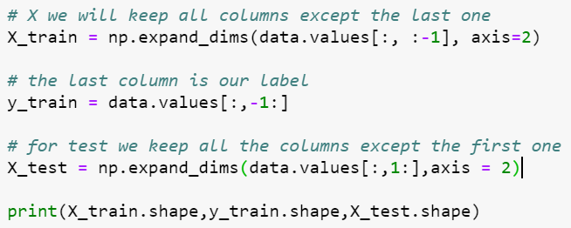
Splitting the data
Train the data on the first 32 months, then test on the 33rd month
Model selected: LSTM network

Slide 13
Long short-term memory(LSTM)
Long short-term memory (LSTM) is an artificial recurrent neural network (RNN) architecture used in the field of deep learning. A common LSTM unit is composed of a cell, an input gate, an output gate and a forget gate. The cell remembers values over arbitrary time intervals and the three gates regulate the flow of information into and out of the cell.

Slide 14
Why did we use LSTM?
LSTM networks are very good at holding long term memories.
good choice for such sequences which have long term dependencies in it
Strength
modeling sequential / temporal aspects of data such as text, videos, and time-series

Slide 15
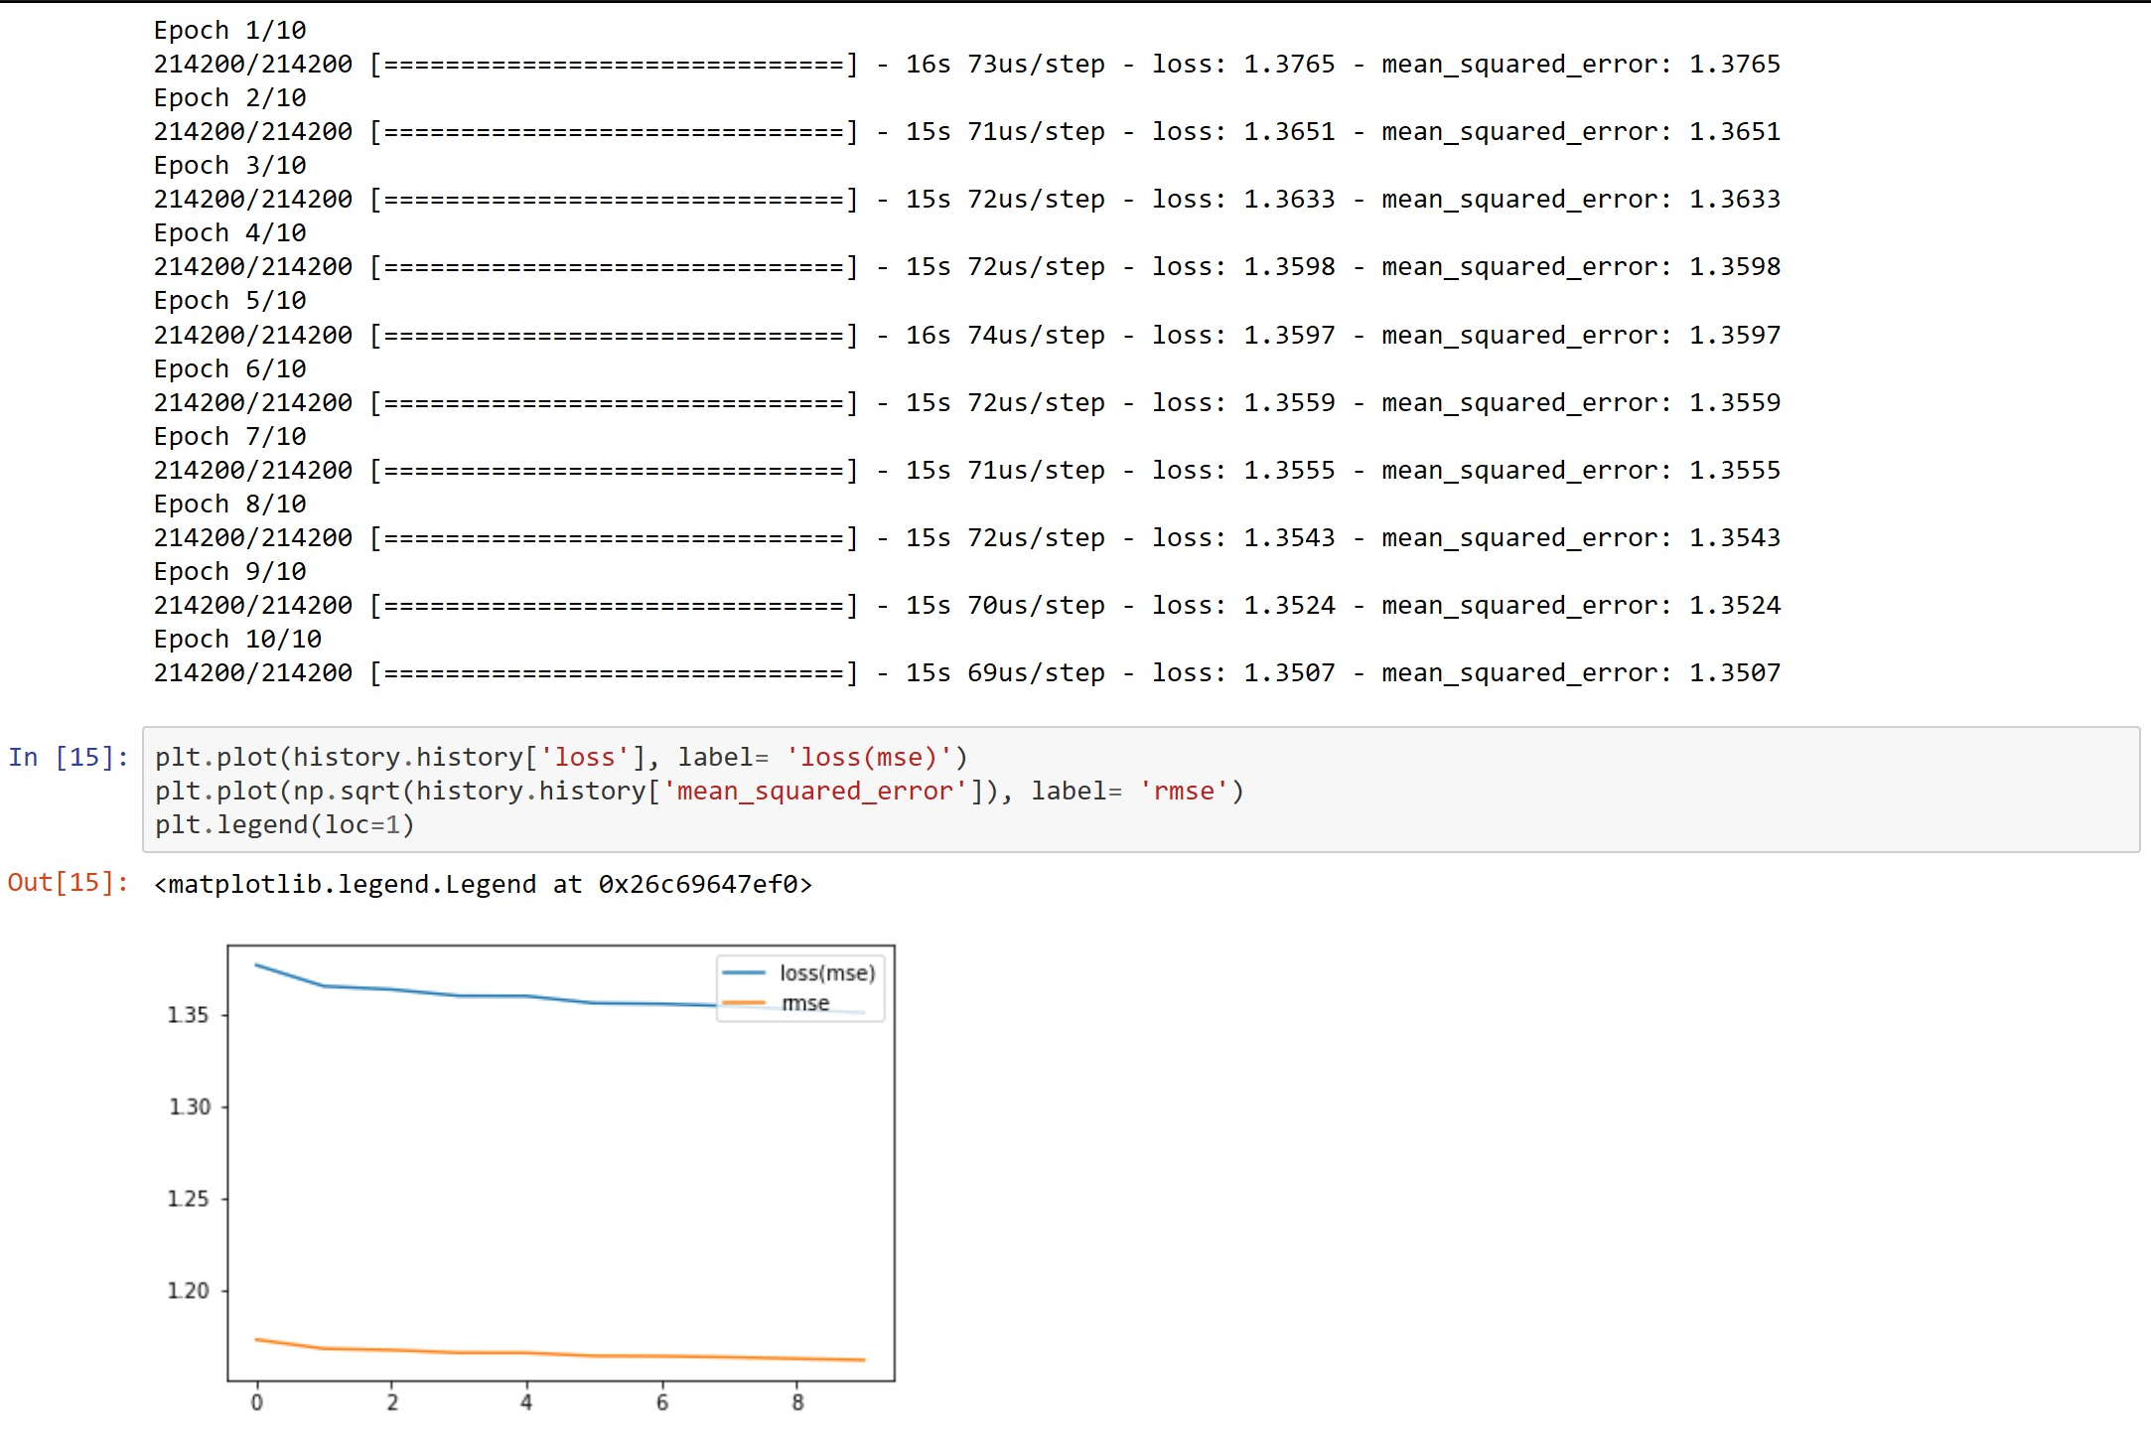
Fit the Network
Fit parameters used
epochs=10
batch_size=4096 Higher value-
Pros: more accurate
Cons: Requires more memory, slower
Why RMSE?
used to compare across two models.
prediction accuracy

