Slide 1
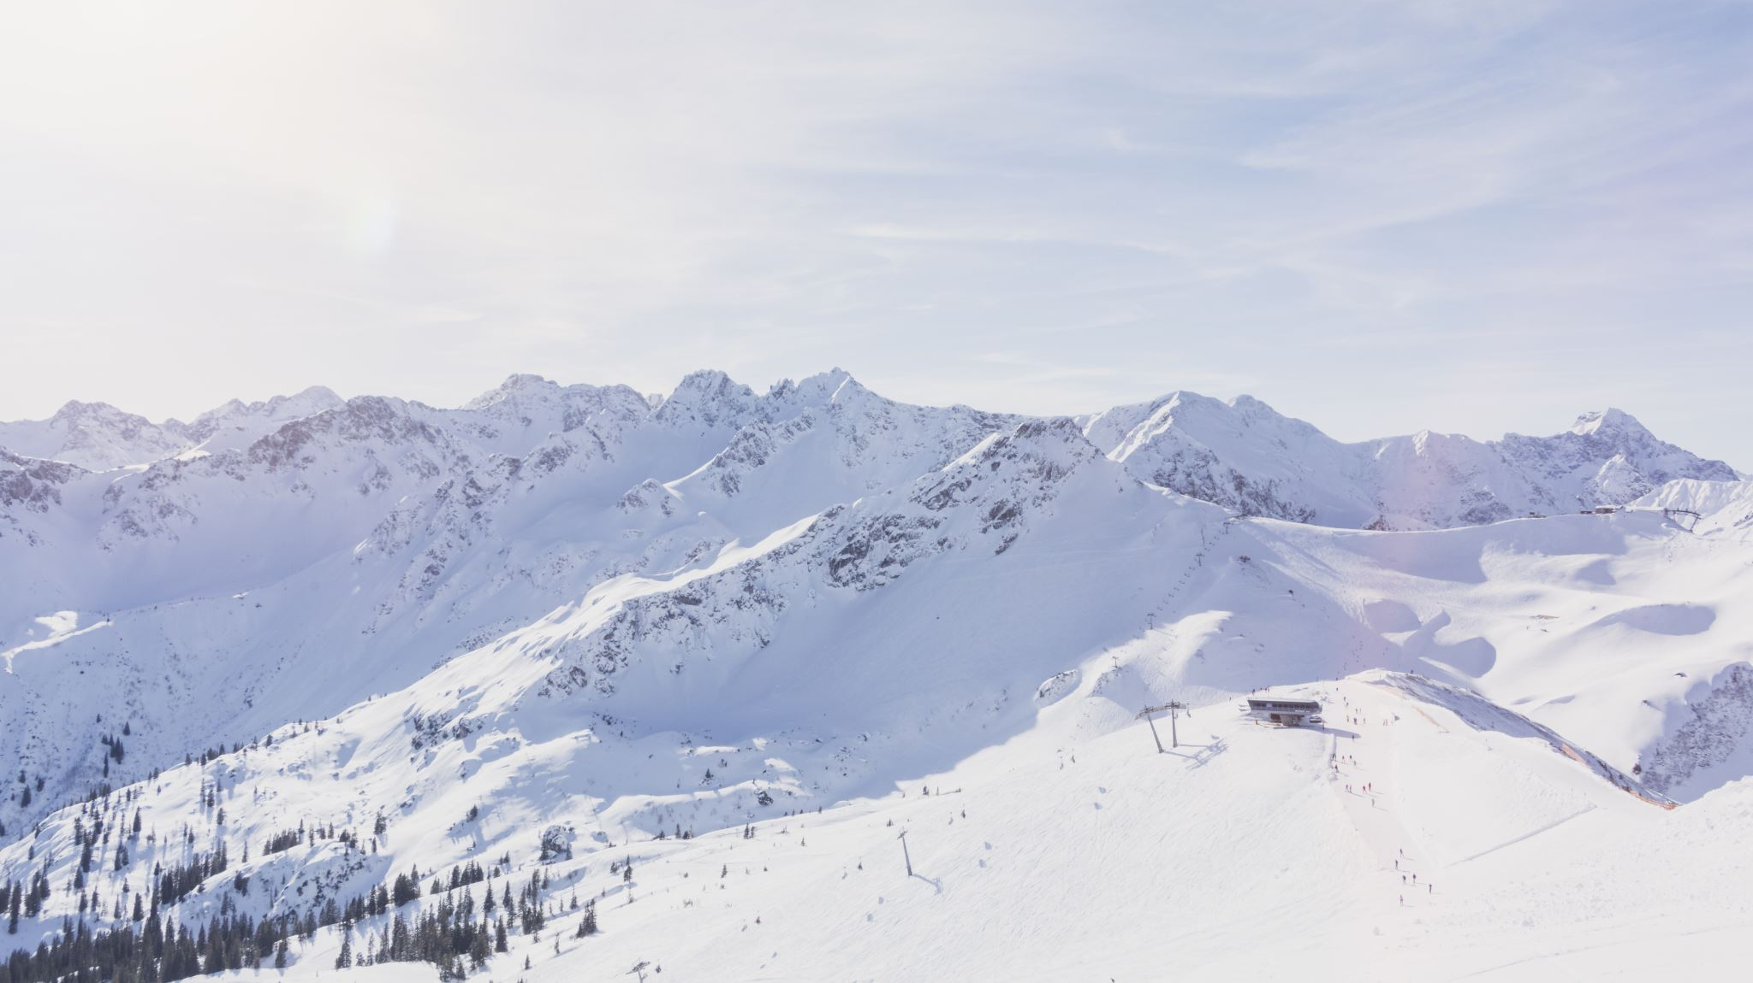
Big Mountain Ski Resort
Pricing / Cost Mitigation Strategy
by
LaShawn Gaines

Slide 2
CONTENTS
How did we get here?
Recommendation and key findings
Modeling and Analysis
Conclusion

Slide 3


How did we get here?
New ski (chair) lift purchased for in the
off-season (increasing operating costs by
$1.5 million annually)
Scope of solution includes the 330 resorts within the competitive market
Key Stakeholder: Jimmy Blackburn, Director of Operations
Key Data sources: Alesha Eisen, Database Manager & file provided
Success criteria to be measured by maintaining profitability this year by either:
Increasing revenue by 10% to offset the costs
Reducing other operating costs by $1.5 million to accommodate the new lift

Slide 4
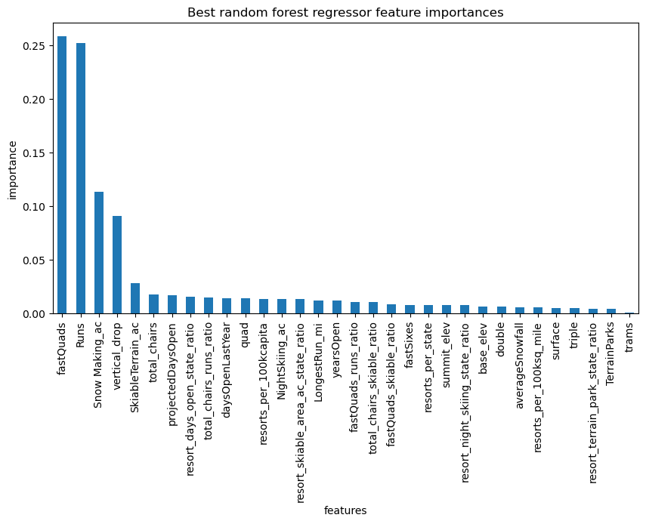
Recommendation and key findings
Amenities most positively correlated to price are:
Vertical Drop
fastQuads
Snow Making (acres covered)
# of runs
Total Chairs
Pricing model suggests there is room to increase ticket prices

Slide 5
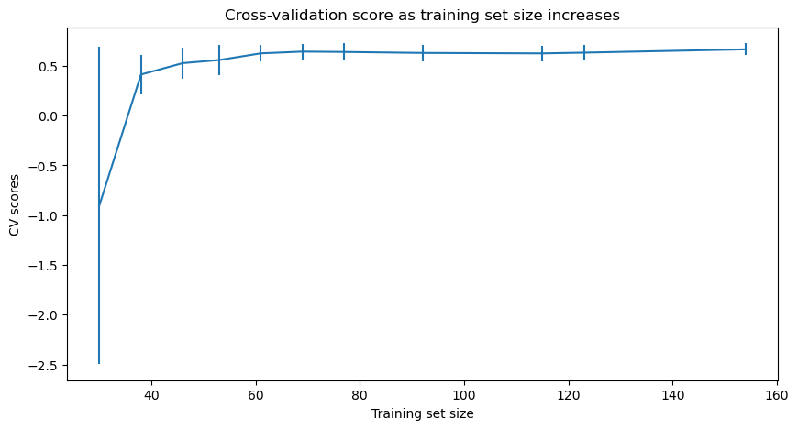
Analysis: Dataset
Began 330 resorts, eliminated many rows due to nulls within pricing columns ending with 277 records
No additional insights would be gained from obtaining more data (levels off between 40-60 samples)

Slide 6

Modeling performed
Simple mean: produced mean squared error of $19
Linear regression: produced significant differences between training and test sets – mean absolute error of $10.50
Random forest model: produces the lowest cross validation error of $9.53
Notes:
l

Slide 7

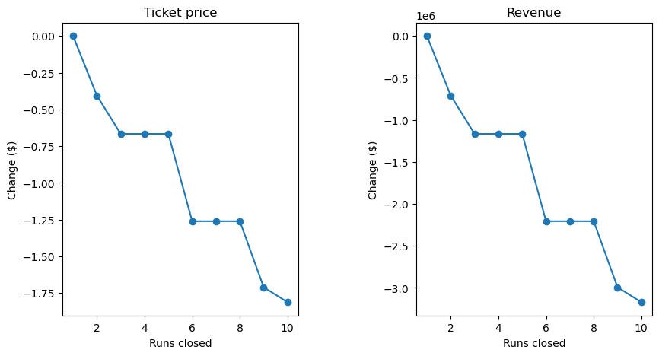
Modeling: Cost reduction scenarios
Closing runs to reduce operating costs may negatively impact ticket prices & revenue
Proceed with caution, close at most 1 ski run

Slide 8
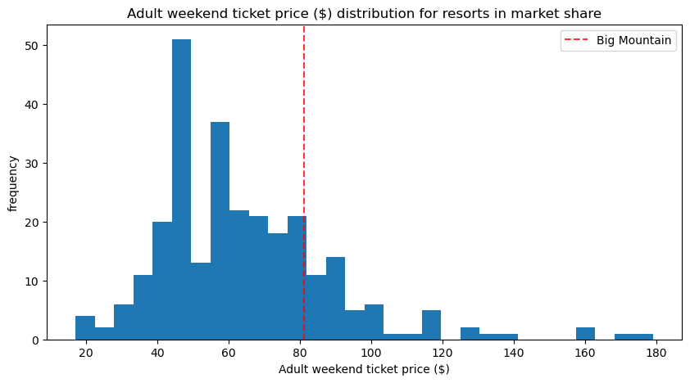
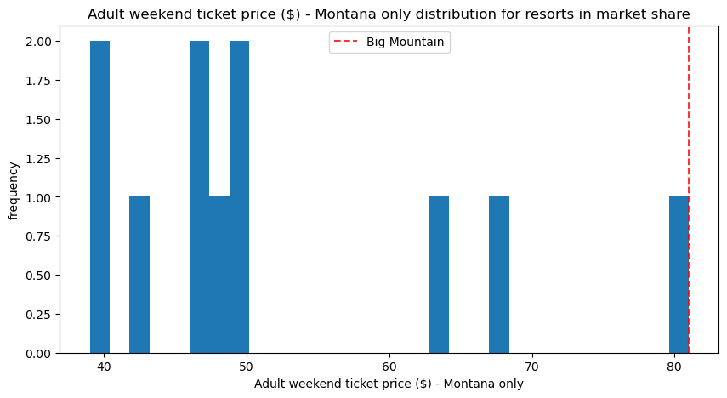
Modeling : Pricing Strategy
Our random forest model suggests a ticket price of $95.87
It fits well within the range for the entire market
However, when looking at Montana the current price of $81 is the highest in the state
Proposal: Modest price increase to $85.48, which is supported by our pricing model’s absolute error ($9.53)
Covers cost of new lift - $0.88 per ticket
Incremental revenue - $3.60 per ticket

Slide 9
Conclusion
Random forest model produced the best results
Modeling confirms a pricing increase can be supported
Scenarios modeled suggest we proceed with caution regarding closing runs to reduce operating costs

