Slide 1

How can telecom companies retain their customers?
An experiment with customer churn prediction
by
LaShawn Gaines

Slide 2

Why is a customer churn prediction model needed?
Mobile telecommunications industry is highly competitive because the consumers have the power
Estimates show that 97% of all Americans own a smartphone
Adding new customers requires attracting them from other service providers
Maintaining market share must also therefore include a customer retention / churn reduction strategy

Slide 3
About the dataset
IBM sample dataset located on kaggle
Usability score of 8.82
Contains sample of 7,043 customer records and 21 columns
customers that left company within the last month
services in which the customers subscribed (phone, internet, streaming)
customer account information (tenure, contract type, pay methods, monthly charges)
customer demographic data (age, gender, single vs partnered, dependents)

Slide 4
Data Wrangling
High Kaggle usability score minimized the amount of cleaning
Total charges was converted from object dtype to float
IsSeniorCitizen was converted to object from numeric to match other categorical fields
Converted service categorical data to numeric to create new bundled services categories
bundled phone & internet
count of total services each customer was subscribed
Dropped 11 rows missing total charge information
Dropped the customer ID

Slide 5
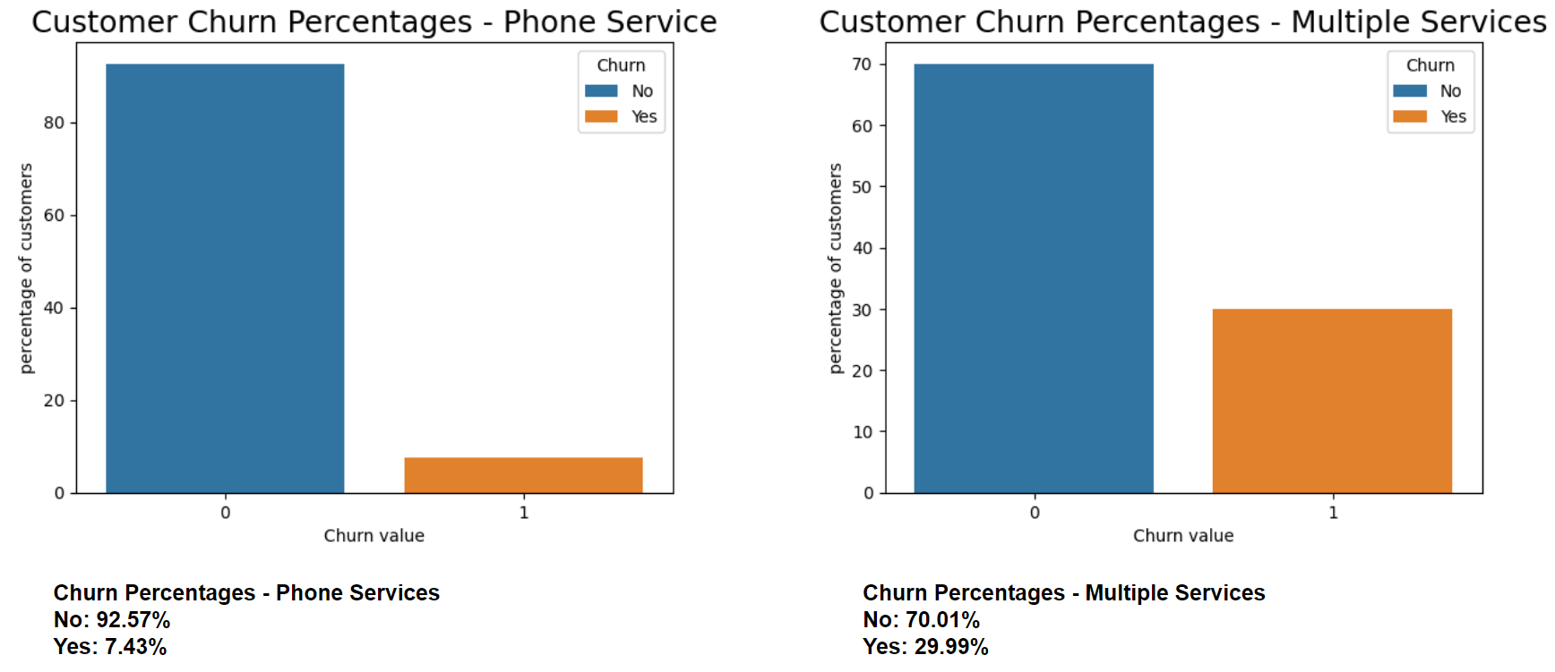
EDA – preliminary churn findings
churn rate across all customers is 26.58%
Phone services appear to have a higher retention rate than customers with multiple services

Slide 6
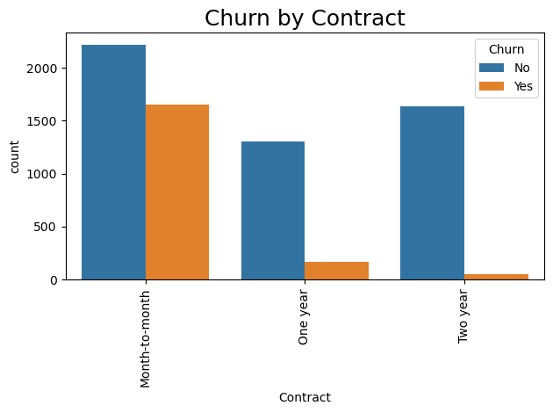
EDA – bivariate analysis
Customers without long-term contracts are churning at a higher rate (lower barriers to disconnect)
Month-to-month contracts are now the norm in the industry
Further support for churn prediction

Slide 7
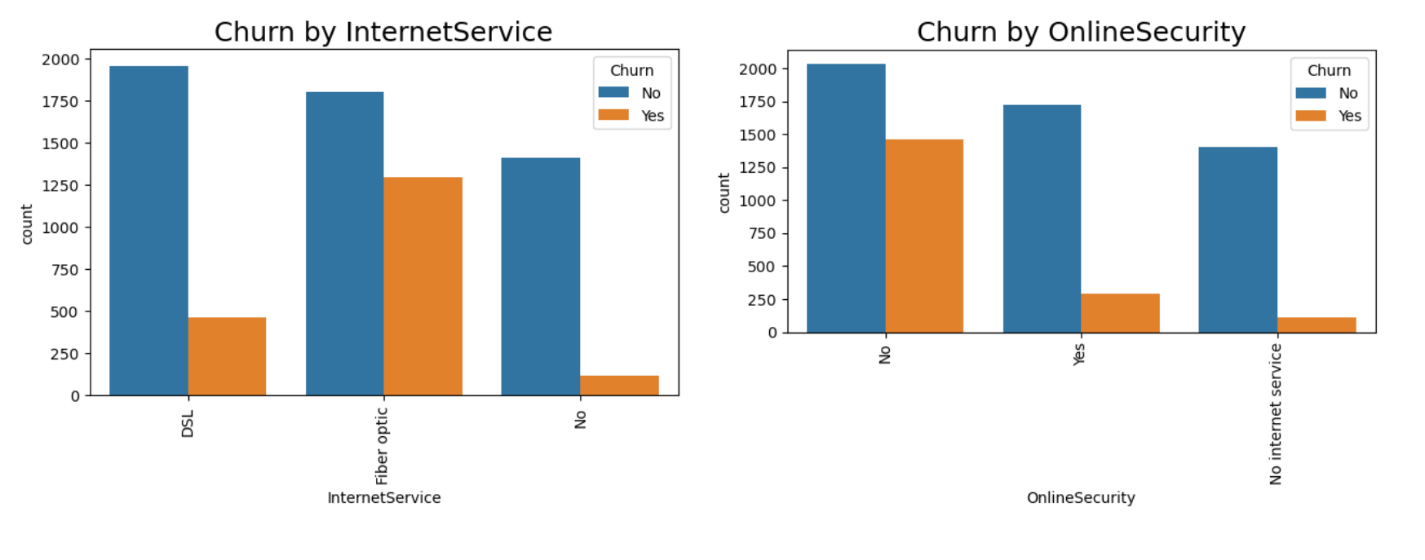
EDA – bivariate analysis of service offerings
Fiber optic internet customer are more likely to churn (potential network performance issues)
Online security customers are less likely to churn (opportunities for future bundled service offerings)

Slide 8
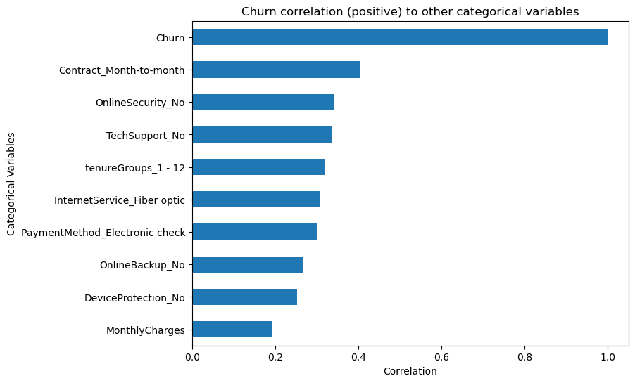
EDA – correlation analysis
strongest correlation is monthly contracts
weakest correlation with monthly charges
Not subscribing to ancillary services (online security and tech support) are moderately correlated

Slide 9
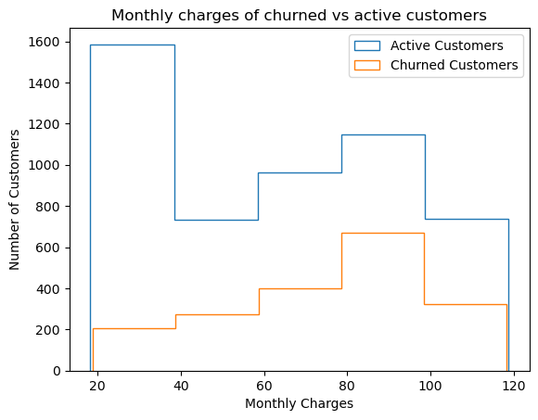
EDA – monthly charges vs customer status
Churned customers with monthly charges between $80 - $100 have highest frequency
Active customers are more frequently paying between $20 - $40 per month
Business leaders may want to look at price/mix strategies to maximize revenues

Slide 10
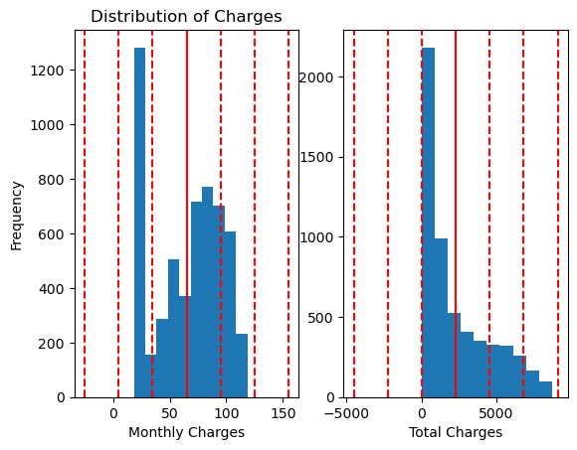
Preprocessing Steps
Dummy encoding (dropping the first feature) performed for all categorical fields, other than churn
Split data into training and test sets
Scaled the data using sklearn’s StandardScaler
Monthly and Total charges are bi-modal and right skewed, respectively
All categorical fields are binary, thus posing a magnitude issue

Slide 11
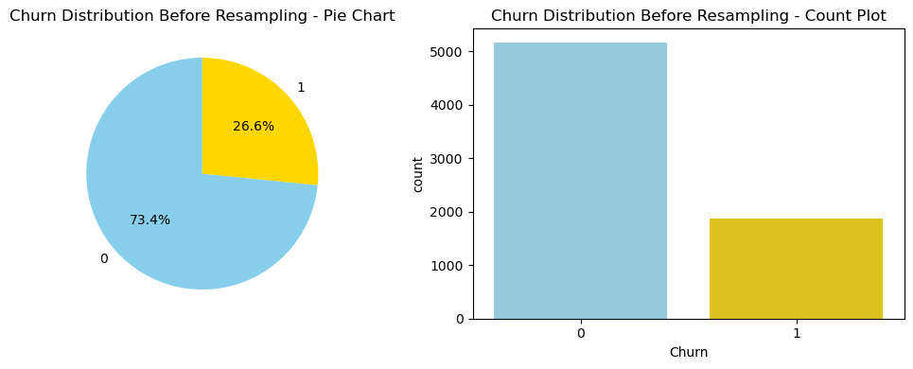
Preprocessing Steps: resampling
Given the nature of churn, data set was highly imbalanced
Given the relatively small dataset we chose an over-sampling technique
SMOTE + Tomek Links
Resulting in a 50% majority to 50% minority

Slide 12

Modeling: churn prediction
Algorithms used (classifiers)
Logistic Regression
Random Forest
Gradient Boosting
K-nearest Neighbors
Support Vector Classifier
Established a baseline running each algorithm with default params
Used GridSearch with 5-fold cross validation for hyperparameter tuning
Scored models based on recall, choosing to minimize the number of false negatives
This Photo by Unknown Author is licensed under CC BY-SA-NC

Slide 13
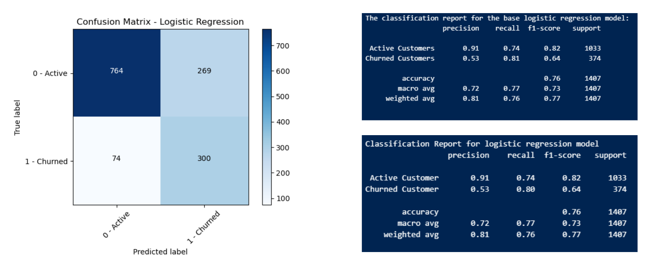
Modeling: winning algorithm is Logistic Regression
Recall scores for churn were best with this model
Minimizes the number of false negatives
Trade-off is the number of false positives is quite high
potential for expending a lot of human capital to contact customers who are not about to churn

Slide 14
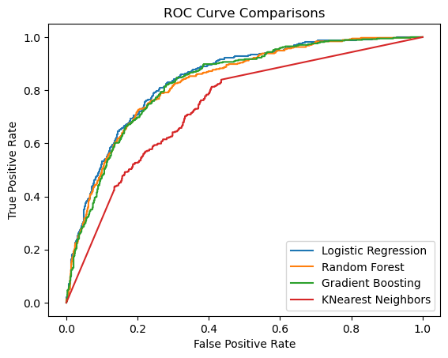
Modeling: Comparative ROC
Due to computational resource constraints, probabilities for the SVC were not calculated
Except for KNN, performance is relatively comparable for the all models
Logistic regression was chosen based on both recall score and it is computationally least expensive

Slide 15

Modeling: potential enhancements
Hyperparameter tuning didn’t increase model effectiveness
Modification to preprocessing steps
Filtering features based on influence
Use a different scaler, such as sklearn’s MinMaxScaler vs StandardScaler or a combination based on each feature
Leveraging different resampling methods (Random over sampling or ADASYN)

Slide 16
Business recommendations: service bundles
During EDA, noted several services that were negatively correlated to churn
Tech Support
Online Security
Online Back-ups
Bundling these services with others may help with customer retention

Slide 17
Business recommendations: potential internal issues
Further research is needed for customers receiving paperless billing, as they appeared to churn more than not
Electronic invoices may be getting caught in customer spam filters
Need to look at business email sender reputation scores
Customer leveraging electronic check as a payment method were also more likely to churn vs those paying by paper check, automatic bank transfers or credit cards
Potential internal systemic issue that is causing frustration for consumers

Slide 18
Thank you!

