Slide 1
TURING COLLEGE CAPSTONE · 2026
Creative Coding Assistant
A reviewer-first workspace that turns creative intent into runnable, traceable, and refinable code artifacts.

Slide 2
Creative coding has a continuity problem
THE GAP
Creative intent, code, runtime feedback, and iteration are usually split across tools.
Generic assistants return snippets; they do not preserve an inspectable product workflow.
Disconnected tools lose intent and state.
CCA keeps the brief, workflow, artifact, and evidence together.
Idea ↔ editor ↔ browser
Manual context recovery
Opaque generation claims
Runnable preview
Session refinement
Visible workflow evidence
2

Slide 3
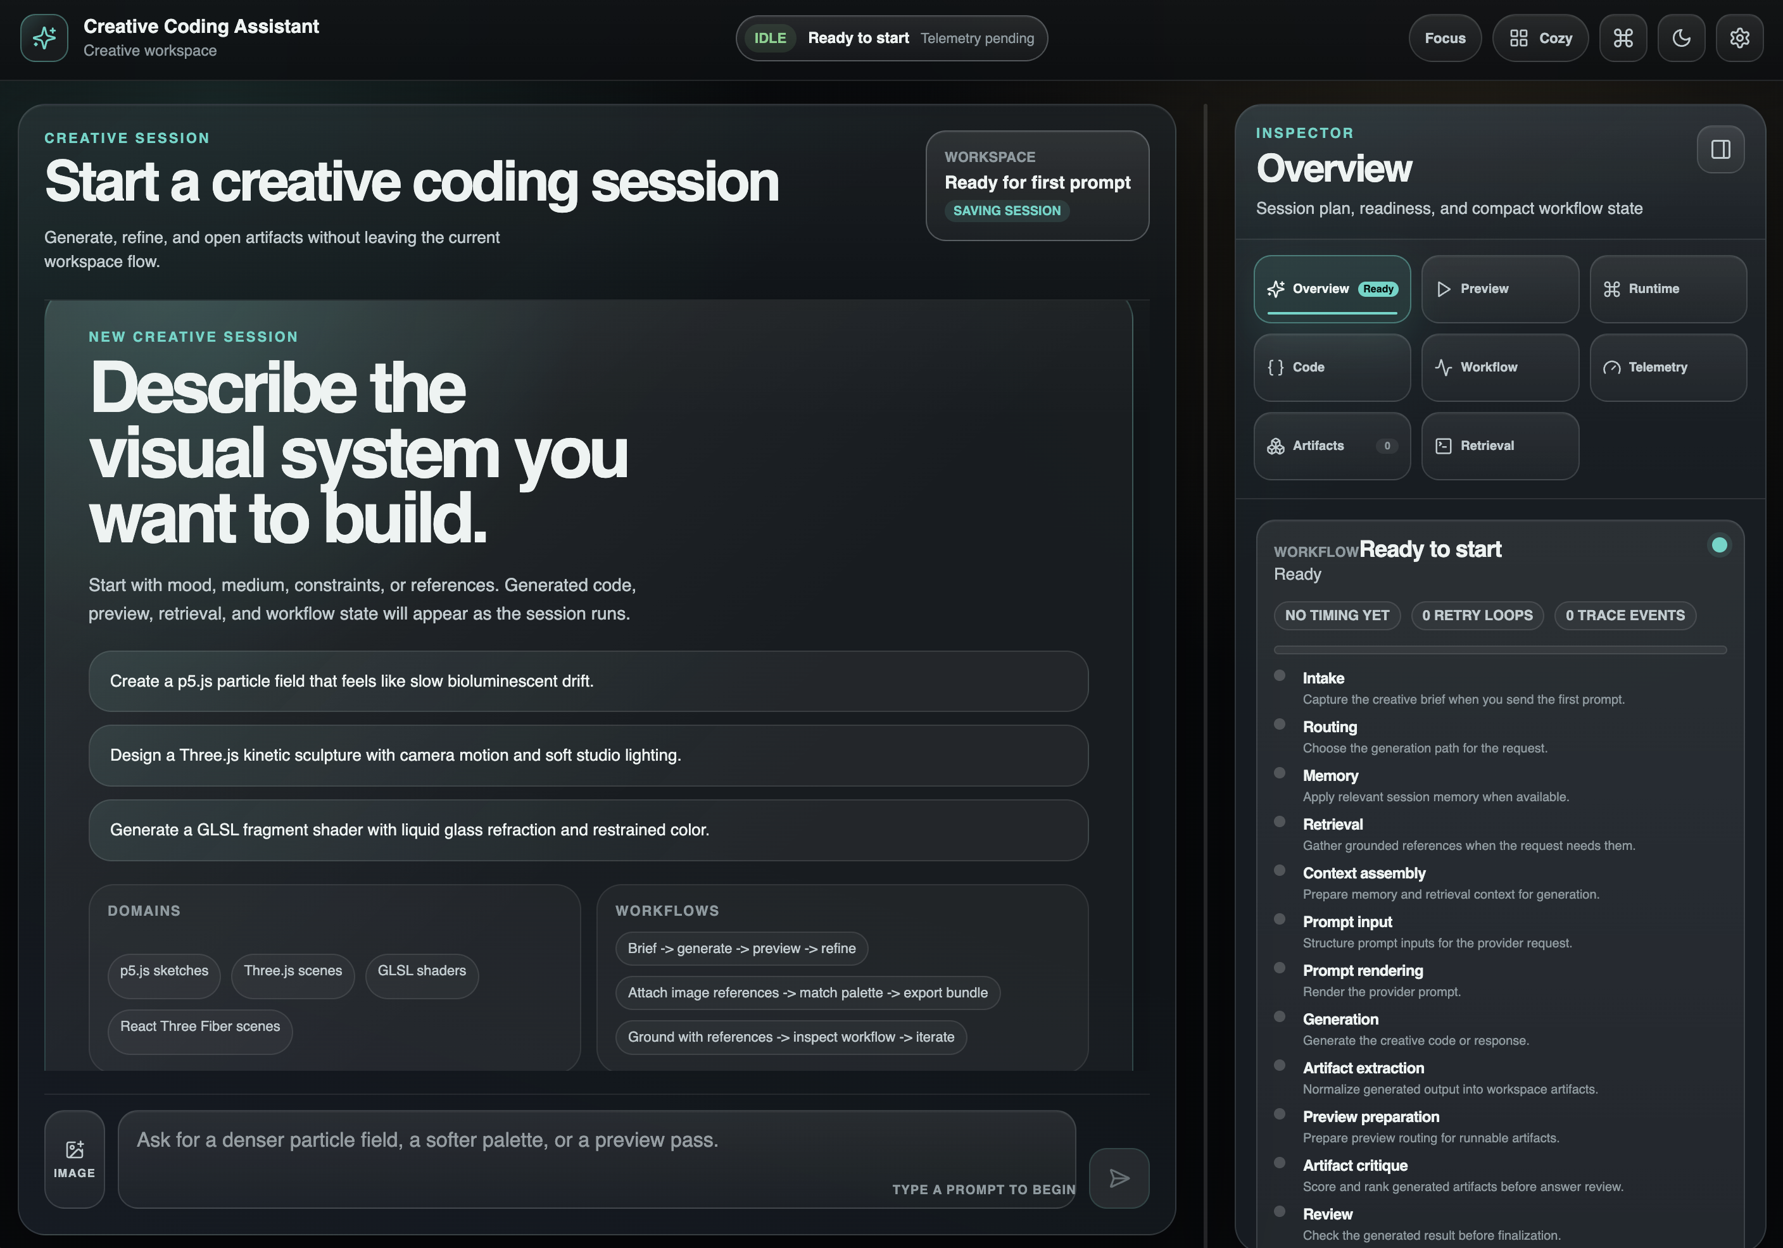
One traceable creative loop
FROM BRIEF TO ARTIFACT
Describe the visual system, attach a reference when needed, choose Single, Multi, or Auto, then generate. The workspace keeps preview, source, retrieval, workflow, telemetry, and refinement in the same session.
3

Slide 4
Workflow choice changes real execution
ROUTE
EXECUTE
REVIEW
Single · Multi · Auto
Auto resolves from the request; the graph shows the chosen path, never a decorative diagram.
Distinct node paths
Single stays lean. Multi adds planner, researcher, critic, and reviewer stages.
Bounded refinement
Critique can trigger one refinement before finalization and artifact delivery.
4

Slide 5
A thin UI over an evidence-bearing AI pipeline
PRODUCT SURFACE Next.js workstation, Dashboard, Inspector, preview runtimes, fullscreen, refinement, and export.
ORCHESTRATION Python WSGI API, LangGraph routing, memory, retrieval, generation, critique, and finalization.
EVIDENCE LAYER SQLite sessions, local Chroma knowledge, sanitized fixtures, telemetry, and explicit fallback states.
5

Slide 6
Hardest challenge: retrieval without moving the goalposts
A fixed seven-query, top-five report measured substantive source overlap and requested-domain coverage. These are deterministic local coverage indicators—not RAGAS scores.
16/23
18/19
Expected-source overlap
Requested-domain coverage
6

Slide 7
Validation is broad, local, and reproducible
LOCAL RELEASE GATES + APPROVED FIXTURE
Local gates passed: 2,688 Python tests + 423 subtests, 553 UI tests, type, lint, build, and 28/28 browser checks. Approved 4-row fixture: precision 1.0000 · faithfulness 0.2958 · answer relevancy 0.4743 · context relevancy 0.6875. It is not current-product quality.
2,688
61.44%
28/28
Python tests + 423 subtests
Approved fixture 4-row macro
Full browser smoke
7

Slide 8
Trust comes from explicit boundaries
ETHICS & PRIVACY
Accepted image bytes enter the request payload and are excluded from session persistence; live provider use remains unproven.
Raw local sessions, secrets, and private retrieval stores stay outside public evidence.
CONSENT
Image attachment is explicit
RETENTION
Pixels are request-scoped
PUBLICATION
Only sanitized fixtures ship
EVALUATION
Blocked evidence stays blocked
8

Slide 9
A capstone demo is a tested product path
10 curated flows, 4 canonical browser-validated showcases
Tone, p5.js, Three.js, and GLSL fixtures verify request contract, exact artifact, live runtime signal, fullscreen restore, refinement, and persistence.
They are deterministic local demo evidence—not provider-generation evidence.
Open a curated flow
Generate and inspect
Open live preview
Fullscreen and refine
Reload and verify
9

Slide 10
NEXT
From creative brief to defensible artifact
Image influence evidence
Parameter experiment dataset
Independent human acceptance

