Slide 1
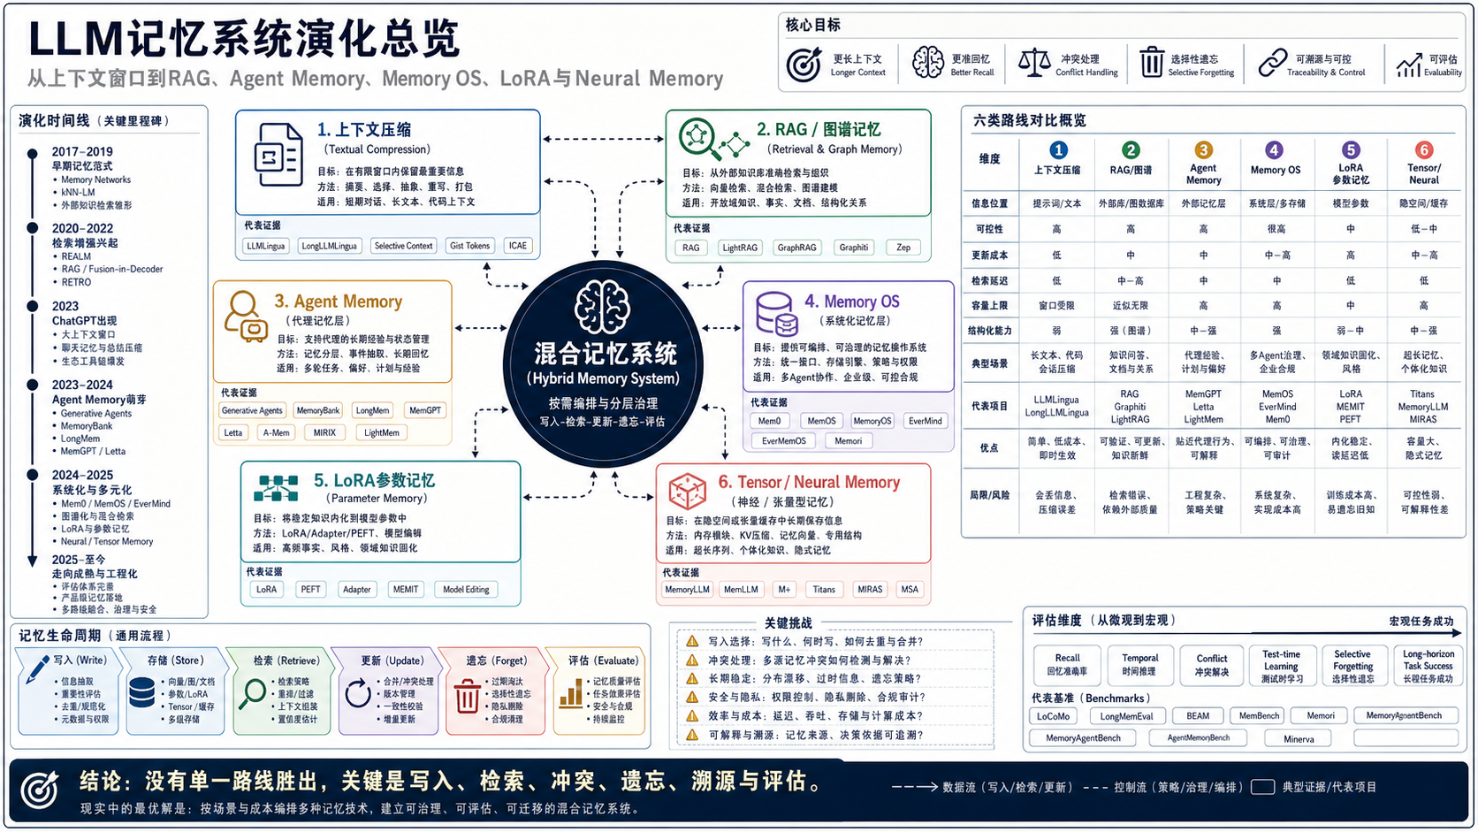
Notes:
Image-only slide 1: slide-01-overview.png. Generated with imagegen as a complete academic infographic page.

Slide 2
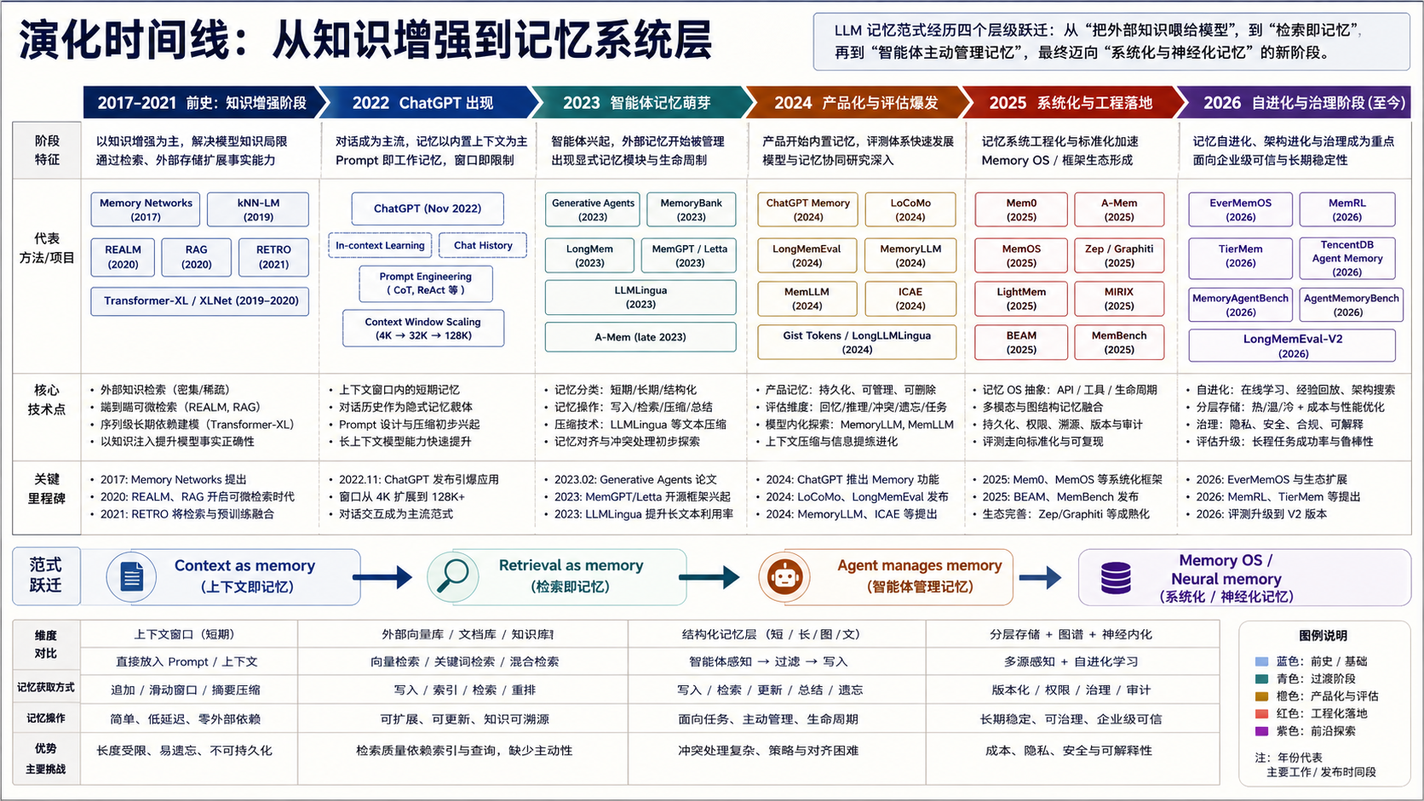
Notes:
Image-only slide 2: slide-02-timeline.png. Generated with imagegen as a complete academic infographic page.

Slide 3
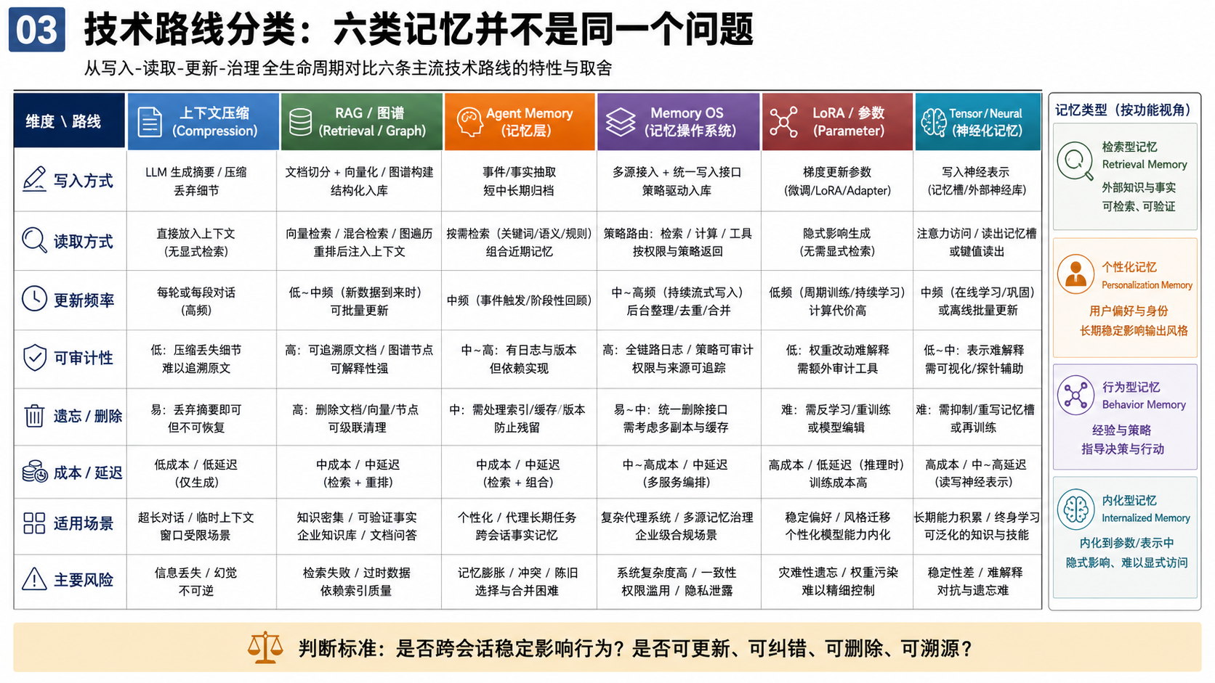
Notes:
Image-only slide 3: slide-03-taxonomy.png. Generated with imagegen as a complete academic infographic page.

Slide 4
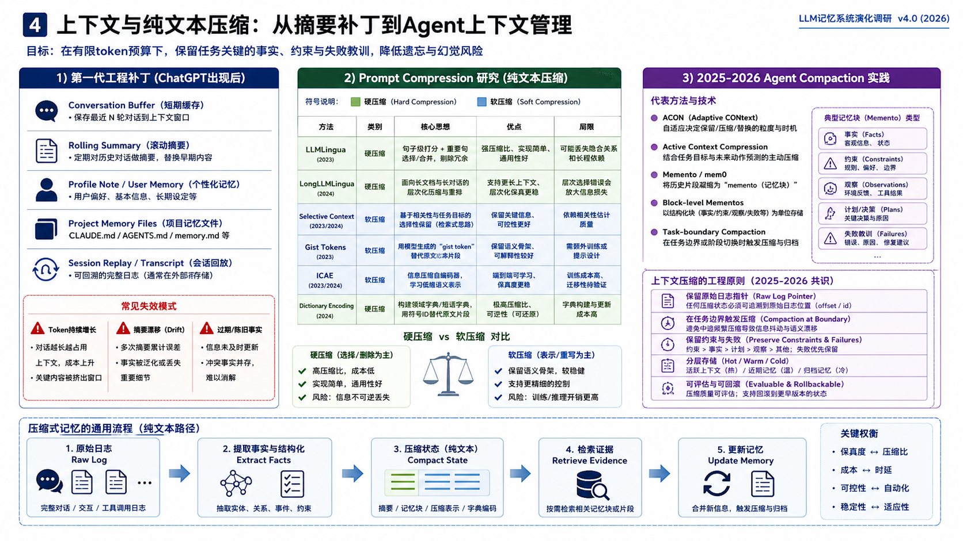
Notes:
Image-only slide 4: slide-04-compression.png. Generated with imagegen as a complete academic infographic page.

Slide 5
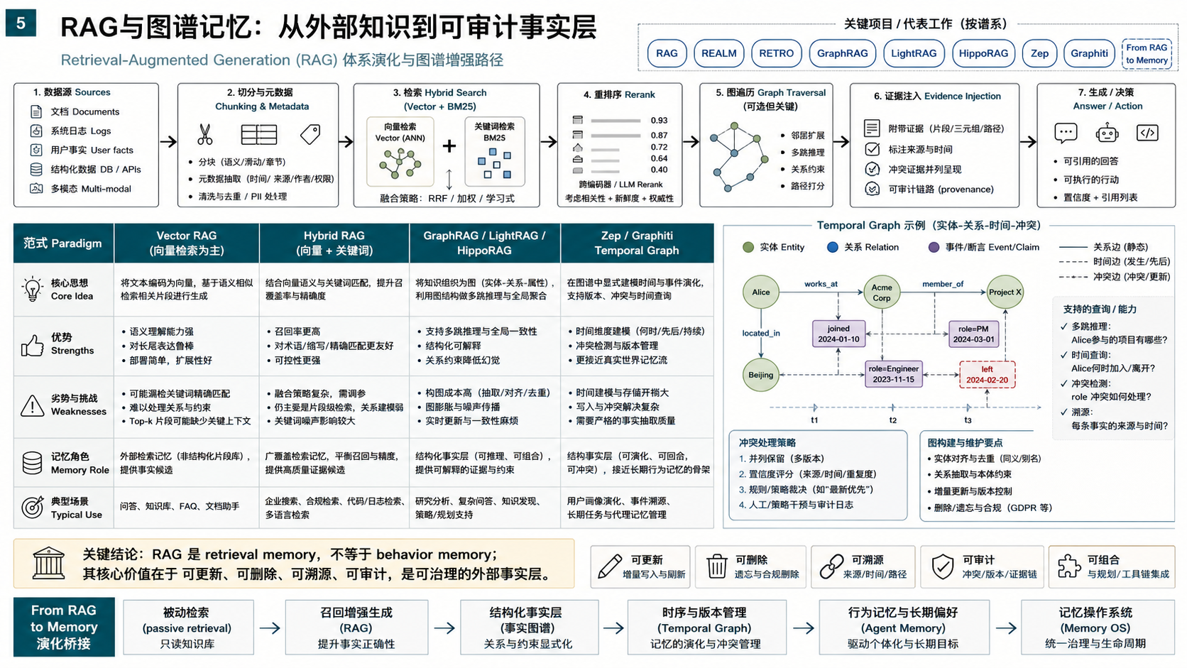
Notes:
Image-only slide 5: slide-05-rag-graph.png. Generated with imagegen as a complete academic infographic page.

Slide 6
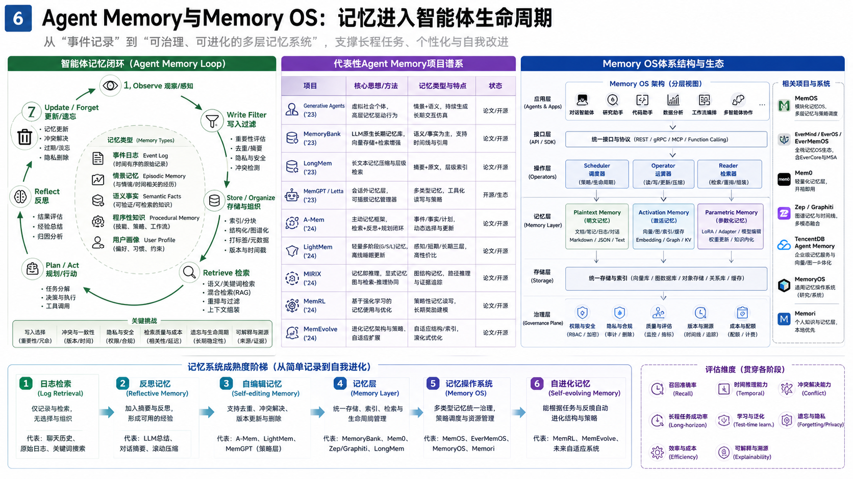
Notes:
Image-only slide 6: slide-06-agent-memory-os.png. Generated with imagegen as a complete academic infographic page.

Slide 7
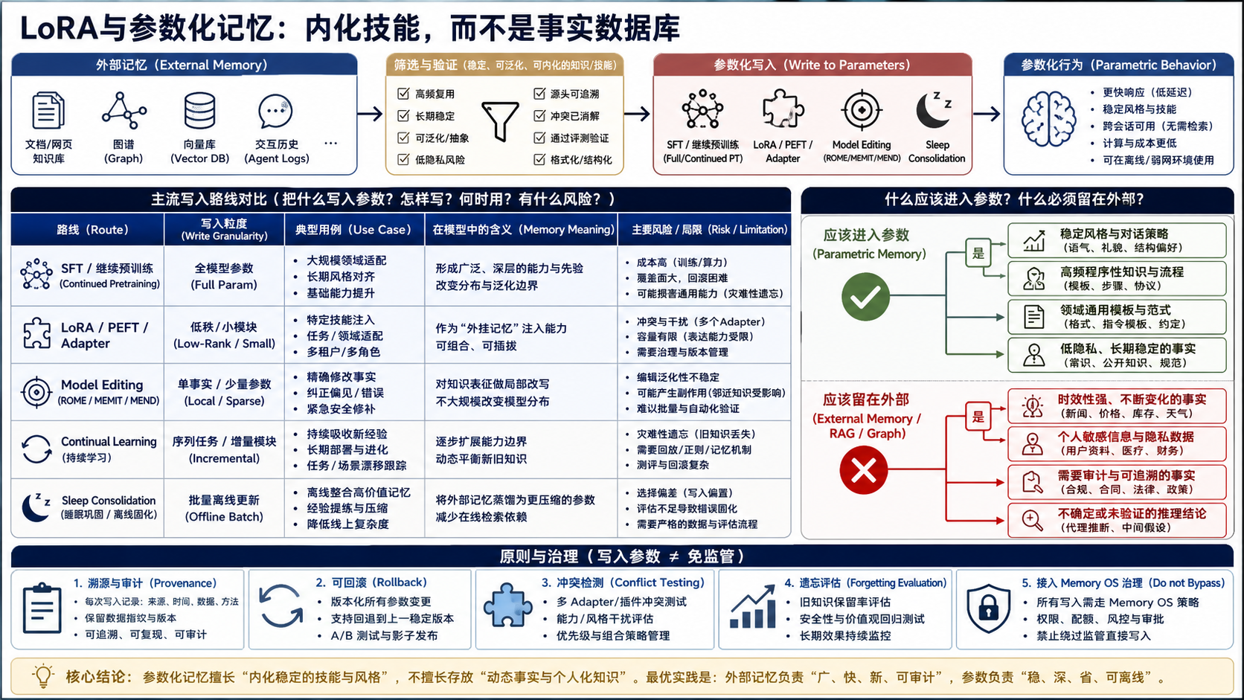
Notes:
Image-only slide 7: slide-07-lora.png. Generated with imagegen as a complete academic infographic page.

Slide 8
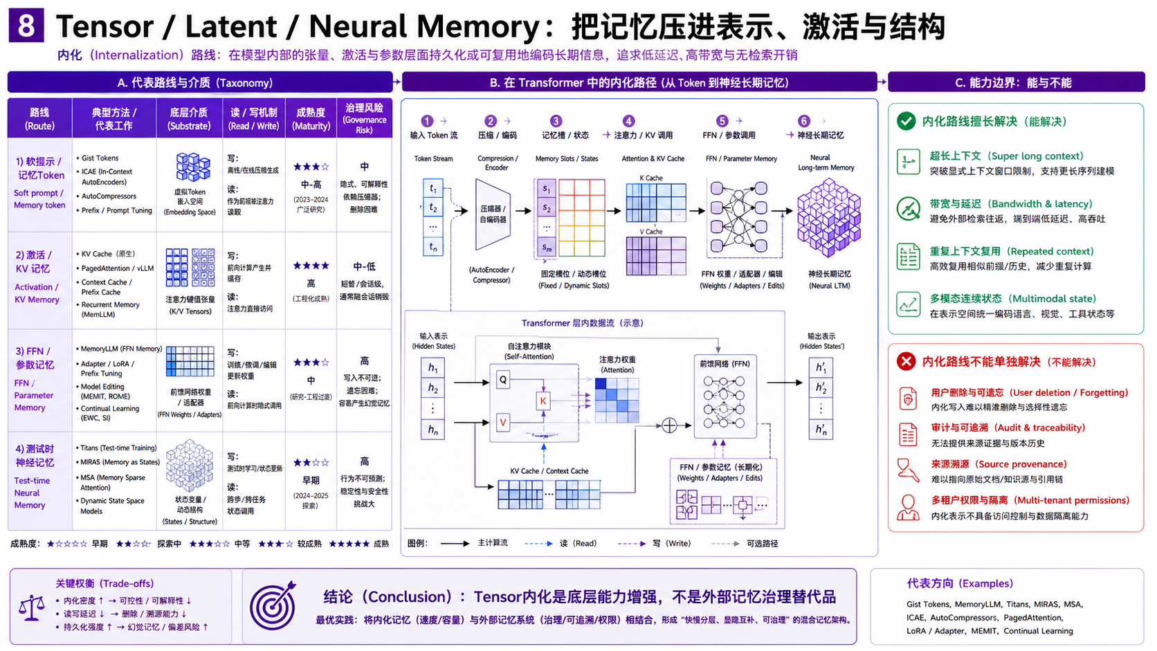
Notes:
Image-only slide 8: slide-08-tensor-neural.png. Generated with imagegen as a complete academic infographic page.

Slide 9
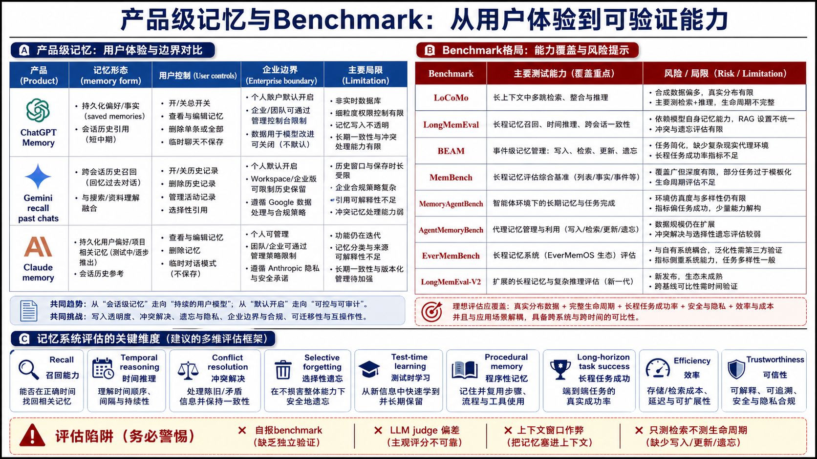
Notes:
Image-only slide 9: slide-09-products-benchmarks.png. Generated with imagegen as a complete academic infographic page.

Slide 10
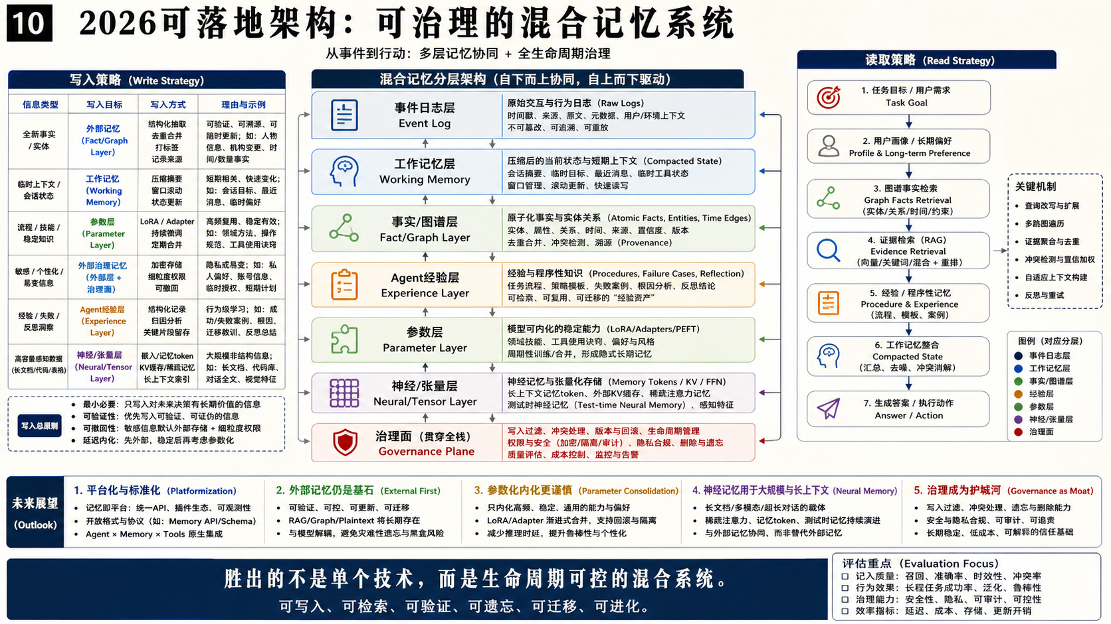
Notes:
Image-only slide 10: slide-10-architecture-outlook.png. Generated with imagegen as a complete academic infographic page.

