Slide 1
Surface-Mount IC
Prototyping Boards
James Bryant
European Applications Manager

Slide 2
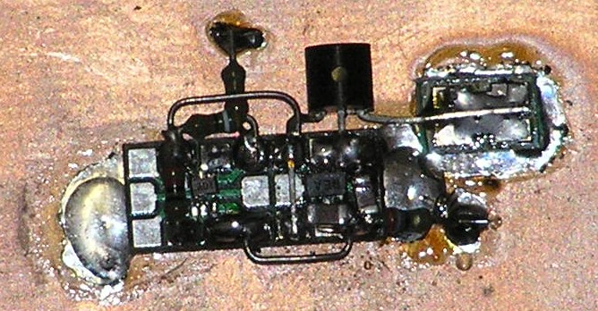
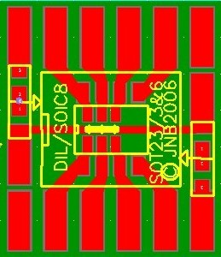
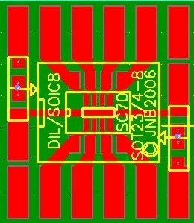
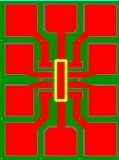
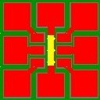

Slide 3
The Problem
Building breadboards with ^{tiny little} surface-mount ICs
The Solution
Small PC boards which hold SMDs and have pads (at 0.1” spacing)
which are large enough to mount larger wired components.
The boards, some of which can also carry DIL ICs, have provision
for supply decoupling and can be mounted on a PCB ground plane
by soldering their back plane to it (use a HOT iron!)
There are also strips of pads for mounting other components.
You can then breadboard just like you always used to.

Slide 4
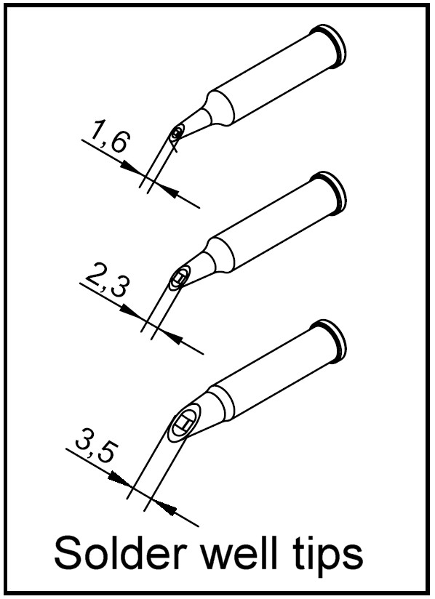
Another Problem
How do I mount the ICs on the little PCBs?
Another Solution
You need a good thermostatic soldering iron with a solder-well tip (see diagram)
1. Set the tip temperature to the temperature appropriate to the solder alloy
being used – lead free or not.
2. Place component and fix two opposing corner pins.
3. Apply flux liberally to all the pins of the IC.
4. Clean the solder-well tip on a sponge. Fill the concave portion of the tip with solder,
to slightly above the rim. DO NOT OVERFILL!
5. Holding your soldering iron VERY LIGHTLY in your hand, set the filled tip,
with the solder-well side parallel to the PCB, down onto the flat exterior portion of the
pins. The iron and tip should be parallel to the body of the SMD. Slowly pull it across
the pins towards you.
6. Repeat steps four and five for the remaining sides of the SMD. Remove flux
residue if necessary.

Slide 5
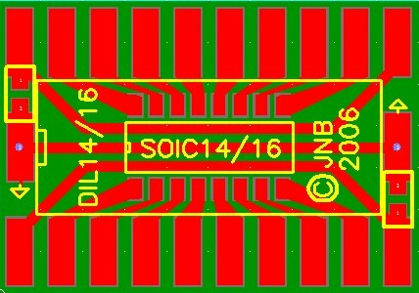
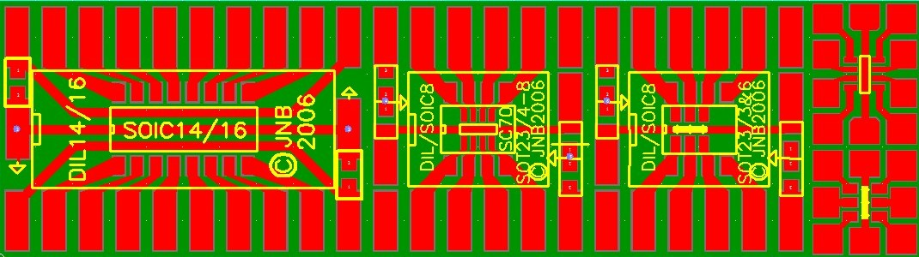
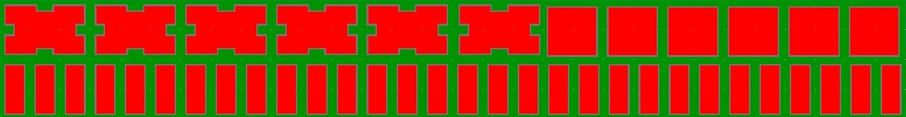
First Boards are Shown Below
Which packages should be next?
DIP 8
SOIC 8
SOT-23 (0.025” pitch)
SC70
With supply decoupling
and ground run-through
DIP 14/16
SOIC 14/16
With supply decoupling
and supply and ground
run-throughs
DIP 8
SOIC 8
SOT-23 (0.0375” pitch)
With supply decoupling
and ground run-through
SOT-23 (0.025” pitch)
SC70
With ground run-through
These boards are all on this
one and can be broken off it
(except that the little SOT-23 boards cannot be broken apart but must be separated with side cutters).
SOT-23 (0.0375” pitch)
With ground run-through
I have also made some strips of component mounting pads like these
They can be cut to length with side cutters
These are broken apart from this board

