Slide 1
Introduction to DHTC
Brian Lin
OSG Software Team
University of Wisconsin - Madison

Slide 2
Local High Throughput Computing
resources
local
UW - Madison
compute

Slide 3
Local High Throughput Computing
resources
local
UW - Madison
compute

Slide 4
How do you get more computing resources?

Slide 5
#1: Buy Hardware

Slide 6
#1: Buy Hardware
Great for specific hardware/privacy requirements
Costs $$$
Initial cost
Maintenance
Management
Power and cooling
Delivery and installation takes time
Rack/floor space
Obsolescence
Plan for peak loads, pay for all loads

Slide 7
#2: Use the Cloud

Slide 8
#2: Use the Cloud - Pay per cycle
e.g. Amazon Web Services, Google Compute Engine, Microsoft Azure, Rackspace
Fast spin-up
Costs $$$
Still needs expertise + management
Easier than in the past with the condor_annex tool
Does payment fit with your institutional or grant policies?

Slide 9
#2: Use the Cloud - ‘Managed’ clouds
e.g. Cycle Computing, Globus Genomics
Pay someone to manage your cloud resources — still costs $$$
Researchers and industry have used this to great success
Using Docker, HTCondor, and AWS for EDA Model Development
Optimizations in running large-scale Genomics workloads in Globus Genomics using HTCondor
HTCondor in the enterprise
HTCondor at Cycle Computing: Better Answers. Faster.

Slide 10
#3: Share Resources

Slide 11
#3: Share Resources - Distributed HTC
University of Chicago
University of Nebraska - Lincoln
UW - Madison

Slide 12
i.
Split Up Your Jobs Manually
Let’s start sharing!

Slide 13

Manual Job Split
Obtain login access
Query each cluster for idle resources
Split and submit jobs based on resource availability
Photo by Denys Nevozhai on Unsplash

Slide 14
#3: Share Resources - Distributed HTC
University of Chicago
University of Nebraska - Lincoln
UW - Madison

Slide 15
#3: Share Resources - Distributed HTC
University of Chicago
University of Nebraska - Lincoln
UW - Madison

Slide 16
Manual Job Split - Shortcomings
Fewer logins = fewer potential resources
More logins = more account management
Why would they give you accounts? Are your friends going to want CHTC accounts?
Querying and splitting jobs is tedious and inaccurate
Not all clusters use HTCondor — other job schedulers e.g., SLURM, PBS, etc.
Pools are independent — workflows must be confined to a single pool

Slide 17
ii.
Split Up Your Jobs Automatically
Let the computers do the work

Slide 18

Automatic Job Split - Shortcomings
Homer: Kids: there's three ways to do things; the right way, the wrong way and the Max Power way!
Bart: Isn't that the wrong way?
Homer: Yeah, but faster!
Groening, M (Writer), Michels, P. (Director) . (1999). Homer to the Max [Television Series Episode]. In Scully, M. (Executive Producer), The Simpsons. Los Angeles, CA: Gracie Films

Slide 19
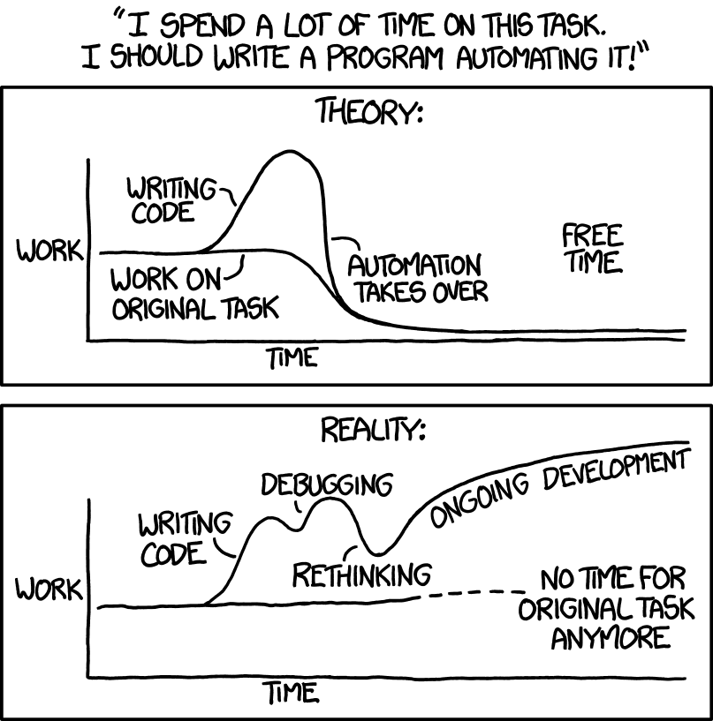
Automatic Partitions - Shortcomings
Source: https://xkcd.com/1319/

Slide 20
#3: Share Resources - Requirements
Minimal account management
No job splitting
DAG workflow functionality
HTCondor only!
No resource sharing requirements

Slide 21
iii.
Overlay Systems
Let the OSG do the heavy lifting

Slide 22
The OSG Model
OSG Submit and CM
OSG
Cluster

Slide 23


The OSG Model
OSG Submit and CM
OSG
Cluster

Slide 24
The OSG Model
Pilot Jobs
OSG Submit and CM
OSG
Cluster

Slide 25
The OSG Model
Pilot Jobs
OSG Submit and CM
OSG
Cluster

Slide 26




Job Matching
On a regular basis, the central manager reviews Job and Machine attributes and matches jobs to slots.
execute
submit
central manager
execute
execute

Slide 27
The OSG Model
OSG Submit and CM
OSG
Cluster

Slide 28

The OSG Model - Jobs in Jobs
Photo Credit: Shereen M, Untitled, Flickr https://www.flickr.com/photos/shereen84/2511071028/ (CC BY-NC-ND 2.0)

Slide 29
#3: Share Resources - Requirements
Minimal account management: only one submit server
No job splitting: only one HTCondor pool
DAG workflow functionality: Only one HTCondor pool
HTCondor only: Only one HTCondor pool
No resource sharing requirements: the OSG doesn’t require that users “pay into” the OSG

Slide 30
The OSG Model - Recap
Pilot jobs (or pilots) are special jobs
Pilots are sent to sites with idle resources
Pilot payload = HTCondor execute node software
Pilot execute node reports to your OSG pool
Pilots lease resources:
Lease expires after a set amount of time or lack of demand
Leases can be revoked!

Slide 31
The OSG Model - Leasing the Cloud
What if there aren’t enough idle resources?
Combine overlay system with cloud technology
Some of your OSG jobs may run in the cloud in the next few years
… but this should be completely transparent to you

Slide 32

The OSG Model - Collection of Pools
Your OSG pool is just one of many
Separate pools for each Virtual Organization (VO)
Your jobs will run on the OSG VO pool
Photo by Martin Sanchez on Unsplash

Slide 33
The OSG Model - Getting Access
During the school:
OSG submit node at UW (exercises)
OSG submit node via OSG Connect (Thursday)
After the school:
Both of the above
VO-hosted submit nodes
Institution integration with the OSG

Slide 34
Questions?

