Slide 1
What’s Different About Overlay Systems?
Brian Lin
OSG Software Team
University of Wisconsin - Madison

Slide 2

Overlay Systems are Awesome!
Photo by Zachary Nelson on Unsplash

Slide 3
What’s the Catch?
Requires more infrastructure, software, set-up, management, troubleshooting...

Slide 4
“You know you have a distributed system when the crash of a computer you’ve never heard of stops you from getting any work done.”
- Leslie Lamport

Slide 5
#1: Heterogenous Resources
Accounting for differences between the OSG and your local cluster

Slide 6
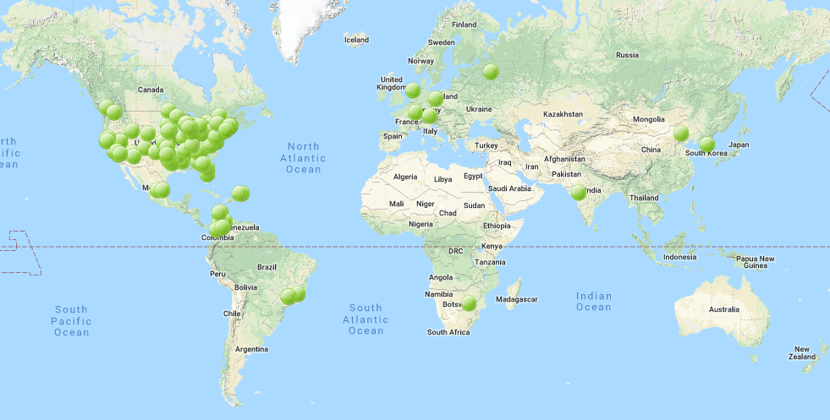
Sites of the OSG
Source: http://display.opensciencegrid.org/

Slide 7
Heterogeneous Resources - Software
Different operating systems (Red Hat, CentOS, Scientific Linux; versions 6 and 7)
Varying software versions (e.g., at least Python 2.6)
Varying software availability (e.g., no BLAST*)
Solution: Make your jobs more portable: OASIS, containers, etc (more in Wednesday’s talks)

Slide 8
Hetero. Resources - Hardware
CPU: Mostly single core
RAM: Mostly < 8GB
GPU: Limited #s but more being added
Disk: No shared file system (more in Thursday’s talks)
Solution: Split up your workflow to make your jobs more high throughput

Slide 9
#2: With Great Power Comes Great Responsibility
How to be a good netizen

Slide 10

Resources You Don’t Own
Primary resource owners can kick you off for any reason
No local system administrator relationships
No sensitive data (again)!
Photo by Nathan Dumlao on Unsplash

Slide 11
Be a Good Netizen!
Use of shared resources is a privilege
Only use the resources that you request
Be nice to your submit nodes
Solution: Test jobs on local resources with condor_submit -i

Slide 12
#3: Slower Ramp Up
Leasing resources takes time!

Slide 13
Slower Ramp Up
Adding slots: pilot process in the OSG vs slots already in your local pool
Not a lot of time (~minutes) compared to most job runtimes (~hours)
Small trade-off for increased availability
Tip: If your jobs only run for < 10min each, consider combining them so each job runs for at least 30min

Slide 14
Robustify Your Jobs
Succeeding in the face of failure

Slide 15
Job Robustification
Test small, test often
Specify output, error, and log files at least while you develop your workflow
Use on_exit_hold to catch different failure modes
on_exit_hold = (ExitCode =?= 3)
on_exit_hold = (time() - JobCurrentStartDate < 1 * $(HOUR))
For jobs that run too long:
periodic_hold = (time() - JobCurrentStartDate > 4 * $(HOUR))
periodic_release = (HoldReasonCode == 3) && (NumJobStarts < 3)
HoldReasonCode is 3 for any jobs where on_exit_hold or periodic_hold evaluate to True

Slide 16
Job Robustification
In your own code:
Self checkpointing
Different exit codes for use with on_exit_hold
Defensive troubleshooting (hostname, ls -l, pwd, condor_version in your wrapper script)
Add simple logging (e.g. print, echo, etc)

Slide 17
Questions?

