Slide 1
Security in the OSG
King of France, Louis XVI Restorer of French Liberty
Place d'Armes, 78000
Versailles, France

Slide 2
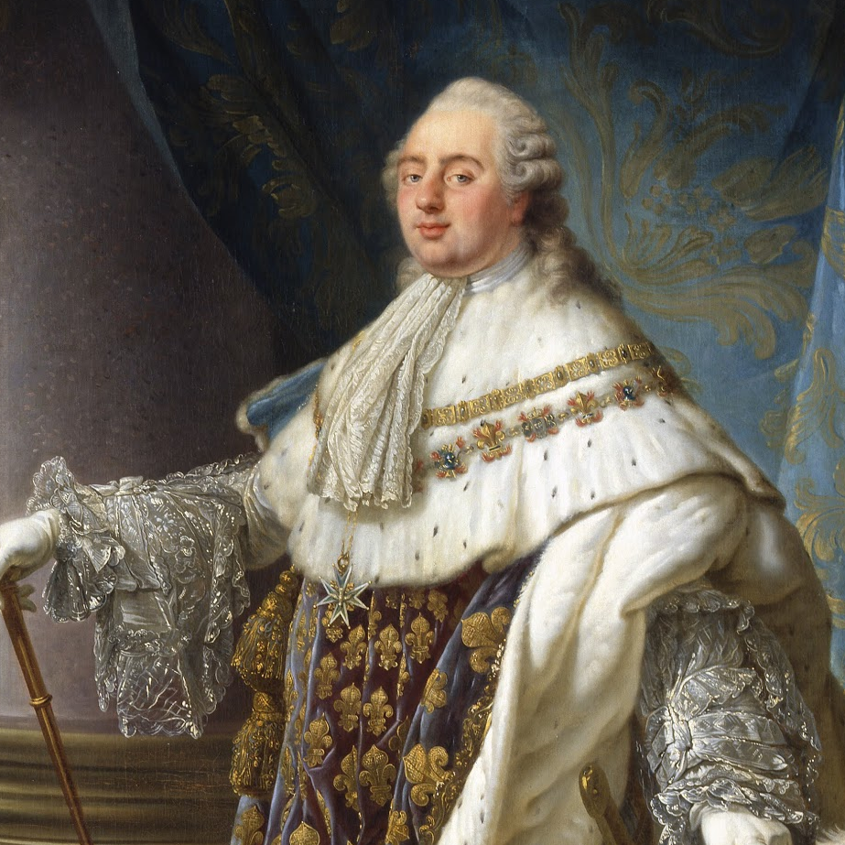
The Real King Louis XVI?
Nope, he was a decoy because I’m not about those guillotines

Slide 3
Security in the OSG
Brian Lin
OSG Software Team
University of Wisconsin - Madison

Slide 4
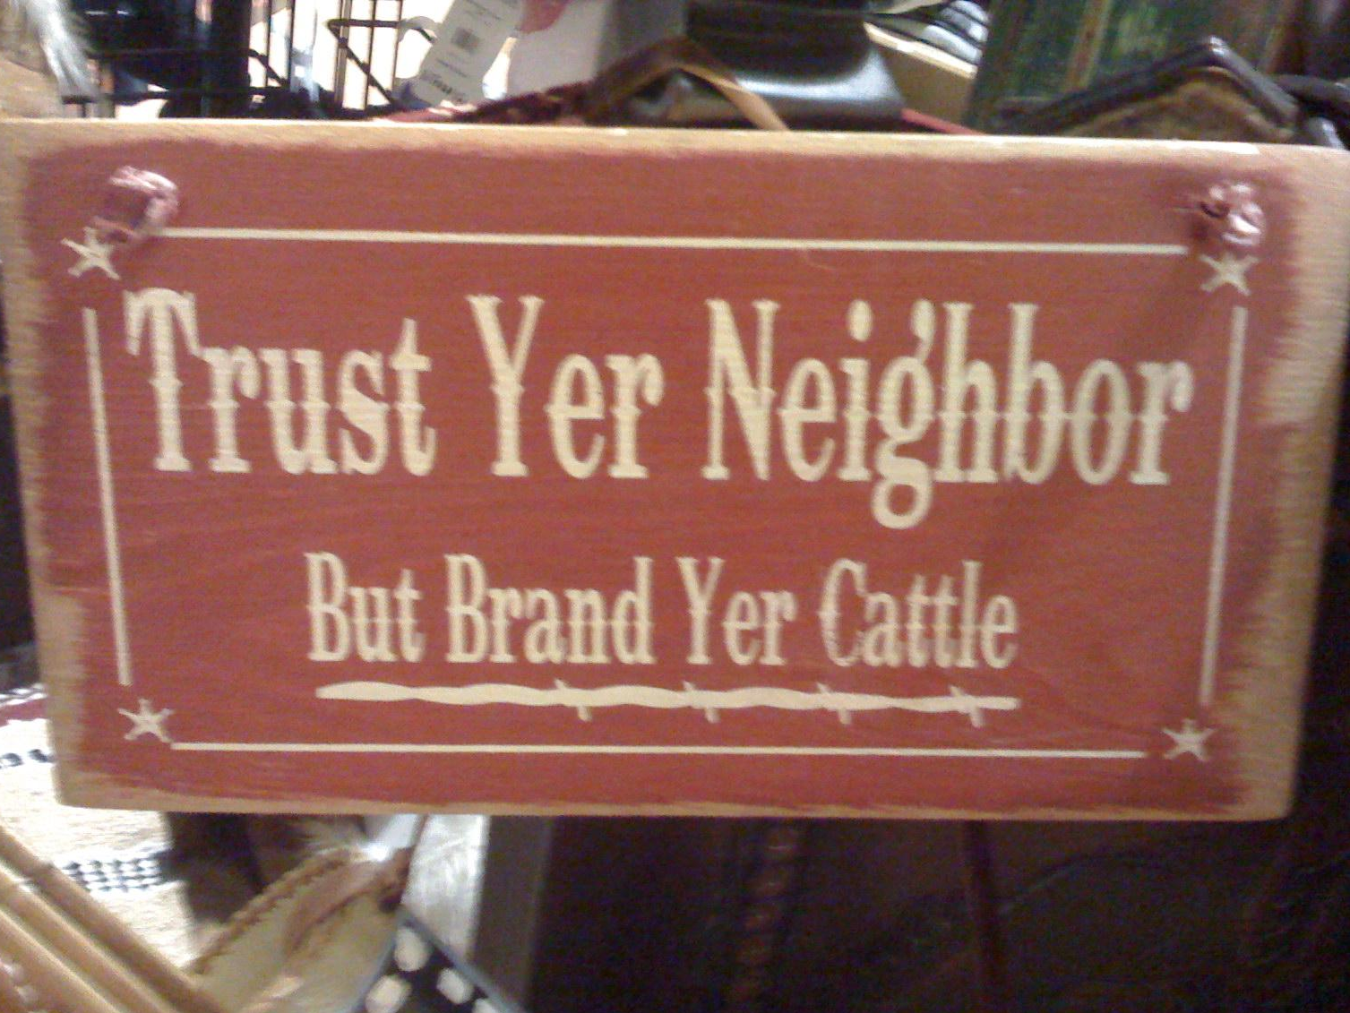
What is Trust?
Trust: reliance on the integrity or surety of a person or thing
Obtaining trust:
Prior knowledge and/or experience
Appeal to authority
Chains of trust
Photo by wfryerCC BY-SA

Slide 5
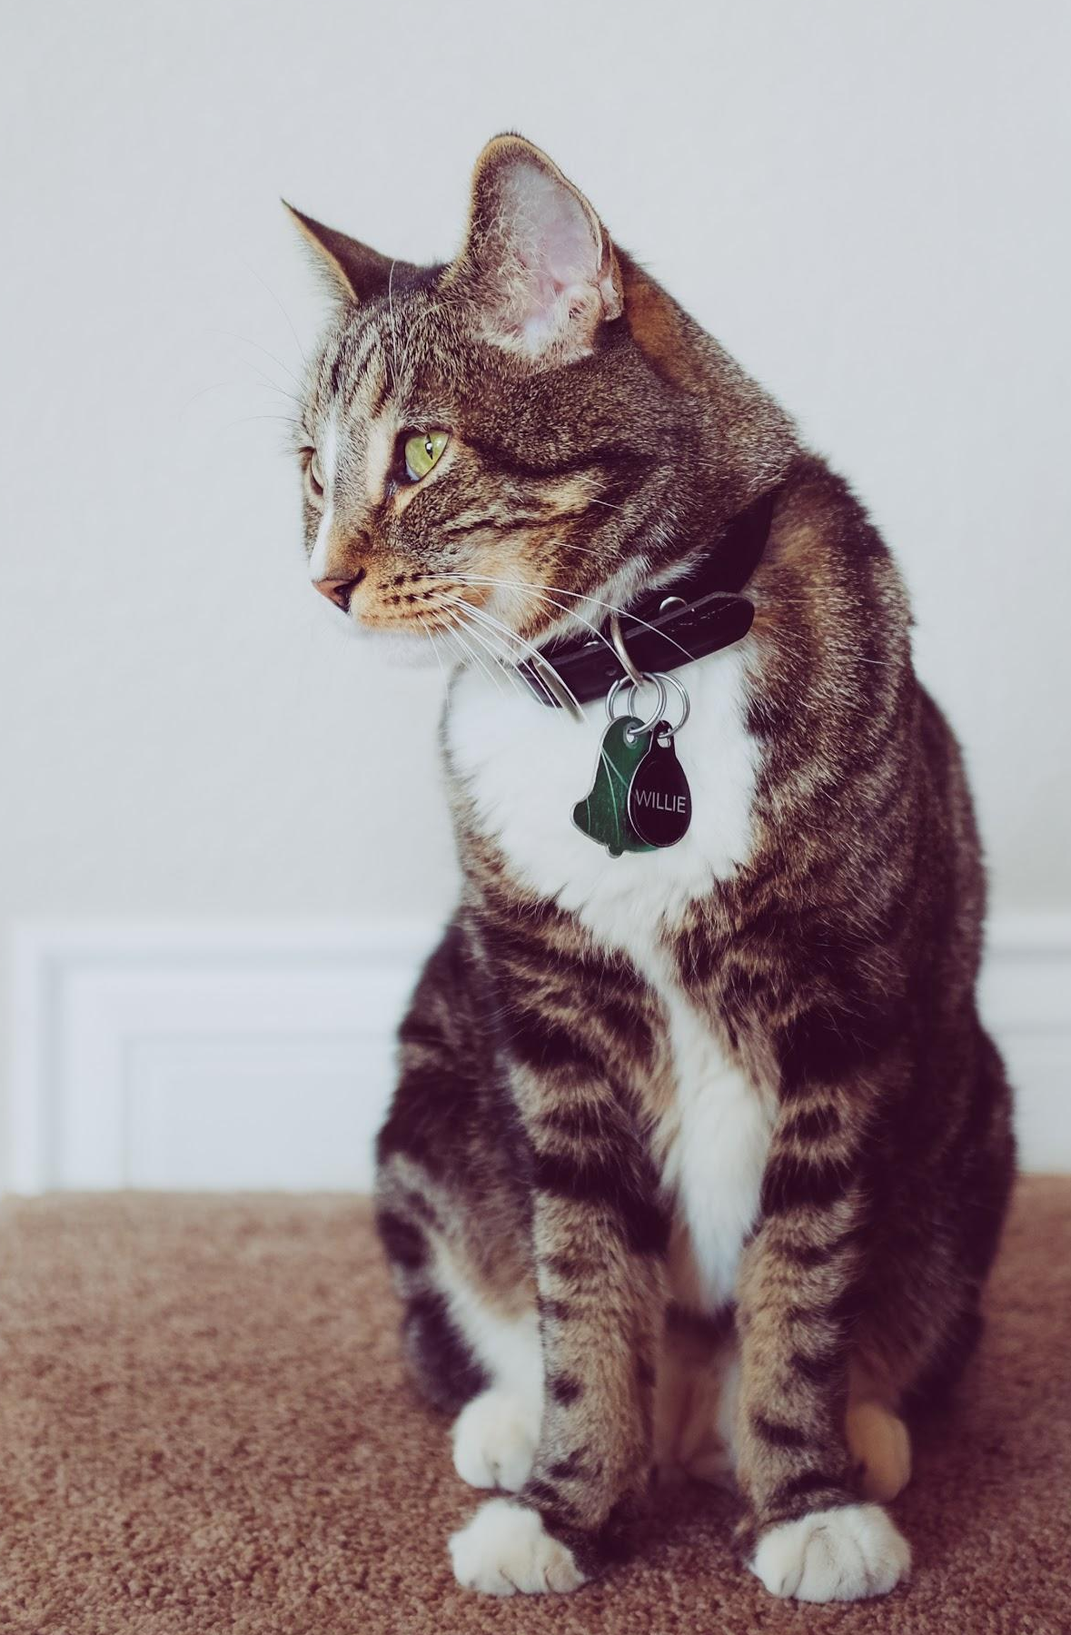
Identity and Identification
Identity: who someone is, Willie the Cat
Identification: proof of who someone is, Willie’s collar
Real word ID: photos, SSN, driver’s license, passport, etc.
Internet ID: usernames (kinglouis16), certificates
Photo by NeONBRAND on Unsplash

Slide 6
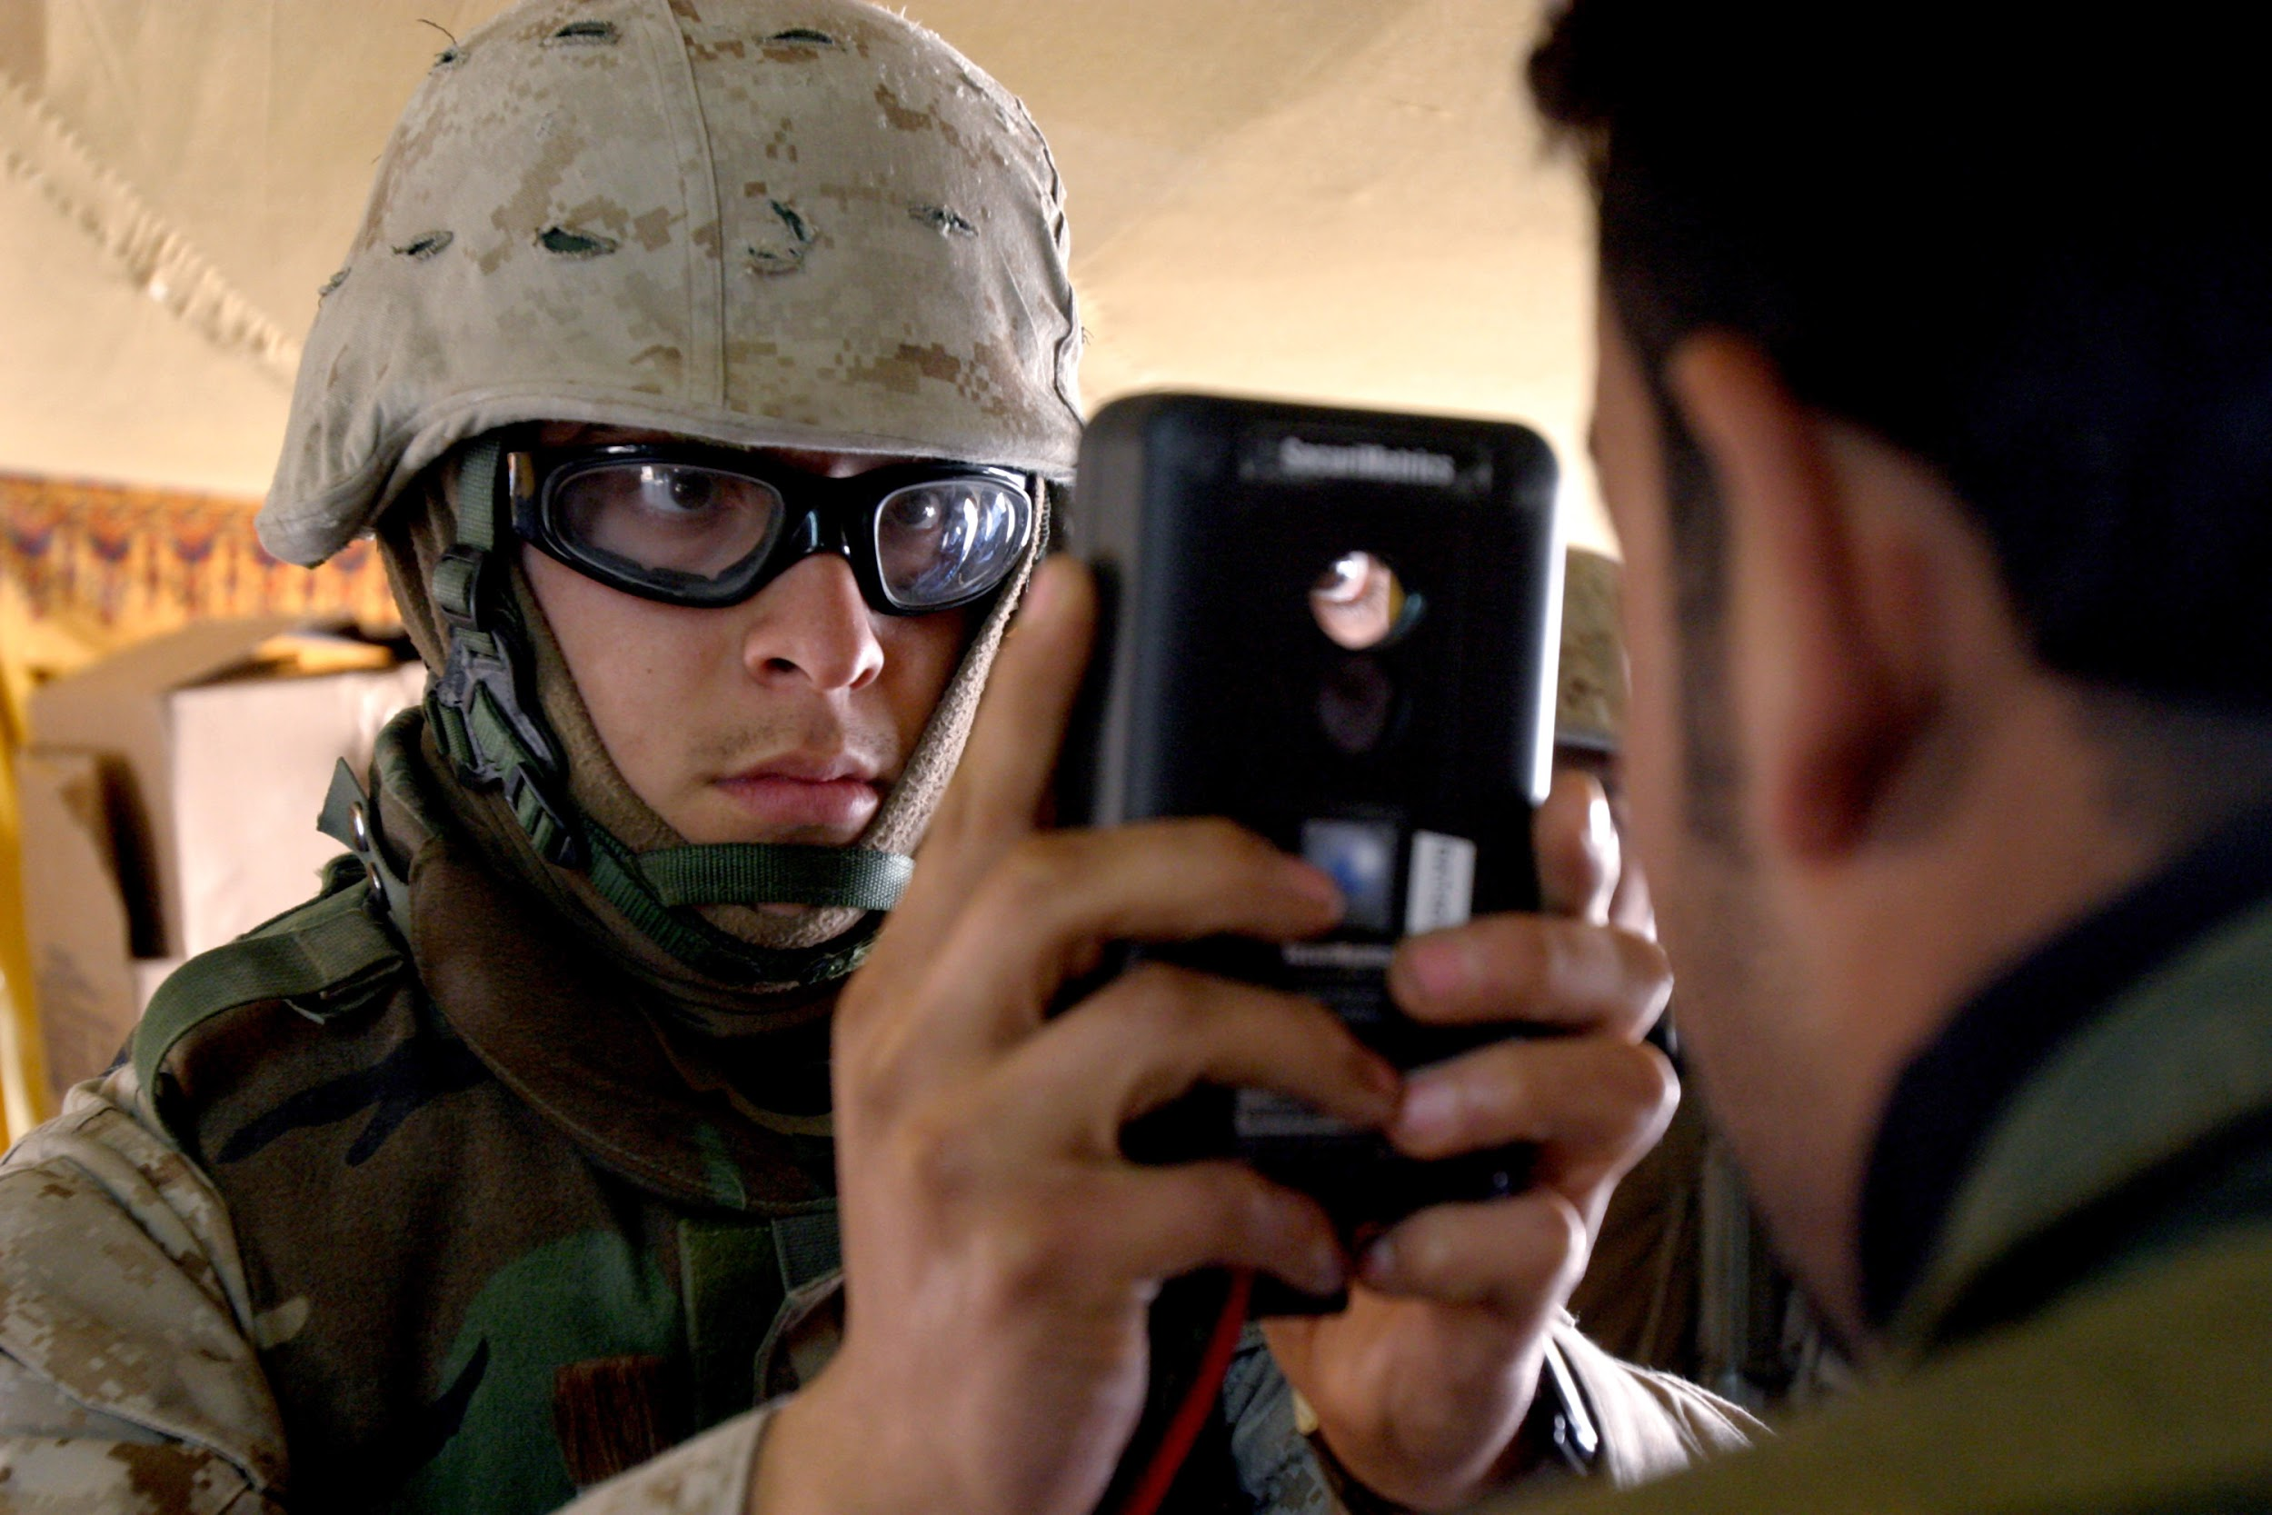
Authentication (AuthN)
Authentication: trusting identification
Username + password, shared secret (public key cryptography), two-factor, etc.
Authentication online often goes both ways
Photo by expertinfrantry BY-SA

Slide 7
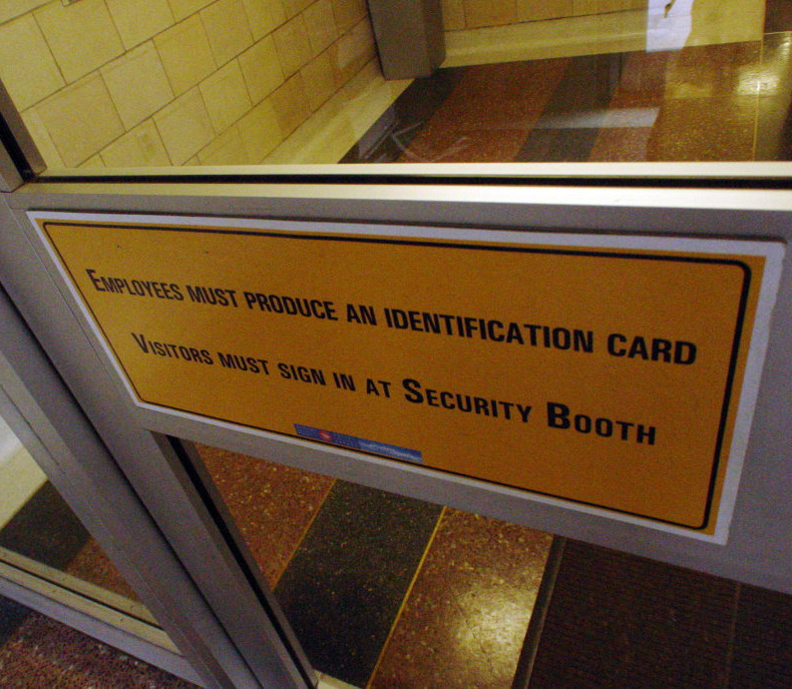
Authorization (AuthZ)
Authorization: trusting identities
A description of the privilege level of an identity
What are you authorized to do on our submit nodes?
Photo by jmv BY-SA

Slide 8
HTCondor AuthN and AuthZ
Many different authentication methods (Unix file system, SSL, Kerberos, etc)
Fine grained control over authorization levels and who belongs to each authorization level
Not just any server can join the pool
Not just any user can submit jobs
Jobs run as your Unix user on the execute servers

Slide 9

Is Your Data Secure?
You are using a shared computer so take basic precautions (no world-writable files)!
Save strong login credentials in a password store
NO sensitive data (e.g. HIPAA)
Otherwise, relatively low risk
Photo by sebastiaan stam on Unsplash

Slide 10
Security in the OSG
Certificate-based security for pilots jobs and servers
Pilot jobs run under the same Unix user, Singularity containers provide some separation between VO users
VOs vet users; system administrators vet servers
The OSG Security Team tracks software vulnerabilities and responds to security incidents
Certificate revocation of compromised machines
Site administrators keep audit logs for traceability in case of security issues

Slide 11
Questions?

