Slide 1

High-Throughput Machine Learning from Electronic Health Records
Ross Kleiman
Paul Bennett, Scott Hebbring,
Charles Kuang, Peggy Peissig,
Michael Caldwell, David Page,
Finn Kuusisto, Ron Stewart
Notes:
Mention Paul is an equal partner on this work

Slide 2

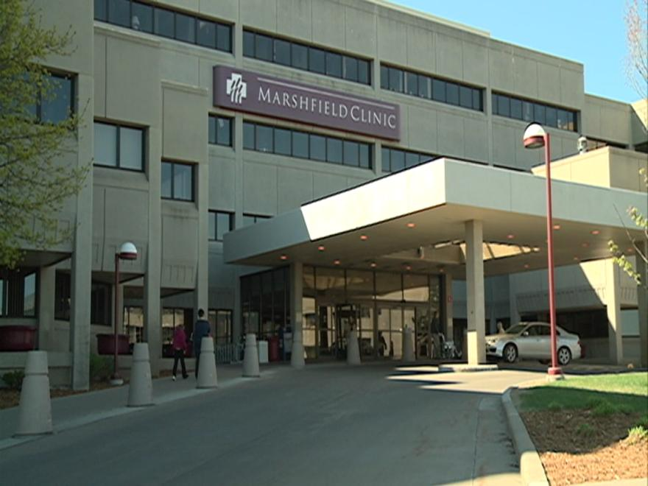
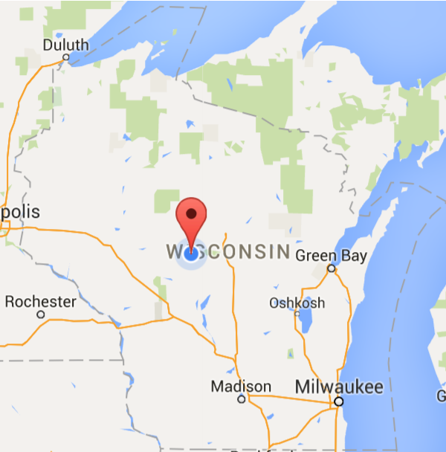
Marshfield Clinic EHR
Marshfield Clinic
Health system in North Central Wisconsin
1.5M Patient Records spanning 40 years
Demographics
Diagnoses (ICD-9)
Labs
Procedures
Vitals
Notes:
Discuss what EHR data looks like

Slide 3

Predicting All Diagnoses
Prior work: Individual disease models
How well can we predict all diagnoses?
Given: All EHR data
Do: Learn model to predict each disease
Build a high-throughput machine learning pipeline
ICD-9 Code
>100 Years of Computing!
Notes:
Would like to model each disease, but only given ICD-9 codes
ICD-9 codes -> disease: phenotyping task
Rule-of-2 definition
How far in advance can we predict?
We are building a pipeline, I will walk through it
HTML is building thousands of models from one database
This is a novel contribution

Slide 4
Data Cleaning
Originally 1.5M patients
Remove Infrequent Patients
4 diagnoses and 2 encounters
1.1M patients remained (~73%)

Slide 5
Case and Control Definition
Identify cases and controls for each ICD-9 code
Rule-of-2
Case has 2 or more target codes
Control has no target codes
Minimum of 500 cases per ICD-9 code
DX1
DX2
…
…
…
DXn

Slide 6
Case Control Matching
Case
Censor
DX
DX
Birth
Present day
+++++
Chart data
Control
Birth
Death
Chart data
Notes:
Look for a minimum of 500 pairs of patients
Orange is case, purple is control
Match on gender, and age (30 days)
30 day right-censor to prevent class label leakage

Slide 7
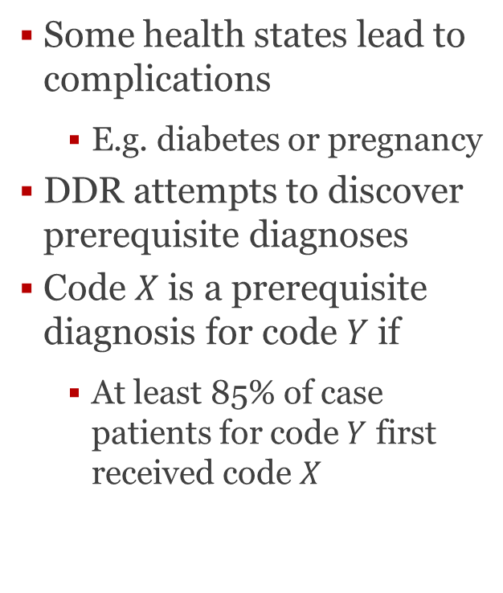
Dynamic Definition Refinement
Some health states lead to complications
E.g. diabetes or pregnancy
DDR attempts to discover prerequisite diagnoses
Code $X$ is a prerequisite diagnosis for code $Y$ if
At least 85% of case patients for code $Y$ first received code $X$
DX1
DXi
DX2
…
…
…
DXn
DK_{j}, DXk

Slide 8
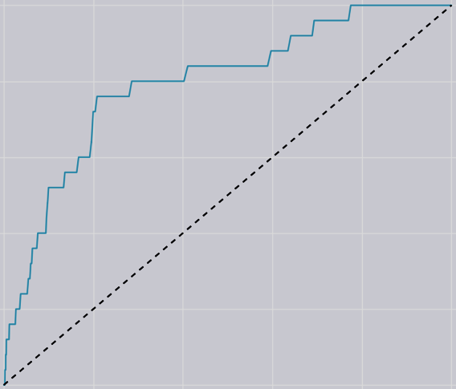
Model Construction and Evaluation
Model nearly every ICD-9 code
At least 500 case-control pairs
Exclude symptoms
Build model: Random Forest Classifier
Evaluation metric: AUC-ROC
Notes:
Nearly 4,000 codes modeled

Slide 9
HTCondor & Our Research
Compute time
~47,500 Condor jobs
~18 hours per job
~400 concurrent jobs
~1 Century of compute time in 3 months
Specialized security measures
Healthcare data is sensitive
Fully separate submit server with highly restricted user pool
Data encrypted during transmission and on disk

Slide 10
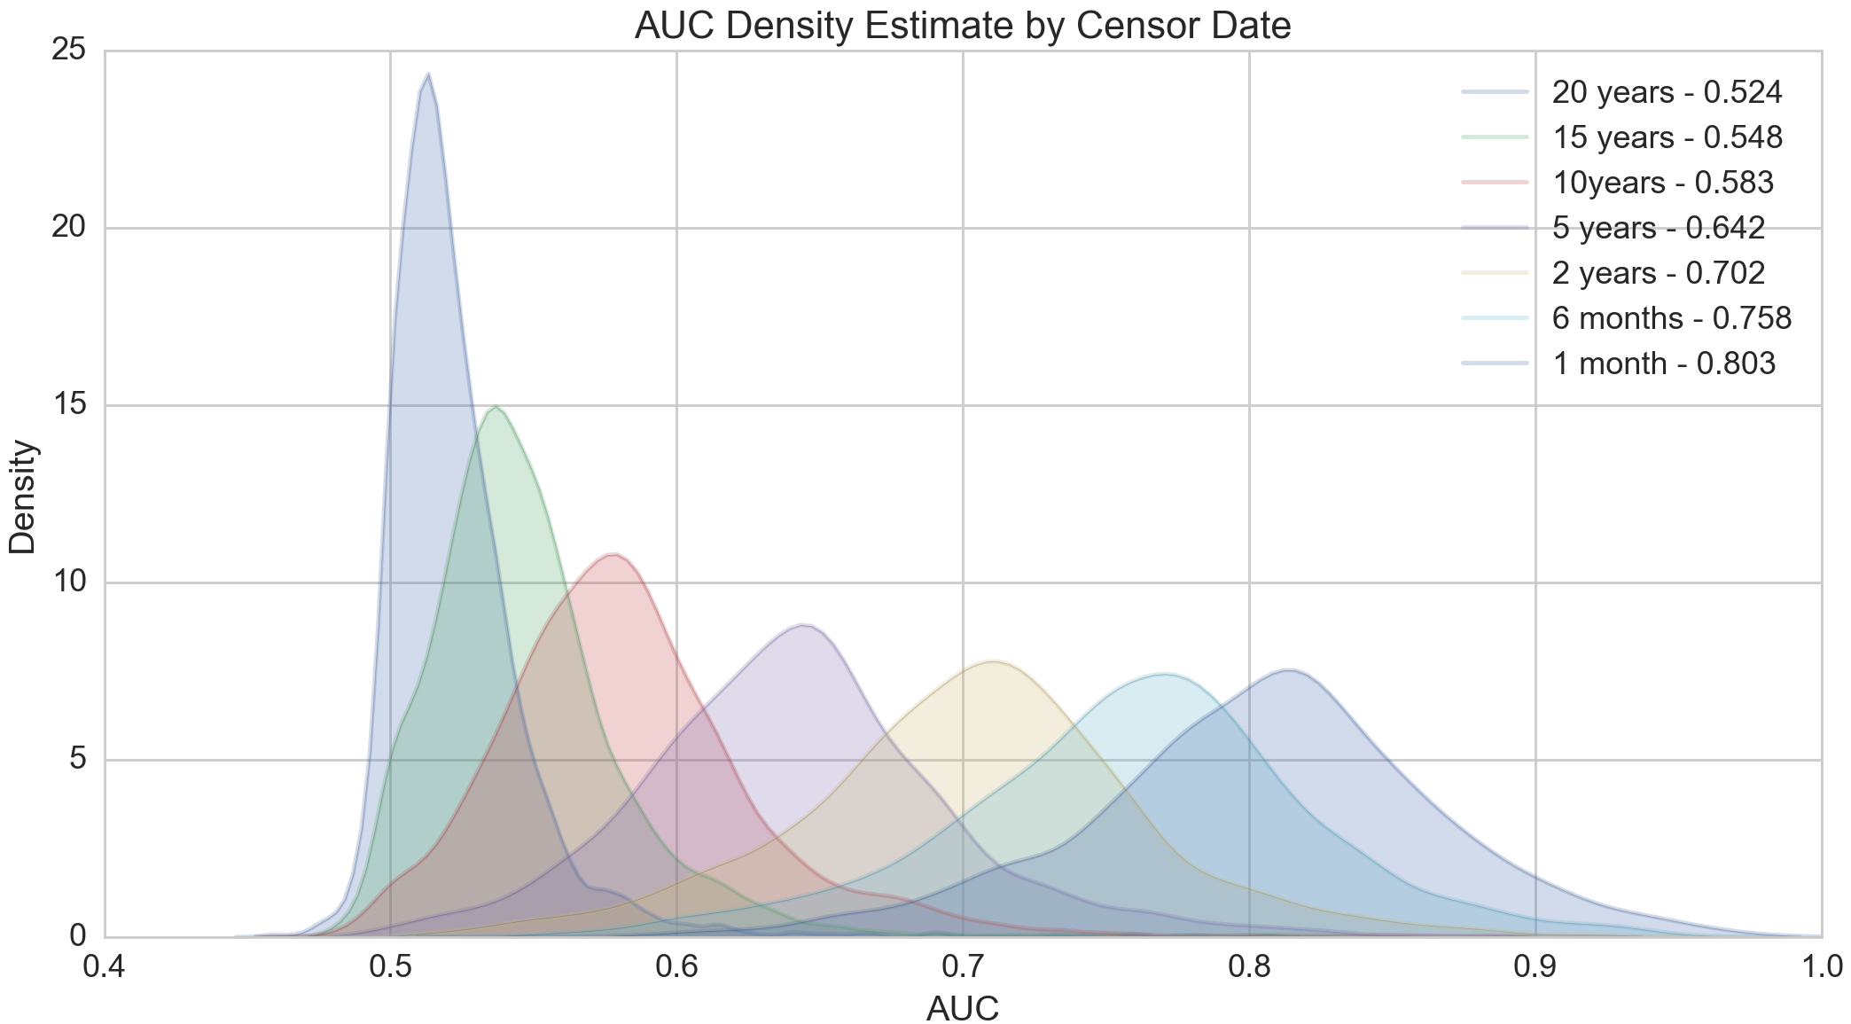
Predictive Accuracy of Models
Notes:
AUC is performance metric (.5=random, 1=perfect)
KDE for smoothing
1 month & 6 months both strong, 1mo stronger

Slide 11
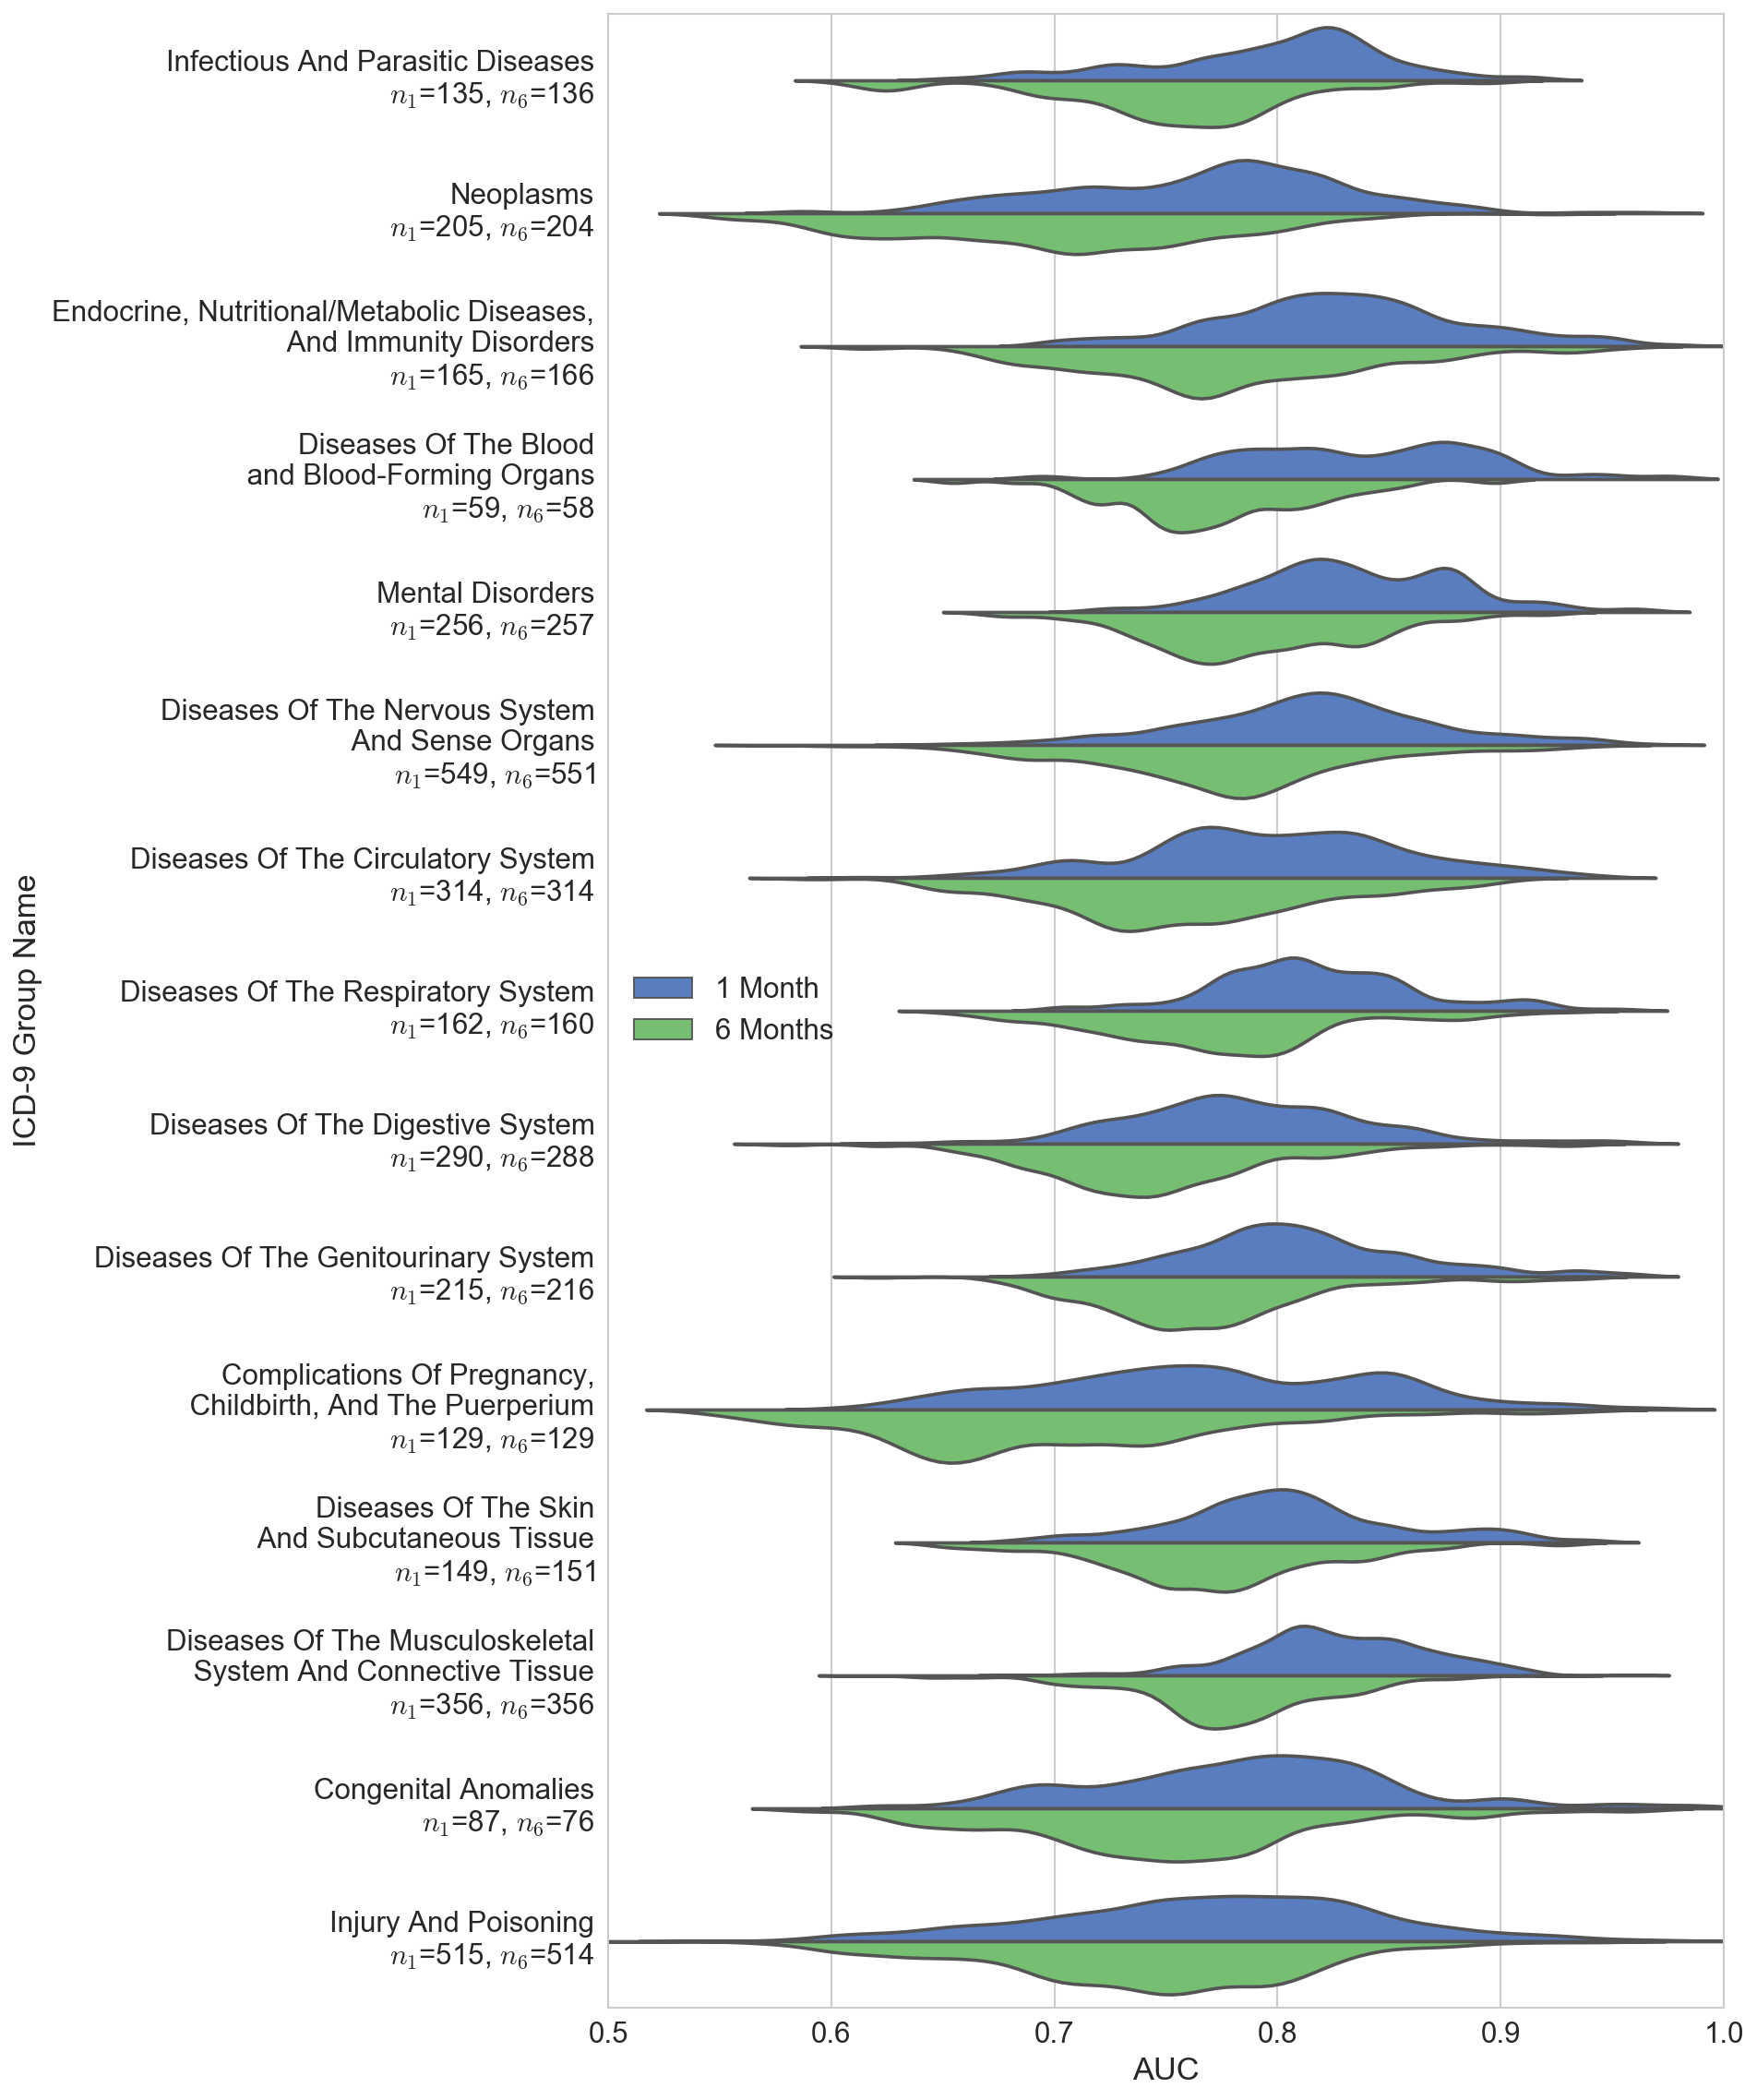

Slide 13
Simulated Prospective Study
How well would these models perform in practice?
Evaluate model accuracy on 10,000 test patients
Training Data
Activity Window
Study Year
2013
2014
2015

Slide 14
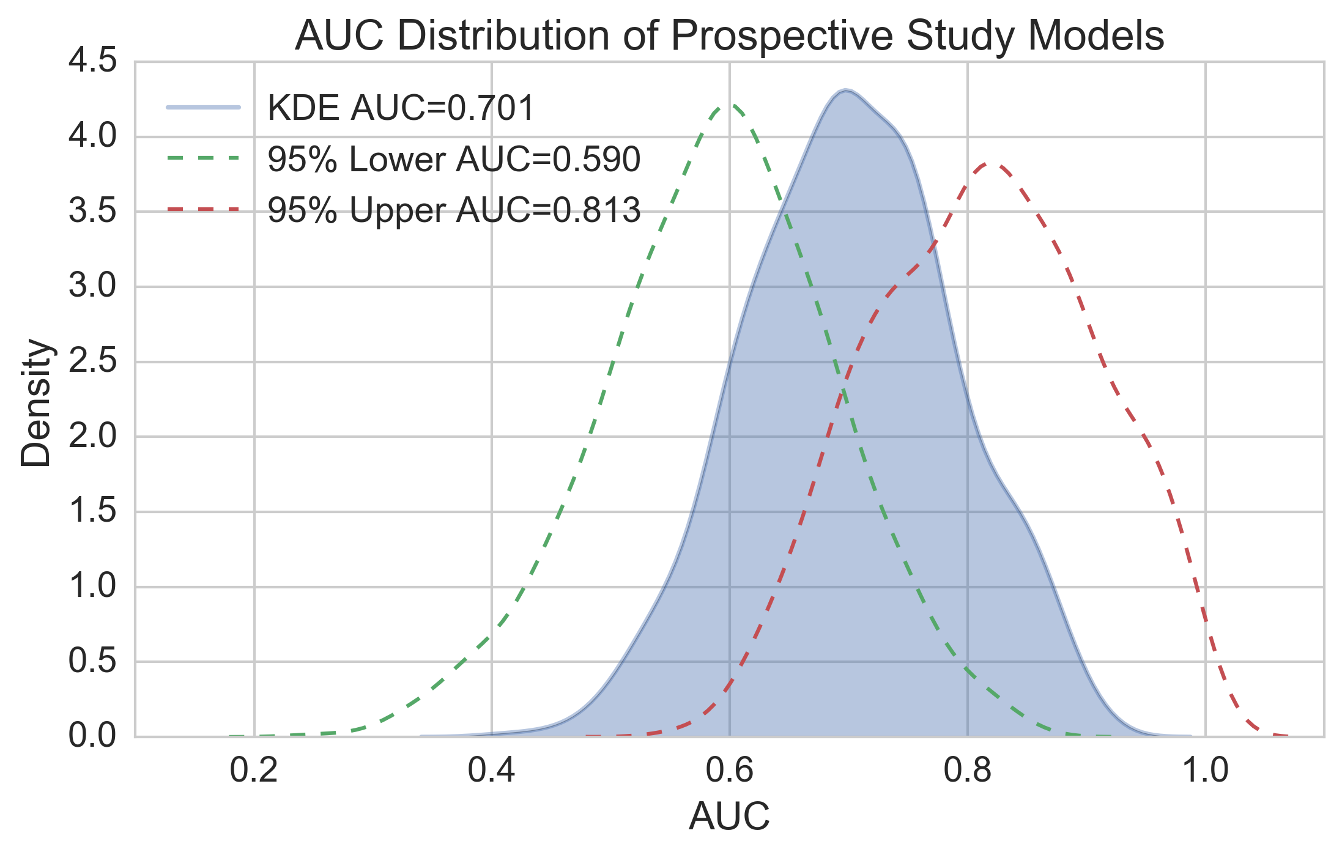
Simulated Prospective Study
Notes:
Many diseases only had a very small number of positive patients in the test population
Needed confidence intervals since AUC is sensitive at smaller sample sizes

Slide 15
Project Summary
We created a flexible and modular machine learning pipeline for all EHR diagnoses
Can predict across all ICD-9 codes with reasonable degree of accuracy
This is an initial baseline for “pan-diagnostic machine learning”
Models promise more than just predictive use

Slide 16
What Have Our Models Learned?
Feature importances are a window into a model
Top heart attack features
Age/Gender
Hypertension
Atherosclerosis
Interesting features
COPD & Red cell distribution width
Tertemiz, et.al 2016 discovery
Can we automatically discover useful lab tests?

Slide 17
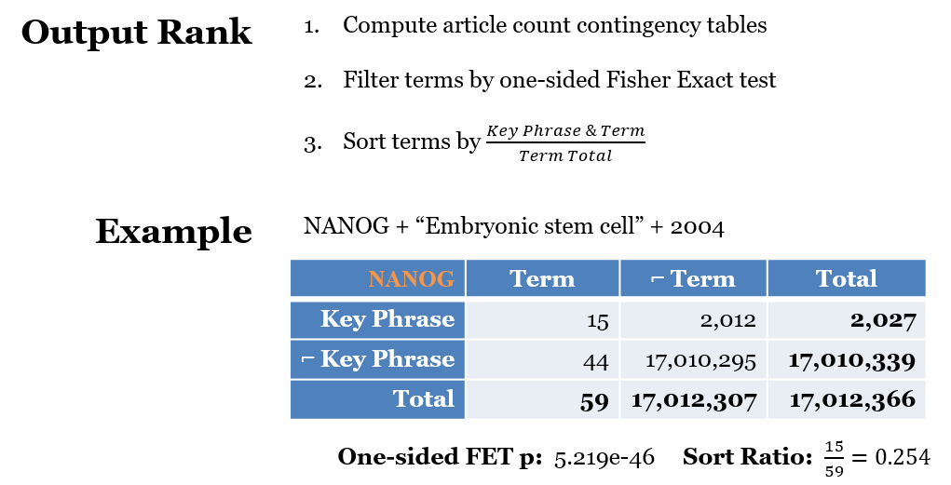
KinderMiner
Notes:
Once we’ve computed the contingency tables for every term
We filter them to those with statistically significant co-occurrence with the key phrase
and then sort those remaining by the ratio of the number of articles in which the term and phrase co-occur over the number of times the term shows up in general
Does this produce a useful ranking though?

Slide 18
Results
“Embryonic Stem Cell” - 2004
NANOG
UTF1
CBX4
POU5F1
EZH1
SOX1
IRX4
FOXD3
MYF6
HOXB4
LMO2
SOX2
EOMES
LMX1B
LHX2
HOXD9
HOXD11
OTX1
HAND1
HOXB3
“Cardiomyocyte” - 2008
MESP1
THRAP1
TBX20
GATA4
NKX2-5
TBX5
GATA5
MEF2C
HAND2
CSRP3
IRX4
HDAC9
NFATC4
IRX5
MKL2
ISL1
GATA6
HAND1
HES2
TBX18
“Hepatocyte” - 2009
HNF1A
HNF1B
HNF4A
ONECUT1
HNF4G
FOXA3
ONECUT3
FOXA1
FOXA2
TCF2
MLX
NR0B2
NR1I3
NR1H4
HGBOX1
NR1I2
ONECUT2
TCF1
CREB3L3
CUTL2
Notes:
And, overall, we found that KinderMiner was able to recapitulate the relevant transcription factors for each, the ones highlighted in blue
Most impressively, on the left, KinderMiner produced a sufficient set of transcription factors for producing iPS cells in the first 12 hits.
Again though, this is with articles published through two years in advance of the landmark papers.
So it looks like it would have been handy to have KinderMiner back then.

Slide 19
Lab Test “Repurposing”
Goal: Discover novel diagnostic uses for currently available lab tests
Ongoing work with Dr. Finn Kuusisto and Dr. Ron Stewart
Candidate for lab repurposing
Useful for predicting a diagnosis
Not well known in literature
KinderMiner to build the knowledge base on Condor
Combine with feature importance values to find candidate labs

Slide 20
Acknowledgements
Page Lab
Dr. David Page, Ph.D.
Paul Bennett
Charles Kuang
Marshfield Clinic
Dr. Michael Caldwell, M.D.
Dr. Peggy Peissig, Ph.D.
Dr. Scott Hebbring, Ph.D.
Thompson Lab
Dr. Finn Kuusisto, Ph.D.
Dr. Ron Stewart, Ph.D.
CHTC
Dr. Miron Livny, Ph.D.
Lauren Michael
Christina Koch
Todd Tannenbaum
Zach Miller
Funding
NLM Biomedical Training Grant 5T15LM007359
NIH BD2K Grant U54 AI117924
NLM Grant R01LM011028

Slide 21
Questions?

