Slide 1
Containers and GPUs
Mats Rynge (rynge@isi.edu)
Christina Koch (ckoch5@wisc.edu)

Slide 2
GPUs

Slide 3

What is a GPU?
GPU = Graphical Processing Unit
Has hundreds to thousands of “cores” that can be used to parallelize work.

Slide 4
GPU Use Cases
Programs that map well to GPUs include:
Deep learning
Molecular dynamics
Anything with lots of number crunching (like matrix operations) and low(er) data load.

Slide 5
GPUs on the OSG
Scale: 100s (vs 10,000s of CPUs)
Variety of available GPU cards
Same restrictions as always: not sure what you’ll get, jobs can be interrupted
May take longer to start

Slide 6
Making robust GPU jobs
Use a software strategy that can run on different GPU types:
Container
Install inside the job
OR use job requirements to request certain kind of GPU (more limiting)

Slide 7
Submit File options
Request GPUs with “request_gpus”
Can use custom requirements
request_gpus = 1
requirements = (CUDACapability >= 6.0)

Slide 8
Containers

Slide 9
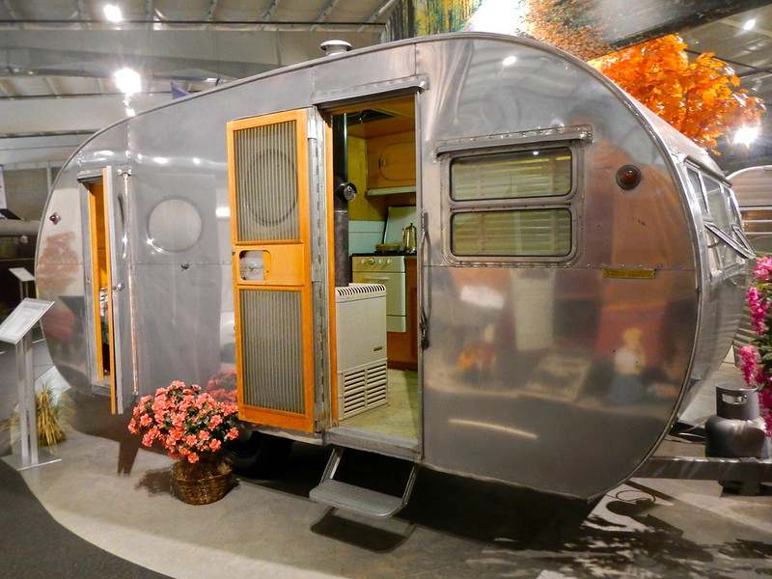
Returning to Our Analogy…
Using a container is kind of like bringing along a whole kitchen…
Photo by PunkToad on Flickr, CC-BY

Slide 10






Containers
Containers are a tool for capturing an entire job “environment” (software, libraries, operating system) into an “image” that can be used again.
polaroid photos by Nick Bluth from the Noun Project

Slide 11
Container Motivations
Consistent environment (default images) - If a user does not specify a specific image, a default one is used by the job. The image contains a decent base line of software, and because the same image is used across all the sites, the user sees a more consistent environment than if the job landed in the environments provided by the individual sites.
Custom software environment (user defined images) - Users can create and use their custom images, which is useful when having very specific software requirements or software stacks which can be tricky to bring with a job. For example: Python or R modules with dependencies, TensorFlow
Enables special environment such as GPUs - Special software environments to go hand in hand with the special hardware.
Process isolation - Sandboxes the job environment so that a job can not peek at other jobs.
File isolation - Sandboxes the job file system, so that a job can not peek at other jobs’ data.

Slide 12


Container Types
Two common container systems:
Docker Singularity
https://www.docker.com/ https://sylabs.io/
The container itself will always be some version of Linux - but can be run on Linux / Mac / Windows if Docker or Singularity is installed

Slide 13
Focus on Docker
Docker has well-established and well-documented ways to build container images. It has huge library of images!
If you have a Docker image:
Can run with Docker
Can run with Singularity – Remember this
Can convert to a Singularity image

Slide 14
Running Containers
docker run <container> <command>
$
docker run –it <container> /bin/sh

Slide 15

Docker Hub
docker push
docker pull
docker pull

Slide 16


Building Containers
Dockerfile
docker build .
16

Slide 17
Sample Dockerfile
# Start with this image as a "base".
# It's as if all the commands that created that image were inserted here.
FROM continuumio/miniconda:4.7.12
# Use RUN to execute commands inside the image as it is being built up.
RUN conda install --yes numpy
# Try to always "clean up" after yourself to reduce the final size of your image.
RUN apt-get update \
&& apt-get --yes install --no-install-recommends graphviz\
&& apt-get --yes clean \
&& rm -rf /var/lib/apt/lists/*

Slide 18
cvmfs-singularity-sync
Containers are defined using Docker
Public Docker Hub
… and executed with Singularity
No direct access to the Singularity command line - that is controlled by the infrastructure
https://github.com/opensciencegrid/cvmfs-singularity-sync (next slide)

Slide 19


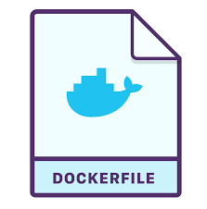
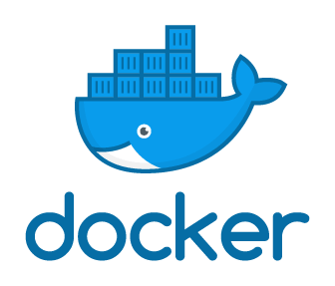

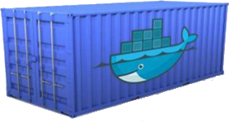
User-defined Container Publishing
Pull request or ticket to register container (one time)
docker_images.txt cvmfs-singularity-sync
Option 2
docker build + push
Option 1
git push
Automatic sync on changes
Automatic builds on changes
Hub
/cvmfs

Slide 20
CVMFS Repositories
/cvmfs/
ams.cern.ch
atlas.cern.ch
cms.cern.ch
connect.opensciencegrid.org
gwosc.osgstorage.org
icecube.opensciencegrid.org
ligo-containers.opensciencegrid.org <- large project with their own containers
nexo.opensciencegrid.org
oasis.opensciencegrid.org <- “modules” software
singularity.opensciencegrid.org <- general containers (next few slide)
snoplus.egi.eu
spt.opensciencegrid.org
stash.osgstorage.org <- ~1PB of user published data
veritas.opensciencegrid.org
xenon.opensciencegrid.org

Slide 21
Extracted Images
OSG stores container images on CVMFS in extracted form. That is, we take the Docker image layers or the Singularity sif files and export them onto CVMFS. For example, ls on one of the containers looks similar to ls / on any Linux machine:
$ ls /cvmfs/singularity.opensciencegrid.org/opensciencegrid/osgvo-el7:latest/ cvmfs host-libs proc sys anaconda-post.log lib64 dev media root tmp bin sbin etc mnt run usr image-build-info.txt singularity home opt srv var lib
Result: Most container instances only use a small part of the container image (50-150 MB) and that part is cached in CVMFS!

