Slide 1

Software Engineering
Gruppo 9 – Drawing App
Lorenzo Mignone - 0622701866
Artemis Ostadimitris - 0622701874
Gaetano Parolise - 0622701919
Davide Parente - 0622701859

Slide 2
Coding Convention
Java JDK 8
Apache Netbeans
Javafx.
Java.util
Comment out each function, specifying the parameters, the return value and its functionality
CamelCase

Slide 3
Software Architecture
Model View Controller (MVC)
The Model consists of the specific application of the domain object and will therefore contain the implementation of all methods of the drawing app.
The View consists of the FXML file, created using JavaFXSceneBuilder and will define the GUI of the drawing app.
The Controller is represented by the Java code that defines the behavior of the interface that interacts with the user. Therefore, it will receive the user's commands and based on them it will implement the interface changes. Contains all functions of the drawing app.
For the Design, we thought to use the following patterns: Command pattern, Decorator pattern and Abstract Factory pattern.

Slide 4
Definition of Done
The function has been completely implemented
The code has been reviewed by all members of the team
The product owner has accepted the implementation of the user story
The user story implementation meets ALL the acceptance criteria
The unit tests were written, executed and passed
Every acceptance criteria have at least a test case associated
Integration testing performed and compiles

Slide 5
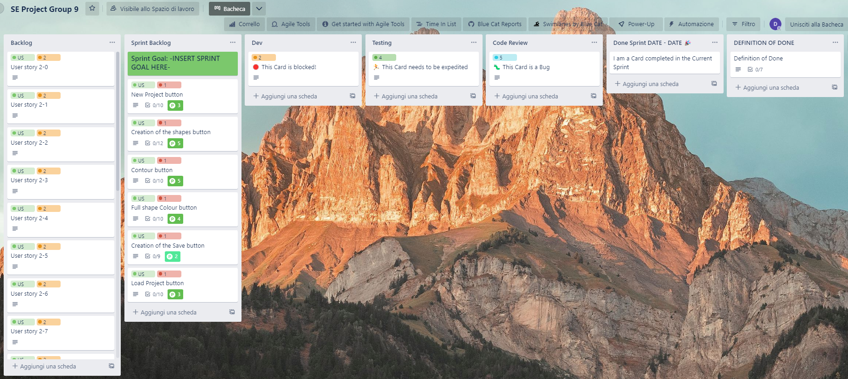
Board Trello

