Slide 1

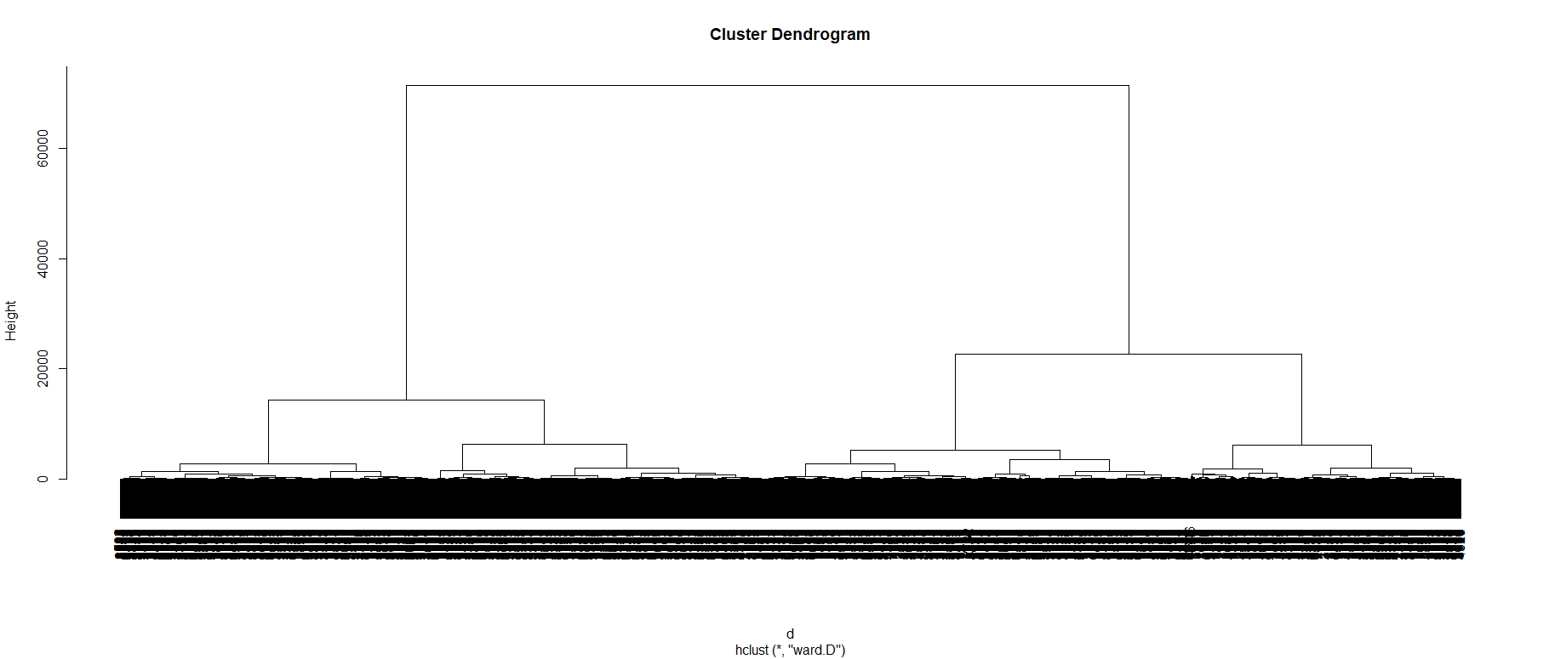
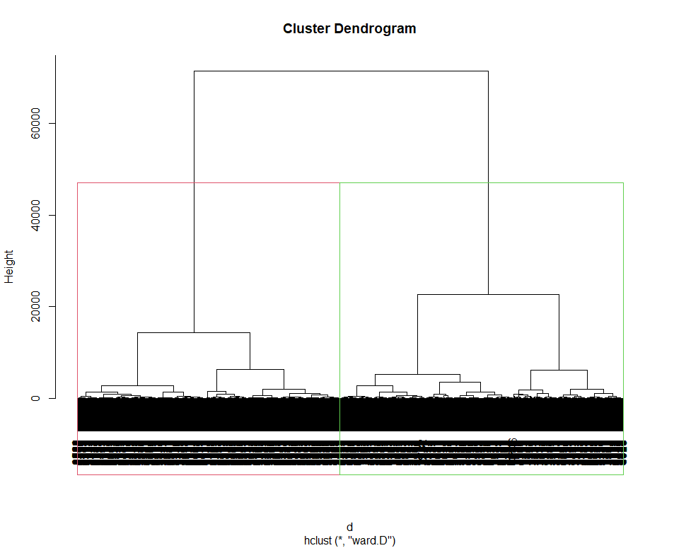
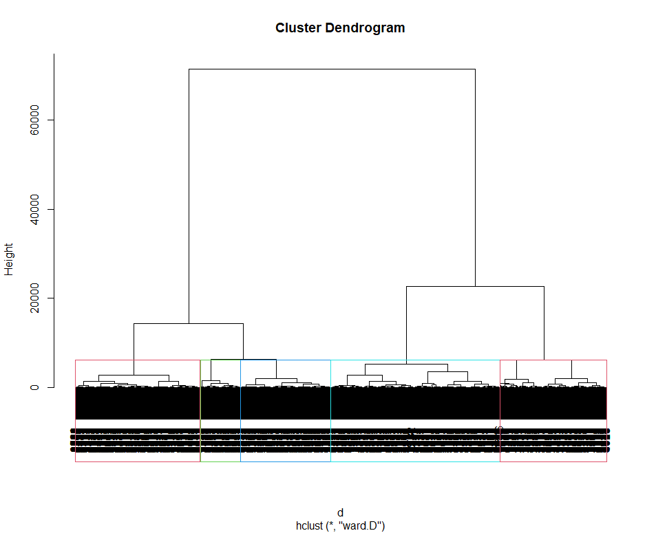
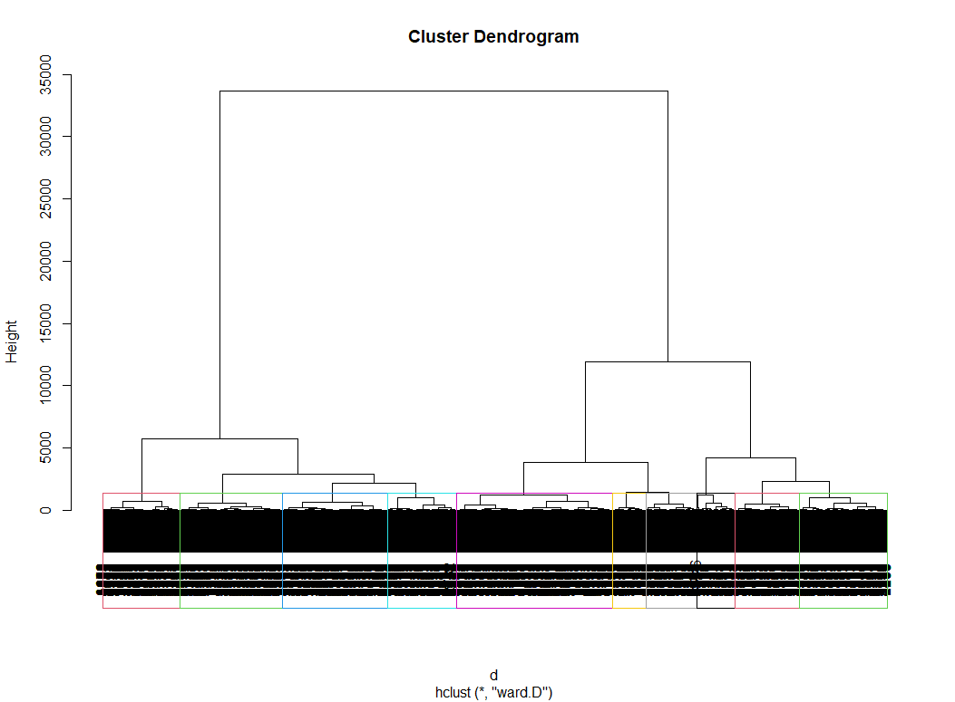
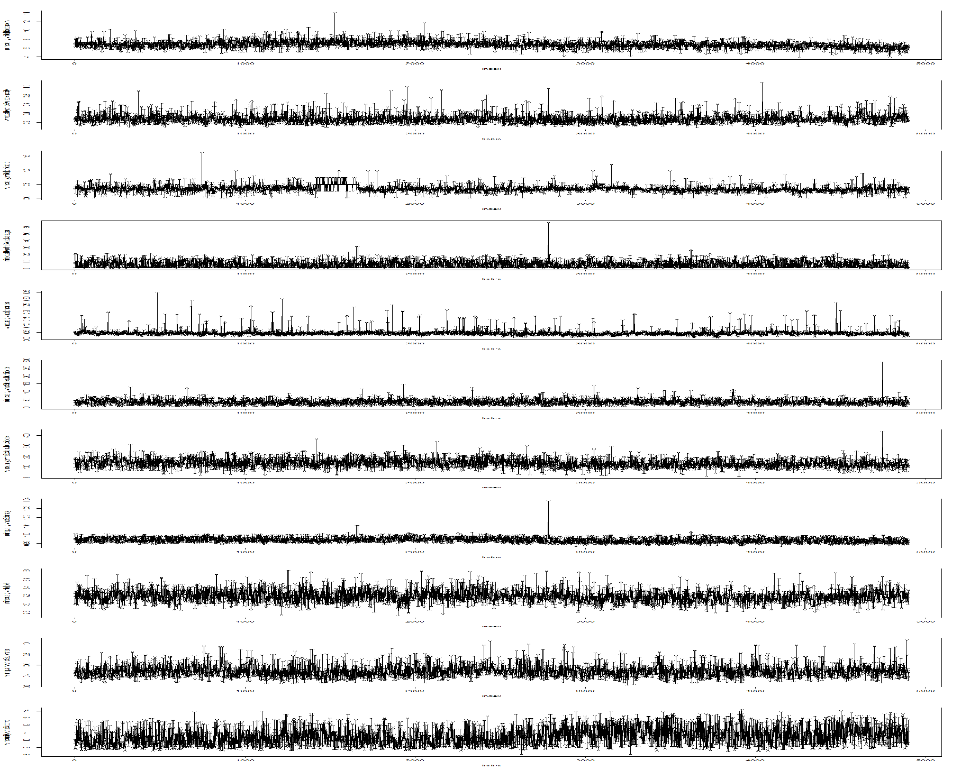
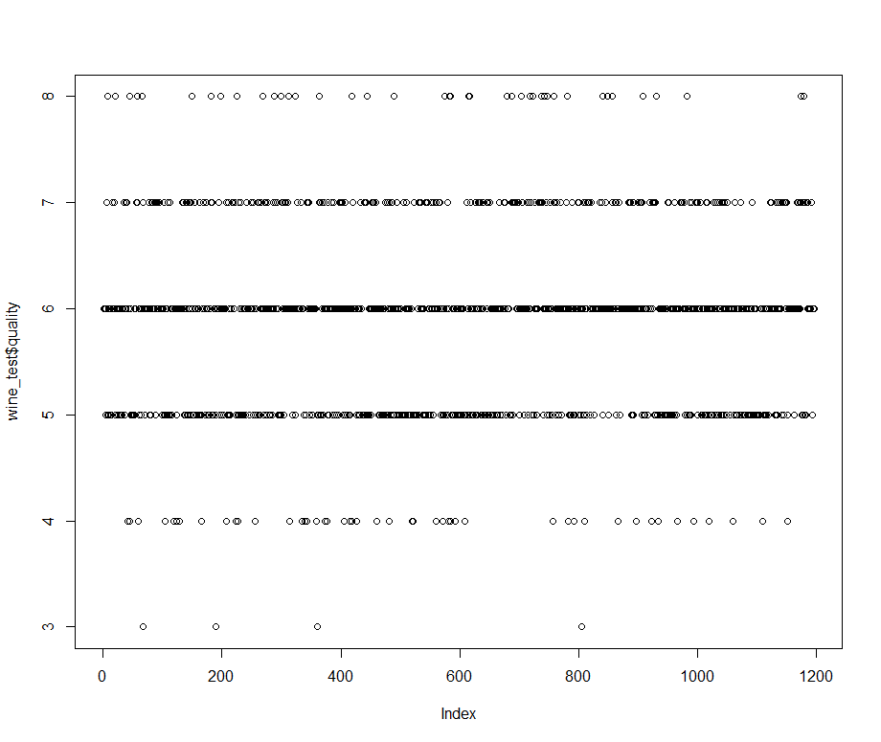
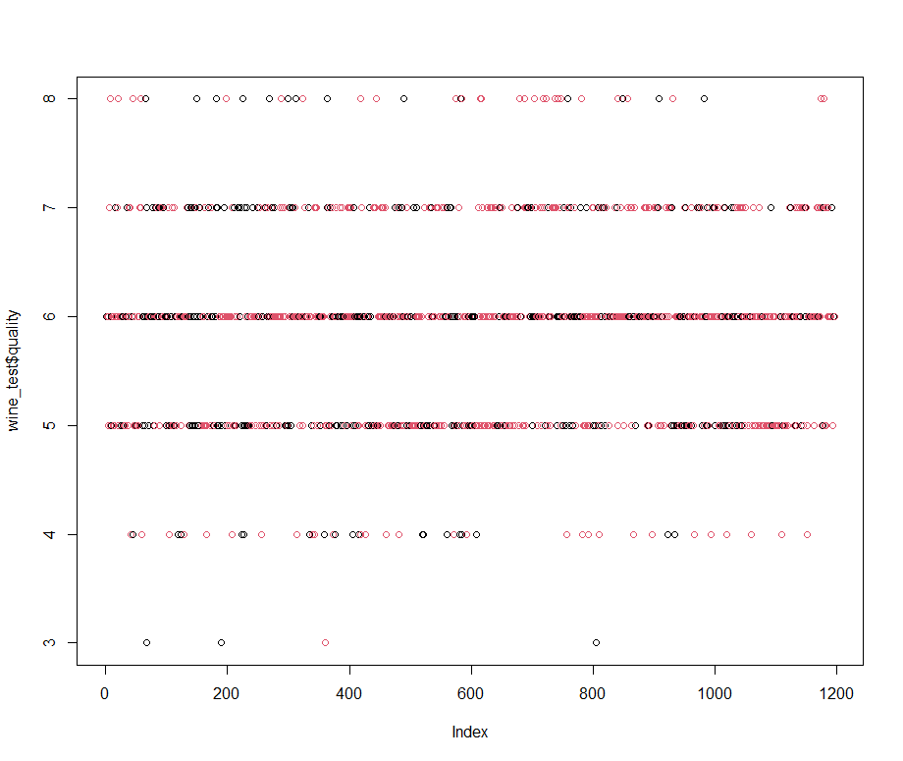
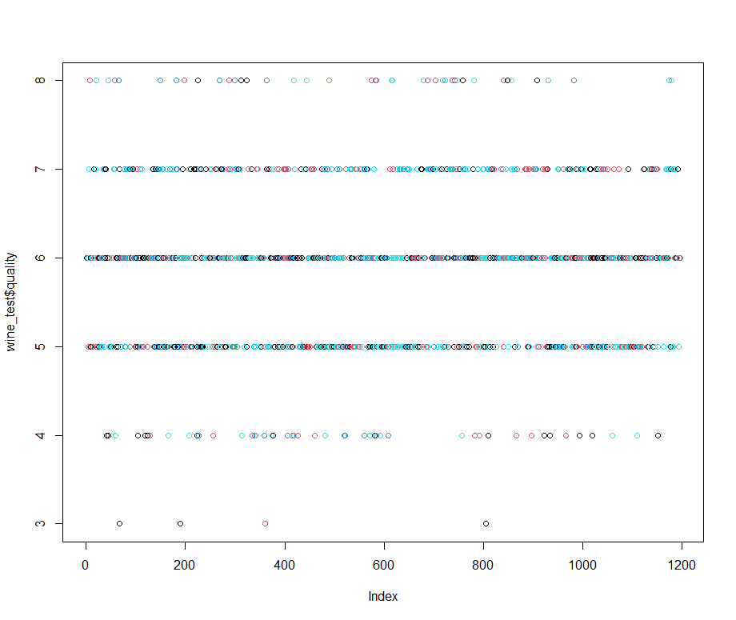
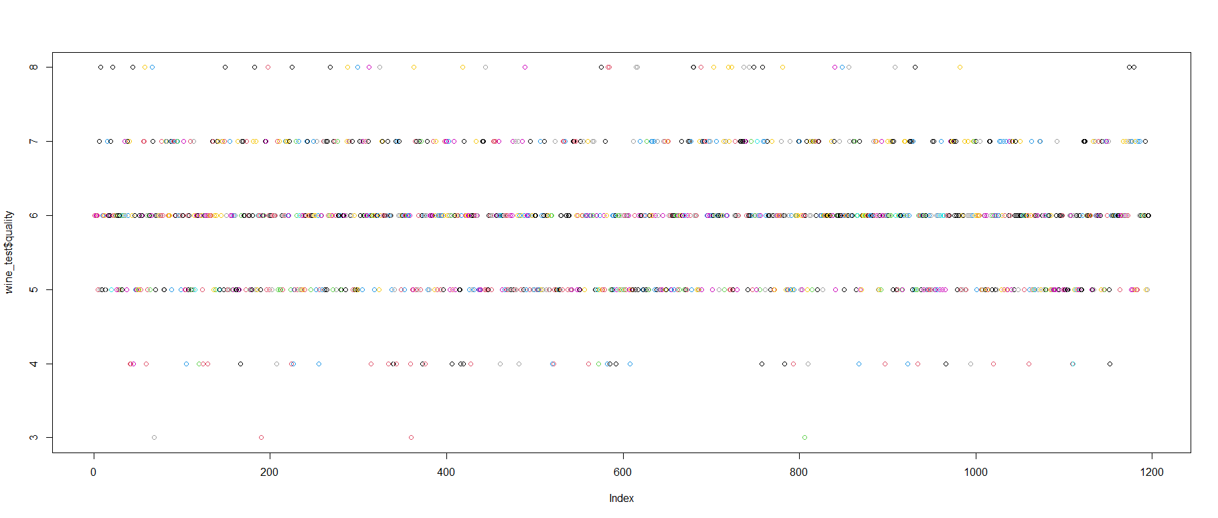
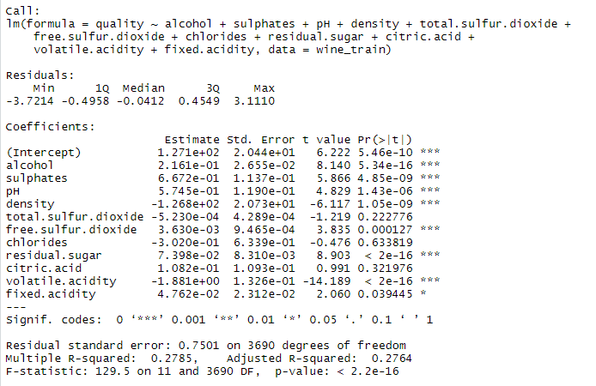
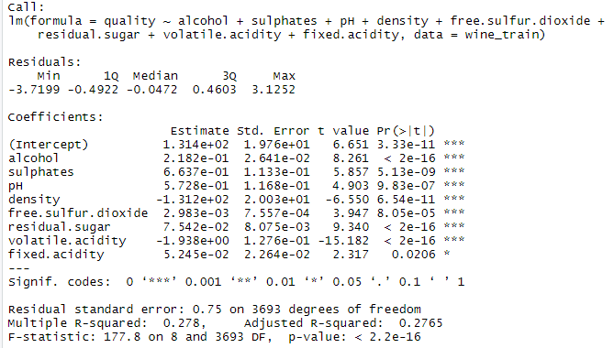
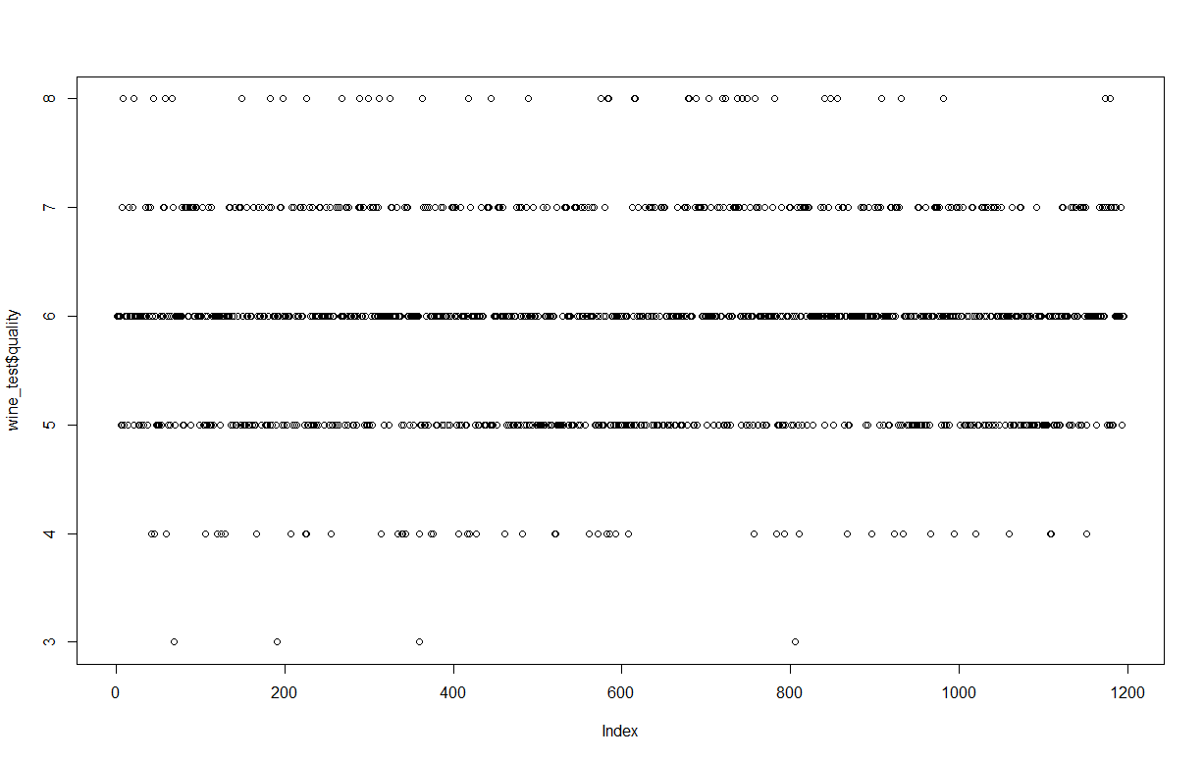
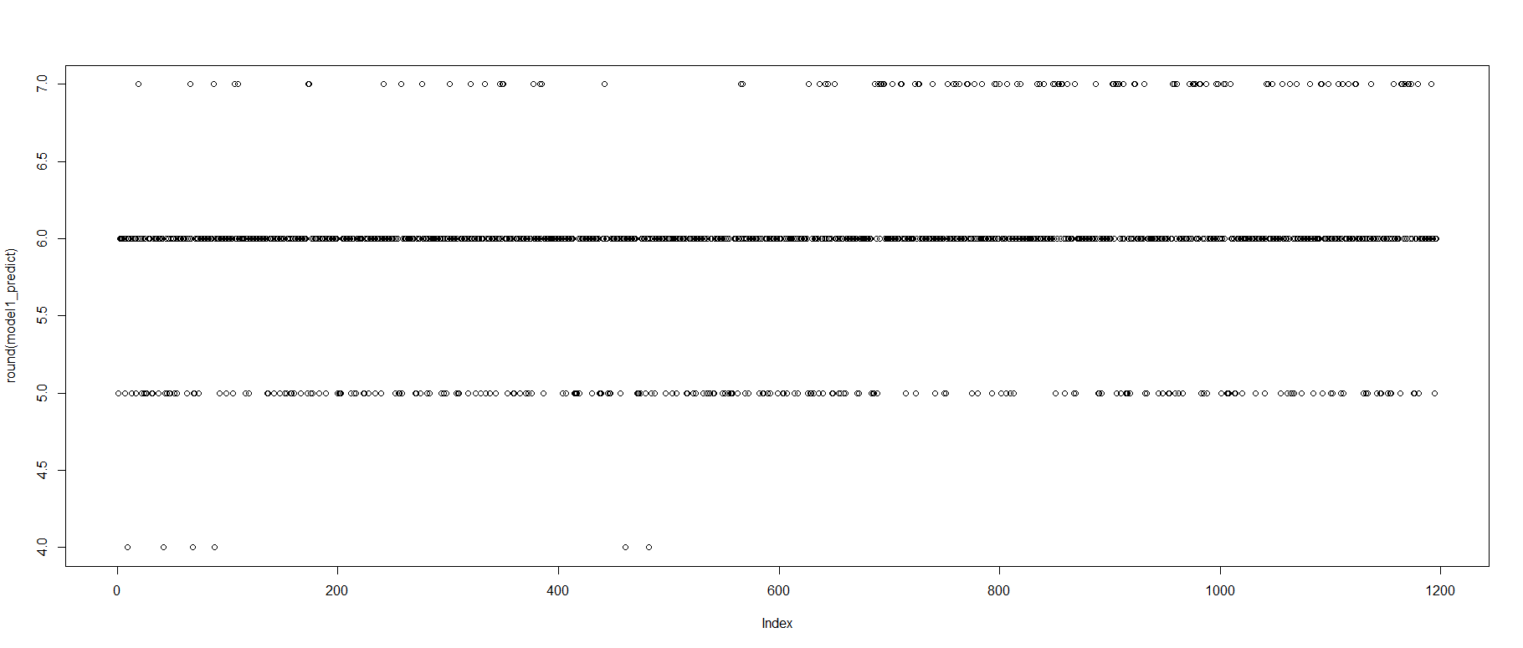
Wine Quality 🍷
Lora Milam, Sally Comer, and Payal Pawar
Computer Science Department, Texas Tech University
Abstract
Producing high quality wine is desirable for wineries. Unfortunately, wine quality can only be known after wine has been made and aged. To predict quality, this poster proposed a K-means clustering approach versus the hierarchical clustering approach. K-means algorithm is an iterative algorithm that tries to partition the dataset into K pre-defined distinct non-overlapping clusters. Similarly, Hierarchical clustering is a method of clustering analysis that tries to partition the dataset into clusters. However, hierarchical clustering also tries to build a hierarchy out of the clusters made. The proposed methods use variables such as sulphates, volatile acidity, and residual sugar to predict wine quality.
Method and Proposed Model Comparison
Hierarchical Clustering
Wine Dataset
Factor of: 1 2 5 10
Predictor Variables Plotted
K-Means Clustering Performance
Factor of: 1 2 5 10
Experimental Results
Contribution
For this dataset, modeling methods used were k-means clustering and hierarchical clustering. The modeling type that best represented this data set, however, was Hierarchical clustering. K Means clustering starts with random choice of clusters, the results produced by running the algorithm multiple times might differ in clusters in other scenarios but showed very little difference in this one. While results are reproducible in Hierarchical clustering and have a more visible view of differences in clusters. So since hierarchical clustering provides constant results, there was a visualization for the data set rather than the visualization provided by K-means clustering.
Correlation of Variables with Wine Quality
Predictive Experimental Results
Acknowledgment
This data set was provided by P. Cortez, A. Cerdeira, F. Almeida, T. Matos and J. Reis. Modeling wine preferences by data mining from physicochemical properties. We thank the authors for their detailed dataset.
Original Processed Top: Predicted; Bottom: Actual

