Slide 1
Title Layout
Subtitle

Slide 2
overview
Add your first bullet point here
Add your second bullet point here
Add your third bullet point here

Slide 3
Hardware Block Schematic
Smartdraw.com?

Slide 4
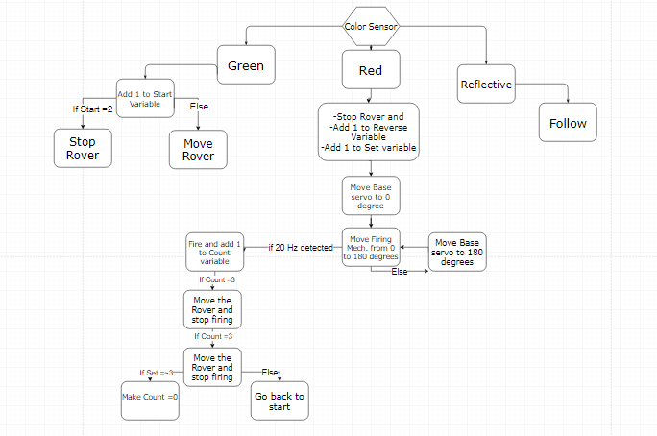
software flowchart

Slide 5
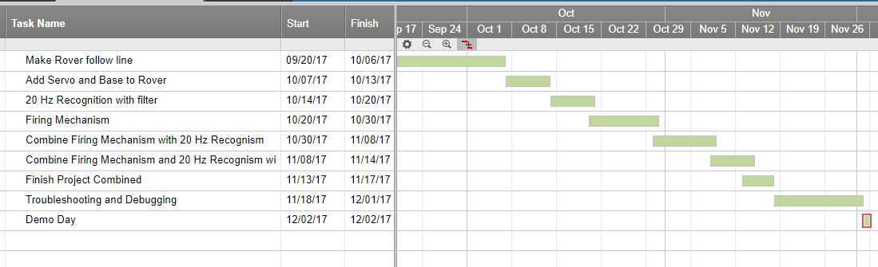
Roadmap

Slide 6
budget

Slide 7
recap
Add your first bullet point here
Add your second bullet point here
Add your third bullet point here

Slide 8
Works cited

