Slide 1
Initial Design review
Group 4
Alejandro Garcia, Lora Milam, David Ozoude

Slide 2
overview
Hardware Blocks
Circuit Blocks
Firing mechanism
Software Flowchart
Roadmap/Milestones
Budget

Slide 3
Hardware BlocKs
Rover Chassis
Basys 3 board
Power supply

Slide 4
Circuit Blocks
Light Filtering and detection circuit
H-Bridge motor control circuit
Tape detection circuit

Slide 5
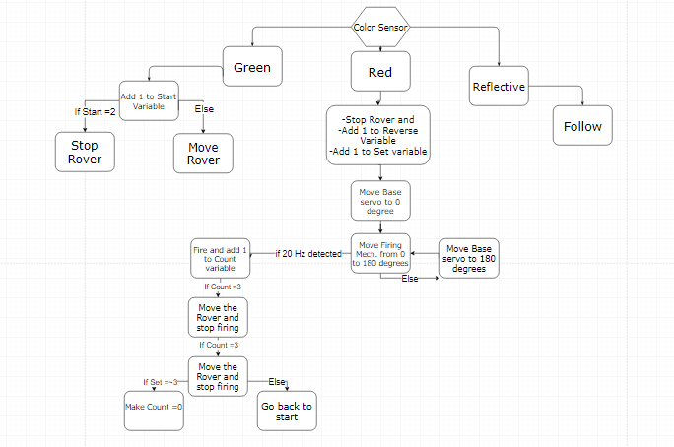
software flowchart

Slide 6
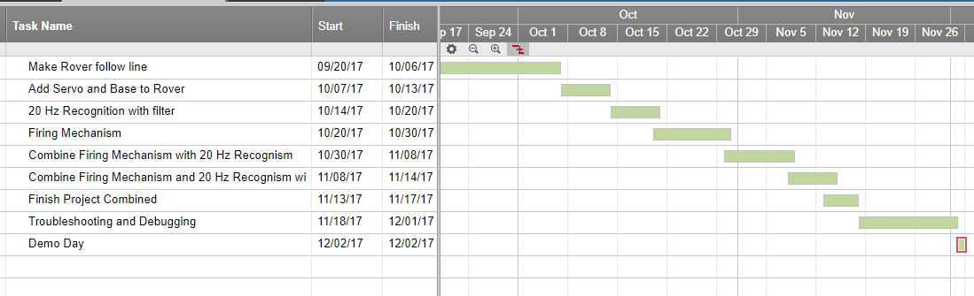
Roadmap

Slide 7
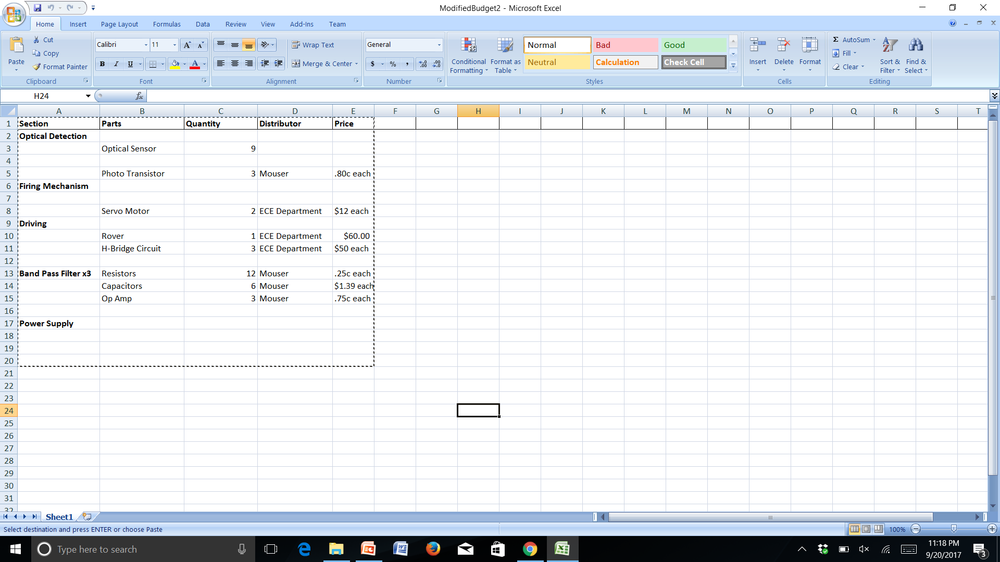
budget

Slide 8
recap
What hardware components do we need.
What are we trying to do with the software.
Quick overview of milestones
Overview of bugdet.

Slide 9
Work Cited
http://www.electronics-tutorials.ws/filter/filter_7.html
http://www.mouser.com/

