Slide 1
Python the Lingua Franca of SeqFEWS
2019 AUS FEWS Users Conference
Lindsay Millard, Hydrologist
Notes:
What is this presentation about? In essence it is the presentation that I had seen several years ago. Many presentations are about the what, but not many are about the ‘how’. I have had a go at solving a few problems that have cropped up. I am no expert configuration guru nor am I formally trained in programming. I have just hammered away problems and found solutions that I would like to share with the rest of you. Everything I am showing is available on GitHub and I am more than happy to talk it through with anyone wanting more detail. If I can inspire one person in this audience to have a go at coding either in Python or Delft FEWS then it was success. A few years ago I began to realise during FEWS training that the days of sloppy spreadsheets and manual translation of model input/outputs was not the right way to attack all of this ensemble /monte carlo modelling. Last year I presented I on Data Fabriek.

Slide 2
This presentation started in 2016:
Coupling external modules into Delft-FEWS
2016 FEWS User Day – Antonio Morales (ADASA)
Outlined Java, .NET, R methods to integrate data in FEWS
Used Java to Link MIKE hydrological model / Irrigation into FEWS.
Used Java and R to link MIKE 11 model to FEWS
Conclusion:
Take the best of Delft-FEWS: visualisation, modifiers, general adapters but don’t be limited by it. Add what you need.
R can do complex statistical analytics
Notes:
The inspiration from this presentation came from reflecting on why did I start doing so much coding. I sat in Audience in 2016 and listened to Antonio discuss coupling of FEWS to various models and then chaining them together in a workflow. About the same time I was involved in the Brisbane River Flood Study where URBS monte carlo models had been done. I had no idea how all of that was happening, it was an itch I had to scratch. First it started with a simple python script that linked URBS csv straight into Tuflow boundaries. Then it became For loop that scrapped all of the ensemble results, then it went to plotting. It was a rabbit hole that I disappeared down. I found it very satisfying and rewarding, with a little persistence I started figuring out how to do more and more.

Slide 3
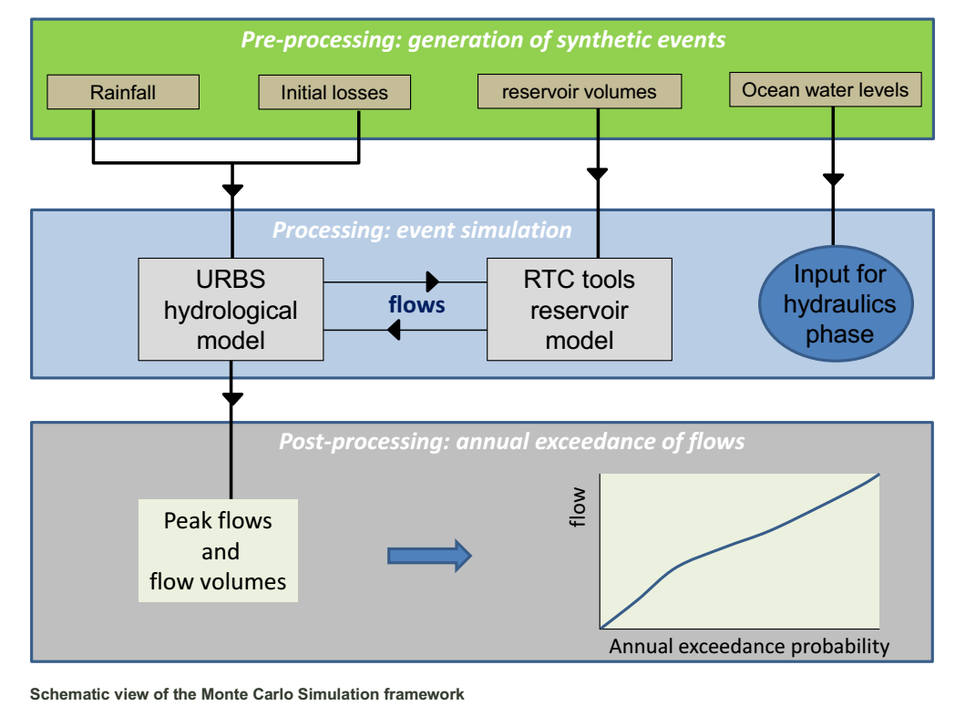
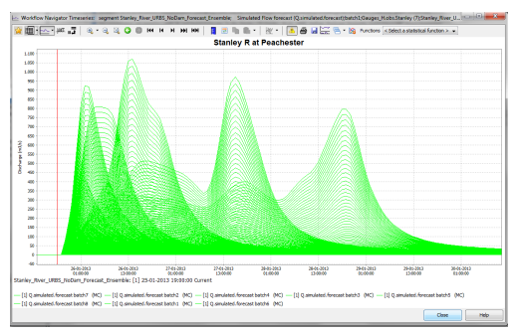
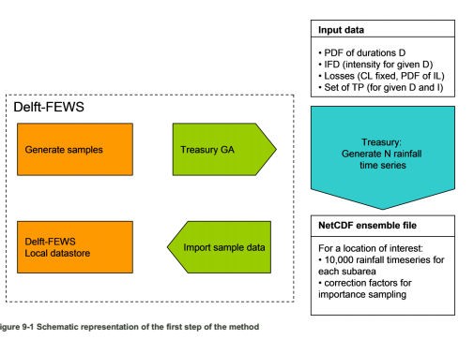
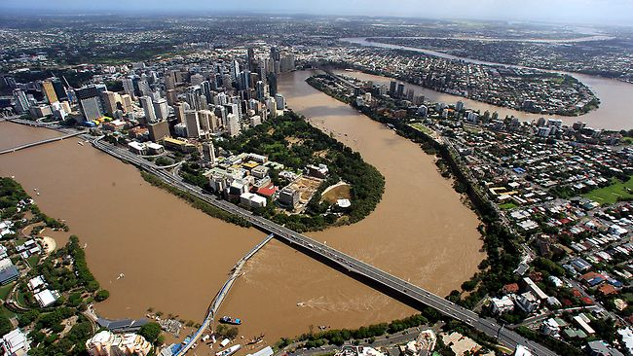
Brisbane River Catchment Flood Study - 2015
7Tb of data to harvest

Slide 4
Refresher from 2018
What is a Dutch word to describe FEWS?
“Datafabriek”
“Data-centric Workflow Manager”
Why not use it for non-forecasting purposes?
It would:
assist with task efficiency and maximising skillsets
avoid buying and learning new software
enable efficient data management of AR&R 2016
centralise and allow auditing of tailored design engineering workflows
Notes:
My colleagues, Steve and Dave presented on the work they have done using FEWS with Design Hydrology. This work is also inspired by cracking the same problem – Australian Rainfall and Runoff. I am confident that Steve convinced many of you that my using FEWS to aggregate data is possible. I’d like to think that his presentation bookends my presentation from last year of a possible vision for FEWS outside of just Forecasting.

Slide 5
Itinerary for “terra Python”
Presentation will walk through how to build an adapter using Python
Simple steps, a quick-start guide to linking models
This allows FEWs to become the wrapper for all the code and data.
Proof of concept before getting official support
You can access an array of powerful Monte Carlo libraries to drive your model.
Notes:
So the Presentation is the HOW you can do this. I want you to leave here today knowing that you have all the tools to get started to stitch a model into FEWS.
Have greater flexibility, stay on the bleeding edge, learn something. You might have simple models and spreadsheets and wonder why change, alternatively you may be interested in expanding the scope of your system – this will allow you to scale it up. The future is probabilistic models. Handling all of that data is going to need new tools
Try a new feature, calibrate/compare models

Slide 6
Orientation
Roll your own adapter/plugin from boilerplate code
What do you need to do
Linking models to FEWs, can do a lot already but can do exponentially more with python or R or JavaScript etc
Allow use of Monte Carlo frameworks for solving probabilistically/ Bayesian Inference
Rasmus Baath, Youtube / sumsar.net
Notes:
Known output probabilistic determination of possible inputs
Hamiltonian PY mc3 or Stan sumsar.net Rasmuss Baath youtube
PyMC3 strives to make Bayesian modeling as simple and painless as possible, allowing users to focus on their scientific problem, rather than on the methods used to solve it. Here is a partial list of its features:
Modern methods for fitting Bayesian models, including MCMC and VI.
Includes a large suite of well-documented statistical distributions.
Uses Theano as the computational backend, allowing for fast expression evaluation, automatic gradient calculation, and GPU computing.
Built-in support for Gaussian process modeling.
Model summarization and plotting.
Model checking and convergence detection.
Extensible: easily incorporates custom step methods and unusual probability distributions.
Bayesian models can be embedded in larger programs, and results can be analyzed with the full power of Python.

Slide 7

“terra Python” Lonely Planet Guidebook
“Datafabriek” POPULATION: YOU
Includes ››
What to Pack …. 1
Activities ……… 2
Sights ………… 3
Phrase book ….. 4
Why Go?
Delft FEWS is one of the world’s most flexible data management frameworks. Its architecture allows for the seamless integration of numerous modelling dialects. FEWS’ epic flexibility is awe-inspiring and there is still much more substance here than in other dynastic capitals. You just need to a bit of patient exploration to tap into its full potential.
The city’s denizens chat in extensible markup language – the gold standard of Markup – and marvel at their good fortune for occupying the centre of the flexible languages. Delft-FEWS dispenses with the peristent pace of procurement and locals instead find time to develop and build a city that truly reflects their needs.
Best Places to Visit
›› Github
›› Delft FEWS Wiki
›› HydPy
›› HKVfewspy
›› Slideshare
Best Places to Stay
›› XML Spy
›› Visual Studio Code
›› Anaconda Distribution
›› R Studio
›› Python 3.6 / Pandas
›› Jupyter Notebook
When do you go?
As soon as your model is packed and ready to be implemented. Model environment. Requires a pre-adapter to translate XML to local language, Model runtime execution, and then post-adapter to translate from local language to XML.
Notes:
Highlights
Top Five
Weblinks
Things to Take
Cuisine
Do’s and Don’ts
Resources
Essential Information
Exploring/Orientation
Price Guide
Phrase Book
Itineraries
Don’t Miss
Best Places to Visit
Guide Map
Walking Tour
Trivia

Slide 8
Top Places to Visit
Ingredients:
Download Anaconda using Jupyter Notebook
Python Dependencies PANDAS
FEWS Standalone – Configuration Course
A Model that can be driven from .BAT files. (most can be)
RORB, URBS, TUFLOW, GoldSIM, Probabilistic Modelling
Setup a Bin and Model folder that unzips from:
$Region Home$\config\ModuleDataSetFiles\_yourModel_.zip
$Region Home$\Modules\_yourModel\bin and \model
Use the Bin to store .bat to drive the model and .py file to Pre/Post translate from FEWS.

Slide 9
SeqFEWS
transformation
\ModuleConfig\
\RegionConfig\
\WorkflowFiles\
0d, 1d, 2d T.S.
General Adapter
Plots
Module Data set
export
import
.XML
Runtime parameters
.XML .NC
.CSV
\ModuleDataset\ model.zip
.bat / .py
.bat / .py
\Modules\model\
Model Input
Model Results/Log
Run files
Geometry
Input TS
Output TS Grid
\bin
\model
Model .exe
\Module\bin\
\Module\bin\

Slide 10
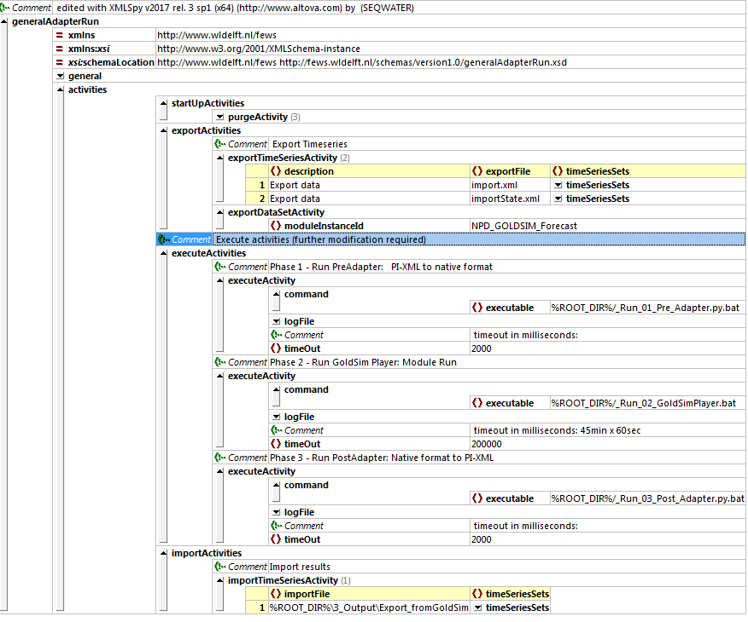
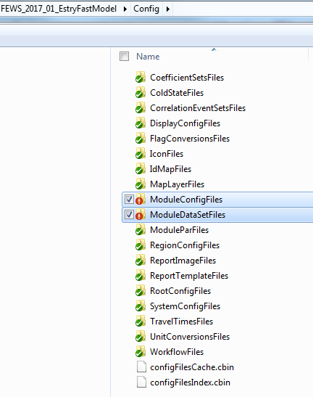
Getting Around
General Adapter XML
\bin
\model
Notes:
I am going to gloss over the detail of configuration course, but essentially the one file you need to know about is the General Adapter. It lives in the Module Config Files
In this file, you can layout your executables – this case batch file that calls Python pre/post adapter or your Model. Other housekeeping can be accomplished in this XML file.
The model and its binary are zipped up and live in the Module Data Set files. The zip contains all of the batch and your running model files.

Slide 11
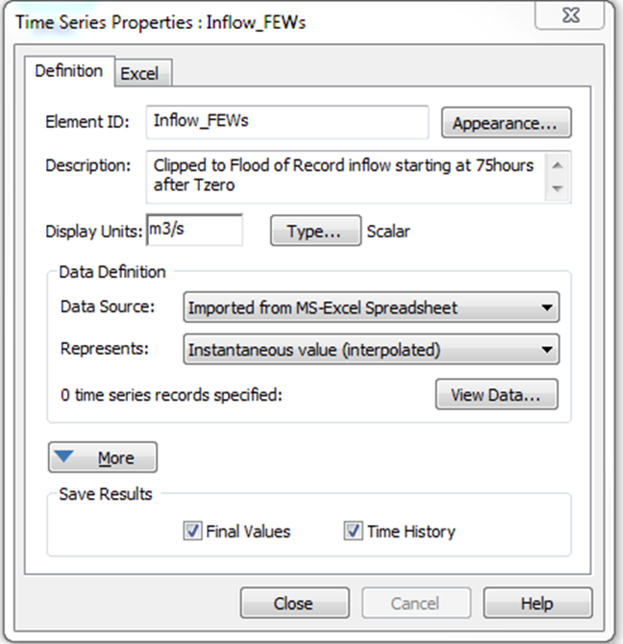
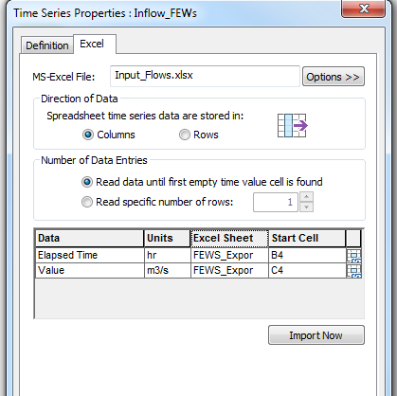
GoldSim Import

Slide 12
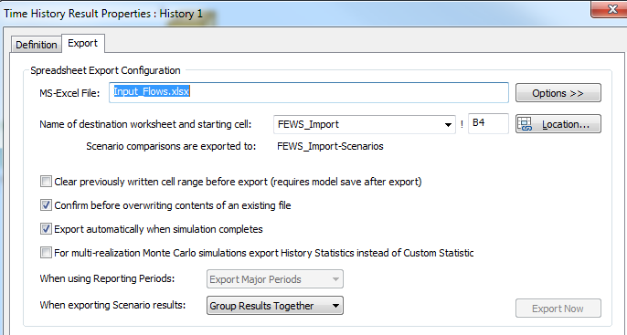

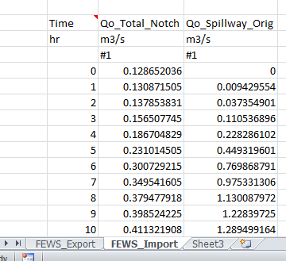
GoldSim Export

Slide 13
Essential Phrases and Orientation
\Config\ModuleDataSetFiles\_yourModel_.ZIP
A zipped folder with a \bin\ that contains .bat and .py scripts to drive the model. A \model\ that contains all of the model components
If python installed you can call it from the General Adapter via a batch file:
››› c:\python36\python.exe ‘yourScript.py’ >log.txt
Python will need other modules, most will be available, others will need to be installed using:
››› c:\python36\scripts\pip.exe install _module_
Notes:
Simple tasks can be accomplished using batch command syntax. More complicated steps you can use Powershell, R, Python
Anaconda takes care of a lot of the necessary steps Python from

Slide 14
Guided Walking Tour
https://notebooks.azure.com/lamilla79/projects/dfuda-2019-adapter
Worked_Example_FEWS-GoldSim-Adapter.ipynb
Folder

Slide 15
Missing a Package?
import subprocess
import sys
def install(package):
subprocess.call([sys.executable, "-m", "pip", "install", package])
# If they are missing then
››› c:\Python36\Scripts\Pip.exe install pandas
››› c:\ProgramData\Anaconda3\Scripts\Conda.exe install pandas
Notes:
One of the biggest frustrations with Python is that you have some code, but it won’t run because you have an error message about a missing library.
Arrgh - what to do. It is quite simple, ICT willing, it should just be matter of pulling the latest library from the repository

Slide 16
Web Links to Aid your visit
HYDPY
https://github.com/hydpy-dev/hydpy
HKV-FEWS-PY
FEWS Wiki: Adding External Module

Slide 17
Key Takeaways
Variety of different types of models available in FEWS
All stitched together using the “adapter” concept
Python is a toolbox to overcome non-standard issues
Models can be mixed in a single workflow for auditing
Increasing use of distributed & complex models in workflows
Issues: speed, database sizes, complexity, …
Keep the design workflow organised and repeatable

Slide 18
FEWS building blocks:
An application that manages model runs efficiently
Management of model queue to:
assist event and scenario runs
maximise license/hardware utilisation
Import/Export Timeseries:
Point, Grid and export self-contained NC.
Transformations of Timeseries:
Grid-grid interpolation / 2D Lookup Tables

Slide 19
Key Takeaways
Variety of different types of models available in FEWS
All stitched together using the “adapter” concept
Python is a toolbox to overcome non-standard issues
Models can be mixed in a single workflow for auditing
Increasing use of distributed & complex models in workflows
Issues: speed, database sizes, complexity, …
Keep the design workflow organised and repeatable

Slide 20
Tenets of modelling
All Models are wrong
Models are never finished, only abandoned
If you can’t make it perfect, make it adjustable

