Slide 1

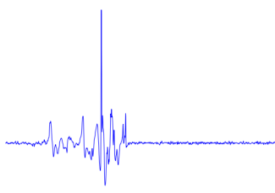

Slide 2
Fall detection systems
Signal acquisition
Vision
Wearable
Ambient
RGB-Camera
Omni-Camera
Depth-Camera
Accelerometer
Gyroscope
Barometric pressure
Microphone
Radar
Wi-Fi
Vibrational
Floor
Feature extraction
Vision
Wearable
Ambient
Position
Motion
Shape
Position
Velocity
Angle
Statistical measures
Fourier transform
Wavelet transform
Cepstrum features
Decision rule
Threshold
Machine learning
kNN
SVM
HMM
Decision Tree

Slide 3
Fall detection systems
Signal acquisition
Vision
Wearable
Ambient
RGB-Camera
Omni-Camera
Depth-Camera
Accelerometer
Gyroscope
Barometric pressure
Microphone
Radar
Wi-Fi
Vibrational
Pressure

Slide 4
Fall detection systems
Signal acquisition
Vision
Wearable
Ambient
RGB-Camera
Omni-Camera
Depth-Camera
Accelerometer
Gyroscope
Barometric pressure
Microphone
Radar
Wi-Fi
Vibrational
Pressure
Feature extraction
Vision
Wearable
Ambient
Position
Motion
Shape
Position
Velocity
Angle
Statistical measures
Fourier transform
Wavelet transform
Cepstrum features

Slide 5
Fall detection systems
Signal acquisition
Vision
Wearable
Ambient
RGB-Camera
Omni-Camera
Depth-Camera
Accelerometer
Gyroscope
Barometric pressure
Microphone
Radar
Wi-Fi
Vibrational
Pressure
Feature extraction
Vision
Wearable
Ambient
Position
Motion
Shape
Position
Velocity
Angle
Statistical measures
Fourier transform
Wavelet transform
Cepstrum features
Decision rule
Threshold
Machine learning
kNN
SVM
HMM
Decision Tree

Slide 6

Measure
Mass

Slide 7
Measure
Mass

Slide 12
Sensor
Mat
Gasket

Slide 13
Sensor
Mat
Gasket

Slide 14
Sensor
Mat
Gasket

Slide 15
Sensor
Mat
Gasket

Slide 16
Sensor
Mat
Gasket

Slide 17

Measure
Mass

Slide 18
Measure
Mass

Slide 19
Al 9 μm
PET 75 μm
PP 65 μm

Slide 20
Al 9 μm
PET 75 μm
PP 65 μm

Slide 21
Entrance
Bedroom
Processing unit
Bathroom

Slide 22
Entrance
Bedroom
Processing unit
Bathroom

Slide 23
Entrance
Bedroom
Processing unit
Bathroom

Slide 24
Flooring
Cable
Sensor
Concrete

Slide 25
Flooring
Cable
Sensor
Concrete

Slide 26
Flooring
Cable
Sensor
Concrete

Slide 27
Flooring
Cable
Sensor
Concrete

Slide 28
Processing unit

Slide 29





$$X_{2}<σ_{a}$$
$$X_{1}<σ_{b}$$
$$R_{3}$$
$$R_{1}$$
$$R_{2}$$

Slide 30







$$R_{3}$$
$$X_{2}$$
$$σ_{b}$$
$$R_{1}$$
$$R_{2}$$
$$σ_{a}$$
$$X_{1}$$

Slide 31
$$R_{3}$$
$$X_{2}$$
$$σ_{b}$$
$$R_{1}$$
$$R_{2}$$
$$σ_{a}$$
$$X_{1}$$

Slide 32
$$R_{3}$$
$$X_{2}$$
$$σ_{b}$$
$$R_{1}$$
$$R_{2}$$
$$σ_{a}$$
$$X_{1}$$

Slide 33
$$R_{3}$$
$$X_{2}$$
$$σ_{b}$$
$$R_{1}$$
$$R_{2}$$
$$σ_{a}$$
$$X_{1}$$

Slide 34
$$R_{3}$$
$$X_{2}$$
$$σ_{b}$$
$$R_{1}$$
$$R_{2}$$
$$σ_{a}$$
$$X_{1}$$

Slide 35
$$R_{3}$$
$$X_{2}$$
$$σ_{b}$$
$$R_{1}$$
$$R_{2}$$
$$σ_{a}$$
$$X_{1}$$

Slide 36
A
B
40 40
40 40
30 10
10 30
20 40
20 0

Slide 38

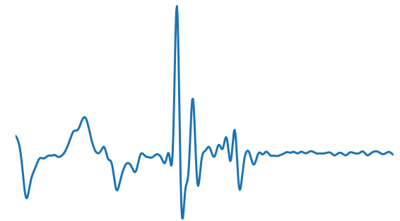
Supervised
Learning

Slide 39
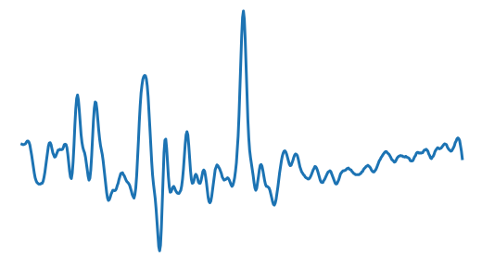
Supervised
Learning

Slide 40
Supervised
Learning
Poor results

Slide 41
Supervised
Learning
Few data
Imbalanced

Slide 42
Supervised
Learning
Few data
Imbalanced
Transfer Learning

Slide 43
Target data

Slide 44
2. Reduction
1. Expansion

Slide 45


2. Threshold update
$$τ_{m}$$
$$τ_{m}$$
1. Pruning

Slide 46
Target data

Slide 47

Target data
$$f_{i},{τ_{i}}^{new}$$

Slide 48


Target data
Target data
$$f_{i},{τ_{i}}^{new}$$
$$f_{j},{τ_{j}}^{new}$$

Slide 49
$$f_{i},{τ_{i}}^{new}$$
$$f_{j},{τ_{j}}^{new}$$

Slide 50
Target data
Target data
$$f_{i},{τ_{i}}^{new}$$
$$f_{j},{τ_{j}}^{new}$$

Slide 51
Target data
Target data
$$f_{i},{τ_{i}}^{new}$$
$$f_{j},{τ_{j}}^{new}$$

Slide 52
Target data
Target data
$$f_{i},{τ_{i}}^{new}$$
$$f_{j},{τ_{j}}^{new}$$

Slide 53
Target data
Target data
$$f_{i},{τ_{i}}^{new}$$
$$f_{j},{τ_{j}}^{new}$$

Slide 54
Target data
Target data
$$f_{i},{τ_{i}}^{new}$$
$$f_{j},{τ_{j}}^{new}$$

Slide 55
Target data
$$f_{i},{τ_{i}}^{new}$$
$$f_{j},{τ_{j}}^{new}$$

Slide 60
Target data

Slide 65
Target data

Slide 68
$$τ_{m}$$

Slide 70
Target data

Slide 75
Target data

Slide 81
Target data

Slide 84


$$τ_{m}$$
$$τ_{m}$$

Slide 85

$τ_{m}$?

Slide 86


$${Q_{l}}_{}^{S}$$
$${Q_{r}}_{}^{S}$$

Slide 87



$${S_{v}}_{}^{T}$$
$${Q_{l}}_{}^{S}$$
$${Q_{r}}_{}^{S}$$
$${S_{v,l}}_{}^{T},{Q_{l}}_{}^{T}$$
$${S_{v,r}}_{}^{T},{Q_{r}}_{}^{T}$$

Slide 88






$${S_{v}}_{}^{T}=\left\{x_{1},…,x_{N}\right\}$$
$${Q_{l}}_{}^{S}$$
$${Q_{r}}_{}^{S}$$
$${S_{v,l}}_{}^{T},{Q_{l}}_{}^{T}$$
$${S_{v,r}}_{}^{T},{Q_{r}}_{}^{T}$$
$$φ$$
$$φ(x_{1})$$
$$φ(x_{2})$$
$$…$$
$$φ(x_{N})$$

Slide 89



$${S_{v}}_{}^{T}=\left\{x_{1},…,x_{N}\right\}$$
$${Q_{l}}_{}^{S}$$
$${Q_{r}}_{}^{S}$$
$${S_{v,l}}_{}^{T},{Q_{l}}_{}^{T}$$
$${S_{v,r}}_{}^{T},{Q_{r}}_{}^{T}$$
$$φ$$
$$φ(x_{1})$$
$$φ(x_{2})$$
$$…$$
$$τ_{N−1}$$
$$φ(x_{N})$$
$$τ_{1}$$
$$…$$

Slide 90
Area equipped with sensor
Common
room
Office
Dining
room
Corridor

Slide 91
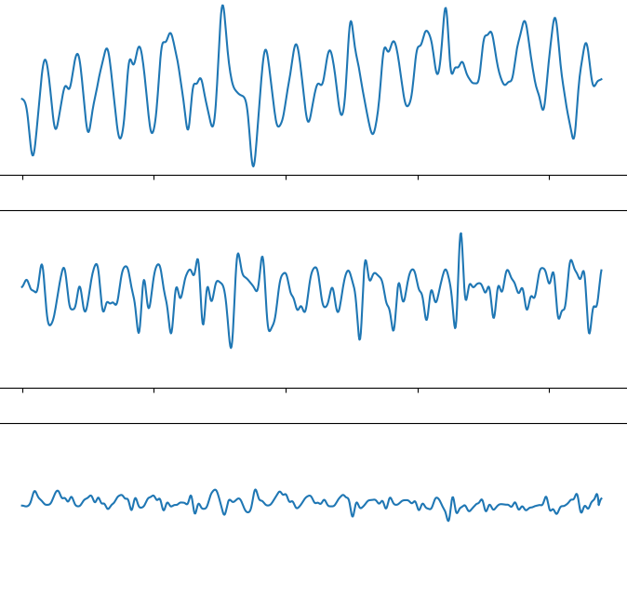
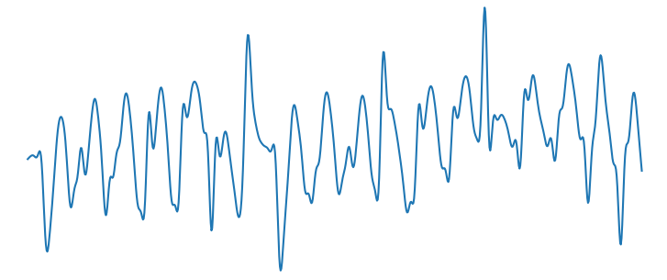
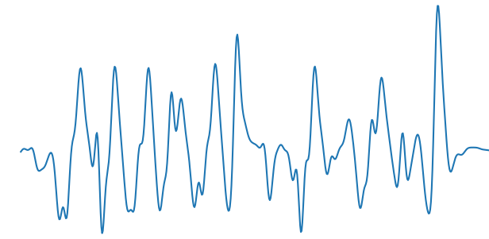

Slide 92
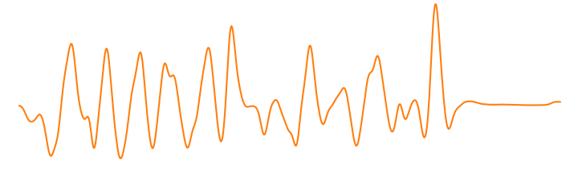
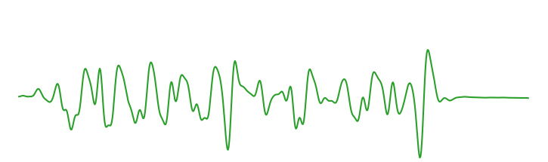
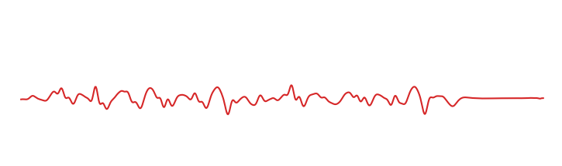
Max-pooling
Input signal
…
…
…
Output
1
5
60
1
Fully-connected
(64 neurons)
Fully-connected
(16 neurons)
Signal embedding
Convolution
(32 filters, size 60, str 10)
+ tanh
Convolution
(16 filters, size 1, str 1)
+ tanh
Convolution
(8 filters, size 1, str 1)
+ tanh
Convolution
(1 filter, size 5, str 1)
+ ReLu

Slide 93
Output
Input signal
…
…
…
1
5
60
1
Signal embedding
Convolution
(32 filters, size 60, str 10)
+ tanh
Convolution
(16 filters, size 1, str 1)
+ tanh
Convolution
(8 filters, size 1, str 1)
+ tanh
Convolution
(3 filters, size 1, str 1)
+ sigmoid

Slide 95


Hidden layer 1
Input vector $x$
Hidden layer 2
Output $y$

Slide 96
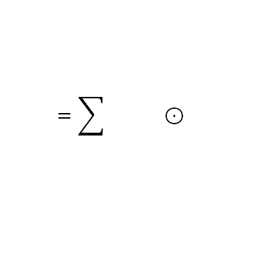
Filters
Input channel
Output channels
$$=\sum{} ⊙$$
element-wise

Slide 97
Stride 1
Stride 2
Stride 3
Input
Output
Input
Output
Input
Output

Slide 98
Input
Output
1

Slide 99
Input
Output
2

Slide 100
Input
Output
3

Slide 101
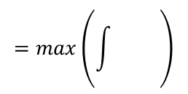
Input channel
Output channel
$$=max\left(\int{} \right)$$

Slide 102








$$Θ^{(q+1)}$$
$$βv^{(q)}$$
$$Θ^{(q)}$$
$−∇_{Θ}J(Θ^{\left(q\right)})$
$−∇_{Θ}J(Θ^{\left(q\right)}+βv^{(q)})$
$$βv^{(q)}$$
$$Θ^{(q+1)}$$
$$Θ^{(q)}$$

