Slide 1

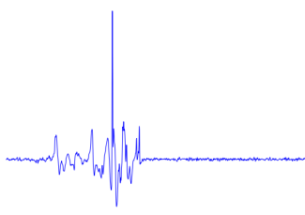

Slide 2
Fall detection systems
Signal acquisition
Vision
Wearable
Ambient
RGB-Camera
Omni-Camera
Depth-Camera
Accelerometer
Gyroscope
Barometric pressure
Microphone
Radar
Wi-Fi
Vibrational
Pressure
Feature extraction
Vision
Wearable
Ambient
Position
Motion
Shape
Position
Velocity
Angle
Statistical measures
Fourier transform
Wavelet transform
Cepstrum features
Decision rule
Threshold
Machine learning
kNN
SVM
HMM
Decision Tree

Slide 3
Fall detection systems
Signal acquisition
Vision
Wearable
Ambient
RGB-Camera
Omni-Camera
Depth-Camera
Accelerometer
Gyroscope
Barometric pressure
Microphone
Radar
Wi-Fi
Vibrational
Pressure

Slide 4
Fall detection systems
Signal acquisition
Vision
Wearable
Ambient
RGB-Camera
Omni-Camera
Depth-Camera
Accelerometer
Gyroscope
Barometric pressure
Microphone
Radar
Wi-Fi
Vibrational
Pressure
Feature extraction
Vision
Wearable
Ambient
Position
Motion
Shape
Position
Velocity
Angle
Statistical measures
Fourier transform
Wavelet transform
Cepstrum features

Slide 5
Fall detection systems
Signal acquisition
Vision
Wearable
Ambient
RGB-Camera
Omni-Camera
Depth-Camera
Accelerometer
Gyroscope
Barometric pressure
Microphone
Radar
Wi-Fi
Vibrational
Pressure
Feature extraction
Vision
Wearable
Ambient
Position
Motion
Shape
Position
Velocity
Angle
Statistical measures
Fourier transform
Wavelet transform
Cepstrum features
Decision rule
Threshold
Machine learning
kNN
SVM
HMM
Decision Tree

Slide 6

Measure
Mass

Slide 7
Measure
Mass

Slide 12
Sensor
Mat
Gasket

Slide 13
Sensor
Mat
Gasket

Slide 14
Sensor
Mat
Gasket

Slide 15
Sensor
Mat
Gasket

Slide 16
Sensor
Mat
Gasket

Slide 17

Measure
Mass

Slide 18
Measure
Mass

Slide 19
Al 9 μm
PET 75 μm
PP 65 μm

Slide 20
Al 9 μm
PET 75 μm
PP 65 μm

Slide 21
Entrance
Bedroom
Processing unit
Bathroom

Slide 22
Entrance
Bedroom
Processing unit
Bathroom

Slide 23
Entrance
Bedroom
Processing unit
Bathroom

Slide 24
Flooring
Cable
Sensor
Concrete

Slide 25
Flooring
Cable
Sensor
Concrete

Slide 26
Flooring
Cable
Sensor
Concrete

Slide 27
Flooring
Cable
Sensor
Concrete

Slide 28
Processing unit

Slide 29





$$X_{2}<t_{2}$$
$$X_{1}<t_{1}$$
$$R_{3}$$
$$R_{1}$$
$$R_{2}$$

Slide 30







$$R_{3}$$
$$X_{2}$$
$$t_{2}$$
$$R_{1}$$
$$R_{2}$$
$$t_{1}$$
$$X_{1}$$

Slide 31
$$R_{3}$$
$$X_{2}$$
$$t_{2}$$
$$R_{1}$$
$$R_{2}$$
$$t_{1}$$
$$X_{1}$$

Slide 32
A
B
40 40
40 40
30 10
10 30
20 40
20 0

Slide 34

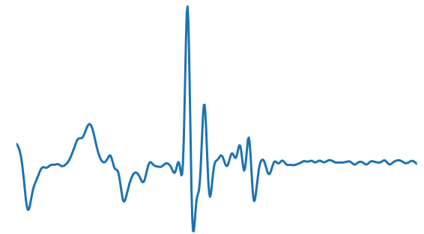
Supervised
Learning

Slide 35
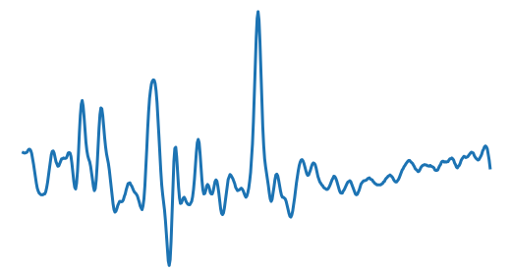
Supervised
Learning

Slide 36
Supervised
Learning
Poor results

Slide 37
Supervised
Learning
Few data
Imbalanced

Slide 38
Supervised
Learning
Few data
Imbalanced
Transfer Learning

Slide 39
Target data

Slide 40
2. Reduction
1. Expansion

Slide 41


2. Threshold update
$$τ_{m}$$
$$τ_{m}$$
1. Pruning

Slide 42
Target data

Slide 43

Target data
$$f_{i},{τ_{i}}^{new}$$

Slide 44


Target data
Target data
$$f_{i},{τ_{i}}^{new}$$
$$f_{j},{τ_{j}}^{new}$$

Slide 45
$$f_{i},{τ_{i}}^{new}$$
$$f_{j},{τ_{j}}^{new}$$

Slide 46
Target data
Target data
$$f_{i},{τ_{i}}^{new}$$
$$f_{j},{τ_{j}}^{new}$$

Slide 47
Target data
Target data
$$f_{i},{τ_{i}}^{new}$$
$$f_{j},{τ_{j}}^{new}$$

Slide 48
Target data
Target data
$$f_{i},{τ_{i}}^{new}$$
$$f_{j},{τ_{j}}^{new}$$

Slide 49
Target data
Target data
$$f_{i},{τ_{i}}^{new}$$
$$f_{j},{τ_{j}}^{new}$$

Slide 50
Target data
Target data
$$f_{i},{τ_{i}}^{new}$$
$$f_{j},{τ_{j}}^{new}$$

Slide 51
Target data
$$f_{i},{τ_{i}}^{new}$$
$$f_{j},{τ_{j}}^{new}$$

Slide 56
Target data

Slide 61
Target data

Slide 64
$$τ_{m}$$

Slide 66
Target data

Slide 71
Target data

Slide 77
Target data

Slide 80


$$τ_{m}$$
$$τ_{m}$$

Slide 81

$τ_{m}$?

Slide 82


$${Q_{l}}_{}^{S}$$
$${Q_{r}}_{}^{S}$$

Slide 83



$${S_{v}}_{}^{T}$$
$${Q_{l}}_{}^{S}$$
$${Q_{r}}_{}^{S}$$
$${S_{v,l}}_{}^{T},{Q_{l}}_{}^{T}$$
$${S_{v,r}}_{}^{T},{Q_{r}}_{}^{T}$$

Slide 84






$${S_{v}}_{}^{T}=\left\{x_{1},…,x_{N}\right\}$$
$${Q_{l}}_{}^{S}$$
$${Q_{r}}_{}^{S}$$
$${S_{v,l}}_{}^{T},{Q_{l}}_{}^{T}$$
$${S_{v,r}}_{}^{T},{Q_{r}}_{}^{T}$$
$$φ$$
$$φ(x_{1})$$
$$φ(x_{2})$$
$$…$$
$$φ(x_{N})$$

Slide 85



$${S_{v}}_{}^{T}=\left\{x_{1},…,x_{N}\right\}$$
$${Q_{l}}_{}^{S}$$
$${Q_{r}}_{}^{S}$$
$${S_{v,l}}_{}^{T},{Q_{l}}_{}^{T}$$
$${S_{v,r}}_{}^{T},{Q_{r}}_{}^{T}$$
$$φ$$
$$φ(x_{1})$$
$$φ(x_{2})$$
$$…$$
$$τ_{N−1}$$
$$φ(x_{N})$$
$$τ_{1}$$
$$…$$

Slide 86
Area equipped with sensor
Common
room
Office
Dining
room
Corridor

Slide 87
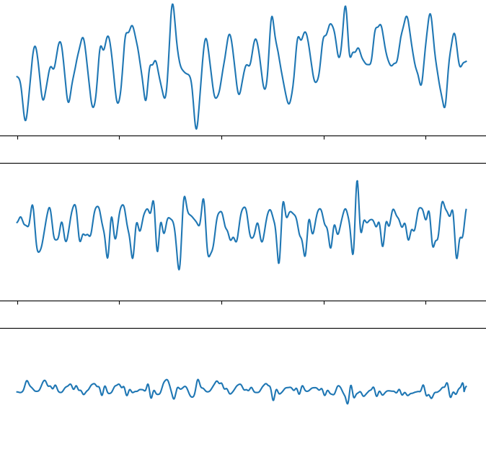
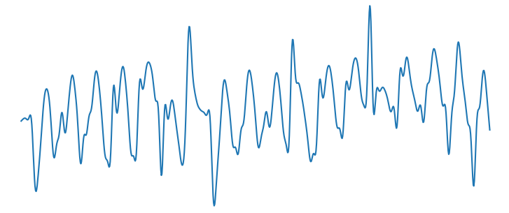
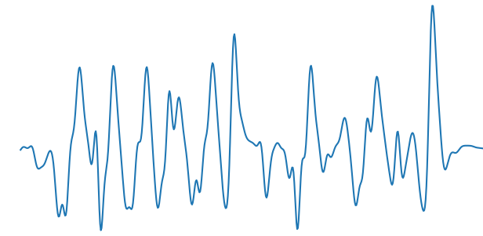

Slide 88
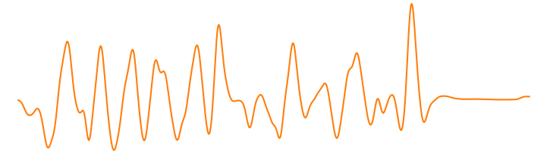
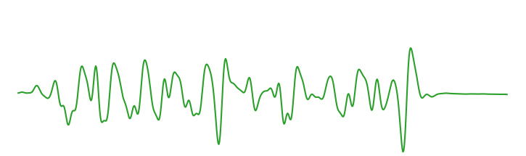
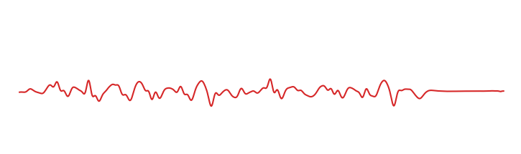
Max-pooling
Input signal
…
…
…
Output
1
5
60
1
Fully-connected
(64 neurons)
Fully-connected
(16 neurons)
Signal embedding
Convolution
(32 filters, size 60, str 10)
+ tanh
Convolution
(16 filters, size 1, str 1)
+ tanh
Convolution
(8 filters, size 1, str 1)
+ tanh
Convolution
(1 filter, size 5, str 1)
+ ReLu

Slide 89
Output
Input signal
…
…
…
1
5
60
1
Signal embedding
Convolution
(32 filters, size 60, str 10)
+ tanh
Convolution
(16 filters, size 1, str 1)
+ tanh
Convolution
(8 filters, size 1, str 1)
+ tanh
Convolution
(3 filters, size 1, str 1)
+ sigmoid

Slide 91


Hidden layer 1
Input vector $x$
Hidden layer 2
Output $y$

Slide 92
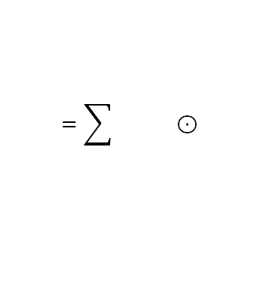
Filters
Input channel
Output channels
$$=\sum{} ⊙$$
element-wise

Slide 93
Stride 1
Stride 2
Stride 3
Input
Output
Input
Output
Input
Output

Slide 94
Input
Output
1

Slide 95
Input
Output
2

Slide 96
Input
Output
3

Slide 97
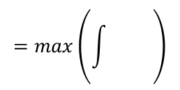
Input channel
Output channel
$$=max\left(\int{} \right)$$

Slide 98








$$Θ^{(q+1)}$$
$$βv^{(q)}$$
$$Θ^{(q)}$$
$−∇_{Θ}J(Θ^{\left(q\right)})$
$−∇_{Θ}J(Θ^{\left(q\right)}+βv^{(q)})$
$$βv^{(q)}$$
$$Θ^{(q+1)}$$
$$Θ^{(q)}$$

