Slide 1

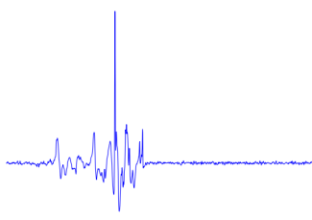

Slide 2
Fall detection systems
Signal acquisition
Vision
Wearable
Ambient
RGB-Camera
Omni-Camera
Depth-Camera
Accelerometer
Gyroscope
Barometric pressure
Microphone
Radar
Wi-Fi
Vibrational
Pressure
Feature extraction
Vision
Wearable
Ambient
Position
Motion
Shape
Position
Velocity
Angle
Statistical measures
Fourier transform
Wavelet transform
Cepstrum features
Decision rule
Threshold
Machine learning
kNN
SVM
HMM
Decision Tree

Slide 3
Fall detection systems
Signal acquisition
Vision
Wearable
Ambient
RGB-Camera
Omni-Camera
Depth-Camera
Accelerometer
Gyroscope
Barometric pressure
Microphone
Radar
Wi-Fi
Vibrational
Pressure

Slide 4
Fall detection systems
Signal acquisition
Vision
Wearable
Ambient
RGB-Camera
Omni-Camera
Depth-Camera
Accelerometer
Gyroscope
Barometric pressure
Microphone
Radar
Wi-Fi
Vibrational
Pressure
Feature extraction
Vision
Wearable
Ambient
Position
Motion
Shape
Position
Velocity
Angle
Statistical measures
Fourier transform
Wavelet transform
Cepstrum features

Slide 5
Fall detection systems
Signal acquisition
Vision
Wearable
Ambient
RGB-Camera
Omni-Camera
Depth-Camera
Accelerometer
Gyroscope
Barometric pressure
Microphone
Radar
Wi-Fi
Vibrational
Pressure
Feature extraction
Vision
Wearable
Ambient
Position
Motion
Shape
Position
Velocity
Angle
Statistical measures
Fourier transform
Wavelet transform
Cepstrum features
Decision rule
Threshold
Machine learning
kNN
SVM
HMM
Decision Tree

Slide 6

Measure
Mass

Slide 7
Measure
Mass

Slide 12
Sensor
Mat
Gasket

Slide 13
Sensor
Mat
Gasket

Slide 14
Sensor
Mat
Gasket

Slide 15
Sensor
Mat
Gasket

Slide 16
Sensor
Mat
Gasket

Slide 17

Measure
Mass

Slide 18
Measure
Mass

Slide 19
Al 9 μm
PET 75 μm
PP 65 μm

Slide 20
Al 9 μm
PET 75 μm
PP 65 μm

Slide 21
Entrance
Bedroom
Processing unit
Bathroom

Slide 22
Entrance
Bedroom
Processing unit
Bathroom

Slide 23
Entrance
Bedroom
Processing unit
Bathroom

Slide 24
Flooring
Cable
Sensor
Concrete

Slide 25
Flooring
Cable
Sensor
Concrete

Slide 26
Flooring
Cable
Sensor
Concrete

Slide 27
Flooring
Cable
Sensor
Concrete

Slide 28
Processing unit

Slide 29





$$X_{2}<t_{2}$$
$$X_{1}<t_{1}$$
$$R_{3}$$
$$R_{1}$$
$$R_{2}$$

Slide 30







$$R_{3}$$
$$X_{2}$$
$$t_{2}$$
$$R_{1}$$
$$R_{2}$$
$$t_{1}$$
$$X_{1}$$

Slide 31
$$R_{3}$$
$$X_{2}$$
$$t_{2}$$
$$R_{1}$$
$$R_{2}$$
$$t_{1}$$
$$X_{1}$$

Slide 32
A
B
40 40
40 40
30 10
10 30
20 40
20 0

Slide 34
Target data

Slide 35
2. Reduction
1. Expansion

Slide 36


2. Threshold update
$$τ_{m}$$
$$τ_{m}$$
1. Pruning

Slide 37
Target data

Slide 38

Target data
$$f_{i},{τ_{i}}^{new}$$

Slide 39


Target data
Target data
$$f_{i},{τ_{i}}^{new}$$
$$f_{j},{τ_{j}}^{new}$$

Slide 40
$$f_{i},{τ_{i}}^{new}$$
$$f_{j},{τ_{j}}^{new}$$

Slide 41
Target data
Target data
$$f_{i},{τ_{i}}^{new}$$
$$f_{j},{τ_{j}}^{new}$$

Slide 42
Target data
Target data
$$f_{i},{τ_{i}}^{new}$$
$$f_{j},{τ_{j}}^{new}$$

Slide 43
Target data
Target data
$$f_{i},{τ_{i}}^{new}$$
$$f_{j},{τ_{j}}^{new}$$

Slide 44
Target data
Target data
$$f_{i},{τ_{i}}^{new}$$
$$f_{j},{τ_{j}}^{new}$$

Slide 45
Target data
Target data
$$f_{i},{τ_{i}}^{new}$$
$$f_{j},{τ_{j}}^{new}$$

Slide 46
Target data
$$f_{i},{τ_{i}}^{new}$$
$$f_{j},{τ_{j}}^{new}$$

Slide 51
Target data

Slide 56
Target data

Slide 59
$$τ_{m}$$

Slide 61
Target data

Slide 66
Target data

Slide 72
Target data

Slide 75


$$τ_{m}$$
$$τ_{m}$$

Slide 76

$τ_{m}$?

Slide 77


$${Q_{l}}_{}^{S}$$
$${Q_{r}}_{}^{S}$$

Slide 78



$${S_{v}}_{}^{T}$$
$${Q_{l}}_{}^{S}$$
$${Q_{r}}_{}^{S}$$
$${S_{v,l}}_{}^{T},{Q_{l}}_{}^{T}$$
$${S_{v,r}}_{}^{T},{Q_{r}}_{}^{T}$$

Slide 79






$${S_{v}}_{}^{T}=\left\{x_{1},…,x_{N}\right\}$$
$${Q_{l}}_{}^{S}$$
$${Q_{r}}_{}^{S}$$
$${S_{v,l}}_{}^{T},{Q_{l}}_{}^{T}$$
$${S_{v,r}}_{}^{T},{Q_{r}}_{}^{T}$$
$$φ$$
$$φ(x_{1})$$
$$φ(x_{2})$$
$$…$$
$$φ(x_{N})$$

Slide 80



$${S_{v}}_{}^{T}=\left\{x_{1},…,x_{N}\right\}$$
$${Q_{l}}_{}^{S}$$
$${Q_{r}}_{}^{S}$$
$${S_{v,l}}_{}^{T},{Q_{l}}_{}^{T}$$
$${S_{v,r}}_{}^{T},{Q_{r}}_{}^{T}$$
$$φ$$
$$φ(x_{1})$$
$$φ(x_{2})$$
$$…$$
$$τ_{N−1}$$
$$φ(x_{N})$$
$$τ_{1}$$
$$…$$

Slide 81
Area equipped with sensor
Common
room
Office
Dining
room
Corridor

Slide 82
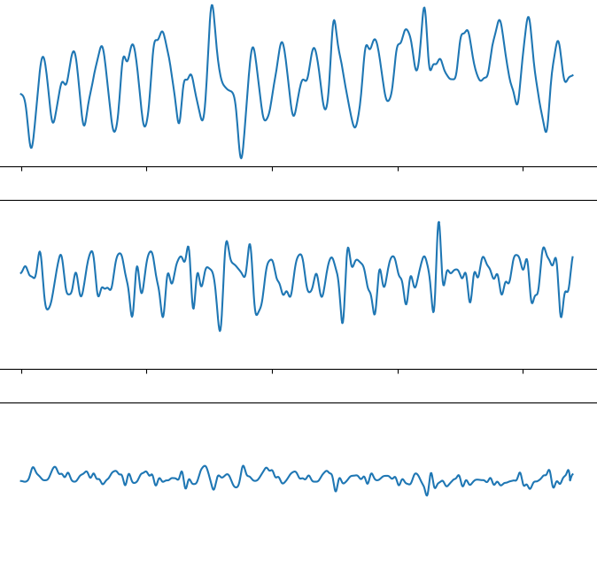
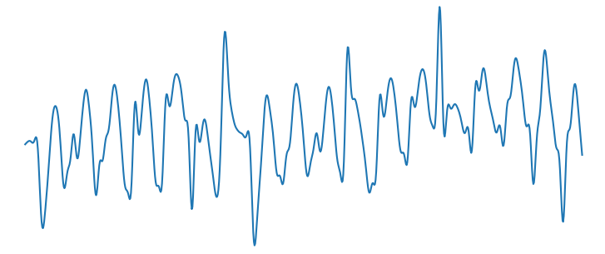
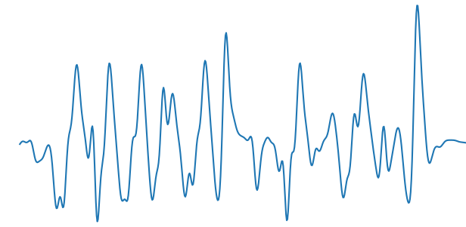

Slide 83
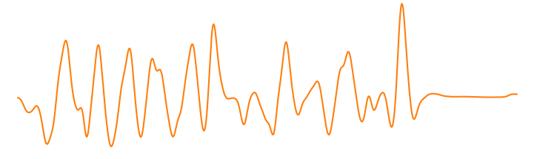
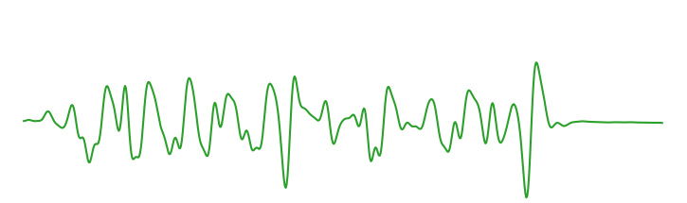
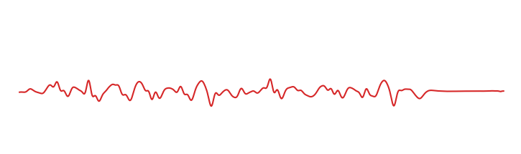
Max-pooling
Input signal
…
…
…
Output
1
5
60
1
Fully-connected
(64 neurons)
Fully-connected
(16 neurons)
Signal embedding
Convolution
(32 filters, size 60, str 10)
+ tanh
Convolution
(16 filters, size 1, str 1)
+ tanh
Convolution
(8 filters, size 1, str 1)
+ tanh
Convolution
(1 filter, size 5, str 1)
+ ReLu

Slide 84
Output
Input signal
…
…
…
1
5
60
1
Signal embedding
Convolution
(32 filters, size 60, str 10)
+ tanh
Convolution
(16 filters, size 1, str 1)
+ tanh
Convolution
(8 filters, size 1, str 1)
+ tanh
Convolution
(3 filters, size 1, str 1)
+ sigmoid

Slide 86


Hidden layer 1
Input vector $x$
Hidden layer 2
Output $y$

Slide 87
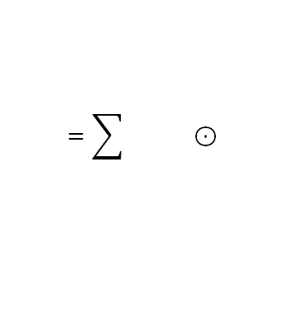
Filters
Input channel
Output channels
$$=\sum{} ⊙$$
element-wise

Slide 88
Stride 1
Stride 2
Stride 3
Input
Output
Input
Output
Input
Output

Slide 89
Input
Output
1

Slide 90
Input
Output
2

Slide 91
Input
Output
3

Slide 92
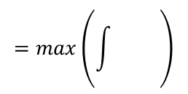
Input channel
Output channel
$$=max\left(\int{} \right)$$

Slide 93








$$Θ^{(q+1)}$$
$$βv^{(q)}$$
$$Θ^{(q)}$$
$−∇_{Θ}J(Θ^{\left(q\right)})$
$−∇_{Θ}J(Θ^{\left(q\right)}+βv^{(q)})$
$$βv^{(q)}$$
$$Θ^{(q+1)}$$
$$Θ^{(q)}$$

