Slide 1
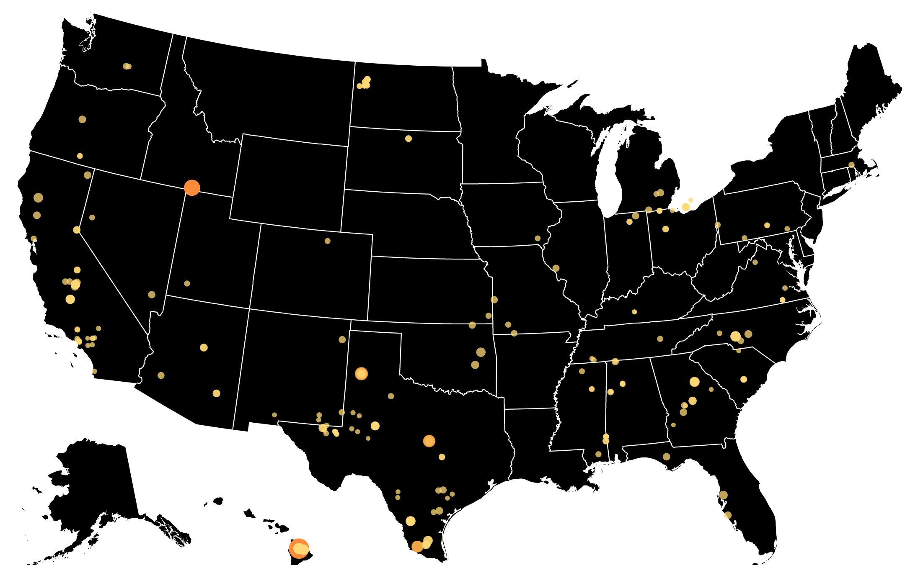
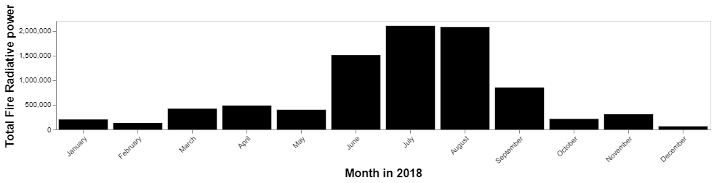
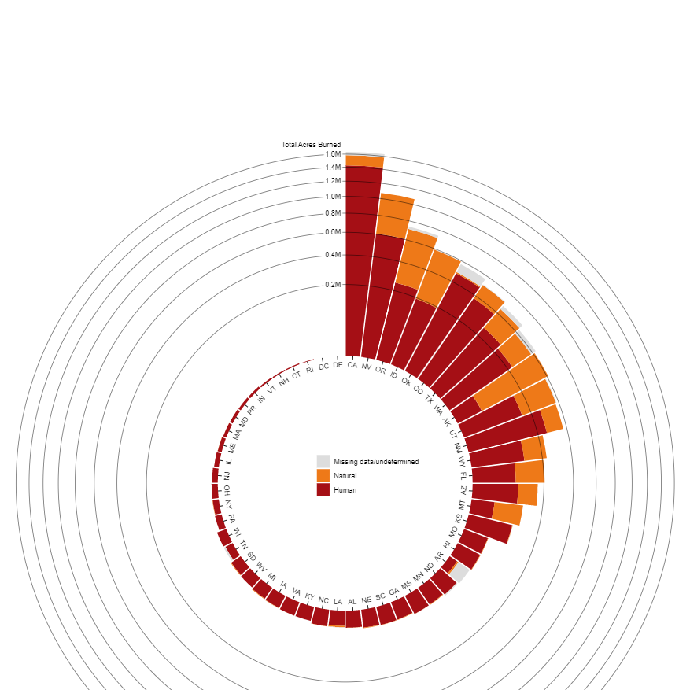
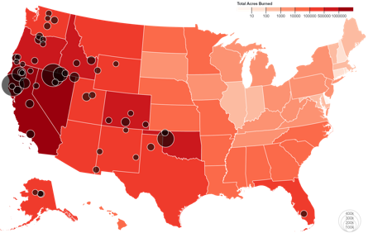
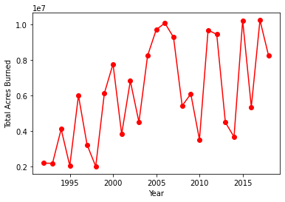
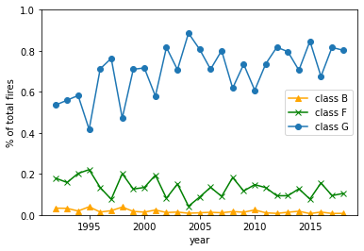
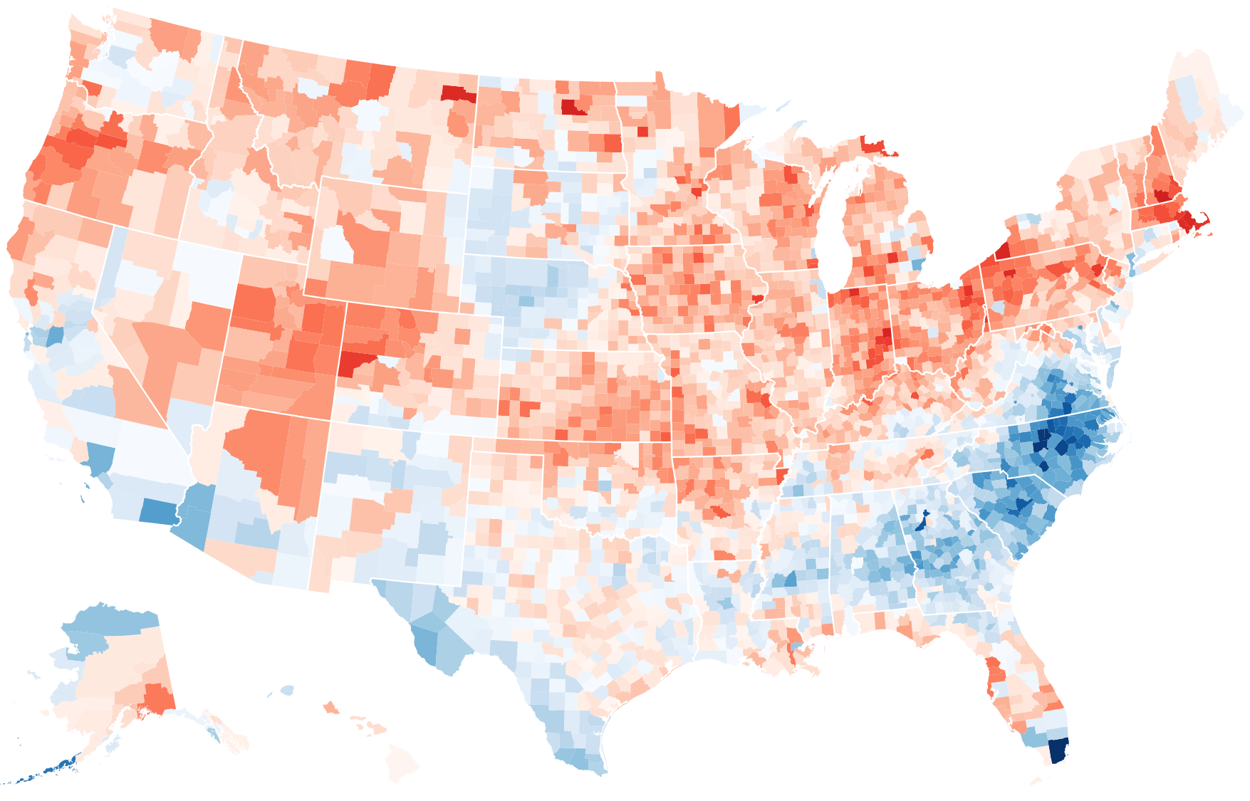
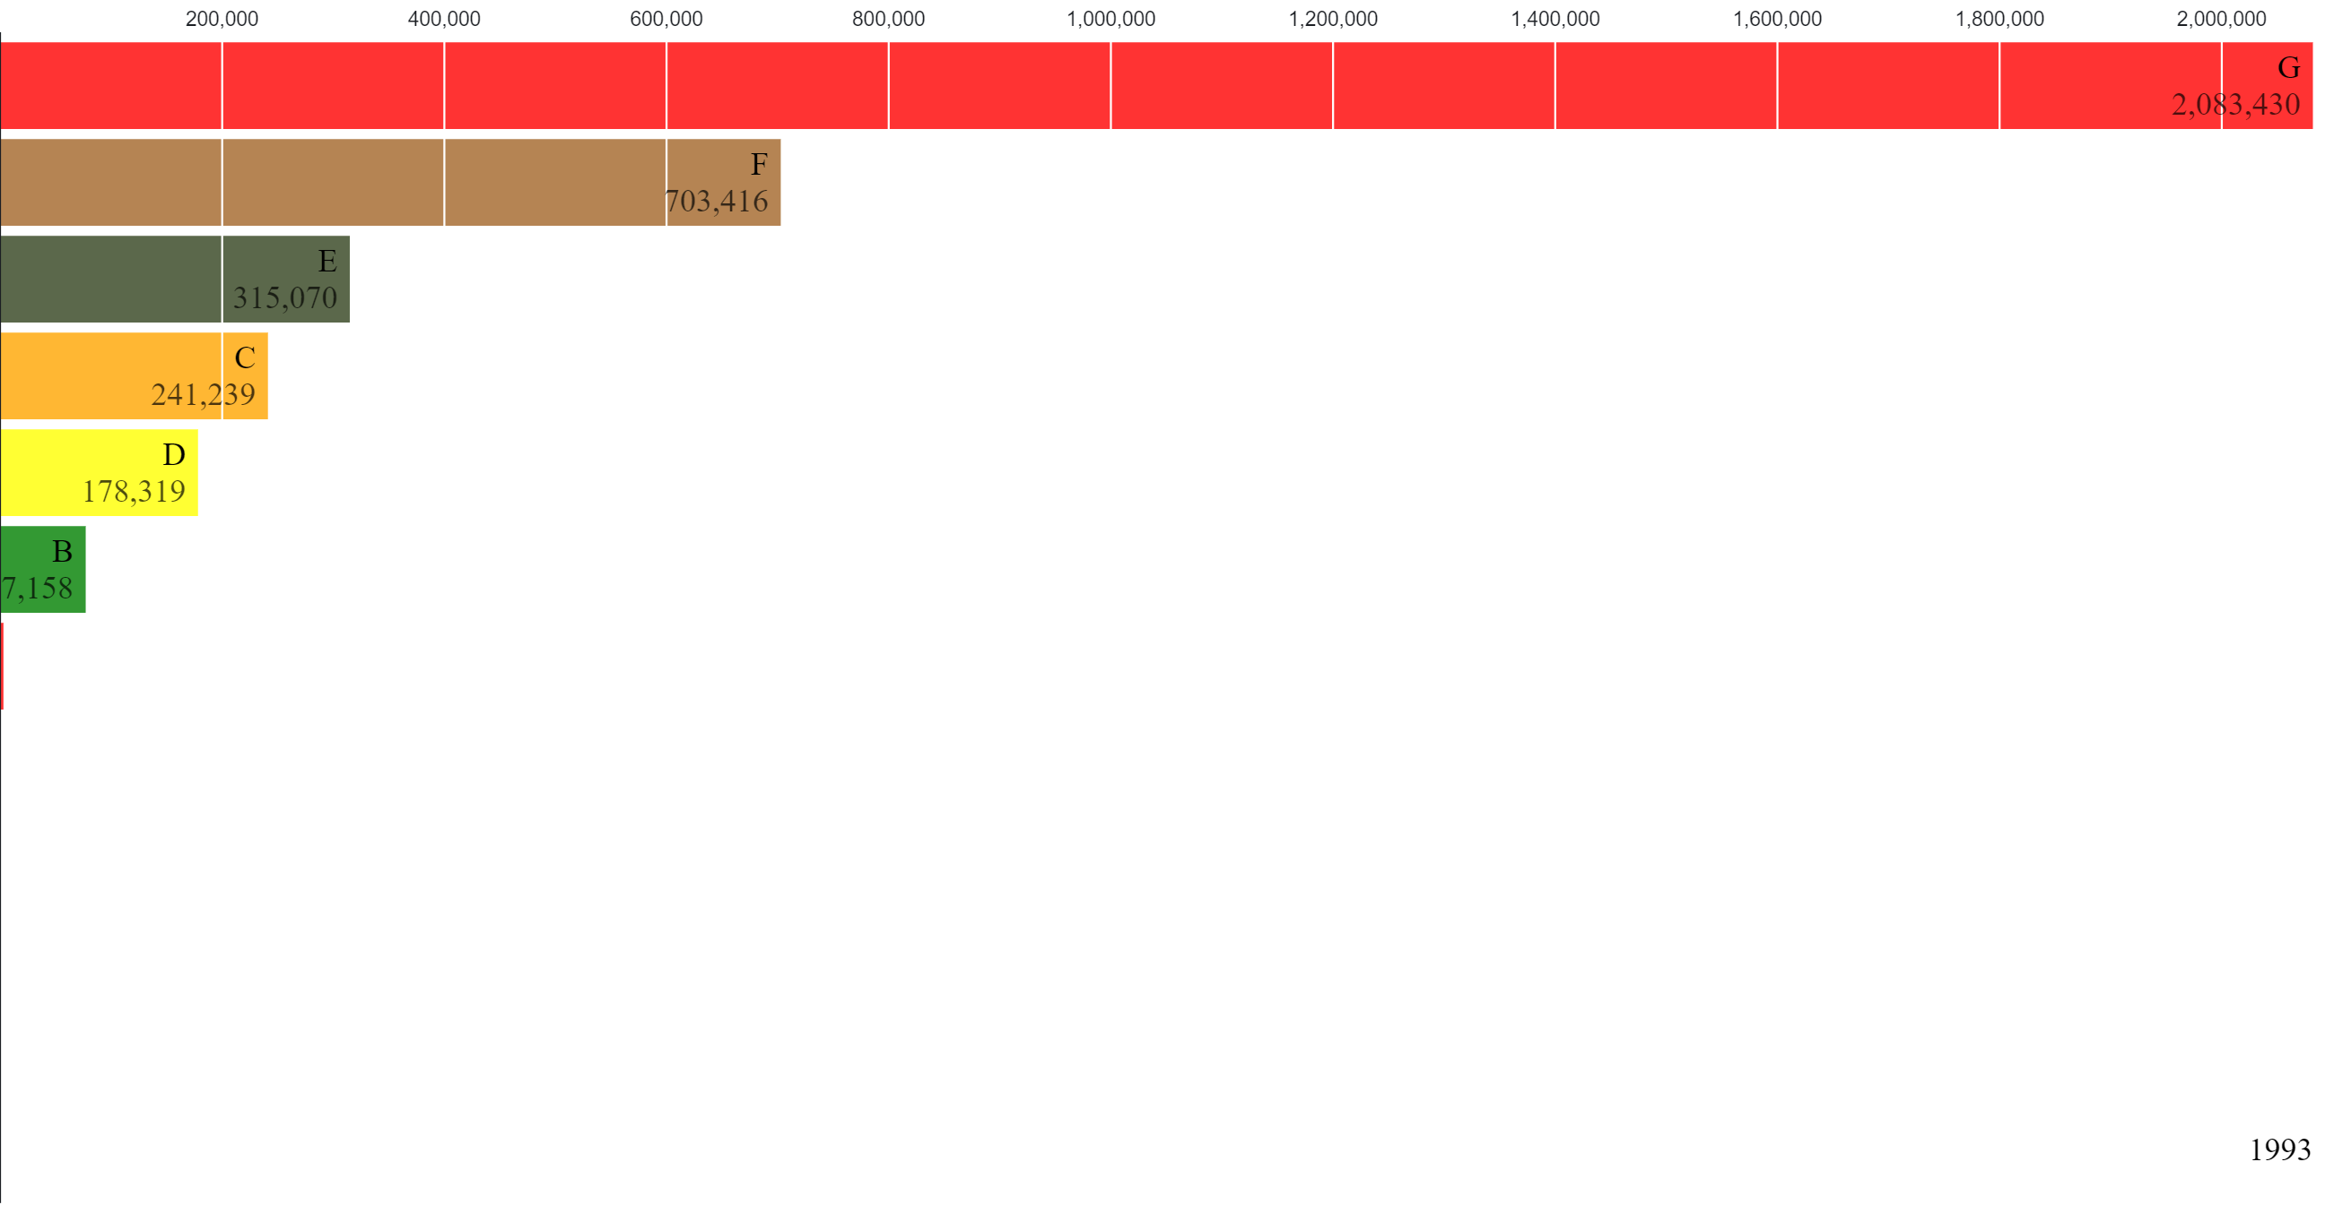
Wildfires
The impact of wildfires in the US in modern history
2018 was one of the most damaging year for wildfires in the US
In this narrative we are going to explore the size and location of wildfires over 2018. The size of fires is measured on frp which are the force radiative power (mW/area). Using the scroller you can focus on any time of the year or just look at the animation in autoplay
Gettin crispy in the Summer
The months in the summer are the most catastrophic for wildfires and the damage they cause
Acres burnt per state
In this chloropleth map we show the acres burnt in 2018 per state.
Morever, the bubbles map overlapped tells you more about the 50 biggest fires of 2018 with specific information shown with the tooltip
Most fires are human caused
In this circular bar chart we show the impact of human and naturally caused wildfires per state.
Wildfires in the US over the last 3 decades
We show two line plot following the total number of acres burnt from 1992 to 2018. Moreover, we divide the fires into their impact which is measured by classes:
Class A: 0.25 acres or less;
Class B: > 0.25 acres, < 10 acres;
Class C: >= 10 acres, < 100 acres;
Class D: >= 100 acres, < 300 acres;
Class E: >= 300 acres, < 1,000 acres;
Class F: >= 1,000 acres, < 5,000 acres;
Class G: >= 5,000 acres.
Relative Increase in fire between 1992 and 2018
Fire class change over time

