Slide 1
Dictionary
Each key is separated from its value by a colon (:), the items are separated by commas, and the whole thing is enclosed in curly braces. An empty dictionary without any items is written with just two curly braces, like this: {}.
Keys are unique within a dictionary while values may not be. The values of a dictionary can be of any type, but the keys must be of an immutable data type such as strings, numbers, or tuples.
To access dictionary elements, you can use the familiar square brackets along with the key to obtain its value.

Slide 2
Updating Dictionary
You can update a dictionary by adding a new entry or a key-value pair, modifying an existing entry, or deleting an existing entry.
You can either remove individual dictionary elements or clear the entire contents of a dictionary. You can also delete entire dictionary in a single operation

Slide 3
DICT.. Methods
dict.clear()Removes all elements of dictionary dict.
dict.copy()Returns a shallow copy of dictionary dict.
dict.items()Returns a list of dict's (key, value) tuple pairs.
dict.values()Returns list of dictionary dict's values.

Slide 4
Functions
A function is a block of organized, reusable code that is used to perform a single, related action. Functions provide better modularity for your application and a high degree of code reusing.
Python gives you many built-in functions like print(), etc. but you can also create your own functions. These functions are called user-defined functions.

Slide 5
Defining Function
Function blocks begin with the keyword def followed by the function name and parentheses ( ).
Any input parameters or arguments should be placed within these parentheses. You can also define parameters inside these parentheses.
The code block within every function starts with a colon (:) and is indented.

Slide 6
Functional Arguments
Required arguments.
Keyword arguments.
Default arguments.
Variable-length arguments.

Slide 7
Return Statement
The statement return [expression] exits a function, optionally passing back an expression to the caller. A return statement with no arguments is the same as return None.

Slide 8
Scope Of Variables
Global variables.
Local variables.

Slide 9
File Handling
Python provides basic functions and methods necessary to manipulate files by default. You can do most of the file manipulation using a file object.
Before you can read or write a file, you have to open it using Python’s
built-in open() function. This function creates a file object, which
would be utilized to call other support methods associated with it.

Slide 10
Optional Parameters in F.H
R, RB, R+, RB+
W, WB, W+, WB+

Slide 11
Lambda
The lambda function is a way to create small anonymous functions, These functions are throw-away functions, i.e. they are just needed where they have been created.
The argument list consists of a comma separated list of arguments and the expression is an arithmetic expression using these arguments. You can assign the function to a variable to give it a name.
Syntax: >>> f = lambda x, y : x + y
>>> f(1,1)

Slide 12
Exception Errors
Zero division error: occurs when a number is divided by zero.
Name error: occurs when name is not found.
Indentation error: if incorrect indentation error is given.
IOError: occurs when i/o operation fails.
EOFError: occurs when end of the file is reached and yet operations are being peformed.

Slide 13
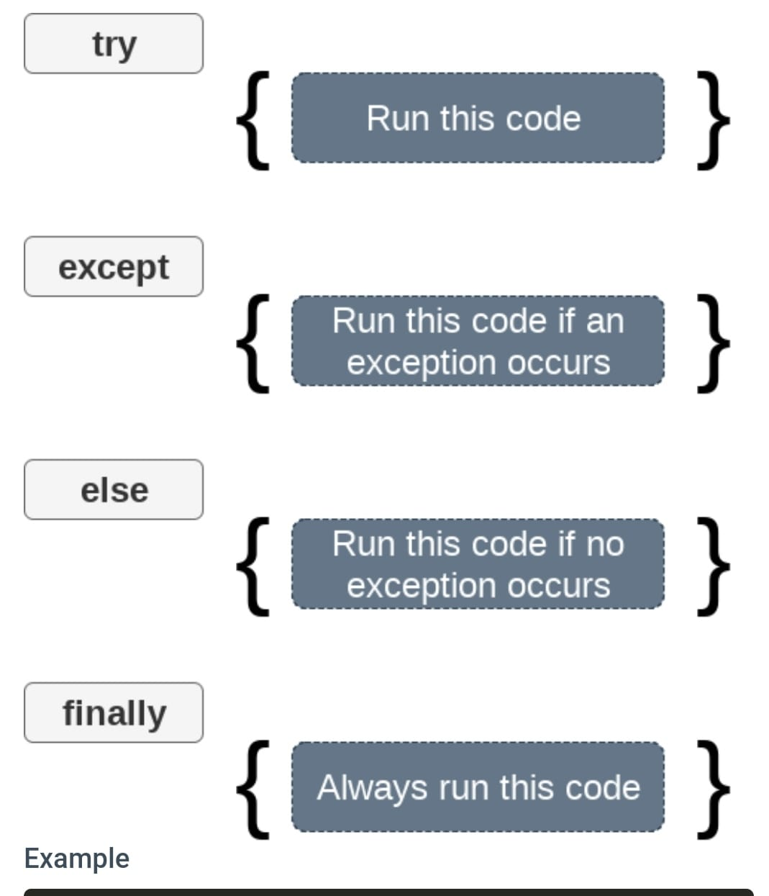
Exception Handling

Slide 14
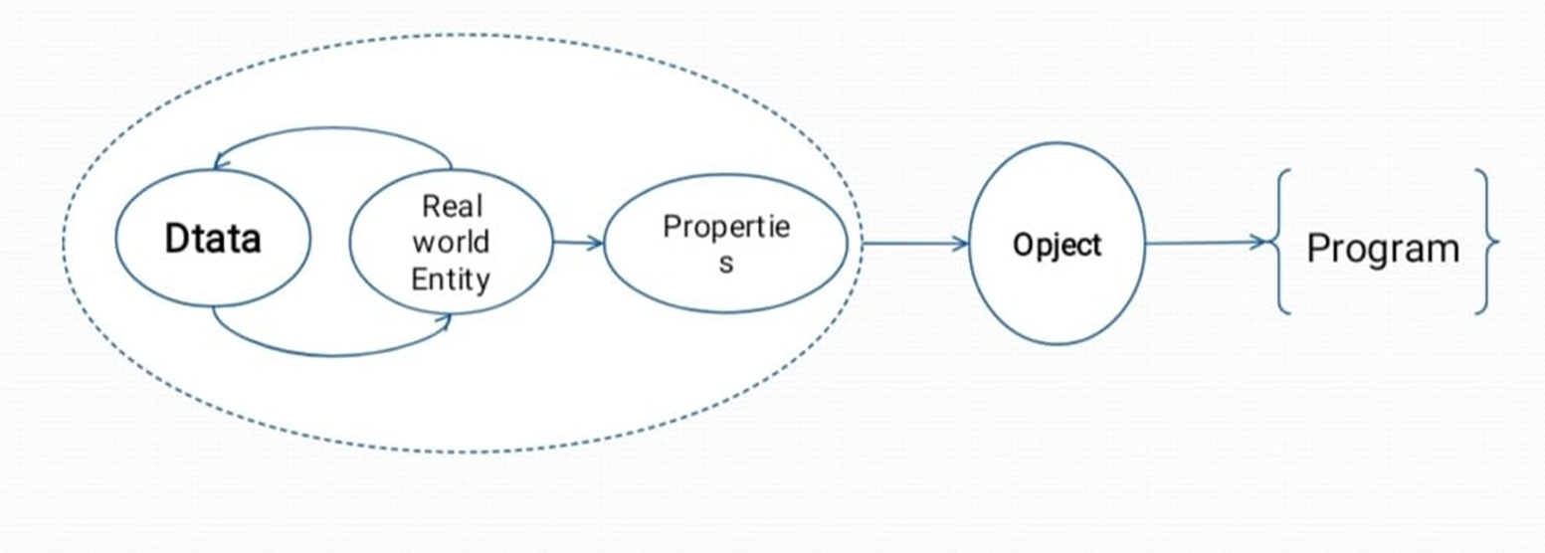
OOPS
Python is an object-oriented programming language. It allows us to develop applications using an Object Oriented approach.

Slide 15
OOPS Methods
Object
Class
Method
Inheritance
Polymorphism
Data Abstraction
Encapsulation

