Slide 1
Testes mutantes + Relatório

Slide 2
Agenda
Introdução aos testes de mutação
Exemplo prático básico
Utilidade
Relatório

Slide 3
Mutações
def calcula_hipotenusa(a, b):
a2 = a*2
b2 = b**2
c2 = a2 + b2
c = math.sqrt(c2)
return c
operator
import math
def calcula_hipotenusa(a, b):
a2 = a**2
b2 = b**2
c2 = a2 + b2
c = math.sqrt(c2)
return c
def calcula_hipotenusa(a, b):
a2 = a**3
b2 = b**2
c2 = a2 + b2
c = math.sqrt(c2)
return c
number
def calcula_hipotenusa(a, b):
a2 = None
b2 = b**2
c2 = a2 + b2
c = math.sqrt(c2)
return c
expr_stmt

Slide 4
Teste “fraco”
def calcula_hipotenusa(a, b):
a2 = a*2
b2 = b**2
c2 = a2 + b2
c = math.sqrt(c2)
return c
def test_calcula_hipotenusa(self):
self.assertEqual(
calcula_hipotenusa(0, 0), 0
)
def calcula_hipotenusa(a, b):
a2 = a**3
b2 = b**2
c2 = a2 + b2
c = math.sqrt(c2)
return c
def calcula_hipotenusa(a, b):
a2 = None
b2 = b**2
c2 = a2 + b2
c = math.sqrt(c2)
return c

Slide 5
Teste “médio”
def calcula_hipotenusa(a, b):
a2 = a*2
b2 = b**2
c2 = a2 + b2
c = math.sqrt(c2)
return c
def test_calcula_hipotenusa(self):
self.assertEqual(
calcula_hipotenusa(2, 2), math.sqrt(8)
)
def calcula_hipotenusa(a, b):
a2 = a**3
b2 = b**2
c2 = a2 + b2
c = math.sqrt(c2)
return c
def calcula_hipotenusa(a, b):
a2 = None
b2 = b**2
c2 = a2 + b2
c = math.sqrt(c2)
return c

Slide 6
Teste “forte”
def calcula_hipotenusa(a, b):
a2 = a*2
b2 = b**2
c2 = a2 + b2
c = math.sqrt(c2)
return c
def test_calcula_hipotenusa(self):
self.assertEqual(
calcula_hipotenusa(3, 4), 5
)
def calcula_hipotenusa(a, b):
a2 = a**3
b2 = b**2
c2 = a2 + b2
c = math.sqrt(c2)
return c
def calcula_hipotenusa(a, b):
a2 = None
b2 = b**2
c2 = a2 + b2
c = math.sqrt(c2)
return c

Slide 7
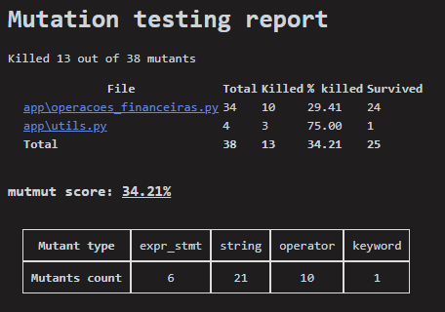
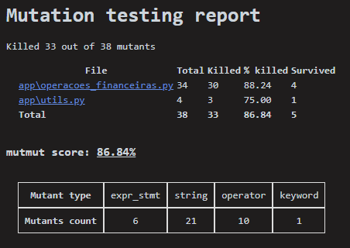
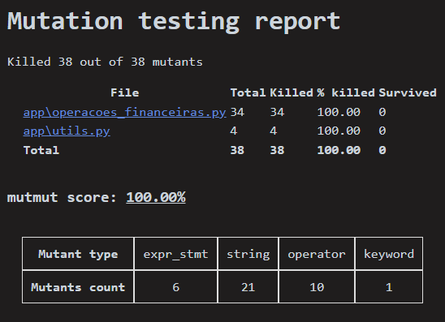

Slide 8
Killed 3 out of 9 mutants
File Total Killed % killed Survived
exemplo.py 9 4 44.44 5
score: 33.33%
self.assertEqual(
calcula_hipotenusa(0, 0), 0
)
self.assertEqual(
calcula_hipotenusa(2, 2),
math.sqrt(8)
)
Killed 3 out of 9 mutants
File Total Killed % killed Survived
exemplo.py 9 7 77.78 2
score: 33.33%
Killed 3 out of 9 mutants
File Total Killed % killed Survived
exemplo.py 9 9 100.00 0
score: 100.00%
self.assertEqual(
calcula_hipotenusa(3, 4), 5
)

Slide 9
Evitar teste “sem conferência” visando cobertura de código
def test_calcula_hipotenusa(self):
calcula_hipotenusa(0, 0), 0
Name Stmts Miss Cover Missing
----------------------------------------------
exemplo.py 7 0 100%
----------------------------------------------
TOTAL 7 0 100%
Killed 3 out of 9 mutants
File Total Killed % killed Survived
exemplo.py 9 3 33.33 6
score: 33.33%

Slide 10
Melhorar os testes
def calcula_hipotenusa(a, b):
a2 = a**2
b2 = b**2
c2 = a2 + b2
c = math.sqrt(c2)
return c
def calcula_hipotenusa(a, b):
a2 = a*2
b2 = b**2
c2 = a2 + b2
c = math.sqrt(c2)
return c
def test_calcula_hipotenusa(self):
self.assertEqual(
calcula_hipotenusa(0, 0), 0
)
Name Stmts Miss Cover Missing
----------------------------------------------
exemplo.py 7 0 100%
----------------------------------------------
TOTAL 7 0 100%

Slide 11
Verificar se há pontos não validados pelos testes
def test_depositar(self):
depositar(self.contas, "client_id_123", 100)
self.assertEqual(self.contas["client_id_123"]["saldo"], 1100)
# self.assertEqual(
# len(self.contas["client_id_123"]["historico"]),
# 1
# )
# self.assertEqual(
# self.contas["client_id_123"]["historico"][0]["operacao"],
# "deposito"
# )
# self.assertEqual(
# self.contas["client_id_123"]["historico"][0]["valor"],
# 100
# )
Killed 3 out of 9 mutants
File Total Killed % killed Survived
Total 38 35 92.11 3
score: 92.11%

